Slide 1
PRINCIPAL COMPONENTS ANALYSIS (PCA)

Slide 2
What is PCA ?
Principal Component Analysis (PCA) is the general name for a technique which uses mathematical tools from Linear Algebra to transform a complex data set with large number of variables into a smaller number of variables called principal components.
It is therefore often the case that an examination of the reduced dimension data set will allow the user to spot trends, patterns and outliers in the data, far more easily than would have been possible without performing the principal component analysis.

Slide 3
What do we need under our BELT
Basics of statistical measures , e.g. variance and covariance.
Basics of linear algebra:
Matrices
Vector space
Basis
Eigenvectors and Eigenvalues

Slide 4
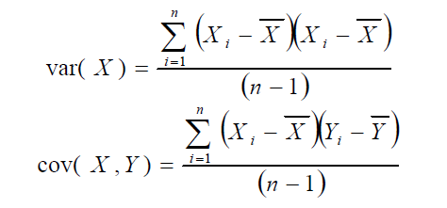
Variance measure of the deviation from the mean for points in one dimension.
Covariance a measure of how much each of the dimensions varies from the mean with respect to each other.
Covariance is measured between 2 dimensions to see if there is a relationship between the 2 dimensions.

Slide 5
What is the interpretation of covariance calculations?
Say you have a 2- dimensional data set
X: number of hours studied for a subject
Y : marks obtained in that subject
• And assume the covariance value (between X and Y ) is: 104.5
What does this mean?
Exact value is not as important as sign
A positive value of covariance indicates that both the dimensions increase or decrease together
A negative value indicates that while one increases, the other decreases and vice-versa.
A zero value indicates that both the variables are independent of each other.

Slide 6
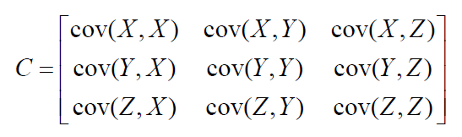
Covariance Matrix
Representing covariance among dimensions as a matrix , e.g. , for 3 dimensions :
Properties:
Diagonal : Variances of the variables
cov(X,Y) = cov(Y,X), hence matrix is symmetrical about the diagonal
m-dimensional data will result in m x m covariance matrix

Slide 7





Inner Product
Inner (dot) product:
Length (Euclidian norm) of a vector :
The angle between two n-dimensional vectors :
An inner product is a measure of collinearity :
a and b are orthogonal iff :
a and b are collinear iff :

Slide 8


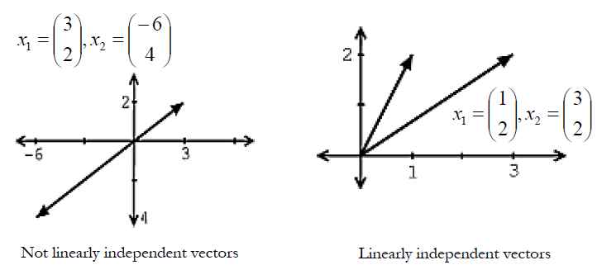
Linear Independence
A set of n – dimensional vectors xi Є Rn , are said to be linearly independent if none of them can be written as a linear combination of the others.
In other words ,
iff
Another approach to reveal a vectors independence is by graphing the vectors .

Slide 9


Span and Basis
A span of a set of vectors x1, x2, …, xk is the set of vectors that can be written as a linear combination of x1, x2, …, xk.
A basis for R^{n} is a set of vectors which :
Spans R^{n} , i.e. any vector in this n –dimensional space can be written as linear combination of these basis vectors.
Are linearly independent.
For example vectors form the basis of R³
They are also linearly independent, because if = 0 , then
a = b = c = 0. hence the basis {e₁ , e₂ , e₃} are called the standard basis of R³

Slide 10

Orthogonal/Orthonormal Basis
An orthonormal basis of a vectors pace V with an inner product , is a set of basis vectors whose elements are mutually orthogonal and of magnitude 1 (unit vectors).
Two vectors are orthogonal if they are perpendicular, i.e., they form a right angle, i.e. if their inner product is zero.
The standard basis of the 3–dimensional Euclidean space R³ is an example of orthonormal (and ordered) basis.

Slide 11
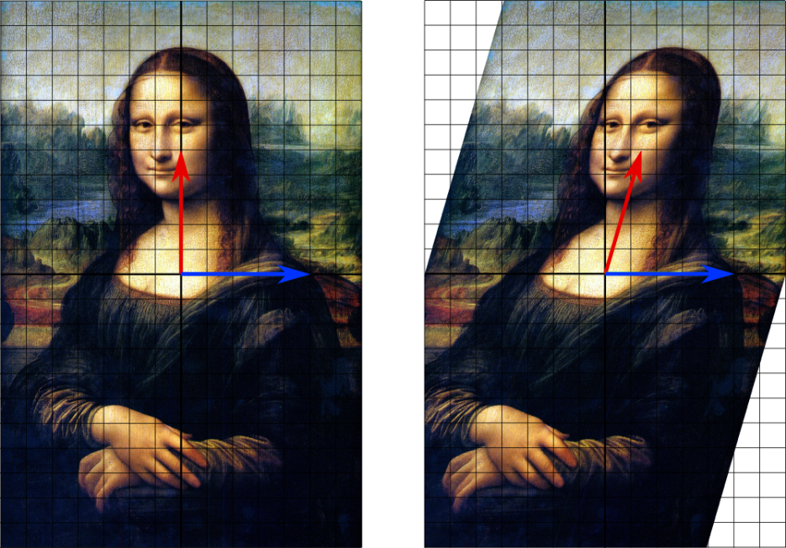
Transformation Matrices
Eigenvectors make understanding linear transformations easy. They are the "axes" (directions) along which a linear transformation acts simply by "stretching/compressing" and/or "flipping"; eigenvalues give you the factors by which this compression occurs.
In linear algebra, an eigenvector or characteristic vector of a square matrix is a vector that points in a direction which is invariant under the associated linear transformation.

Slide 12
Eigenvalues and Eigenvectors
The eigenvalue problem is any problem having the following form:
A . v = λ . v
A: m x m matrix
v: m x 1 non-zero vector
λ:scalar
Any value of λ for which this equation has a solution is called the eigenvalue of A and the vector v which corresponds to this value is called the eigenvector of A.

Slide 13
Calculating Eigenvectors & Eigenvalues
Simple matrix algebra shows that:
A . v = λ . v
⇔ A . v - λ. I. v = 0
⇔ ( A - λ . I ) . v = 0
Finding the roots of | A - λ. I | will give the eigenvalues and for each of these eigenvalues there will be an eigenvector

Slide 14


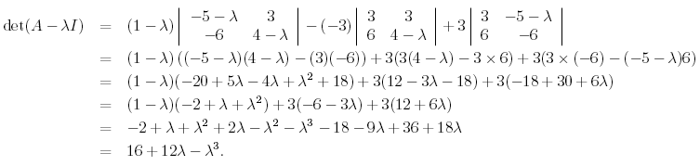
EXAMPLE
To do this, we find the values of λ which satisfy the characteristic equation of the matrix A , namely those values of λ for which
det(A−λI) = 0
Form the matrix (A − λI) :
Calculate det(A − λI):

Slide 15
REQUIRED: To find solutions to det(A−λI) = 0 i.e., to solve:
λ^3 − 12 λ − 16 = 0
By solving we find that the eigevalues of A are : 4, -2 ( λ = -2 is a repeated root of the characteristic equation).

Slide 16

Finding Eigenvectors
Once the eigenvalues of a matrix (A) have been found, we can find the eigenvectors by Gaussian Elimination
STEP 1 : For each eigenvalue λ, we have
(A – λI)x = 0
Where x is the eigenvector associated with eigenvalue λ.
STEP 2 : We find x by Gaussian elimination, i.e, convert the augmented matrix (A – λI : 0) to row echelon form and solve the resulting linear system by back – substitution.
Case 1 : λ = 4
We must find vectors x which satisfy (A – λI)x = 0
First form the matrix (A – 4I)

Slide 17
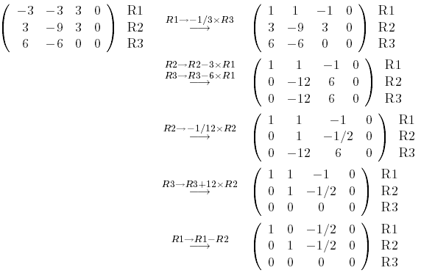

Construct the augmented matrix (A – λI : 0) and convert it to row echelon form.
Rewriting the augmented matrix as a linear system gives :

Slide 18


So the eigenvector x is given by :
For any real number x3 ≠ 0 , those are the eigenvectors associated with the
eigenvalue λ = 4.
Case 2 : λ = -2
We must find vectors x which satisfy (A – λI)x = 0
First form the matrix A – (-2)I = A +2I
Construct the augmented matrix (A – λI : 0) and convert it to row echelon
form.

Slide 19
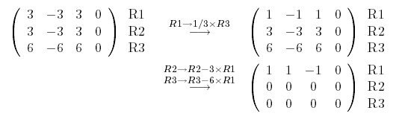



Rewriting the augmented matrix as a linear system gives :
So the eigenvector x associated with λ = -2 is given by :
Thus, for any x3, x2 Є R\{0}
Are the eigenvectors associated with λ = -2

Slide 20
Coming back to Principal Component Analysis

Slide 21
Change of Basis
Let X and Y be m x n matrices related by a linear transformation P.
X is the original recorded data set and Y is a re-representation of that data set
PX = Y
p_{i} are the rows of P.
x_{i} are the columns of X.
y_{i} are the columns of Y.
What does this mean?
P is a matrix that transforms X into Y.
The rows of P, {p₁ ,p₂ ,…,p_{m}} are a set of new basis vectors for expressing the columns of X.

Slide 22
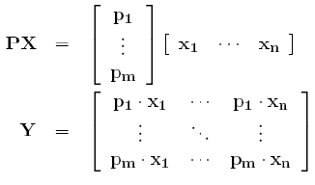

Lets write out the explicit dot products of PX.
We can note the form of each column of Y.
We can see that each coefficient of y_{i} is a dot – product of x_{i} with the corresponding row in P.
In other words , the jth coefficient of y_{i} is a projection on to the jth row of P. This is in fact the very form of an equation where y_{i} is a projection on to the basis of {p₁, p₂, …. p_{m}}.
Therefore, the rows of P are a new set of basis vectors for representing the columns of X.
Later we will see that the row vectors {p₁, p₂, …. p_{m}} in this transformation will become the principal components of X

Slide 23
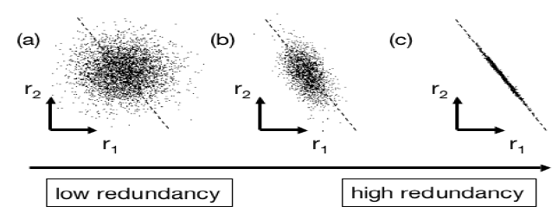

Redundancy
Panel(a) depicts two recordings with no redundancy, i.e. they are un -correlated, e.g. person’s height and his GPA.
However, in panel(c) both recordings appear to be strongly related, i.e. one can be expressed in terms of the other.
Computing the covariance matrix quantifies the correlations between all possible pairs of measurements. Between one pair of measurements, a large covariance corresponds to a situation like panel(c), while zero covariance corresponds to entirely uncorrelated data as in panel(a).

Slide 24
Why Diagonalize Covariance Matrix?
Our goals are to find an optimized covariance matrix S_{y} so that it:
Minimizes redundancy, measured by covariance. (off-diagonal), i.e. we would like each variable to co-vary as little as possible with other variables.
Maximizes the variance. (the diagonal)
Evidently, in an optimized matrix all of diagonal elements in S_{y} are zero. Therefore, removing redundancy diagonalizes S_{y}

Slide 25
PCA Assumptions
PCA assumes that all basis vectors {p₁, p₂, …. p_{m}} are orthonormal. In the language of Linear Algebra, PCA assumes P is an orthonormal matrix.
Secondly, PCA assumes the directions with the largest variances are the most “important” or in other words, most principal.

Slide 26
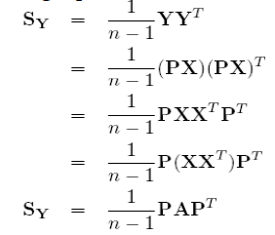
Solving PCA
Objective : Find some orthonormal matrix P where Y = PX such that S_{Y} = 1/(n-1)Y Y^{T} is diagonalized. The rows of P are the principal components of X.
where X is a m x n matrix
n is the number of variables
m is the number of observations.
We begin by writing S_{Y} in the terms of our variable of choice P

Slide 27
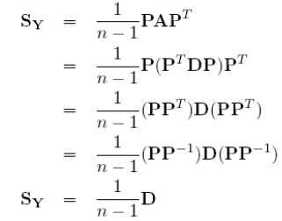
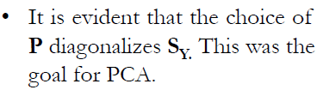
THEOREM : A symmetric matrix is diagonalized by a matrix of its orthonormal eigenvectors.
Hence A = EDE^{T}
D is a diagonal matrix
E is a matrix of eigenvectors of A arranged as column
Now comes the trick. We select the matrix P to be a matrix where each row p_{i} is an eigenvector of XX^{T} .
By this selection, P = E^{T} . Hence A = P^{T}DP.
THEOREM : The inverse of an orthogonal matrix is its transpose.
Hence , P^{T} = P ⁻¹

Slide 28
Using Actual Matrix
X = Ẋ =
Cov(X) -> S_{x =}
Eigenvalues of S_{x} = 20.8 , 0.2
Eigenvectors of S_{x} -> E =
D =
Also, P = E^{T} .
Putting the values in the equation S = 1/(n-1)PAP^{T} , we find that it diagonalizes the covariance matrix S_{x.}
2 | 6
8 | 10
-3 | -2
2 | 2
13 | -10
-10 | 8
-0.788 | 0.615
0.615 | 0.788
20.8 | 0
0 | 0.2

Slide 29


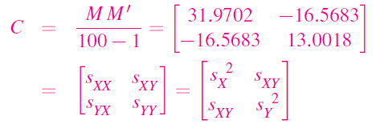
Computing sample covariance matrix
Original data: 100 (x, y) points in a 2 x100 matrix M0:
Centered data: subtract ¯x from x’s and ¯y from y’s to get M; here
¯x = 5, ¯y = 10:
Sample covariance:

Slide 30

Diagonalizing the sample covariance matrix C
C is a real-valued symmetric matrix, so it can be diagonalized C = VDV’ where V’= V transpose. D includes the eigenvalues as the diagonal elements.
It is conventional to put the eigenvalues into D in decreasing order
λ1 ≥ λ2 ≥ … ≥ 0.

Slide 31
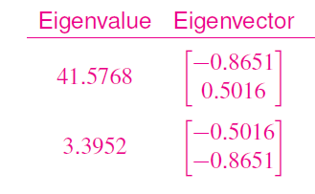
Principal axes
The columns of V are the right eigenvectors of C.
Put them into the columns of a matrix:
The axis of the principal components will be the span of eigenvectors of the covariance matrix .
PC1 | PC2
-0.8651 | -0.5016
0.5016 | -0.8651

Slide 32
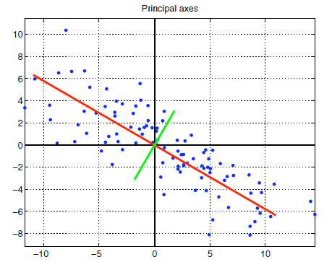
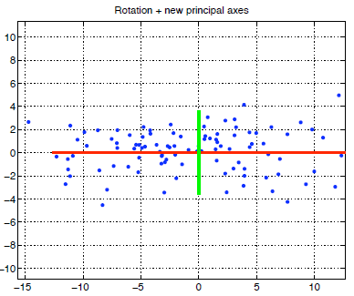
Principal axes
Plot the centered data with lines along the principal axes:
Sum of squared perpendicular distances of data points to first PC line (red) is minimum among all lines through origin.

Slide 33

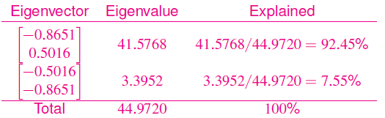
New coordinates
The rotated data has new coordinates (t1, u1), . . . , (t100, u100) and covariance matrix D:
The total variance is λ1 + λ2 + … = Tr(D) = Tr(C).
Here, the total variance is Var(T) + Var(U) = 44.9720.
The part of the variance explained by each axis is λi/total variance:

Slide 34
New Data
Final Data = RowFeatureVector x RowZeroMeanData
RowFeatureVector is the matrix with the eigenvectors in the columns transposed so that the eigenvectors are now in the rows, with the most significant eigenvector at the top.
RowZeroMeanData is the mean –adjusted data transposed, i.e., the data items are in each column, with each row holding a separate dimension.
This gives us the original data solely in terms of the vectors we chose.

Slide 35
PCA Using R
There are two commands for performing principal component analysis (PCA) in the R environment: princomp and prcomp.
We will focus on using the second one but the two are very similar.
princomp uses eigen to compute the PCA, while prcomp uses svd, which can be more stable in some cases. Also for princomp function, number of variables must be less than experimental conditions.

Slide 36
prcomp() Function
Usage : prcomp(x, ...)
Arguments :
x: A numeric or complex matrix (or data frame) which provides the data for the principal components analysis.
center : A logical value indicating whether the variables should be shifted to be zero centered.
scale. : A logical value indicating whether the variables should be scaled to have unit variance before the analysis takes place. The default is FALSE but in general scaling is advisable.
tol : A value indicating the magnitude below which components should be omitted. (Components are omitted if their standard deviations are less than or equal to tol times the standard deviation of the first component.) With the default null setting, no components are omitted.
retx : A logical value indicating whether the rotated variables should be returned. By default, it is true.

Slide 37
Deliverables :
prcomp returns a list with class "prcomp" containing the following components:
sdev : the standard deviations of the principal components (i.e., the square roots of the eigenvalues of the covariance/correlation matrix).
rotation : the matrix of variable loadings (i.e., a matrix whose columns contain the eigenvectors). The function princomp returns this in the element loadings.
x : if retx is true the value of the rotated data (the centered (and scaled if requested) data multiplied by the rotation matrix) is returned.

Slide 38
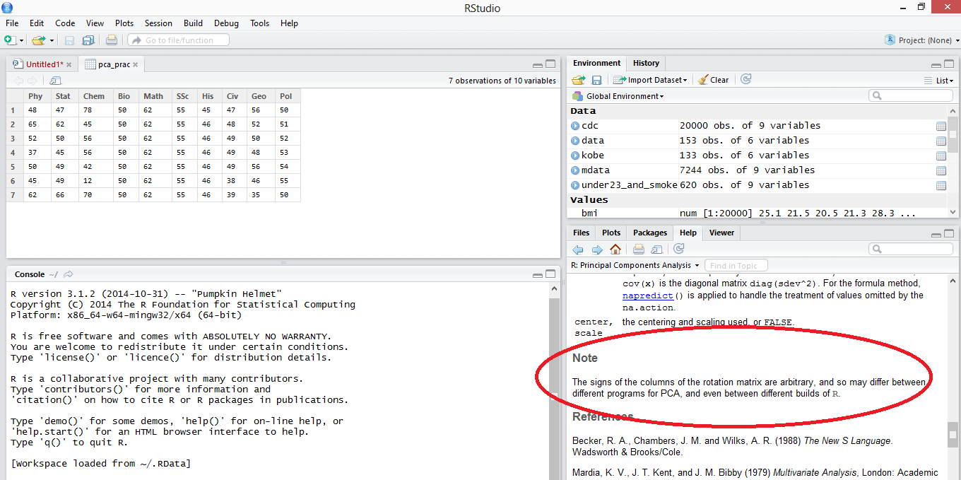
Note : The signs of the columns of rotation matrix are arbitrary, and so may differ between different programs for PCA

Slide 39
Example
Country | Cheese | Carcass meat | Other meat | Fish | Fats & Oils | Sugars | Fresh potatoes | Fresh Veg | Other Veg | Processed potatoes | Processed Veg | Fresh fruit | Cereals | Beverages | Soft drinks | Alcoholic drinks
England | 105 | 245 | 685 | 147 | 193 | 156 | 720 | 253 | 488 | 198 | 360 | 1102 | 1472 | 57 | 1374 | 375
Wales | 103 | 227 | 803 | 160 | 235 | 175 | 874 | 265 | 570 | 203 | 365 | 1137 | 1582 | 73 | 1256 | 475
Scotland | 103 | 242 | 750 | 122 | 184 | 147 | 566 | 171 | 418 | 220 | 337 | 957 | 1462 | 53 | 1572 | 458
N Ireland | 66 | 267 | 586 | 93 | 209 | 139 | 1033 | 143 | 355 | 187 | 334 | 674 | 1494 | 47 | 1506 | 135
This is a data showing the consumption in grams (per person, per week) of 17 different types of foodstuff measured and averaged in the four countries of the United Kingdom in 1997.
17 Variables
4 Observations

Slide 40
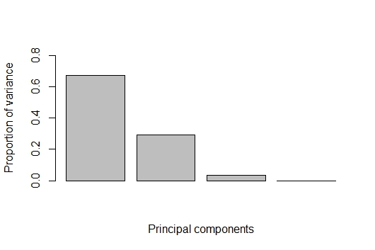
Importance of Components
 | PC1 | PC2 | PC3 | PC4
Standard deviation | 324.0077 | 212.744 | 73.77493 | 2.68E-14
Proportion of Variance | 0.67432 | 0.29072 | 0.03496 | 0
Cumulative Proportion | 0.67432 | 0.96504 | 1 | 1
In practice, it is usually sufficient to include enough principal components so that around 80% of the variation in the data is accounted for.

Slide 41
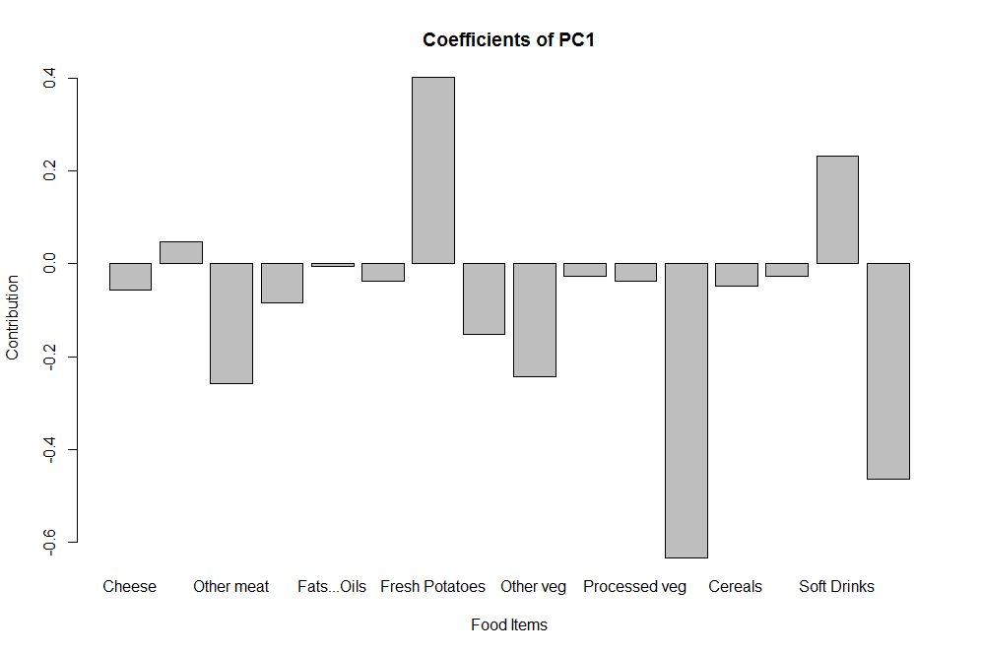
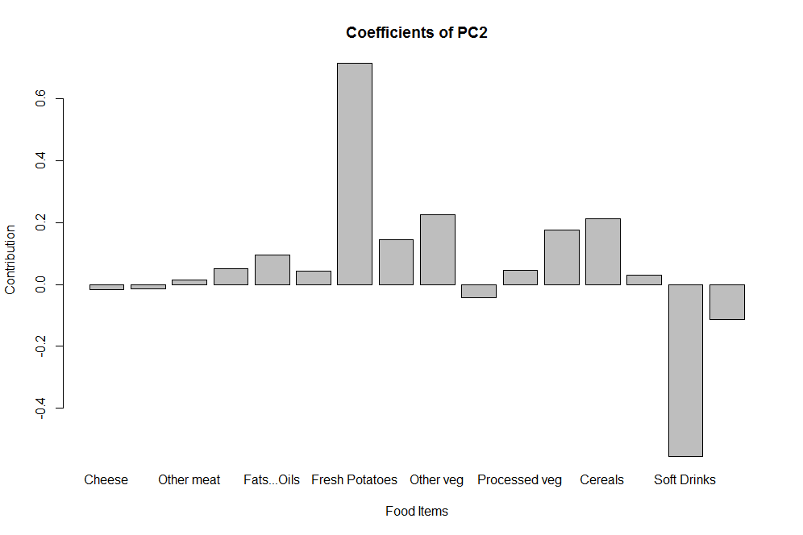

Slide 42
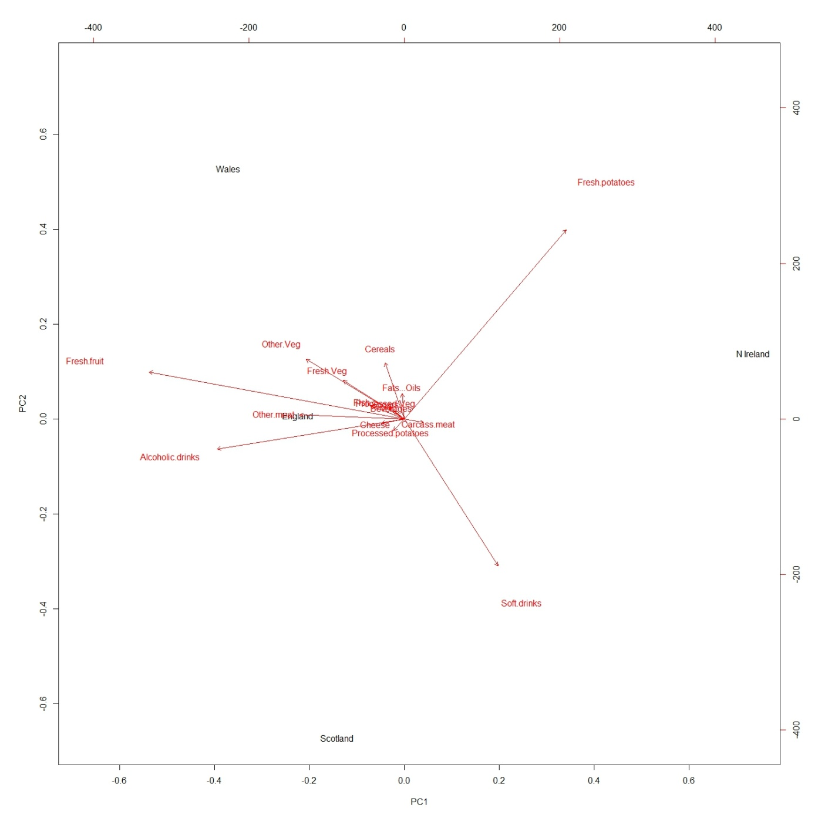
Biplot
We can conclude that N. Ireland is somewhat different from Wales, England, Scotland.
Proximity to the food vectors tells us which country consumes more/less of a certain kind of food product.

Slide 43
Dataset
Days | R1B | R2B | R3B | R4B | R5B | R6B | R7B | R8B | R9B | R11B | R1D | R2D | R3D | R4D | R5D | R6D | R7D | R8D | R9D | R11D | R1M | R2M | R3M | R4M | R5M | R6M | R7M | R8M | R9M | R11M | R14 | R24 | R34 | R44 | R54 | R64 | R74 | R84 | R94 | R114 | R18 | R28 | R38 | R48 | R58 | R68 | R78 | R88 | R98 | R118
7 | 60 | 80 | 90 | 30 | 20 | 80 | 100 | 100 | 80 | 80 | 1.4 | 10 | 80 | 55 | 60 | 40 | 90 | 100 | 60 | 0.3 | 55 | 30 | 90 | 25 | 35 | 80 | 100 | 100 | 90 | 20 | 45 | 30 | 80 | 5 | 10 | 5 | 50 | 90 | 80 | 20 | 25 | 10 | 90 | 0 | 15 | 5 | 65 | 90 | 80 | 5
14 | 70 | 100 | 90 | 100 | 30 | 30 | 100 | 100 | 100 | 100 | 1.6 | 20 | 90 | 35 | 60 | 10 | 80 | 80 | 90 | 1.2 | 70 | 35 | 70 | 40 | 60 | 80 | 90 | 90 | 100 | 25 | 30 | 35 | 80 | 10 | 25 | 0 | 50 | 60 | 90 | 15 | 40 | 30 | 90 | 5 | 40 | 0 | 60 | 60 | 90 | 5
21 | 50 | 70 | 20 | 20 | 25 | 30 | 60 | 80 | 60 | 70 | 1.2 | 70 | 10 | 20 | 20 | 35 | 50 | 60 | 40 | 0.7 | 40 | 20 | 50 | 40 | 25 | 30 | 80 | 90 | 80 | 15 | 45 | 55 | 10 | 25 | 10 | 25 | 25 | 40 | 60 | 40 | 60 | 25 | 20 | 5 | 30 | 30 | 20 | 40 | 50 | 5
28 | 30 | 10 | 40 | 10 | 10 | 40 | 50 | 90 | 40 | 10 | 0.1 | 0 | 60 | 15 | 10 | 15 | 20 | 40 | 40 | 0.4 | 70 | 35 | 80 | 50 | 55 | 30 | 70 | 90 | 100 | 35 | 55 | 5 | 50 | 15 | 10 | 10 | 10 | 70 | 50 | 5 | 70 | 10 | 80 | 30 | 35 | 25 | 20 | 80 | 70 | 0
35 | 40 | 60 | 50 | 10 | 5 | 0 | 10 | 30 | 70 | 70 | 1.2 | 0 | 70 | 30 | 20 | 15 | 10 | 30 | 20 | 0.2 | 50 | 20 | 80 | 45 | 55 | 60 | 80 | 100 | 100 | 10 | 25 | 30 | 40 | 10 | 0 | 0 | 0 | 0 | 40 | 20 | 60 | 5 | 60 | 5 | 10 | 0 | 0 | 10 | 40 | 0
50 variables
5 experimental conditions

Slide 44
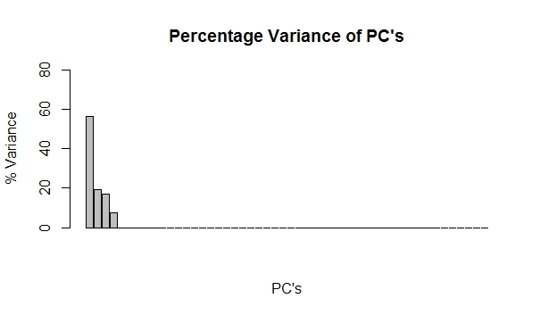
Importance of Components
 | PC1 | PC2 | PC3 | PC4 | PC5
Standard deviation | 116.0472 | 67.91166 | 63.77722 | 42.14877 | 1.09E-14
Proportion of Variance | 0.56293 | 0.19278 | 0.17003 | 0.07426 | 0
Cumulative Proportion | 0.56293 | 0.75571 | 0.92574 | 1 | 1

Slide 45
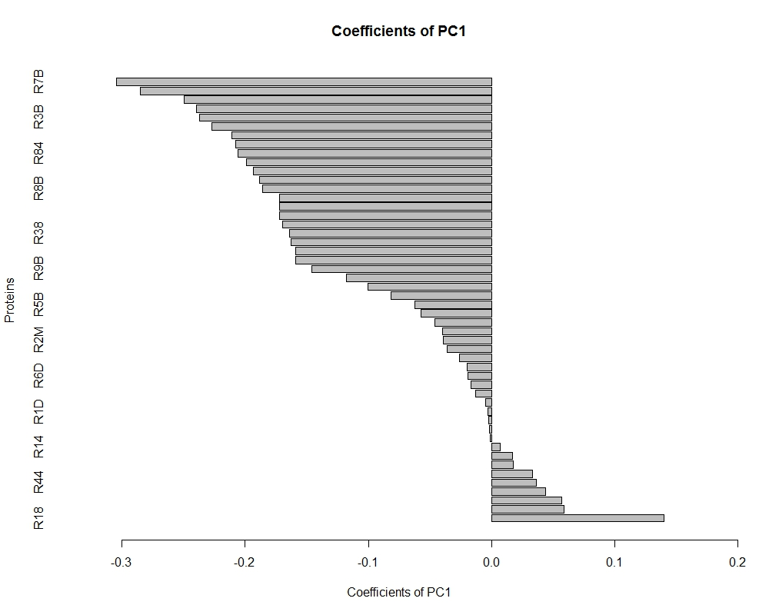

Slide 46
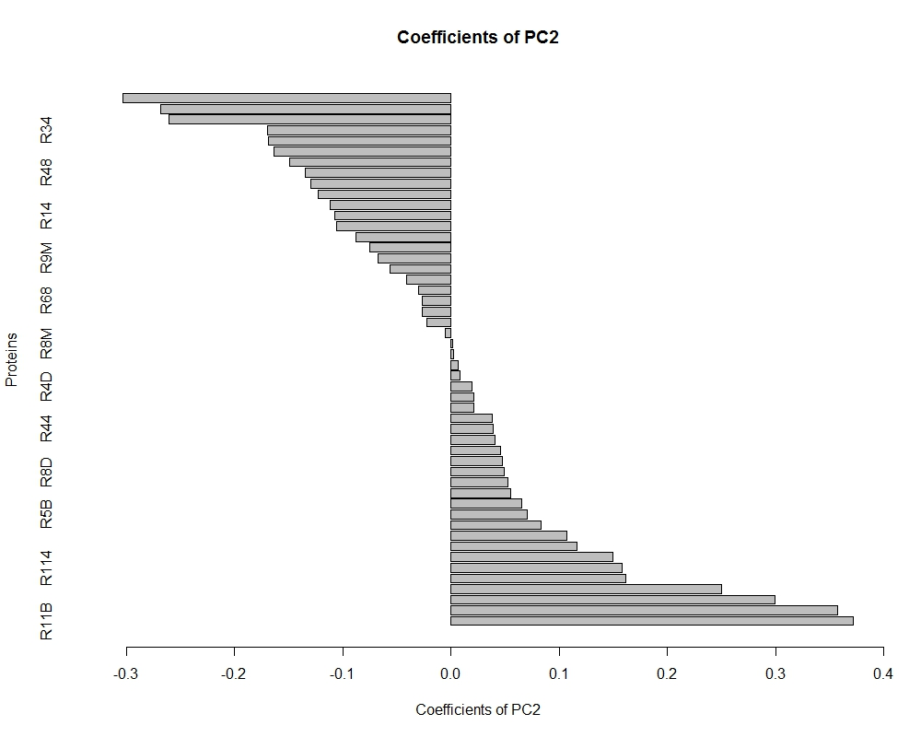

Slide 47
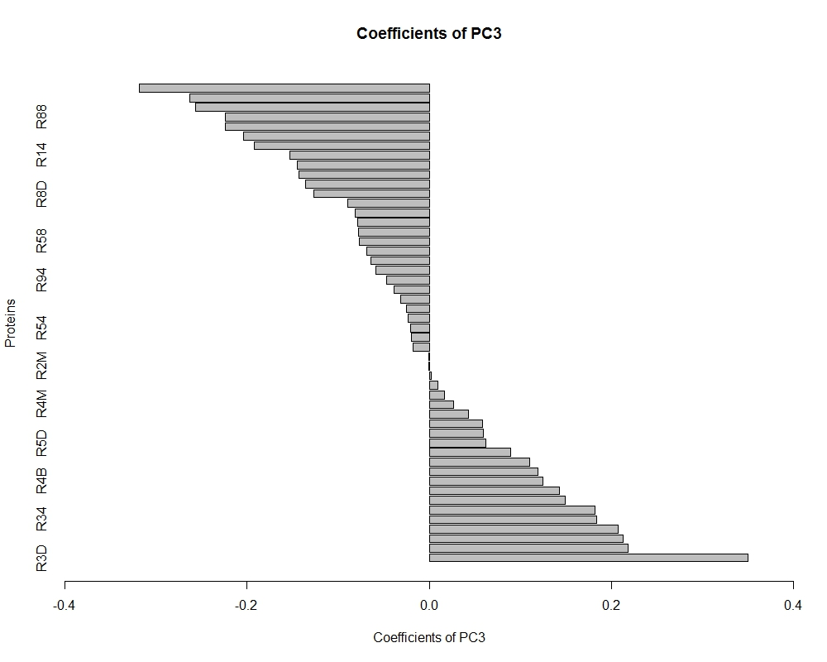

Slide 48
PCA Scores

