Slide 1

INTRODUCTION
Smart Surveillance using computer vision: Develop IoT based surveillance systems that can incorporate, automatic tracking, anomaly detection, facial recognition, or posture analysis

Slide 2
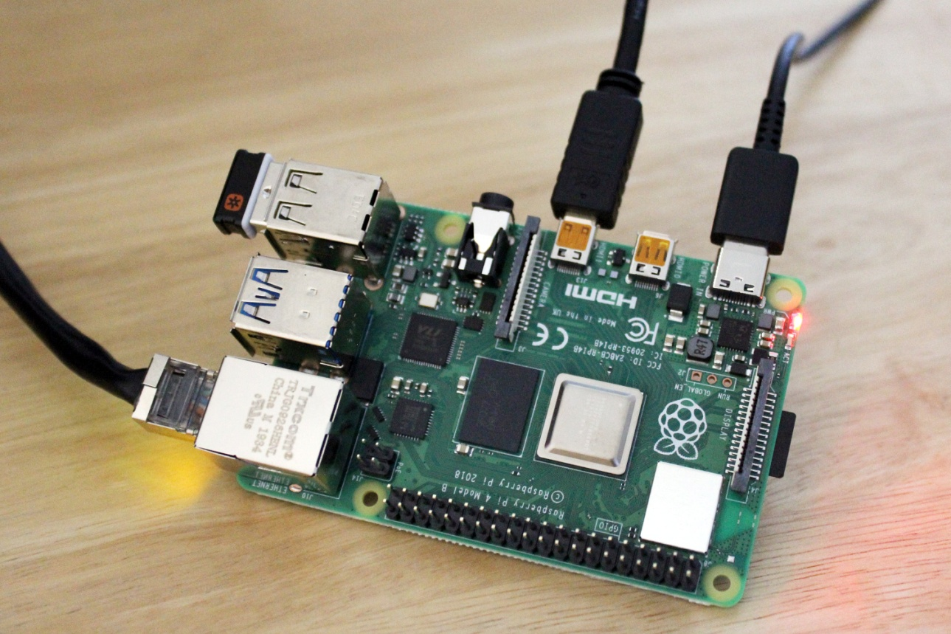
HARDWARE SETUP
For this project we have chosen raspberry pi as the IoT device due to its versatallity and connectivity options.

Slide 3
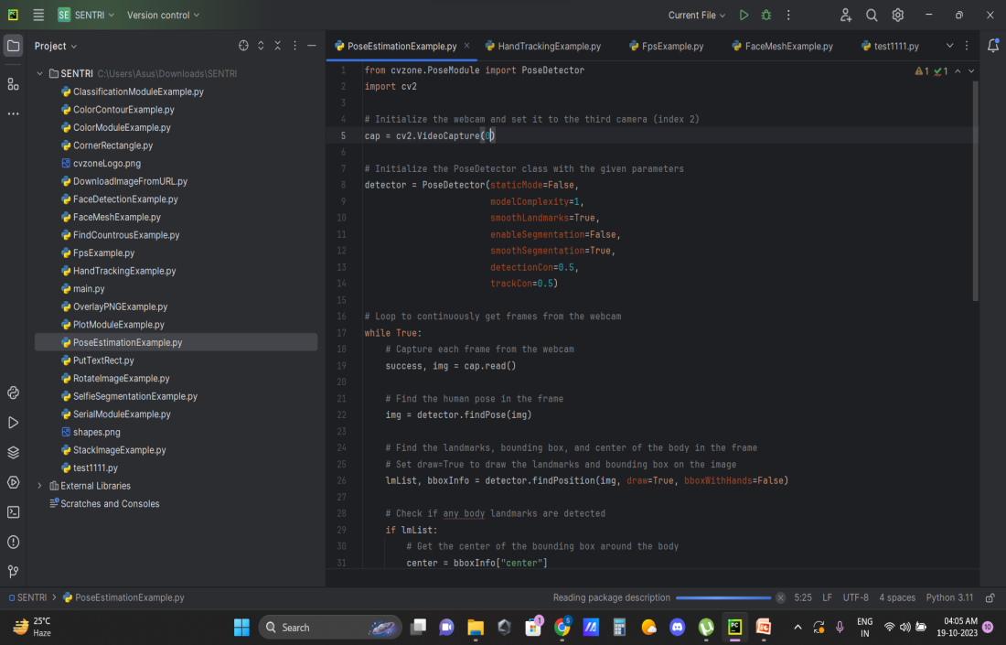
SOFTWARE INTEGRATION
We’ll need a raspberry pi, a PIR motion sensor, jumper wires , and power supply for the raspberry pi.
We are putting the given code In the raspbery pi proccessor(connected with the jumper wire) through some IDE,
that is Visual studio code .

Slide 4
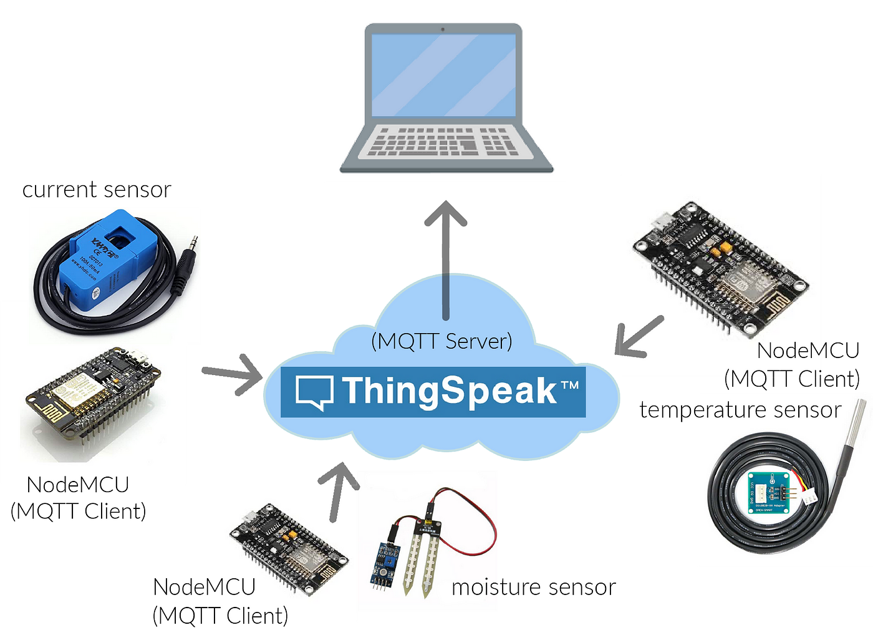
NETWORKING AND COMMUNICATION

Slide 5

IOT PLATFORM SELECTION
For Iot platform we are using ThingSpeak which is a cloud based platform for IoT.
ThingSpeak is an IoT analytics platform service that allows you to aggregate, visualize, and analyze live data streams in the cloud .

Slide 6
REMOTE CONTROL AND MONITORING

Slide 7
THANK YOU

