Slide 1

MSPM’S
Deogiri Institute of Engineering and Management Studies, Aurangabad
IPL SCORE PREDICTION
DEMO-1
Team members
Class – B.Tech CSE A
Abhishek Jaju (46035)
Pradeep Maku (46034)
Vivek Soddy (46039)

Slide 2
INTRODUCTION
Here we will be looking at how you can train a model from scratch and embed it in the web app using simple and powerful libraries like sklearn, pandas, and flask. Also, some web development is involved.
The use of analytical methods in various aspects of cricket including results prediction is very important because of its popularity and huge amount of money involved in the game
Prediction of outcome of a match using machine learning algorithms is an important aspect in cricket. Records of the past performance of players and other related data can be analysed to create models that predicts the team score.

Slide 3
LITERATURE REVIEW
The selection of the best team is always required by the management for best outcome
The results of the IPL batting Statistics were grouped into various clusters and it gave efficient and effective accurate results with the Data Mining Technique – Clustering
The SVM technique holds good on the investigation of the feasibility of using the Twitter data to forecast the results of the match.
The factors such as toss result, ranking of the team, home team advantage were considered.
At Vignesh Veppur Sankaranarayanan and Junaed Sattar, “Auto-play: A Data Mining Approach to ODI Cricket Simulation and Prediction”, Proceedings of SIAM Conference on Data Mining, pp. 1-7, 2014 Sankaranarayanan gives the idea about building a system of prediction that takes the historical data and predicts the victory or loss of the forthcoming matches.

Slide 4
SYSTEM DESIGN
Server
Runs Predictor
Select stadium
Perform Prediction
USER
Give Expected runs
Get player runs
Load user response

Slide 5

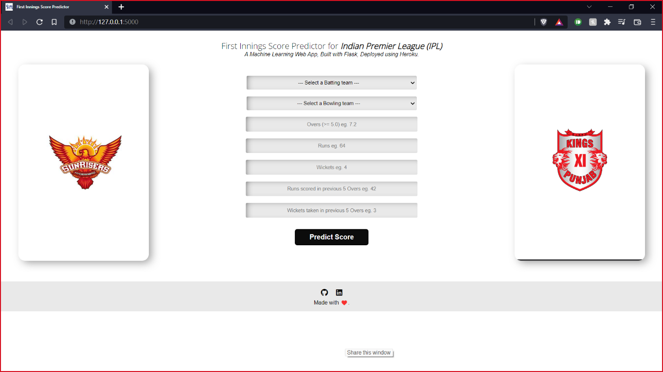
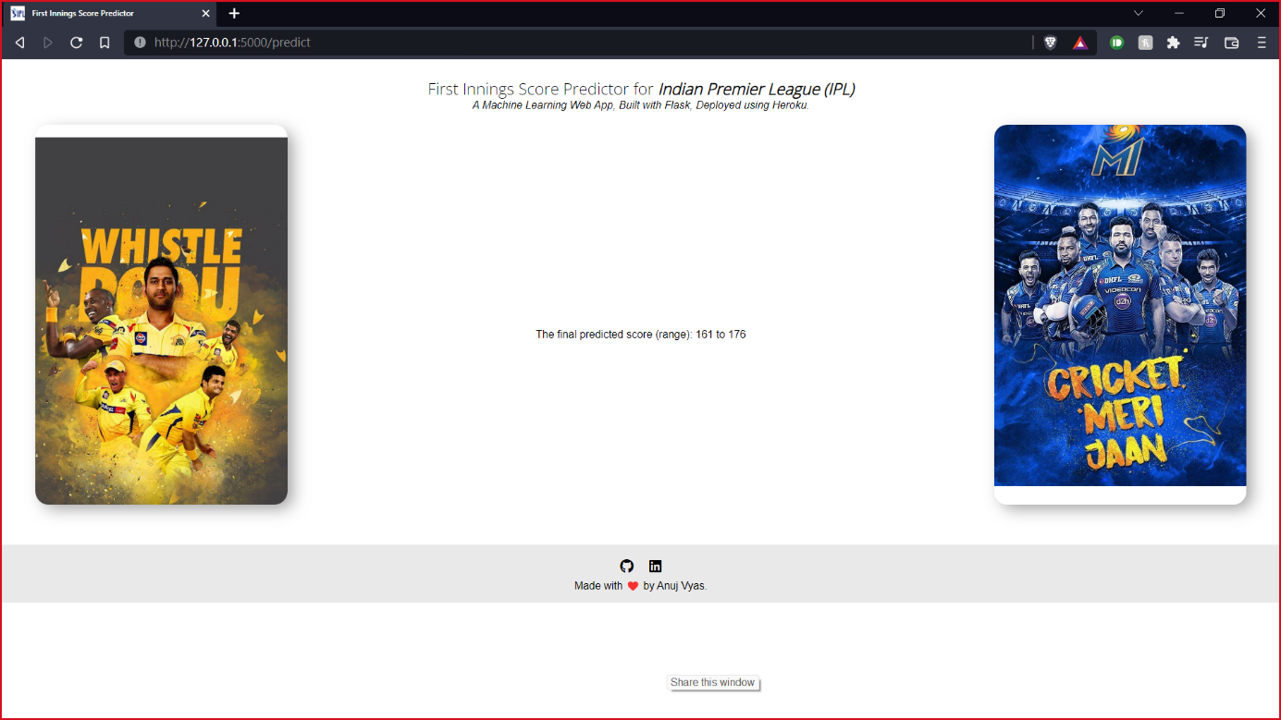
GUI
The Graphical User Interface is developed for the machine learning models using the Flask Framework.
For the backend of the site Python is used. The site can be used to predict the IPL match score with the help of last 5 overs of the data.
We can also predict the Winner of the match with the data of just Toss Winner and Toss Decision.
All the input information necessary for the model for the prediction is provided to the model. The calculation is not stored in the system because all calculations computed at real time

