Slide 1
Assignment List
S# | Assignments
1 | Generate Symbol table, Literal table, Pool table & Intermediate code of a two-pass Assembler for the given source code.
2 | Design suitable data structures & implement pass-I of a two-pass Macro processor.
3 | Write a program to implement a lexical analyzer for parts of speech. Using LEX.
4 | Write a program to evaluate an arithmetic expression, built-in functions, and variables using YACC specification.
5 | Write a program to generate three address code for the simple expression.

Slide 2
Lab Assignment 4
Assignment No. 4 : Write a program to evaluate an arithmetic expression, built-in functions, and variables using YACC specification.

Slide 3
4. Write a program to
4. A To evaluate an arithmetic expression using YACC tool
4.B To evaluate or check built-in functions using YACC tool
4.C To recognize valid variable name using YACC tool.

Slide 4
Samples
4.A To evaluate an arithmetic expression using YACC tool
Input : 5 + 8 * 2
Output : 21
4.B To evaluate or check built-in functions using YACC tool
Input : sqrt(25) [Hint : include math.h]
BF : SQ | STR
;
SQ :
STR:
Output : 5
Input : strlen(“India”) [Hint : include string.h]
Output : 5
4.C To recognize valid variable name using YACC tool.
Input : Stud_Name1
Output : valid variable

Slide 5
Introduction to YACC

Slide 6
Yacc
The parser-generator Yacc takes a (possibly) ambiguous grammar and conflict-resolution information and constructs the LALR states.
It then produces a function that uses these states to perform a bottom-up parse and call an associated function each time a reduction is performed.

Slide 7
Yacc Introduction
Need : Some applications need to recognize specific sequences of tokens and perform appropriate actions (description of set of actions is known as a grammar)
Sample recognition Task – Simple english sentences
noun verb - e.g. Ram eats
noun verb noun -e.g. Ram eats apple

Slide 8
…contd..Yacc Introduction
Parser generator used to facilitate the construction of the front end of a compiler
YACC = “yet another compiler-compiler"
Available as a command on the UNIX system

Slide 9
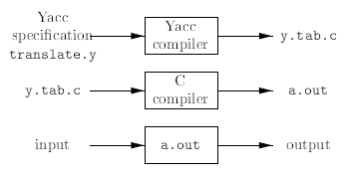
Input/Output Translation in Yacc

Slide 10
Using a lex scanner and a yacc parser together

Slide 11
Parser-Lexer Communication
When you use a lex scanner and a yacc parser together, the parser is the higher level routine.
It calls the lexer yylex() whenever it needs a token from the input.
The lexer then scans through the input recognizing tokens.
As soon as it finds a token of interest to the parser, it returns to the parser, returning the token's code as the value of yylex().
Not all tokens are of interest to the parser (ex. comments and whitespace)
The lexer and the parser have to agree what the token codes are.
YACC defines the token codes (sample below)
# define NOUN 257
# define PRONOUN 258
# define VERB 259
Optionally, Yacc can write a C header file containing all of the token definitions, called y.tab.h

Slide 12
…contd..Parser-Lexer Communication : yylex() as a coroutine
Each time the parser calls yylex(), it takes up processing at the exact point it left off.
This allows us to examine and operate upon the input stream incrementally.

Slide 13
…contd.. Parser-Lexer Communication
Lex was designed to produce lexical analyzers that could be used with Yacc.
Lex library ll : Provides a driver program named yylex(), the name required by Yacc for its lexical analyzer.
If Lex is used to produce the lexical analyzer, we use, in the Yacc specification, statement #include "lex.yy.c" and we have each Lex action return a terminal known to Yacc.
By using the #include "lex.yy.c" statement, the program yylex has access to Yacc's names for tokens, since the Lex output file is compiled as part of the Yacc output file y.tab.c.
Under the UNIX system, if the Lex specification is in the file first.l and the Yacc specification in second.y, we can say -
lex first.l
yacc second.y
gcc y.tab.c lex.yy.c -ly -ll

Slide 14
…contd.. Parser-Lexer Communication: Token Name, Token Codes, Token Value
The name of a token does not have any intrinsic meaning to yacc, although well-chosen token names tell the reader what they represent.
yacc allows any valid C identifier name for a yacc symbol
But by Convention - Token names are all uppercase and other names in the parser mostly or entirely lowercase

Slide 15
…contd.. Parser-Lexer Communication: Token Name, Token Codes, Token Value
Yacc defines each of the TOKENS (Token Name)as a small integer (Token Code) using a preprocessor #define in yacc specification file
(or auto generated in y.tab.h )
Sample
# define NOUN 257
# define PRONOUN 258
# define VERB 259
These definitions (Token Codes) are used Internally
Token code zero is always returned for the logical end of the input

Slide 16
…contd.. Parser-Lexer Communication: Token Name, Token Codes, Token Value
Value of the Token is to be put inside yylval in lexer, to be used by yacc

Slide 17
Compiling and Executing a Parser
> yacc -d Ass4a.y # makes y.tab.c and "y.tab.h”
> lex Ass4a.l # makes lex.yy.c
>gcc -o Ass4a y.tab.c lex.yy.c -ly -ll
# compile and link C files
>Ass4a
99+12
= 111
>Ass4a
2 + 3-14+33
= 24
>Ass4a
100 + +-50
syntax error

Slide 18
(In Brief) Using Lex scanner and a Yacc parser together
Parser is the higher level routine
Yacc (yyparse()) calls the lexer yylex() whenever it needs a token from the input
The lexer then scans through the input recognizing tokens, and returns token to the parser
Returning the token's code as the value of yylex()
The lexer and the parser have to agree what the token codes are

Slide 19
3 parts of Yacc Specification

Slide 20
3 parts of Yacc Specification
declarations
%%
translation rules
%%
supporting C routines

Slide 21
First Section
The first section, the definition section, has a literal code block, enclosed in "%{" and "%}".
Used for - C comment (as with lex, C comments belong inside C code blocks, at least within the definition section), include files and other definitions to be copied into the C code.
Next are the definitions of all the tokens we expect to receive from the lexical analyzer and definition of precedence and associativity
The first %% indicates the end of definition section and beginning of the rules section.

Slide 22
Middle Section : Rule Section
The rules section describes the actual grammar as a set of production rules or simply rules. (/productions.) Each rule consists of a single name on the left-hand side (LHS) of the ":" operator, a list of symbols and action code on the right-hand side (RHS), and a semicolon indicating the end of the rule.
By default, the first rule is the highest-level rule.
That is, the parser attempts to find a list of tokens which match this initial rule, or more commonly, rules found from the initial rule. The expression on the right-hand side (RHS) of the rule is a list of zero or more names. A typical simple rule has a single symbol on the right-hand side (RHS). The symbol on the left-hand side (LHS) of the rule can then be used like a token in other rules. From this, we build complex grammars.

Slide 23
Notations to represent grammar in Middle Section and Parsing with Shift-Reduce
NOTATION to represent (sample) grammar
sentence : subject verb object {printf(“This is a valid english sentence” );}
;
subject : noun | pronoun
;
object : noun
;
------------------------------------------------------------
Shift-Reduce Parsing
Shift, reduce, shift, shift,reduce, reduce
pronoun verb noun
pronoun | verb noun$
subject | verb noun$
subject verb | noun$
subject verb noun | $
subject verb object | $
sentence | $

Slide 24
Third and Final Section (User Subroutine Section)
Begins after the second %%
This section can contain any C code and is copied, verbatim, into the resulting parser.
In general, the minimal set of functions necessary for a yacc-generated parser using a lex-generated lexer to compile are : main() and yyerror()
main()
The most important subroutine is main() which repeatedly calls yyparse() until the lexer's input file runs out.
end-of-file on yyin, the lex input file
The parser returns to its caller, (main program), when the lexer reports the end of the input
yyparse() - Is the parser generated by yacc, so the main program repeatedly tries to parse sentences until the input runs out. (The lexer returns a zero token when there is end of input, which signals to the parser that the input for the current parse is complete). Subsequent calls to yyparse() reset the state and begin processing again.
yylex() : The necessary routine yylex() which is provided by lexer.
yyerror()
When there is some invalid list of tokens - parser calls yyerror(), which is to be provided in the user subroutines section.
Error recovery code (if provided) tries to get the parser back into a state where it can continue parsing.
If error recovery fails or if there is no error recovery code, yyparse() returns to the caller after it finds an error.

Slide 25
Sample Yacc program
% {
/*
* Recognizing english sentences
*/
#include <stdio.h>
#include “lex.yy.c”
% }
%token NOUN PRONOUN VERB
% %
sentence: subject VERB object { printf("Sentence is valid.\n”); }
subject: NOUN
I PRONOUN ;
object: NOUN ;
%%
extern FILE *yyin;
main ( ) {
while ( !feof (yyin)) { yyparse( );}}

Slide 26
Sample Yacc Program for a Expression Grammar
Simple Expression Grammar
E -> E + T | T
T -> T * F | F
F -> ( E ) | DIGIT
Augmented Expression Grammar
L -> E \n
E -> E + T | T
T -> T * F | F
F -> ( E ) | DIGIT
Input:
+ ( 2 + ( 3 * 4)) * 2 + 2 \n
Output Token sequence from LEX
DIGIT ‘+’ ‘(‘ DIGIT ‘+’ ‘(‘ DIGIT ‘*’ DIGIT ‘)’ ‘)’ ‘*’ DIGIT ‘+’ DIGIT ’\n’
Output: 31
YACC SPECIFICATION in RULE SECTION
line : expr ‘\n’ {printf(“%d\n”,$1}
expr : expr ‘+’ term {$$=$1+$3}
| term { $$=$1}
term : term ‘*’ factor {$$= $1 * $3}
| factor {$$ = $1}
factor: ‘(‘ expr ‘)’ {$$=$2}
| DIGIT {$$ = $1}

Slide 27
Running Lex and Yacc
>lex assign.l
>yacc -d assign.y
>gcc -o assign lex.yy.c y.tab.c -ll
The first line runs lex over the lex specification and generates a file,lex.yy.c, which contains C code for the lexer.
In the second line, we use yacc to generate both y.tab.c and y.tab.h (the latter is the file of token definitions created by the -d switch.)
Last line compiles the c codes

Slide 28
Programs 4a,4b,4c

Slide 29
4. Write a program to
4. A To evaluate an arithmetic expression using YACC tool
4.B To evaluate or check built-in functions using YACC tool
4.C To recognize valid variable name using YACC tool.

Slide 30
Samples - 4a, 4b, 4c
4.A To evaluate an arithmetic expression using YACC tool Input : 5 + 8 * 2 Output : 21
4.B To evaluate or check built-in functions using YACC tool Input : sqrt(25) [Hint : include math.h] BF : SQ | STR ; SQ : STR: Output : 5 Input : strlen(“India”) [Hint : include string.h] Output : 5
4.C To recognize valid variable name using YACC tool. Input : Stud_Name1 Output : valid variable

Slide 31
Compiling and Executing a Parser
> yacc -d Ass4a.y # makes y.tab.c and "y.tab.h”
> lex Ass4a.l # makes lex.yy.c
>gcc -o Ass4a y.tab.c lex.yy.c -ly -ll
# compile and link C files
>Ass4a
99+12
= 111
>Ass4a
2 + 3-14+33
= 24
>Ass4a
100 + +-50
syntax error

Slide 32
4c

Slide 33
4.C To recognize a valid variable name Lex file
%{
#include “y.tab.h”
#include<stdio.h>
#include<stdlib.h>
%}
%%
[a-zA-Z] { return A; }
[0-9] return N;
“_” return U;
\n return 0;
. { return yytext[0]; }
%%

Slide 34
(Assign 4c) To recognize a valid variable name YACC file
%{
#include<stdio.h>
#include<stdlib.h>
%}
%token A N U
%%
a : AN
|aA
|aN
|aUa
|A
;
%%
int main()
{
printf(“enter the string”);
yyparse();
printf(“Valid variable”);
}
void yyerror()
{
printf(“invalid variable”);
exit(0); }

Slide 35
4a

Slide 36
Sample LEX file (Ass 4a)
% {
#include "y.tab.h”
extern int yylval;
% }
%%
[0-9]+ { yylval = atoi (yytext) ; return NUMBER; }
[\t ] ; /* ignore whitespace */
\n return 0; /* logical EOF */
. {return yytext [0] ;}
%%

Slide 37
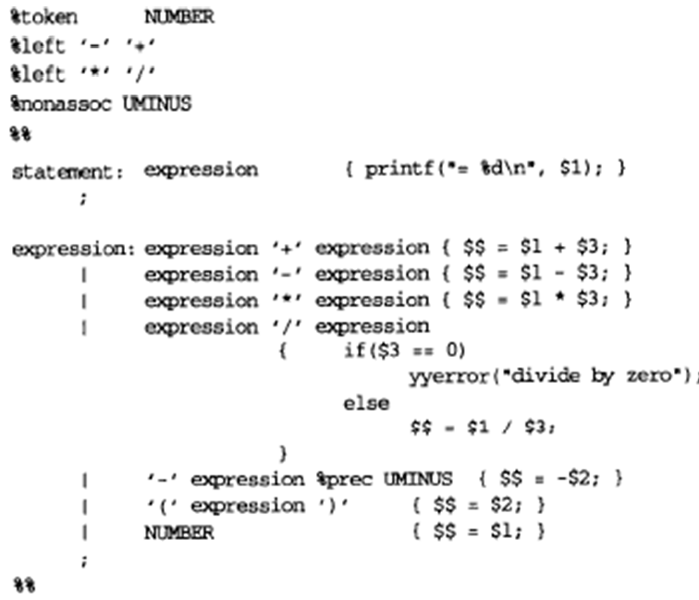
(Assign 4a) Refer : O’Reilly – Lex and Yacc

Slide 38
Assignment Submission
On Volp, Single doc file, with code and screenshots of output – of – all – 4a,4b,4c

Slide 39
Thank You!!

