Slide 1
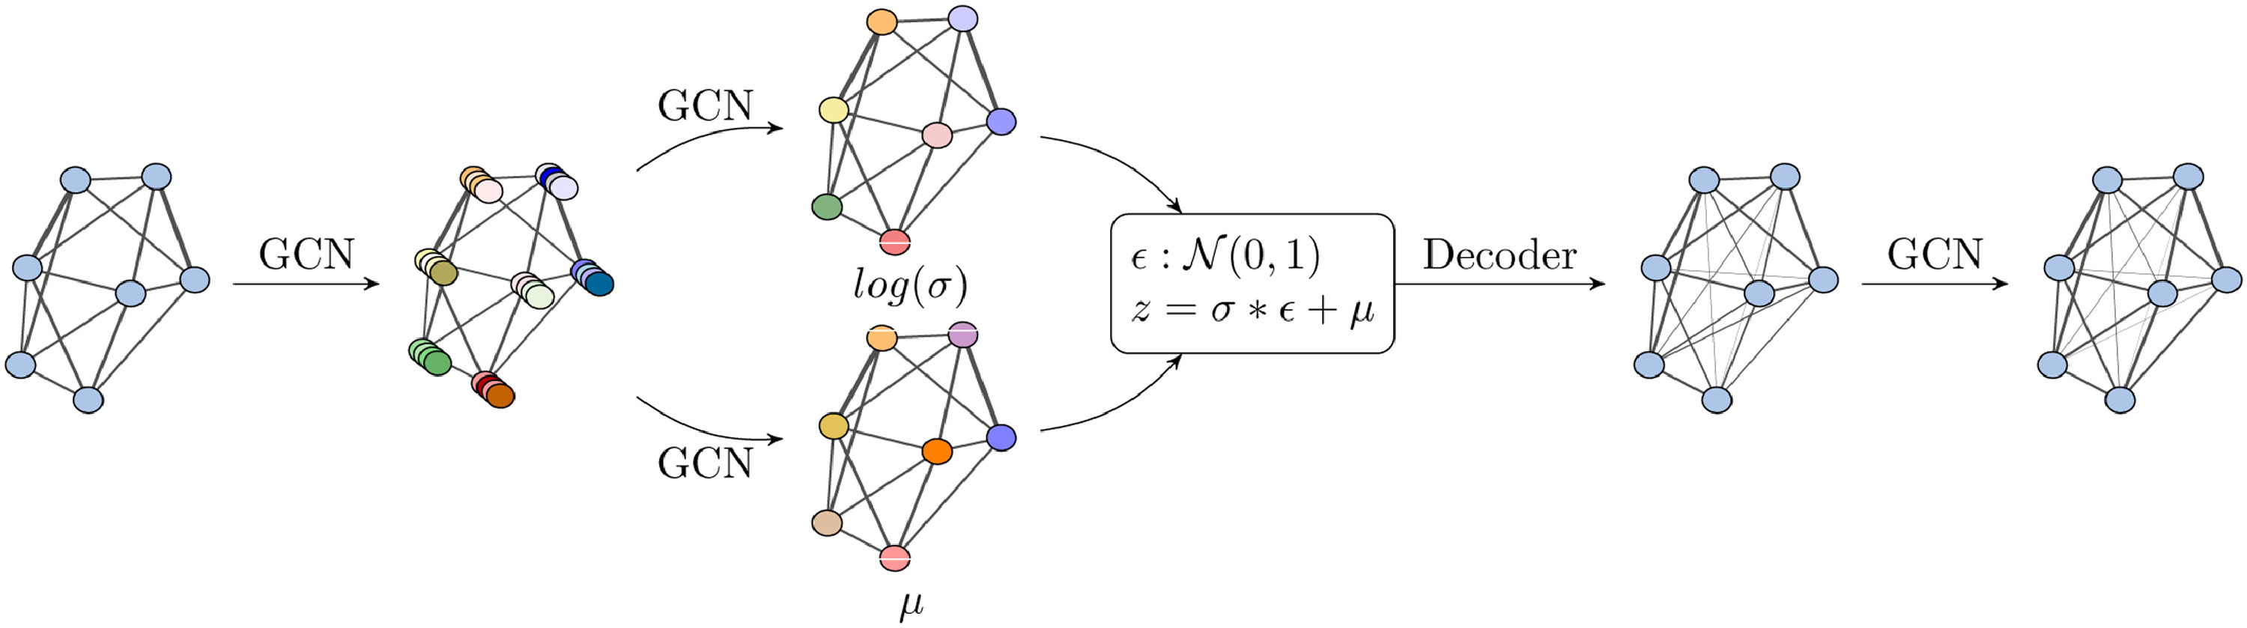
TASK
To detect Faults in a seven bus microgrid with the implementation of Machine Learning Techniques.
Problem Statement
To develop and implement a machine learning model that could accurately identify and localize faults within the microgrid. The model needs to analyze the electrical signals (current and voltage) captured by the relays and determine the specific line where a fault has occurred.
Approach
A microgrid can be conceptualized as a graph, with multiple nodes and interconnected lines forming a network of connections. In a steady state, currents flow between these nodes in various directions and magnitudes, resembling the dynamic nature of a graph. This analogy inspired my approach to implementing a Variational Graph Autoencoder (VGAE) for fault detection in the microgrid. Given that the structure and behavior of a VGAE closely mirror the microgrid system model, it seemed a natural fit for capturing the complex relationships and interactions within the microgrid, enabling effective fault detection

Slide 2
OBSERVATIONS
*Line and node are analogous here since we’re only considering one relay per node

Slide 3
LINE 1

Slide 4
LINE 2

Slide 5
LINE 3

Slide 6
LINE 4

Slide 7
LINE 5

Slide 8
LINE 6

Slide 9
LINE 7

Slide 10
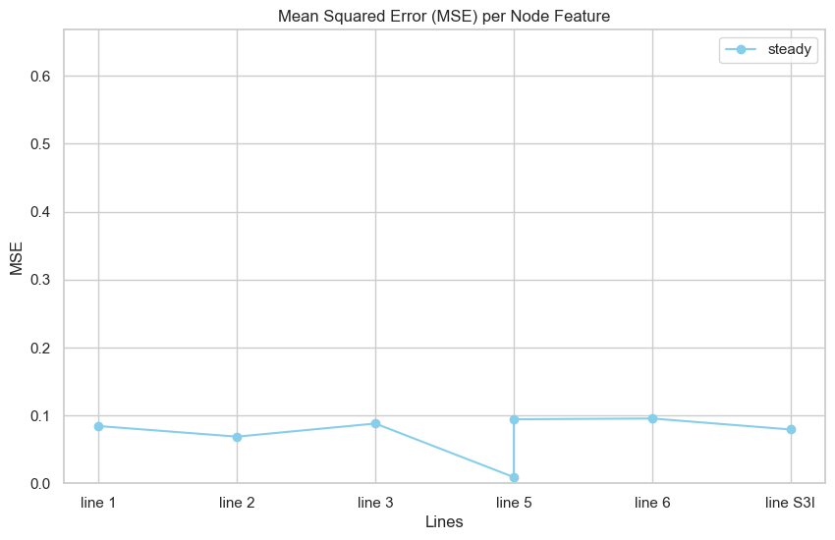
Steady state reconstruction errors

Slide 11
Hurdles and Complications
The proposed model successfully captures the behavior of the microgrid in a steady state.
However, during a fault in the microgrid, one of two possible scenarios arises:
Scenario 1:
A fault occurring on node A is localized and does not propagate to other lines. This leads to an abrupt
increase in the current flow, which is captured by the relay on the affected line.
Scenario 2:
A fault occurring on node A is not localized and propagates to other lines, causing fluctuations in the
current flow captured by relays on several other lines.
These scenarios highlight the complexities involved in accurately detecting and localizing faults within the
microgrid, presenting challenges for the model in maintaining precision across different fault conditions.
The main reason for this behaviour is the physical properties of the line and various other power sinks and
sources on different buses.

Slide 12
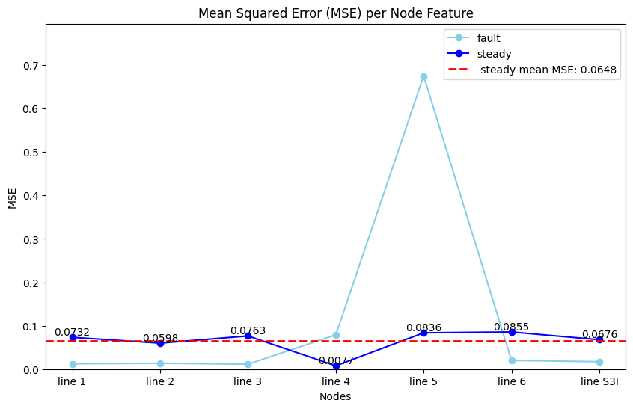
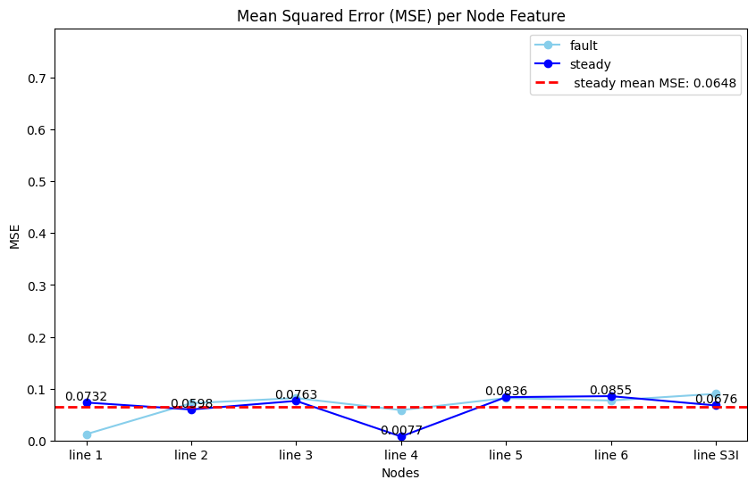
Fault in line 5
sample range: 14600-16000
Fault in line 4
sample range: 4000-12000
=>A fault occurring on a line is confined to that specific line and does not induce fluctuations in the readings of adjacent lines, thereby making a straightforward MSE evaluation suitable for fault detection.

Slide 13
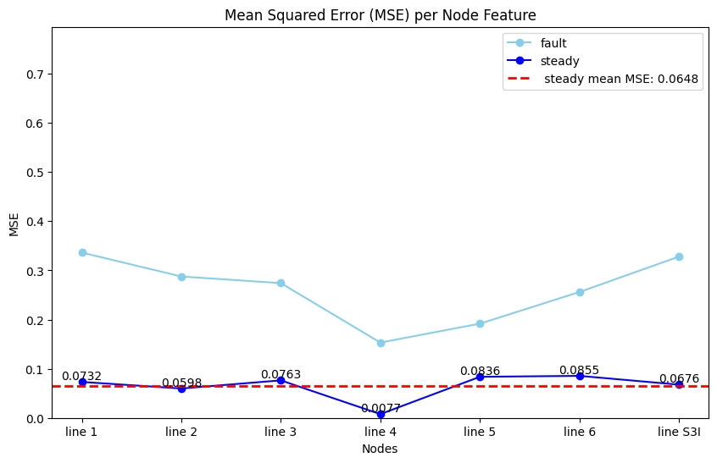
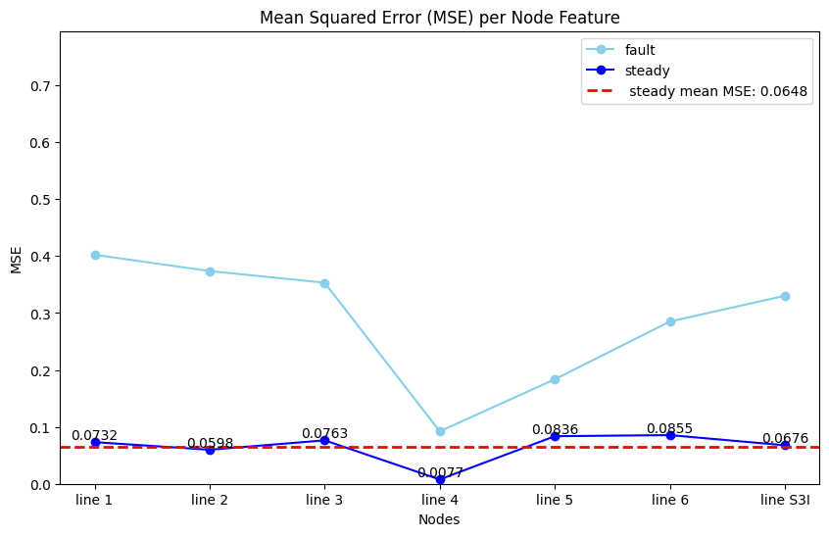
Fault in line 3
Sample range: 0-4000
Fault in line 1
Sample range: 13300-14600
=>A fault occurring on a single line is not confined to that specific line but instead induces significant fluctuations in the readings of adjacent lines. This behavior is influenced by the line characteristics and the resulting current flow. In such cases, the method of testing with MSE proves ineffective, as reconstruction errors increase across multiple nodes, complicating the identification of the specific node where the fault has occurred

Slide 14
Custom testing method:
It was observed that calculating MSE over large intervals leads to inaccuracies in the overall MSE for the lines.
Moreover, behaviour of the system as described in SCENARIO 2 gives rise to the need of a more robust testing function which can promptly analyze the errors on different nodes and make the logical decision of identifying the location of parent fault.
The custom testing function calculates the frequency of faults at each node by dividing the whole fault sample range over smaller batches. In this approach, the node with the maximum reconstruction error is identified as the location where the fault is occurring for the given batch. The node scoring maximum frequency of errors across all the batches is identified as the parent node where fault is occurring.
This method helps mitigate the errors associated with taking MSE over extended periods, resulting in more accurate fault detection in case of faults occurring under SCENARIO 2

Slide 15
RESULTS OBTAINED FROM CUSTOM
TESTING FUNCTION

Slide 16
TEST CASE 1:
Fault range 0-4000
Fault node 3
Custom test function results:
fault data flow in line 3
TEST CASE 2:
Fault range 4000-12000
Fault node 4
Custom test function results:
fault data flow in line 4

Slide 17
TEST CASE 3:
Fault range 13300-14600
Fault node 1
Custom test function results:
Fault data flow in line 1
TEST CASE 4:
Fault range 14600-16000
Fault node 5
Custom test function results:
Fault data flow in line 5

Slide 18
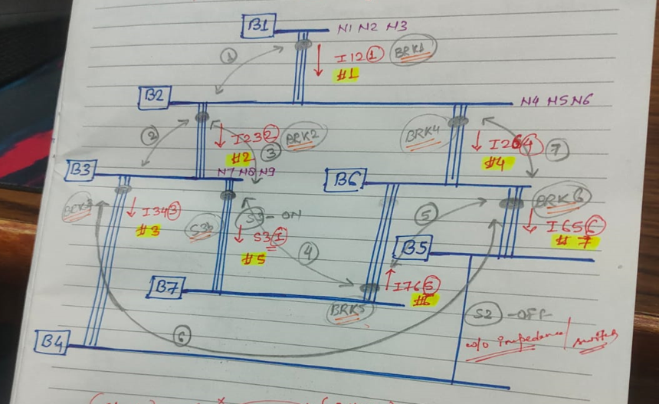
Conclusion
Direct MSE approach over large intervals in not feasible towards testing of fault detection due to reasons mentioned in SCENARIO 2
The custom testing function outperforms the traditional MSE approach over extended intervals. However this function still fails in fault line scenarios of line 2,6,7 which amounts to need for further improvement in the testing method.
Proposed Method for further improving the testing method:
To enhance the detection of de-localized faults, incorporating the physical characteristics of the lines—such as resistance, reactance, and susceptance—and using these properties to assign weights to the calculated MSEs or frequency vector could be beneficial.
This approach would allow for a more accurate representation of the current flow dynamics within the system, thereby improving the detection of non-localized faults.

