Slide 1
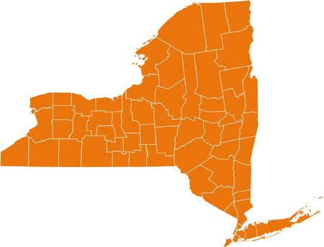
New York State Gender Ratio Prediction
Aastha Agrawal 01
Abhijeet Katiyar 02
Shivaansh Agarwal 24
Mentor:
Ankit Dwivedi Sir
Notes:
Good Morning all of you. So today we going to present before you our findings and analysis regarding the New York State Demographic Data.

Slide 2
Contents:
Understanding The Problem
Project Overview
Exploratory Data Analysis
Data Cleaning
Why Multiple Regression?
Assumptions regarding Multiple Regression
Building the Model
Conclusions
Language Used: R

Slide 3
Understanding
the Business
Perspective
Notes:
So, Government Organizations and private companies in order to make policies, do research, marketing or environmental and human development often use the demographic data,
which is collected by the census organizations which maybe either private or government.
For example in areas where the percentage of elderly people is more than children and middle aged people government may be interested in setting-up more medical care facilities rather than
setting up more schools or industries.

Slide 4
Project Overview

Slide 5
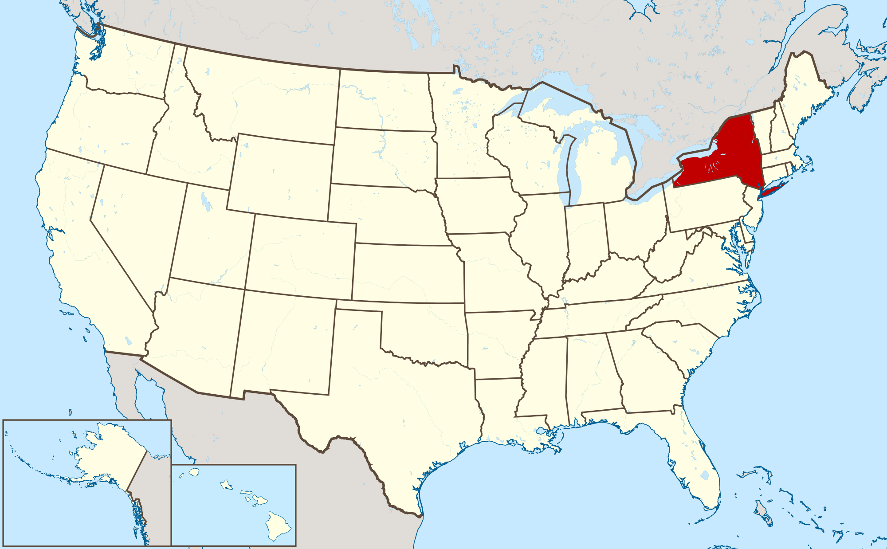
Map of USA highlighting the New York State
Notes:
So in this project we were given the Demographic Data of New York State.

Slide 6
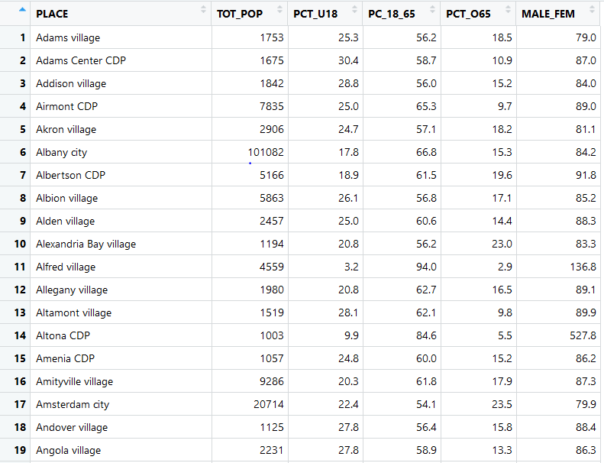
Notes:
This is the snapshot of the dataset which we got.
Since we didn’t knew what is the source of the data i.e from where has this data been generated
we decided to crosscheck whether the data is correct and when this dataset was created.
So after doing some research over the Internet we came to know that the Data is of the 1990 census.
So as we can see the dataset consists of 6 columns:

Slide 7
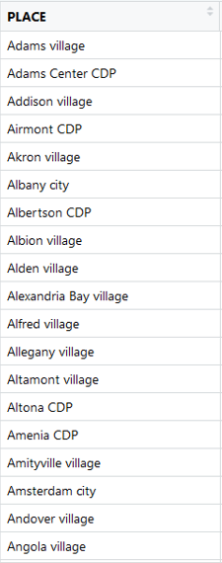
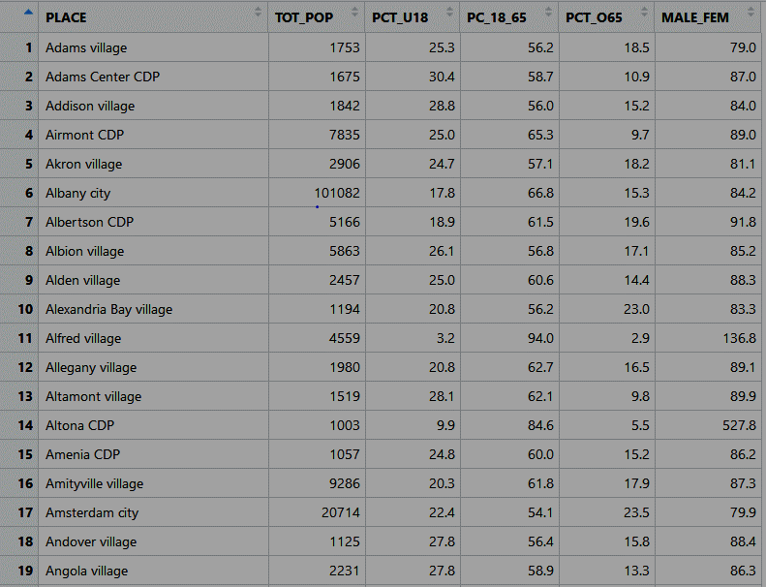
Notes:
PLACE: This column contains the different regions in the New York state.

Slide 8

Notes:
TOT_POP: This column contains the total populations of their respective regions.

Slide 9

Notes:
PCT_U18: This column contains the percentage of people which are below 18 years of age.

Slide 10

Notes:
PC_18_65: This column contains the percentage of people which are between 18 and 65 years of age.

Slide 11
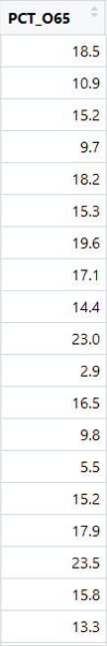
Notes:
PCT_O65: This column contains the percentage of people which are above 65 years of age.

Slide 12
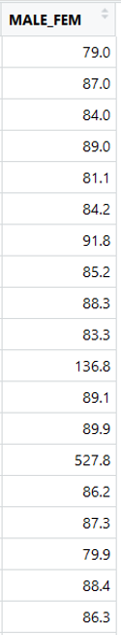
Notes:
MALE_FEM: This column contains the ratio of number of males per 100 females in the region.
Now our task was to predict using Multiple Regression the MALE to FEM ratio.

Slide 13

Notes:
So just like us some of you might also be having the question like just by knowing your age group how can I tell whether you’re a male or female.
So keeping that question aside we bagan our analysis:

Slide 14
Exploratory Data Analysis

Slide 15



Slide 16
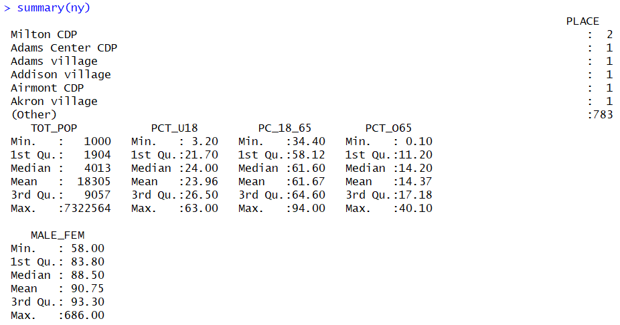
Notes:
After using the summary function over our dataset we found that
The first column i.e. the PLACE is a categorical variable with all values unique.
In the send column we got the minimum value as 1000 but maximum as around 73 lakhs but median 4013.
Although that value was very high but after doing some backtracking we came to know that the value was not wrong.
But for our dataset these types of values were outliers.
Why did you remove those values when they were correct? -> Because they were creating bias in our model.
What is bias?
What are outliers?
Similarly in the other columns also we found some outliers.

Slide 17
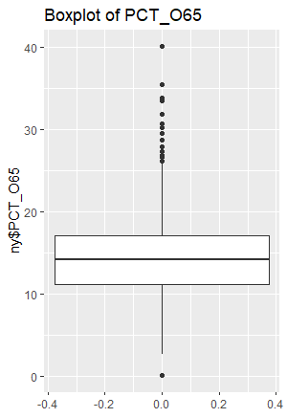
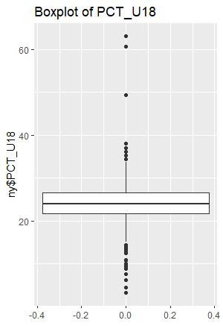
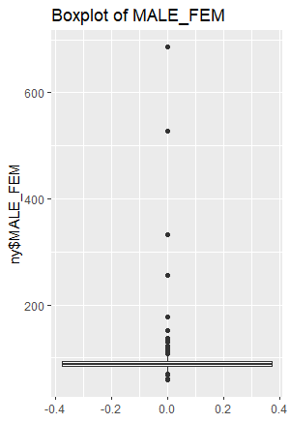
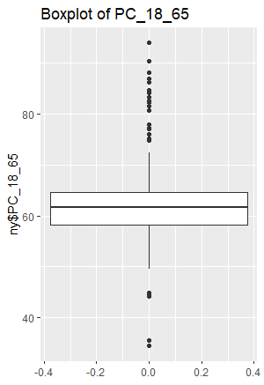
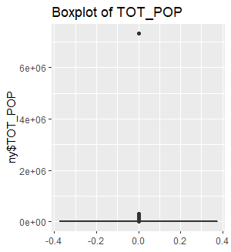

Slide 18
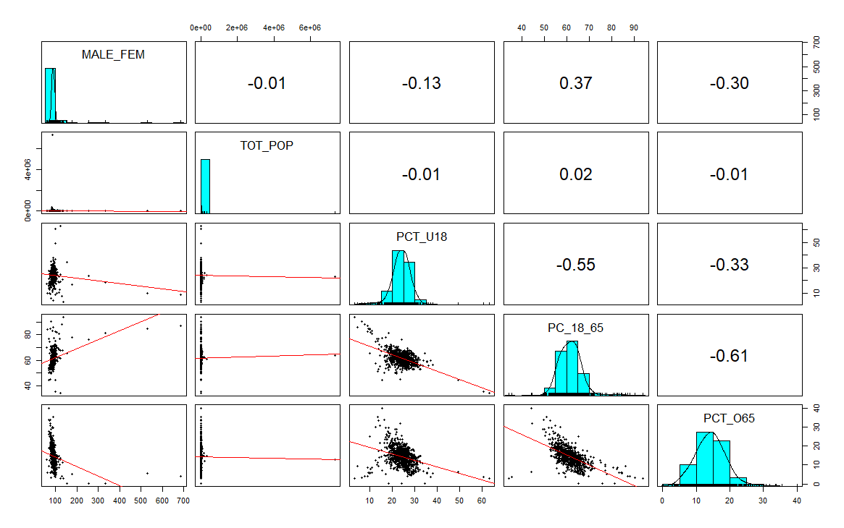
Combination of Scatterplot Matrix, Histograms, Correlation Matrix before Data Cleaning

Slide 19
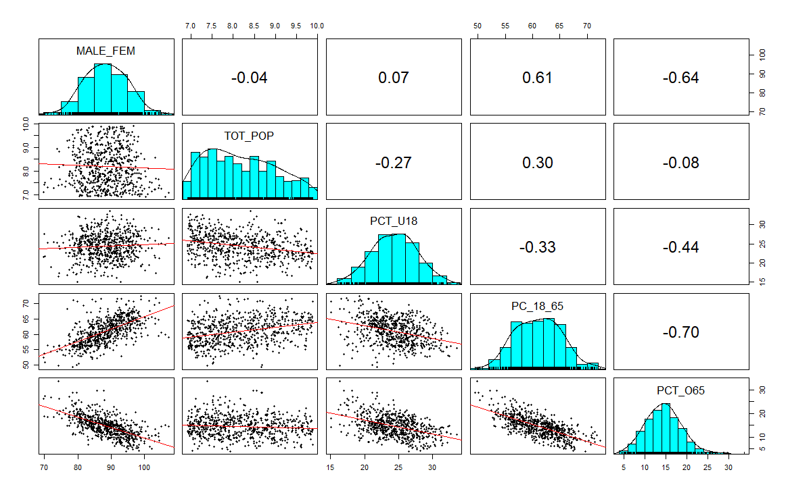
Combination of Scatterplot Matrix, Histograms, Correlation Matrix after Data Cleaning

Slide 20
Why Multiple Regression?
Notes:
Why did we apply Multiple Regression??
Why not others?
1. Since we were given the dependent variable therefore we had to Supervised Learning Algorithm.
2. Dependent Variable as Continuous.
3. There were multiple attributes present.

Slide 21
Assumptions Regarding Multiple Regression

Slide 22
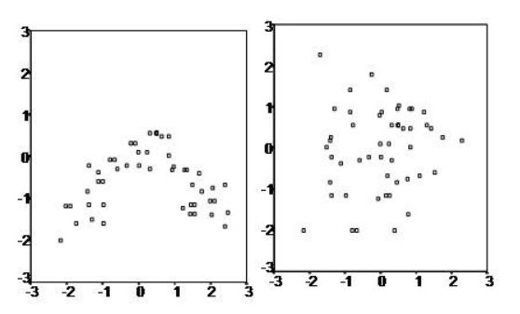
Assumptions Regarding Multiple Regression
LINEAR RELATION between the independent and dependent variables.
Notes:
When the scatter plot is something like the right one, we can use Multiple Regression.
And as we saw in (go to slide 19) these plots the scatterplots are showing Linear Relationship.

Slide 23
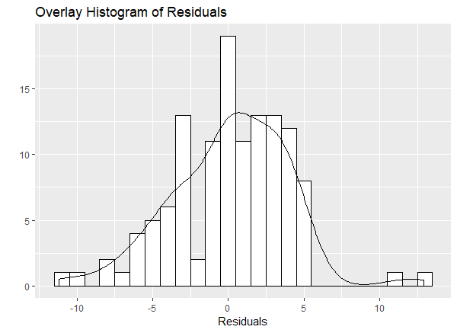
Assumptions Regarding Multiple Regression
LINEAR RELATION between the independent and dependent variables.
Multivariate Normality
Notes:
It means that the residuals are normally distributed.

Slide 24
Assumptions Regarding Multiple Regression
LINEAR RELATION between the independent and dependent variables.
Multivariate Normality
No Multicollinearity

Slide 25
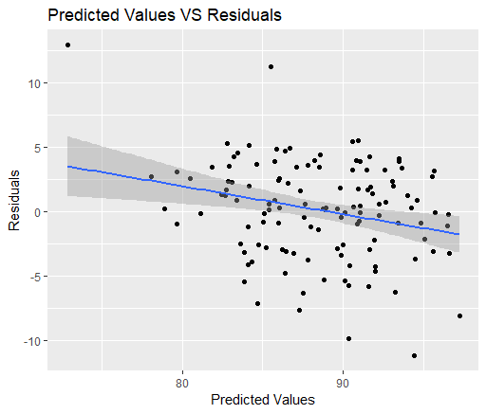
Assumptions Regarding Multiple Regression
LINEAR RELATION between the independent and dependent variables.
Multivariate Normality
No Multicollinearity
Homoscedasticity

Slide 26
Model Building & Evaluation
Notes:
After splitting the Dataset into Training and Testing, we trained our model using multiple regression.
Backward Selection.

Slide 27
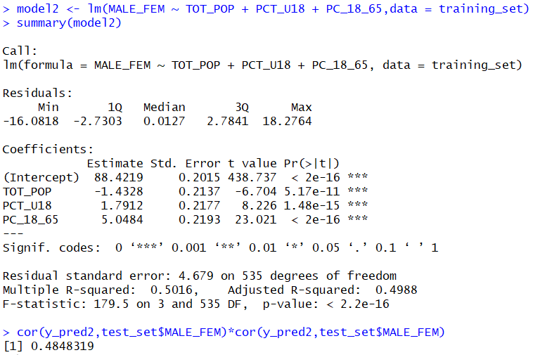
Notes:
Steps to evaluate the model??
How did we evaluate the model?
Accuraccy??

Slide 28
Notes:
Another very important point that we need to check is that our residuals follow roughly normal distribution. We can do so by checking histogram of residuals. If the histogram of residuals looks normal then we have a valid model.
http://analyticspro.org/2016/03/05/r-tutorial-residual-analysis-for-regression/

Slide 29
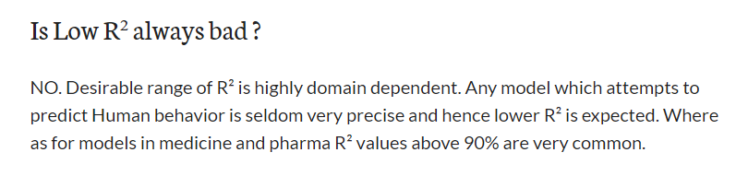

Slide 30
Notes:
So again after listening the accuracy many you might be thinking that our model is not good.
But trust me we applied a whole lot of things to improve our accuracy.
So let me again bring you back to my previous question that just by knowing your age group how can I tell whether you’re a male or female
So maybe the variables from which we had to predict the Male to Female ratio were not enough to predict the male to female ratio.

Slide 31
Thank You

