Slide 1

Cyclistic Case Study
Abhijeet Bhatta

Slide 2
Contents
Business task
Data Sources
Data Wrangling
Analysis
Suggestions

Slide 3
Business Task
Develop marketing strategies to convert Cyclistic’s casual riders to annual members
1
Inform marketing strategy with insightful analysis of data
2
Key stakeholders – Lily Moreno(Director of Marketing), Marketing Team, Analytics Team and Executives
3

Slide 4
Data source
Entire year of data provided my Motivate International Inc under the following license : https://divvybikes.com/data-license-agreement
The dataset contains 12 csv files containing the latest year of Cyclistic’s bike ride data

Slide 5
Does the Data ROCCC?
Reliable (R) – Government data makes it reliable
Original (O) – Contains unique and original data
Comprehensive (C) – Dataset is comprehensive for analysis
Current (C) - Contains latest data
Cited (C) - Not sure

Slide 6
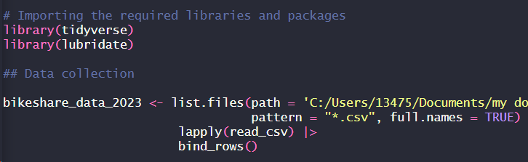
Data Import
R Studio was used for the complete data analysis process
All csv files were imported and merged in a single data frame

Slide 7
Data Wrangling
Unwanted columns were removed
Data was transformed to ensure correct Data type for analysis
Ride length was calculated from date variable
Data was cleaned of null, duplicate and outlier values

Slide 8
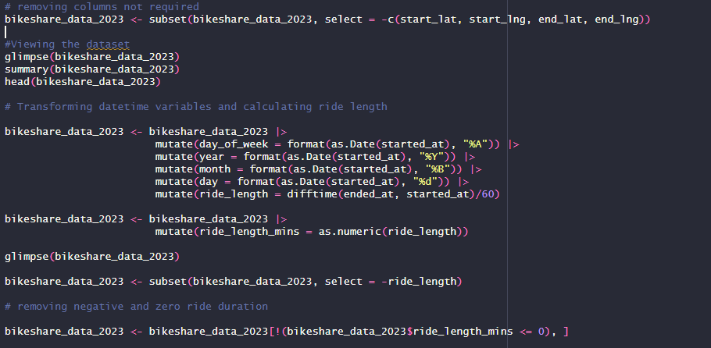

Slide 9
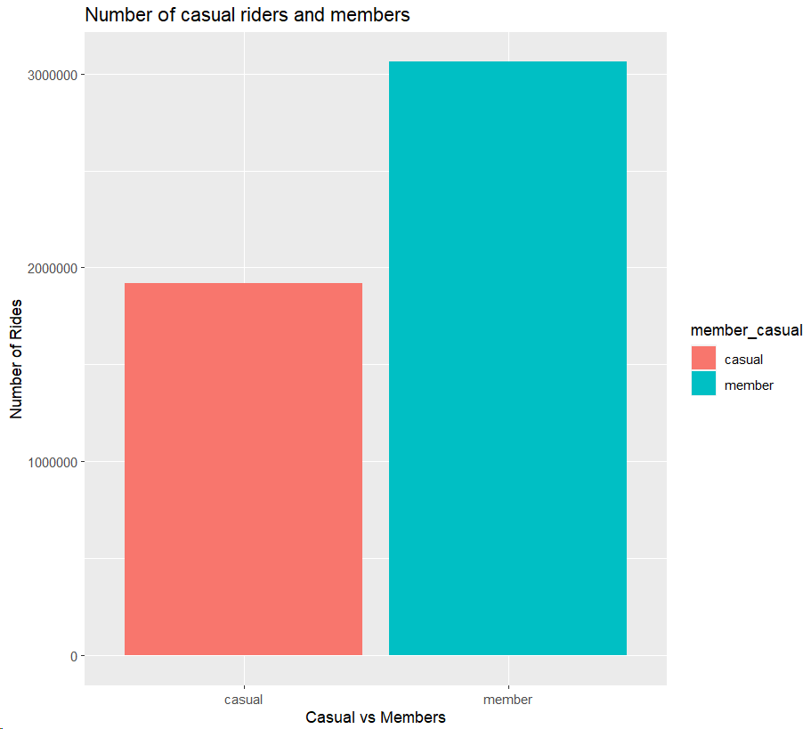
Data Analysis
It looks like riders with annual membership have about a third more rides in total than that of casual riders

Slide 10
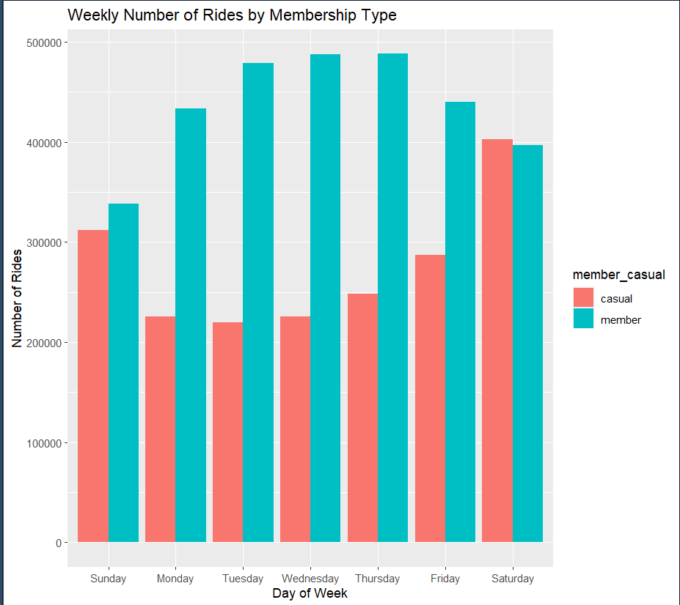
Casual members ride more in the weekends
Annual members have more rides in the weekdays.

Slide 11
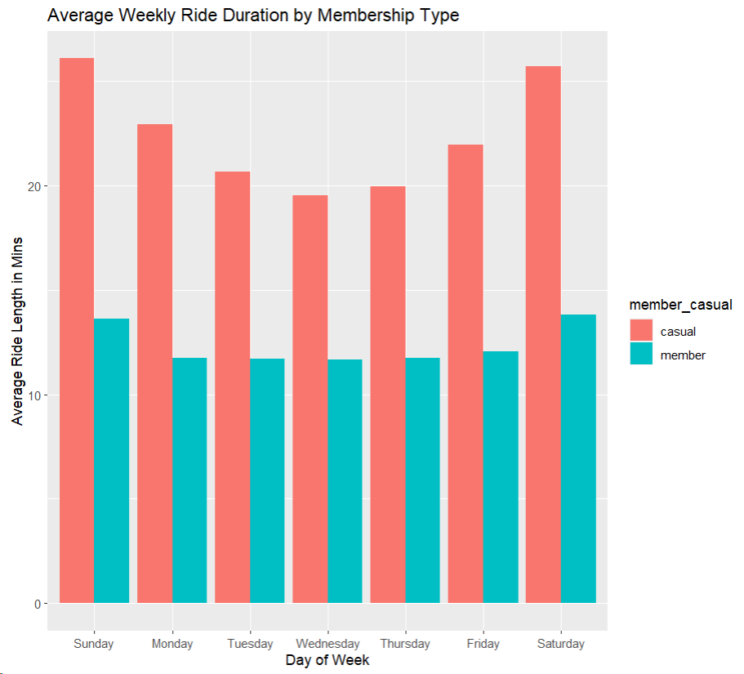
Casual members have higher ride length/duration throughout the week and weekend.

Slide 12
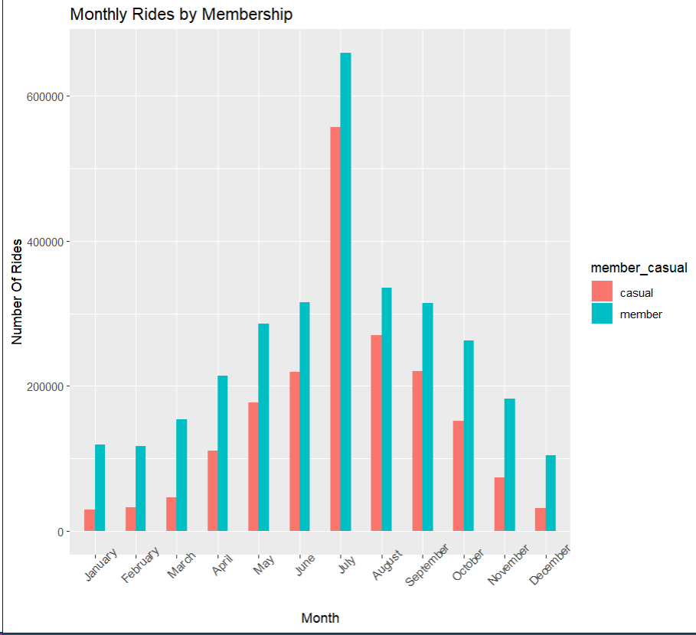
As summer kicks in people like to take bikes for a ride.

Slide 13
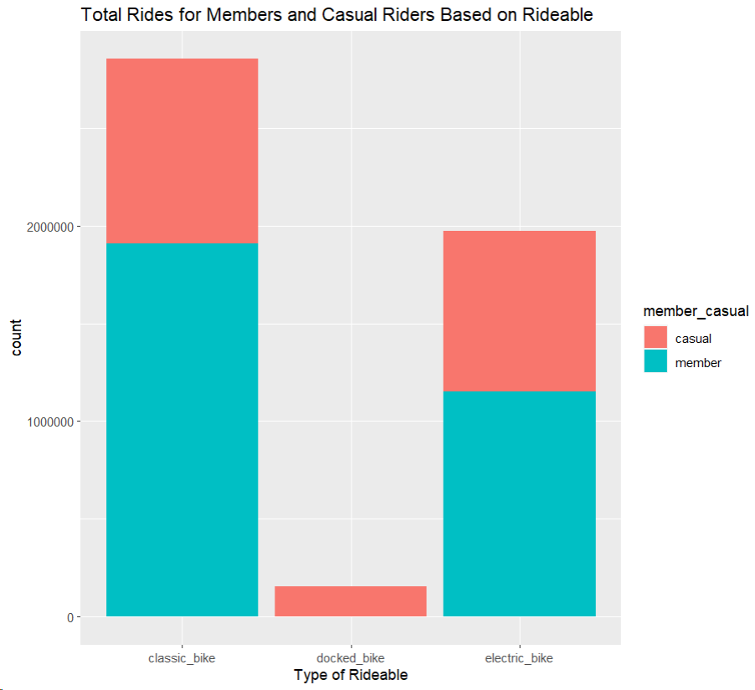
Classic bikes and electric bikes are popular for casual members
Docked bikes seems like the least popular rideable

Slide 14
Suggestions
Offer discounts on annual membership in the summer
Focus marketing effort on electric and classic bikes
Create premium benefits for annual members and offer free premium trials to casual riders in the weekends

