Slide 1
Sales Data Analysis
An overview of key insights from the dataset

Slide 2
Introduction
This presentation provides an analysis of sales data, including key metrics, trends, and visualizations.

Slide 3
Data Loading
The dataset was loaded using Pandas from an Excel file named 'Sample - Superstore.xlsx'.

Slide 4
Libraries Used
- Pandas for data manipulation
- NumPy for numerical operations
- ydata_profiling for automated EDA
-Matplotlib for plotting the data
Seaborn to add various charts

Slide 5
Data Visualization
Various visualizations were created to explore sales trends, customer segments, and product performance.

Slide 6
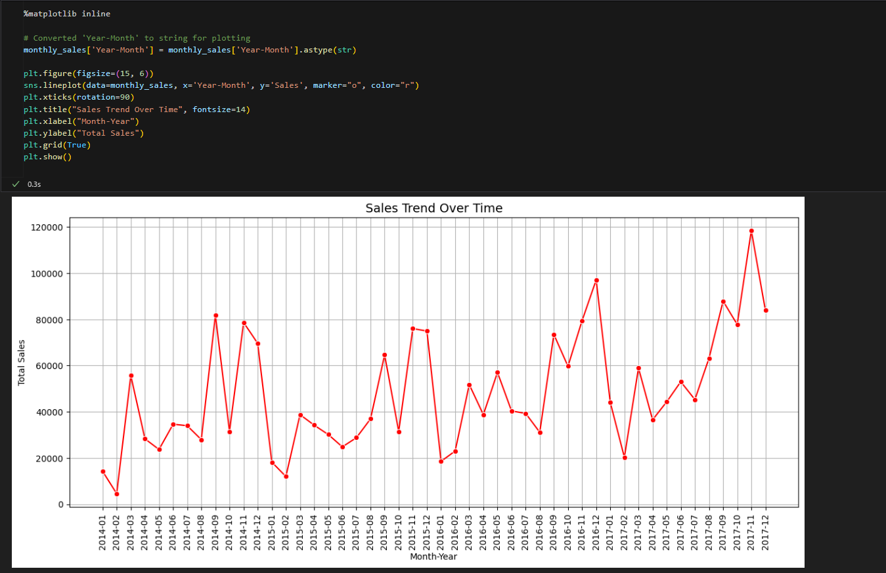
1. Sales Trend Over Time

Slide 7
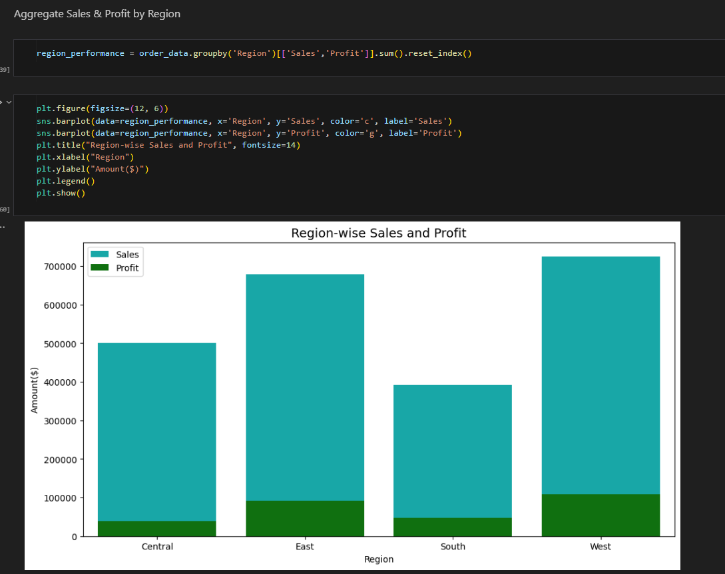
2. Sales & Profit by Region

Slide 8
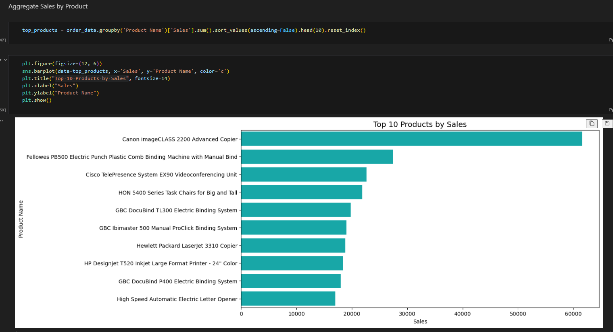
3. Top 10 Best-Selling Products

Slide 9
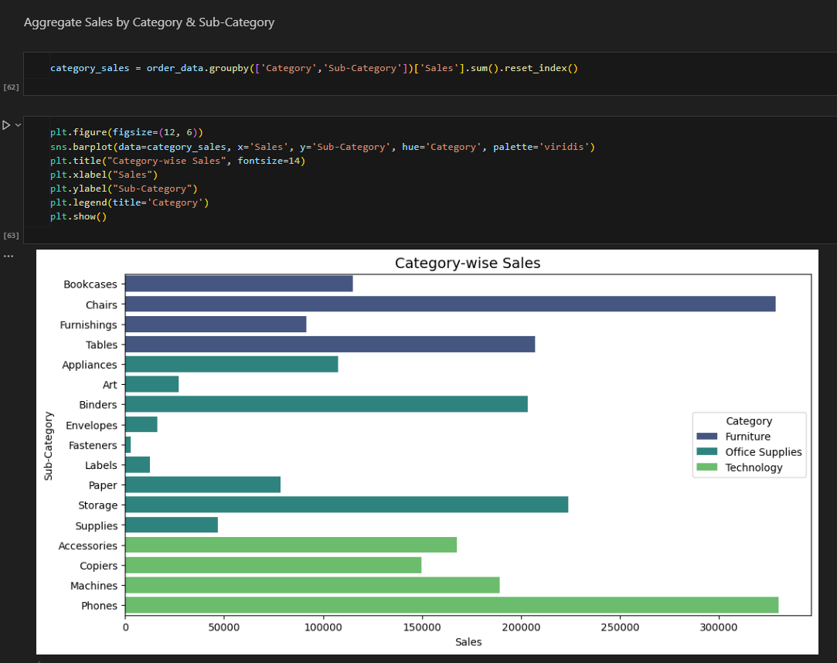
4. Sales by Category & Sub-Category

Slide 10
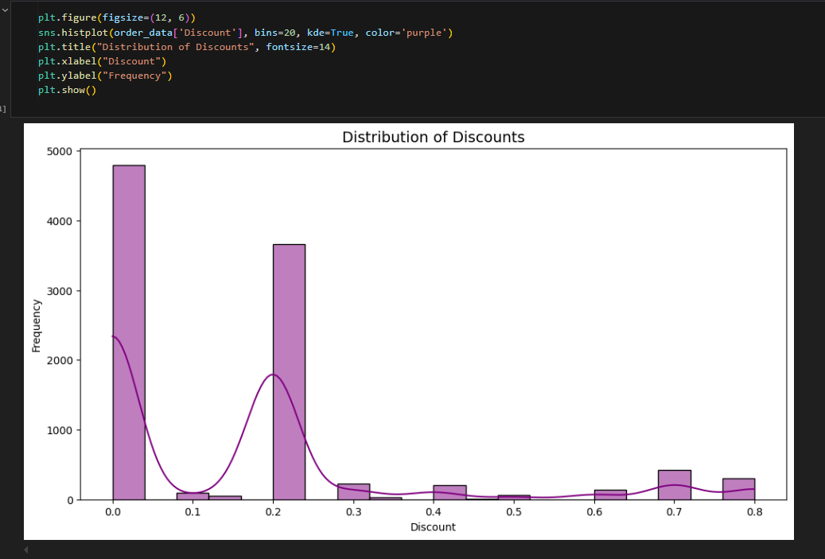
5. Sales Distribution by Discount

Slide 11
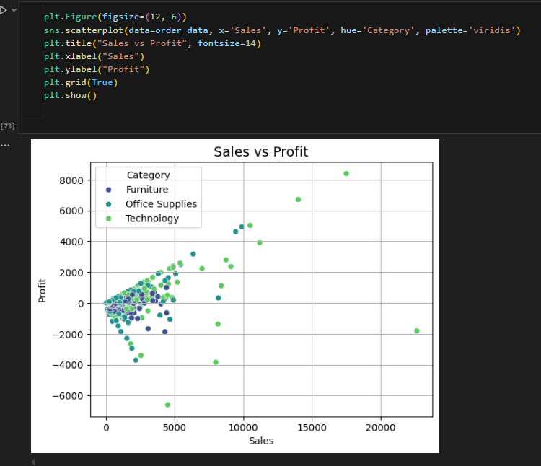
6. Profit vs Sales Scatter Plot

Slide 12
Conclusion
Sales have shown a steady upward trend over time, with peak performance in Q4.
The West region generated the highest sales and profit, while the South lagged behind.
The top-selling product contributed significantly to revenue, with Office Supplies leading sales.
Discounts had a mixed impact—higher discounts increased sales volume but reduced profitability.
A clear correlation exists between higher sales and increased profit, though some products showed low profit margins despite strong sales.

