Slide 1
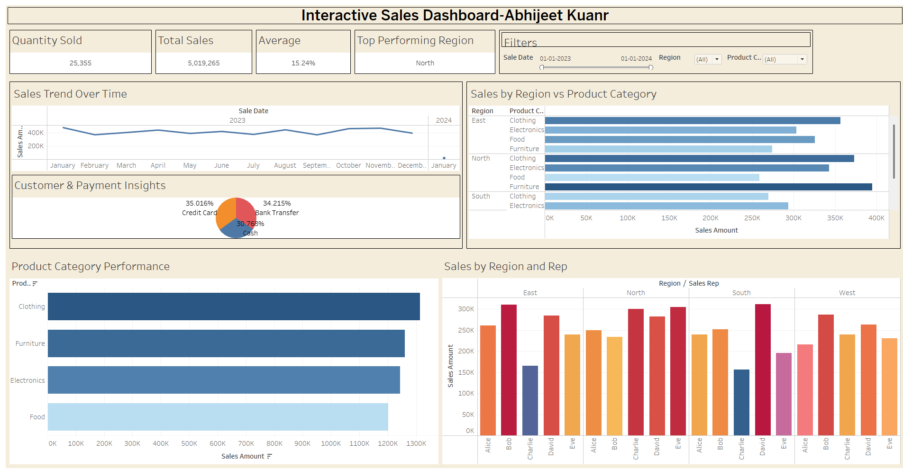
Interactive Sales Dashboard
Presented by: Abhijeet Kuanr
Tool Used: Tableau

Slide 2
Dashboard Overview
Purpose:
- Provide real-time sales performance insights
- Analyze customer behavior and payment trends
- Track sales rep and regional performance

Slide 3
Top-Level KPIs
• Total Sales: ₹5,019,265
• Quantity Sold: 25,355 units
• Average Discount: 15.24%
• Top Performing Region: North

Slide 4
Visual Insights Included
1. Sales Trend Over Time (Line Chart)
2. Customer & Payment Insights (Pie Chart)
3. Sales by Region vs Product Category (Bar Chart)
4. Product Category Performance (Bar Chart)
5. Sales by Region and Rep (Grouped Bar Chart)

Slide 5
Filters and Interactivity
- Filter by Sale Date, Region, and Product Category
- Interactive dashboard with drill-down capabilities
- Slice and explore data with ease

Slide 6
Key Insights
• North region leads in sales
• Clothing and Food are top-selling categories
• Payment methods are evenly distributed
• Sales rep performance varies by region

Slide 7
Next Steps / Suggestions
- Add a slicer for Top N Region filtering
- Include Profit Margin analytics
- Publish dashboard to Tableau Public or Server
- Enable drill-down interactivity

