Slide 1

PetMeNow
Project Group: T01/07-1
COMP90018 Semester 2 Assignment2

Slide 2

Overview
Introduction
Background story
PetMeNow App features
Demo
Architecture
Frontend
Backend

Slide 3





Background
???

Slide 4








Background
Forever??

Slide 5









Introduction
PetMeNow: The temporary freedom for the pet owners, the temporary happiness for the pet lovers.
Search post
View pet detail
Request
Make a deal
Fosterage
Travel end
Pet sitter
Return home

Slide 6

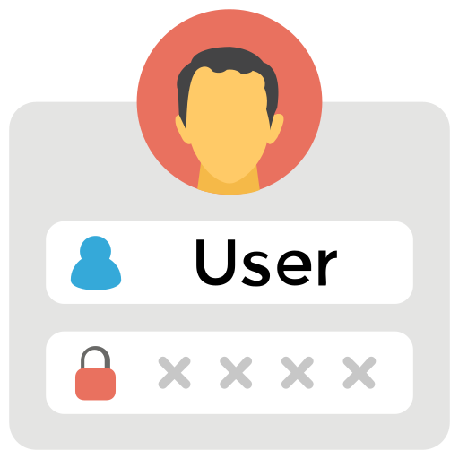










PetMeNow features
Sign up/Sign in
Post
Chat
History
User detail
Search
Refresh
Image
Location
Voice message
Camera

Slide 7



Frontend
Our app uses React Native.
React Native
JavaScript
android and apple
Notes:
For frontend we use React Native for our framework
it uses JavaScript and allows one code base to be shared between android and apple, allowing cross-platfrom development.
with this our team has developed the app and test on both android and apple
with react native, we can also test in phone or emulators
We decided to go with React Native as it is easy to learn, as we are mostly software developers with at least some knowledge on web development, developing mobile app on react native has some similarities, making it easier to develop as well as the reason that it uses JavaScript a language we are familiar with.

Slide 8
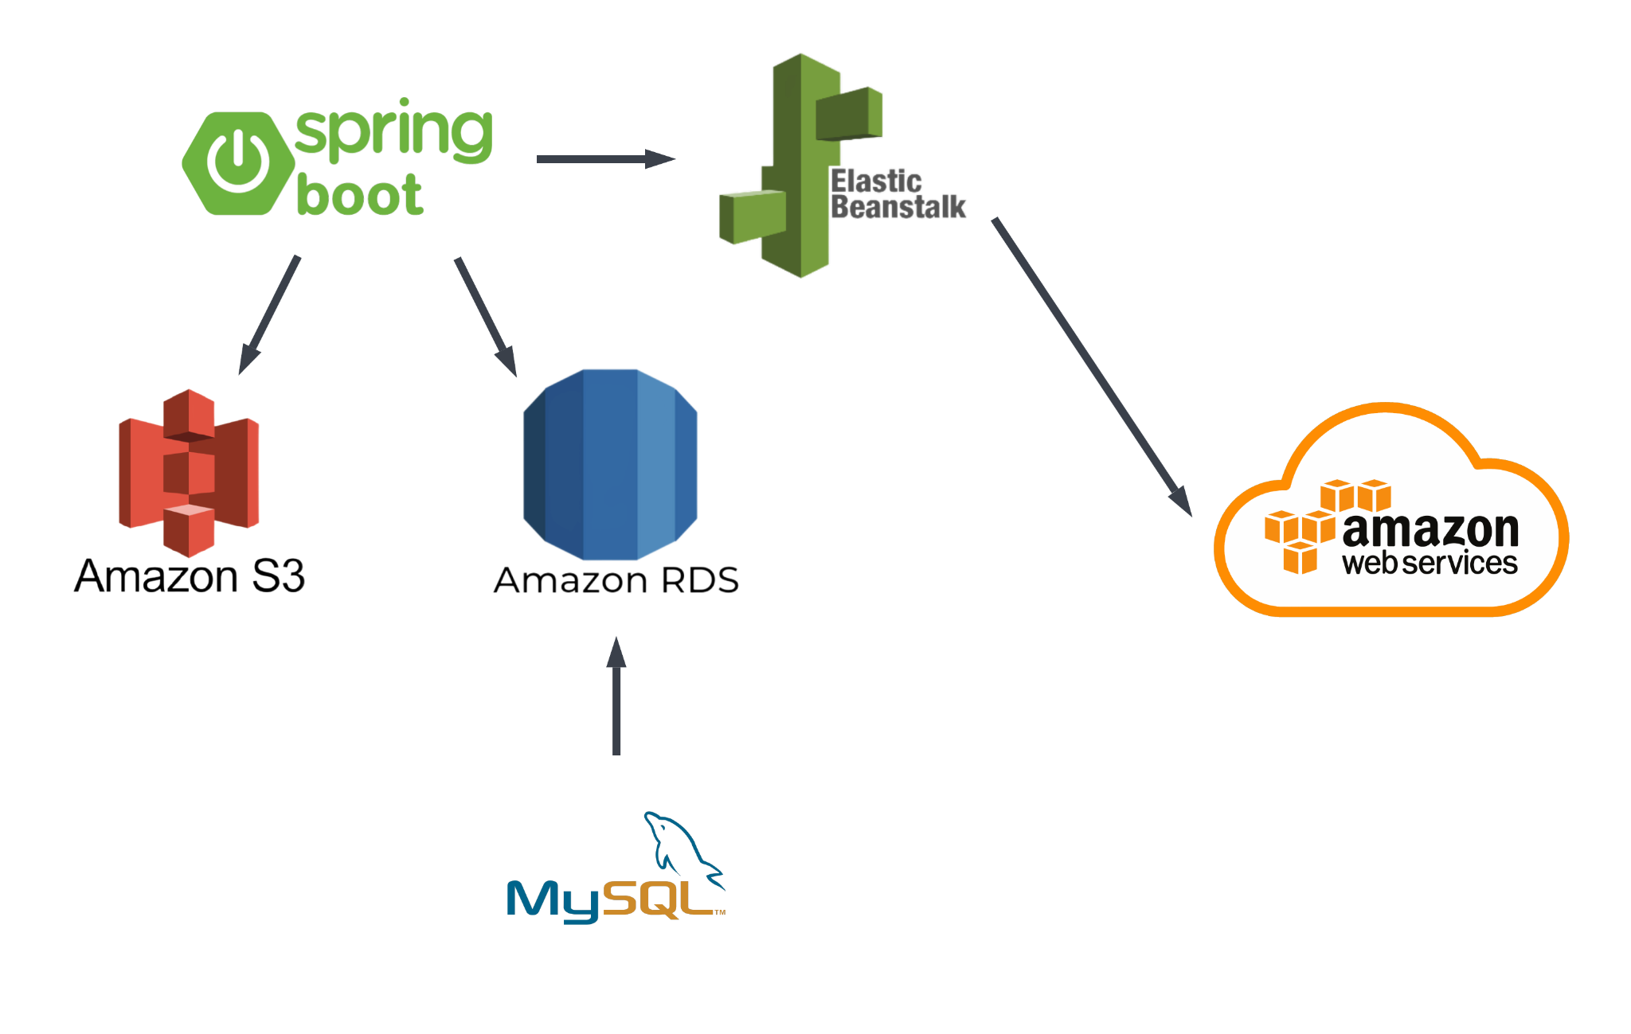
Backend
Notes:
We use Spring boot Application for handling the backend of our app, it is an open-source Java based framework used to create microservices. The Spring boot application is hosted on AWS server which is the backbone of the backend architecture. We make use of Amazon Elastic Beanstalk to quickly deploy and manage our application lifecycle and makes several APIs available on the internet. Our backend application uses Amazon RDS with MySQL a relational database, to store the data produced by the app such as user, pet and order details. We also make use of Amazon S3 which is used to store our application JAR and images uploaded for profile pictures by the users.

Slide 9
Demo of
Home page
History page
Me page

Slide 10
Demo of
Chat function

Slide 11
Thank you for watching!
Group: T01/07-1

