Slide 1
Touchdown Maze Adventure An immersive three.js experience
FINAL PROJECT (CG)
Abhijeet Takale
UGA ID:811848967

Slide 2
Revolutionizing Maze Gaming
Challenge:
Traditional maze games lack depth and engagement, featuring static environments and predictable gameplay.
Objective:
Craft an immersive experience by integrating American football excitement with dynamic 3D maze navigation.
Fusion of Georgia football theme and dynamic gameplay to offer a novel and visually stunning gaming experience.

Slide 3


GAME ELEMENTS
Bulldog vehicle
Maze structure(gltf)
Touchdown point

Slide 4
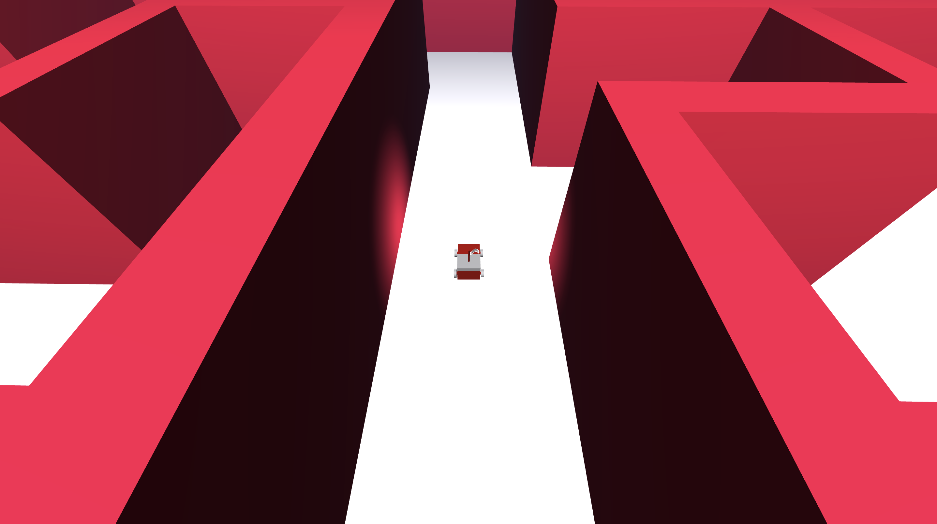
GAME FEATURES
Dynamic vehicle control
Responsive camera controls
Textured Floor elements
Imported Maze structure

Slide 5

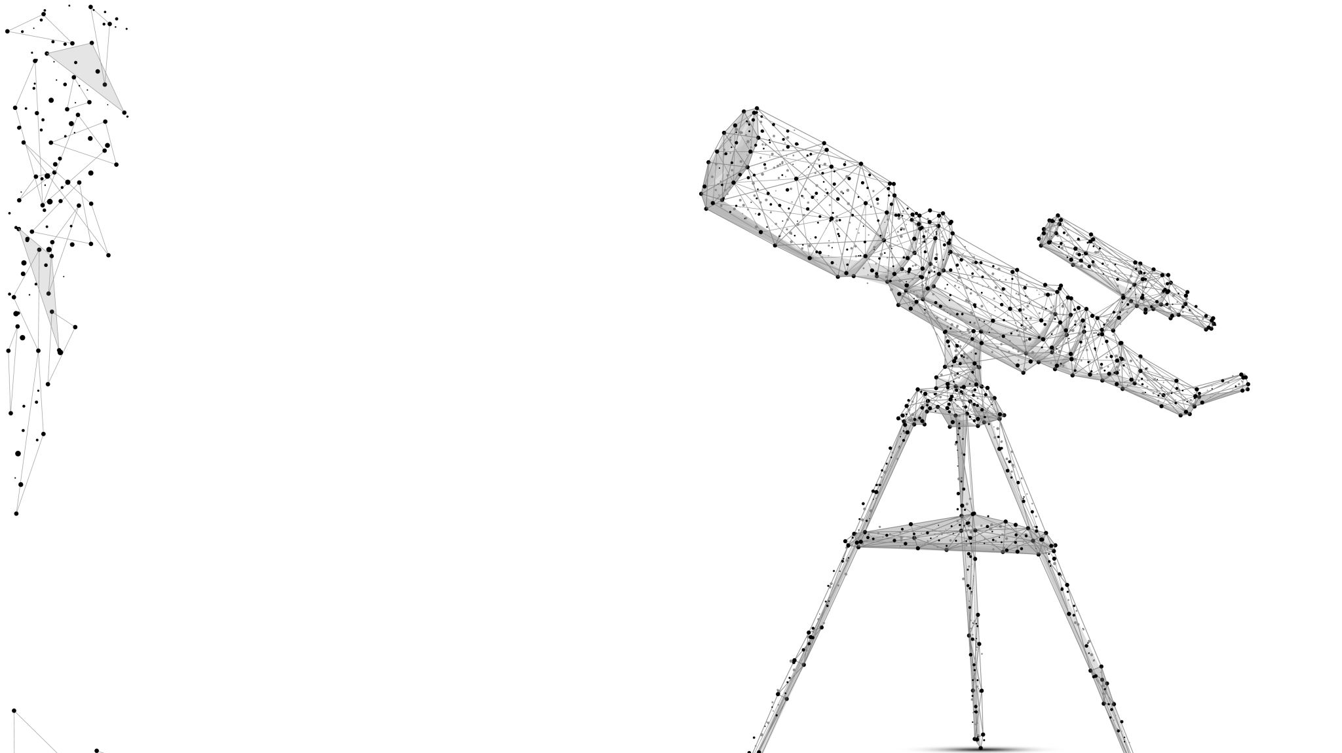
Essential dependencies
THREE.js
Cannon.js
Cannon-debugger
Orbital Controls
GLTFLoader
npm

Slide 6
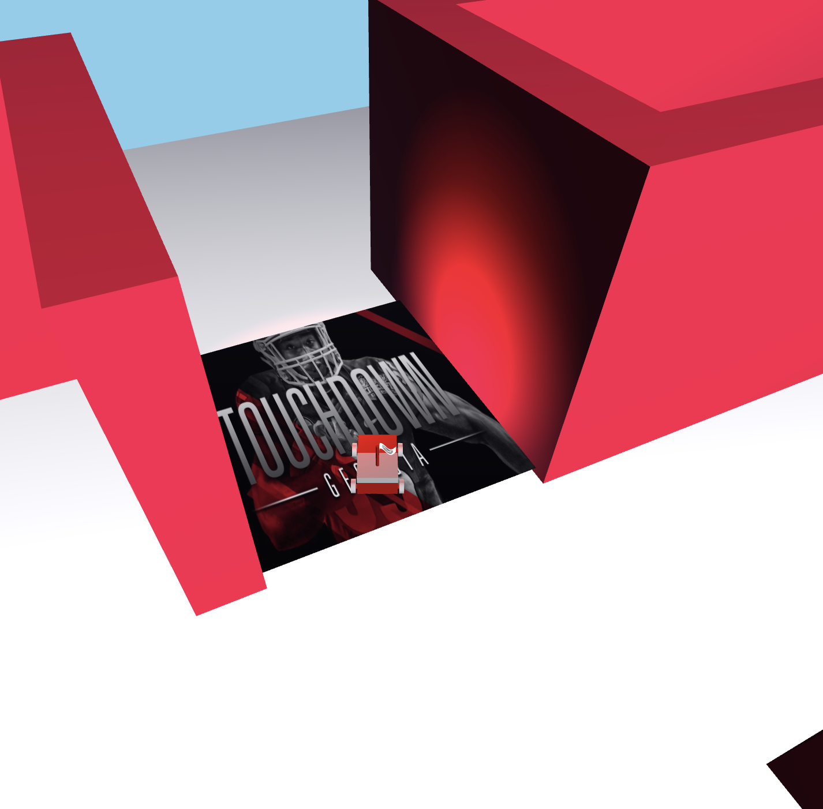
CONCEPTS UTILIZED
Collision Detection (Cannon.js)
Vehicle mechanics (Cannon constraints)
Texturing
Wave motion (Flag)
Lighting (headlights, etc)

Slide 7
Future enhancements
Exploring Multi-player support for competitive edge.
Expanding maze variations & touchdown scenarios.
Introducing Scoring Mechanism & difficulty levels.

Slide 8
REFERENCES
https://threejs.org
https://3dexport.com
https://www.freecodecamp.org/news/three-js-tutorial/
https://pierfrancesco-soffritti.medium.com/how-to-organize-the-structure-of-a-three-js-project-77649f58fa3f

Slide 9
THANK YOU!

