Slide 1
Self-Learning Website
by Team 1
Fresh business general template
Applicable to enterprise introduction, summary report, sales marketing, chart data
汇报人：优品PPT

Slide 2
Our Team
Team Lead
Tejasvi Kandula
Team Member
Abhijeet Vitthal Sawant
Ajinkya Chandurkar
Akshatha Kalyanpur Nayak
Amruta Bhadgaonkar
Suwarna Kale
Xiasong Weng
Xue Yang
Zhong Peng

Slide 3
01
Plan & Design
Introduction
02
Technology Stack
03
Development Strategy
04
Demo

Slide 4
Part I
Plan & Design
self-learning website team1

Slide 5
Plan & Design
The Self-learning website:
Home Page
register as a member
search the courses that they want to
view the most popular courses in the website
Video Page
- watch the video related to the course they want
- Change subtitles of the course in a language of their choice
- view the transcripts
Initial
thoughts

Slide 6
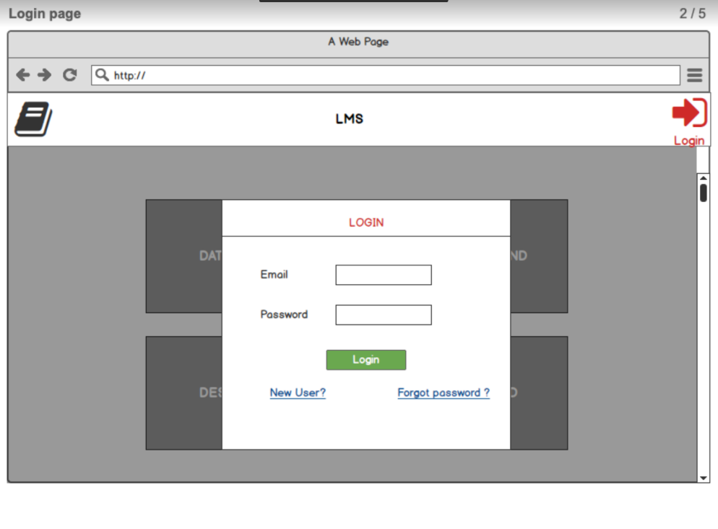
Plan & Design
Home
Page

Slide 7
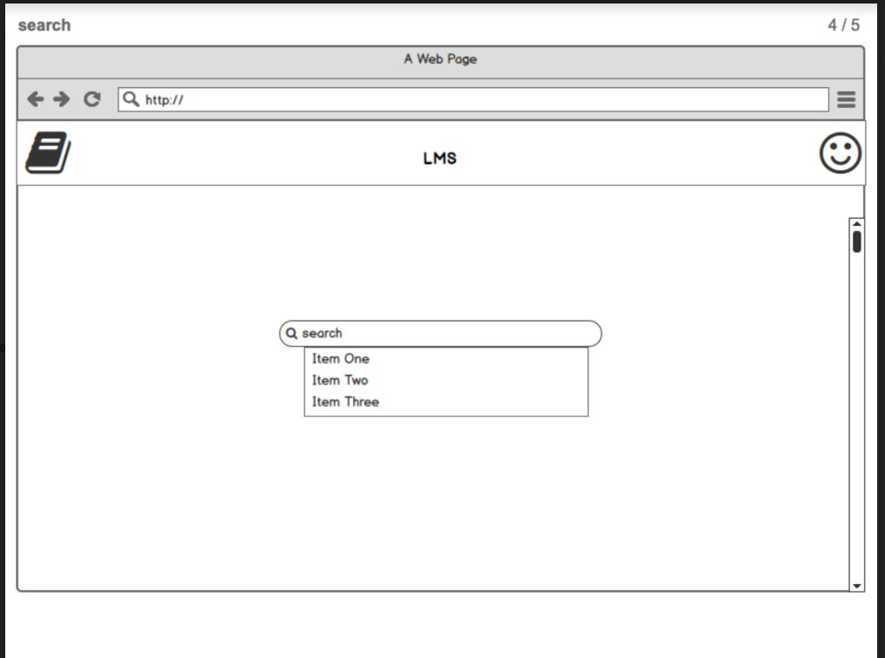
Plan & Design
Home
Page

Slide 8
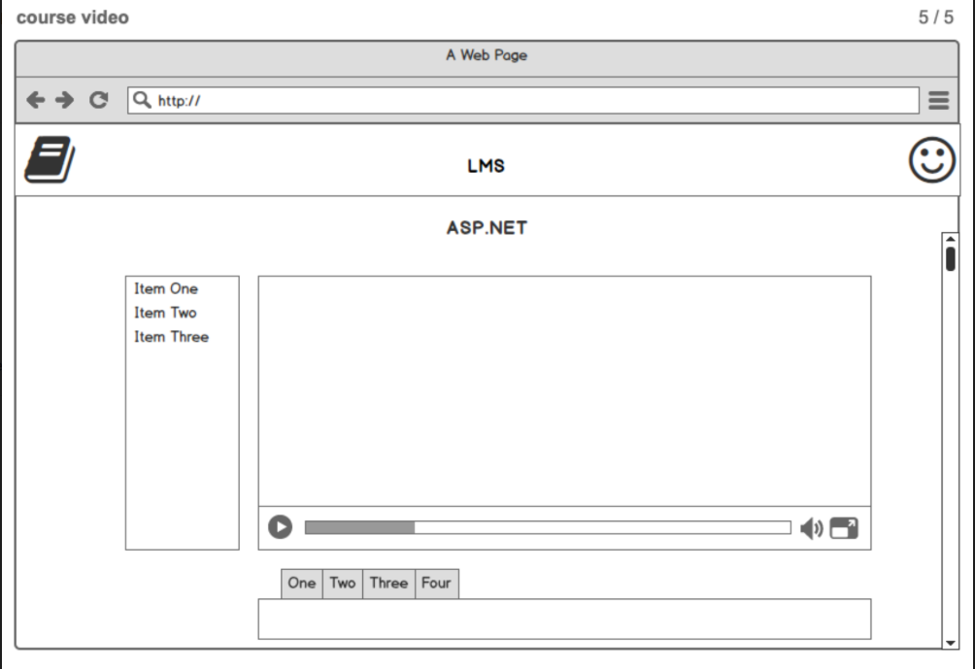
Plan & Design
Video
Page

Slide 9




Plan & Design
Understanding
Design and distribute
Booking Coding
Integrating
Timeline Followed
Week 1: Understanding the project
Week 2: Design & Distribute the job
Week 3,4,5: Coding
Week 6: Integrating

Slide 10
Part II
Technology Stack
self-learning website team1

Slide 11
Technology Stack
01
ASP.NET webform
JavaScript
Front-end
02
03
Bootstrap
04
HTML

Slide 12
Technology Stack
Sql Server
01
Back-end
02
ASP.NET with Entity Framework

Slide 13
Part III
Development Strategy
self-learning website team1

Slide 14
Development Strategy
Agile
We use Google Drive as our source control
Make sure everyone knows what their jobs
Team meeting twice a week
Only moving on when the current code is perfectly functional

Slide 15
Part IV
Demo
self-learning website team1

Slide 16
Thank You

