Slide 1
LAMP BRUSH CHROMOSOME
(LBC)
Study material for:
B.Sc. Part II
BOTANY HONS.
PAPER IV
Dr. Pushpanjali khare
Sr. Asstt.Professor & Head
Dept. of Botany
MMC (PU)
Patna

Slide 2
LAMP BRUSH CHROMOSOME
Lamp Brush Chromosome (LBC) is a type of Giant Chromosome
It is also known as Special Chromosome due to its specific structure which differs from general chromosomal structure (Ref: slide no. 3)
Commonly found in animal oocytes
LBC have also been reported in plants (Grun,1958), e.g. Acetabularia, the siphonal green algae

Slide 3
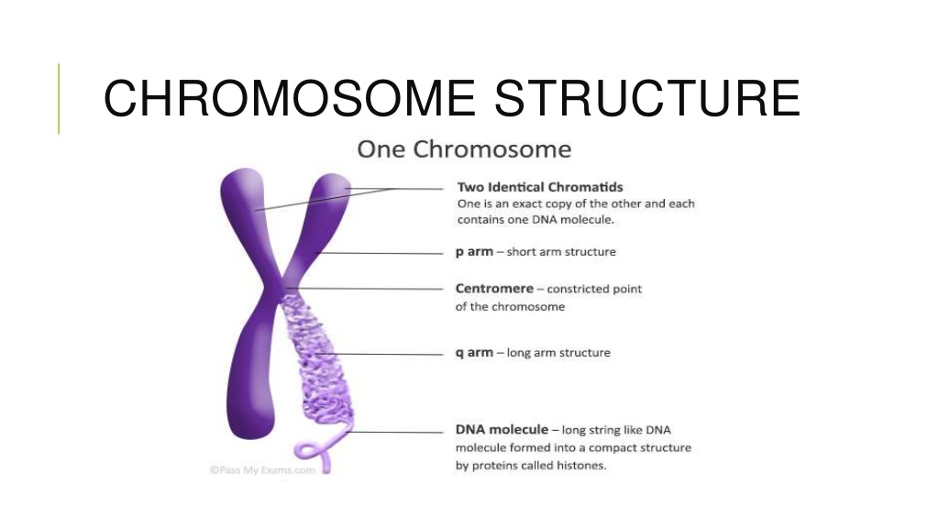
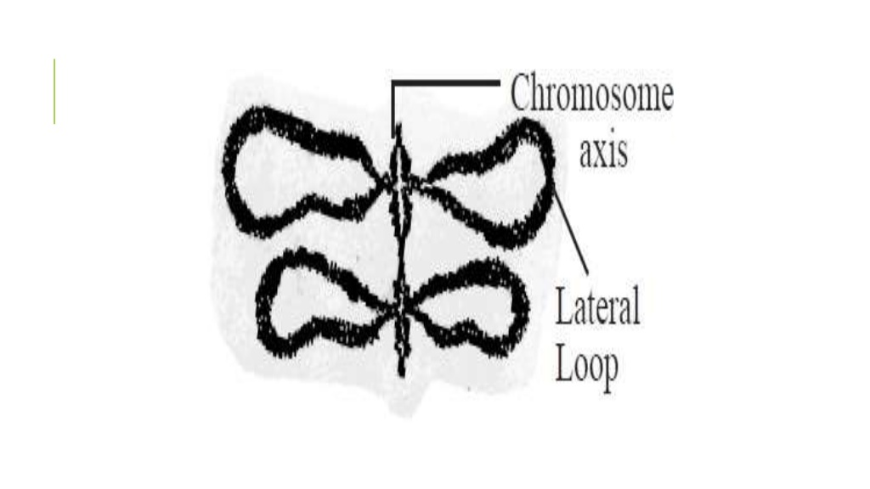
MORPHOLOGICAL DIFFERENCE BETWEEN GENERAL CHROMOSOME AND LAMP BRUSH CHROMOSOME (LBC)
Lamp brush chromosome(LBC)
General idea of str. of chromosome

Slide 4
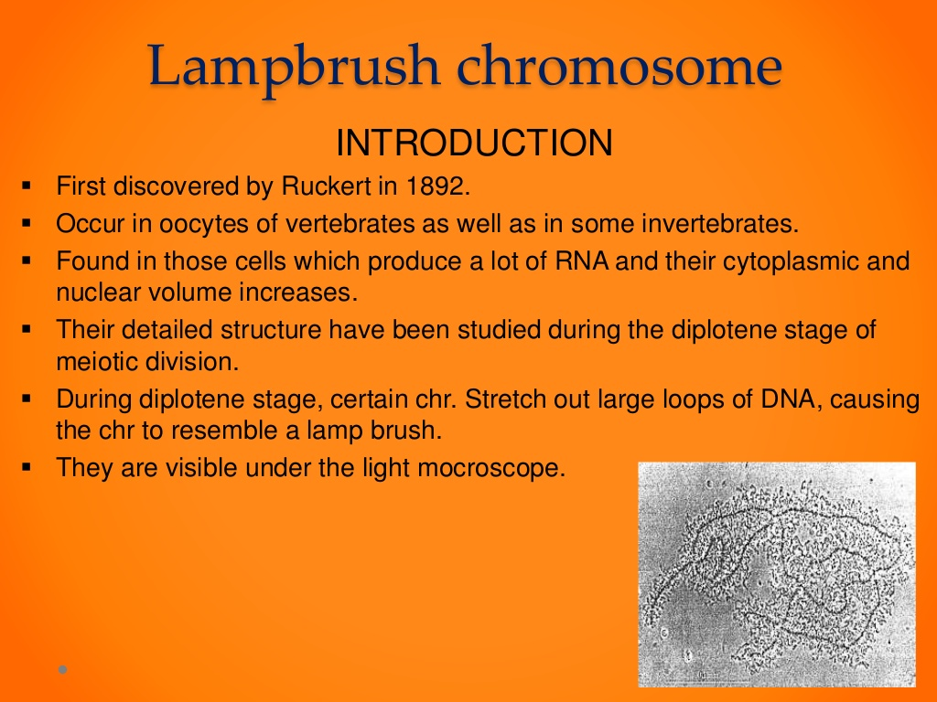
LAMP BRUSH CHROMOSOME (LBC)

Slide 5
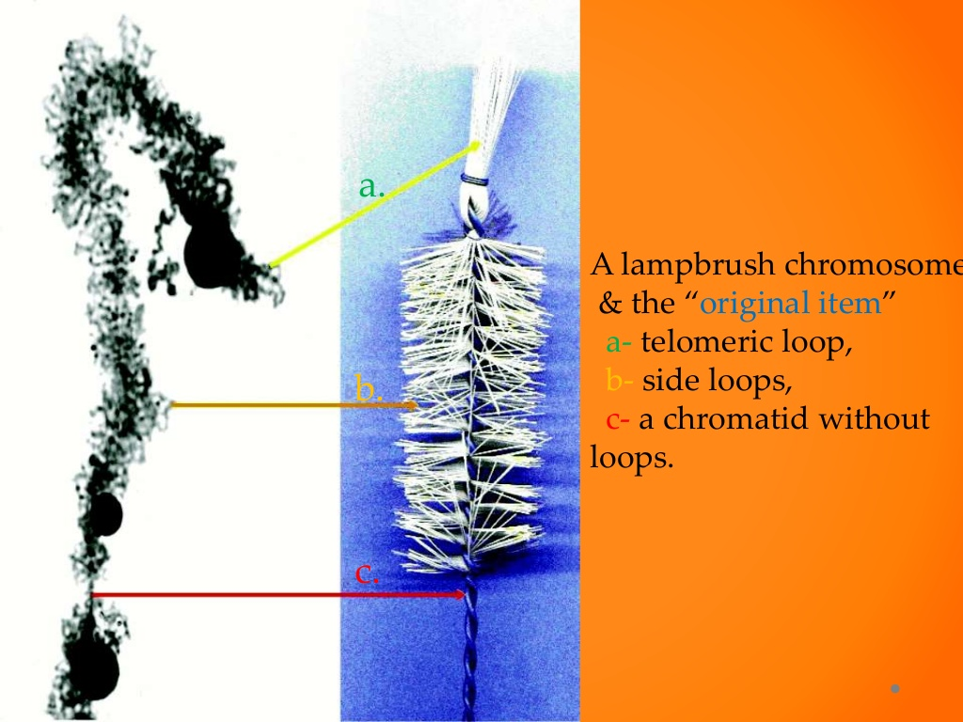
Morphological resemblance of Lamp brush chromosome with original lamp cleaning brush
a-telomeric loop
b-side loops
c-chromatid without loops

Slide 6
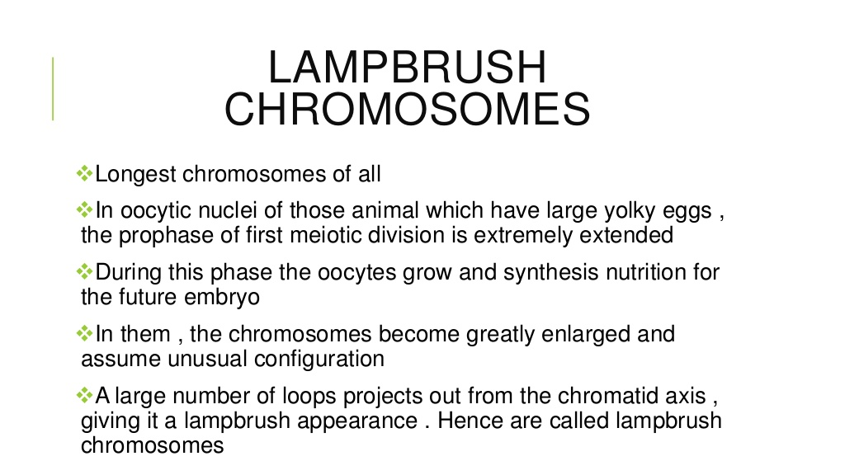
Lamp brush chromosome

Slide 7
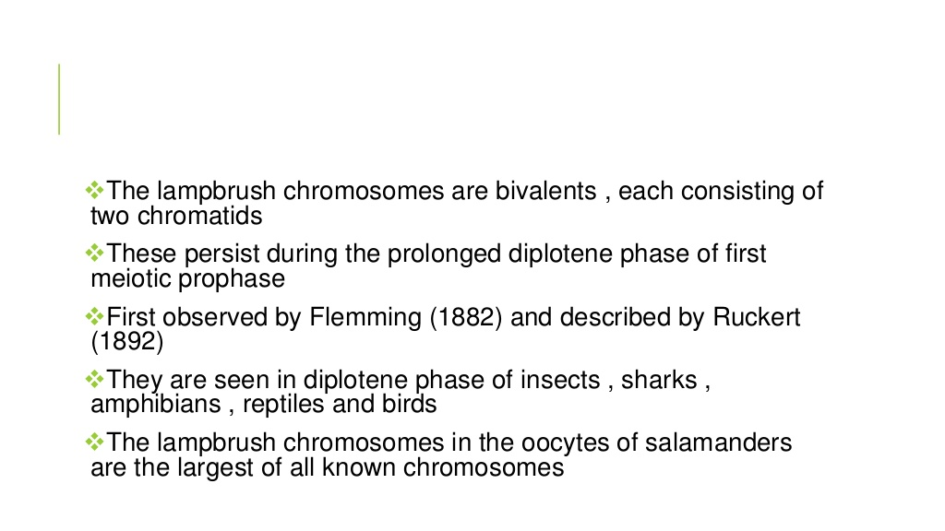
Lamp brush chromosome

Slide 8
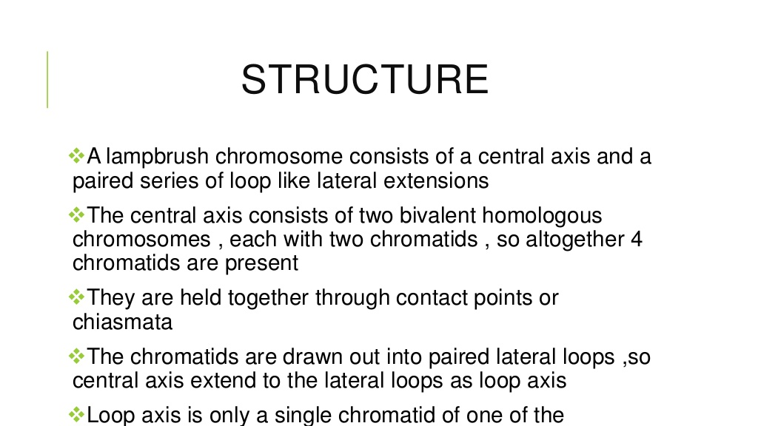
Lamp brush chromosome

Slide 9
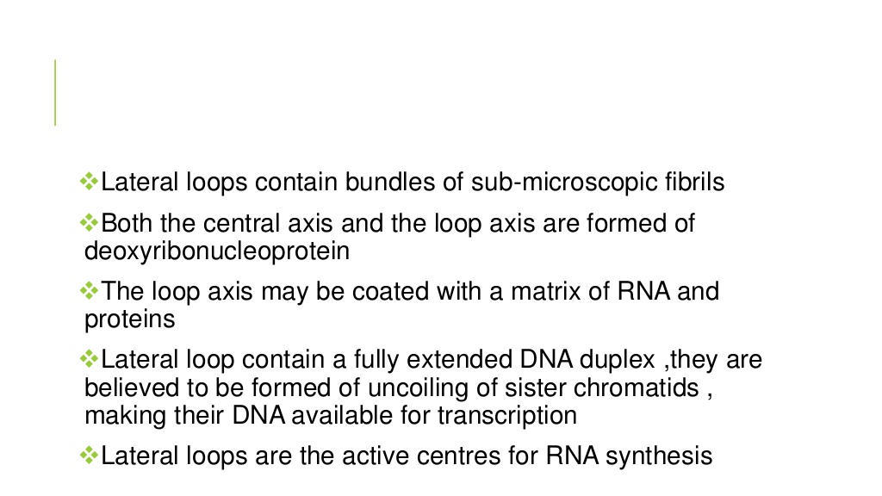
Lamp brush chromosome

Slide 10
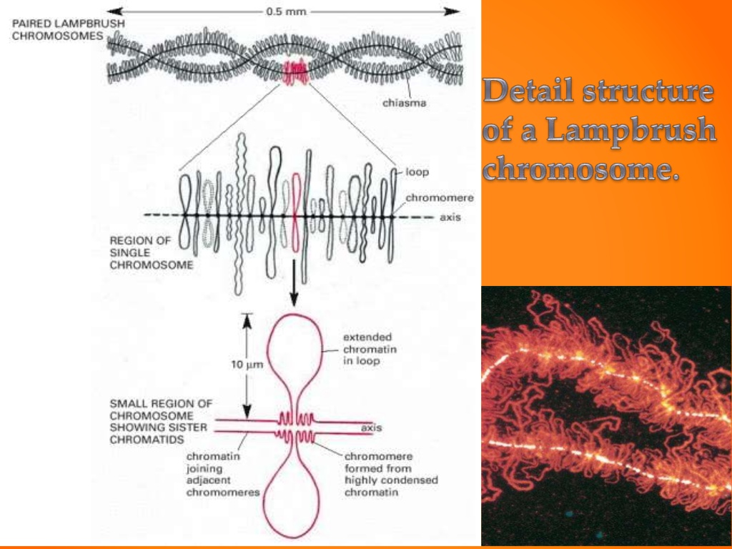
Detail structure of LBC

Slide 11
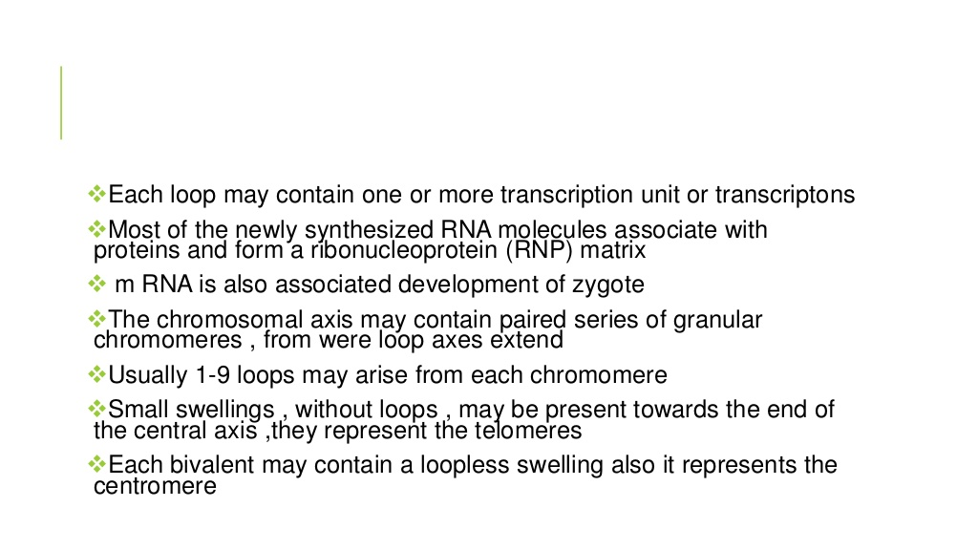
Lamp brush chromosome

Slide 12
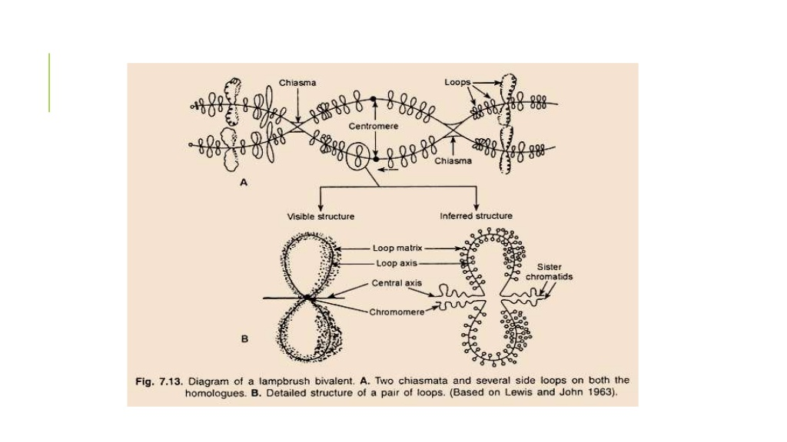
Detail structure of LBC

Slide 13
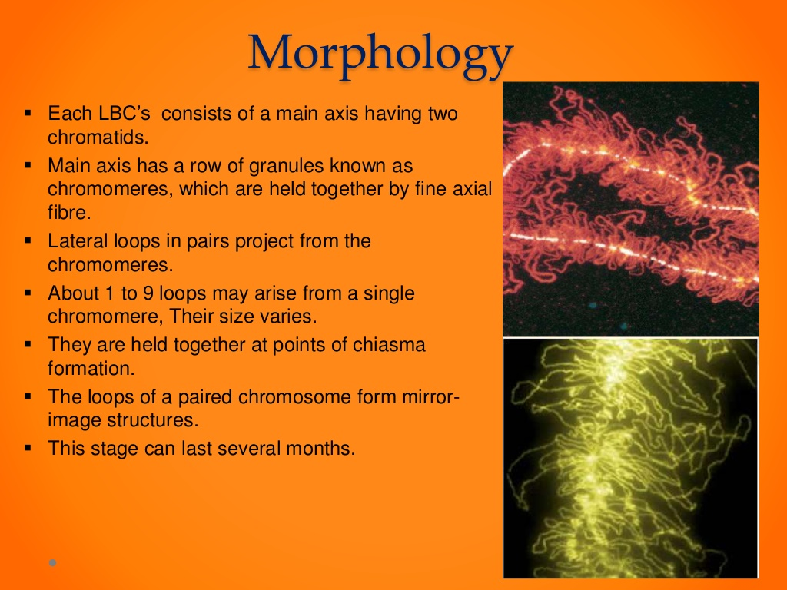
Detail structure of LBC

Slide 14
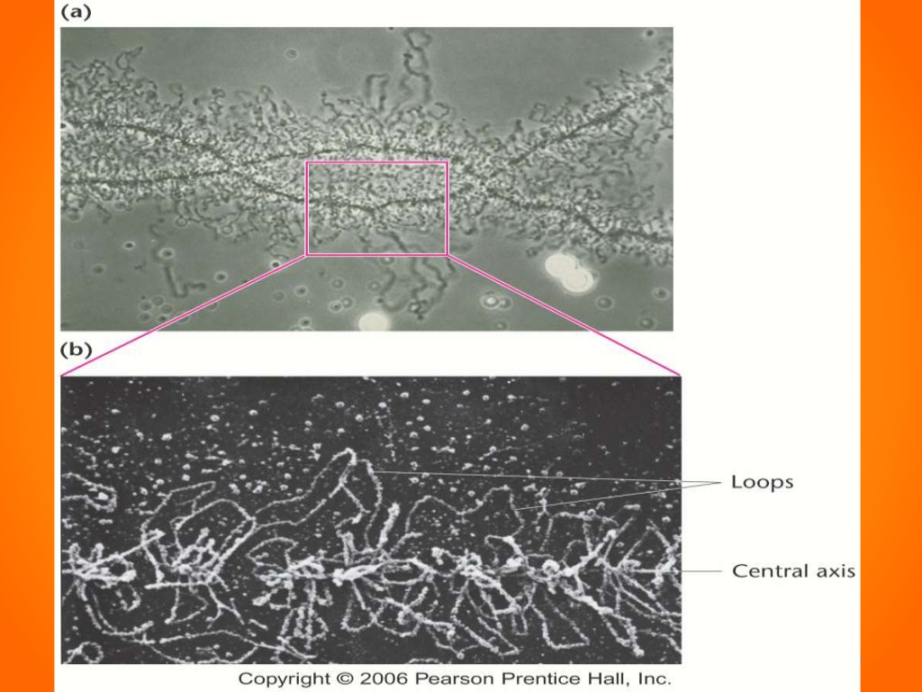
Ref: Pearson Prentice Hall. Inc

Slide 15
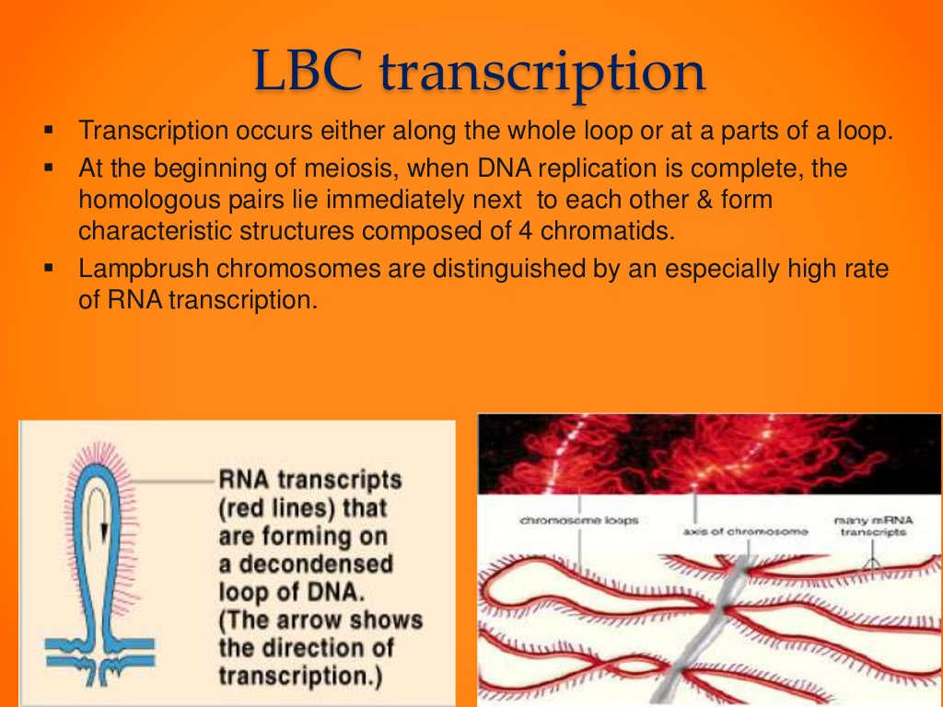
Transcription in LBC

Slide 16
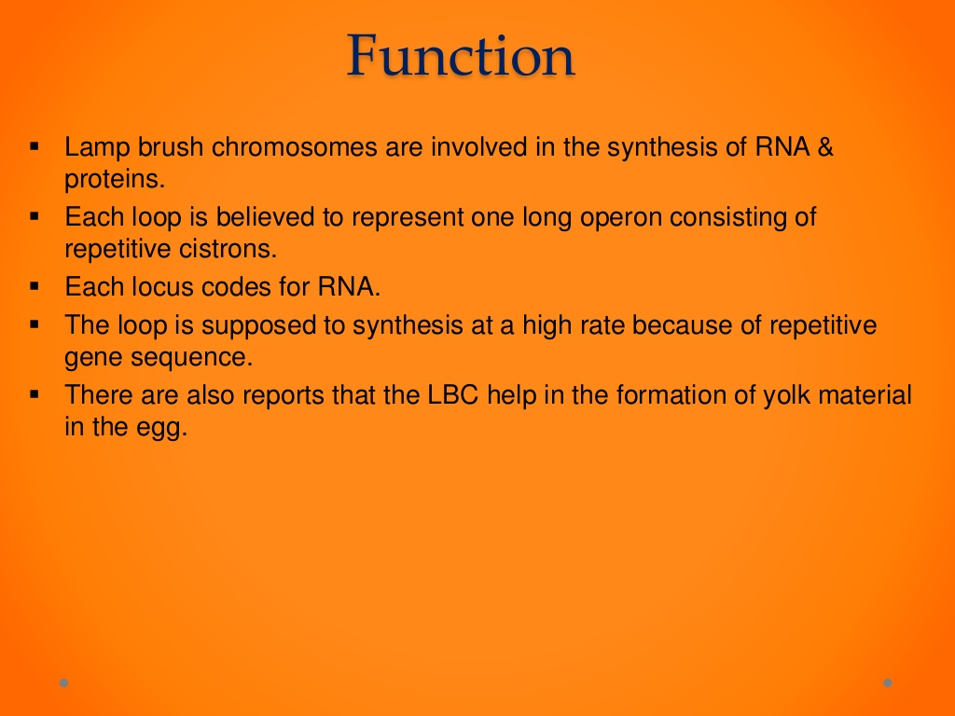
Function of LBC
Students are requested to share their queries on whatsapp group of class: MMC botany(D2)
OR
Khare.pushpanjali2@gmail.com
OR
# 9708063491

