Slide 1
Augustan Prose
-Dr. Khushboo
Assistant Professor
Magadh Mahila College

Slide 2
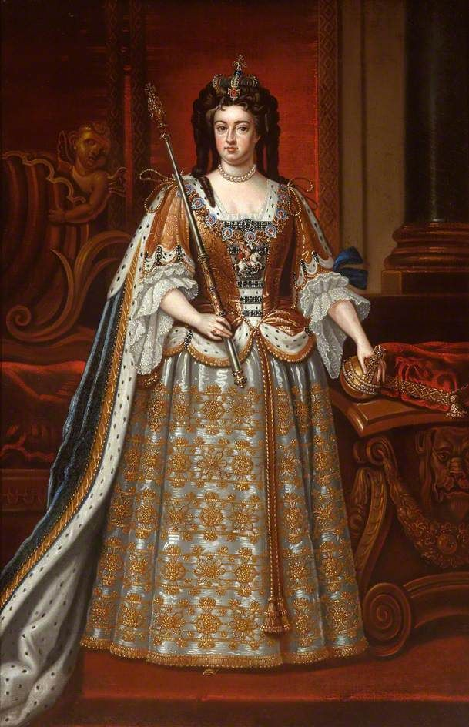
CONTENTS
INTRODUCTION
AGE OF ‘PROSE’ AND REASON
DIFFERENT NAMES AND REASONS
FAMOUS WRITER
DANIEL DEFOE
JONATHAN SWIFT
SAMUEL RICHERDSON
HENRY FIELDING
OLIVER GOLDSMITH
FANNY BURNEY
PERIODICAL ESSAYS
MISCELLANIOUS PROSE WRITERS
CONCLUSION

Slide 3
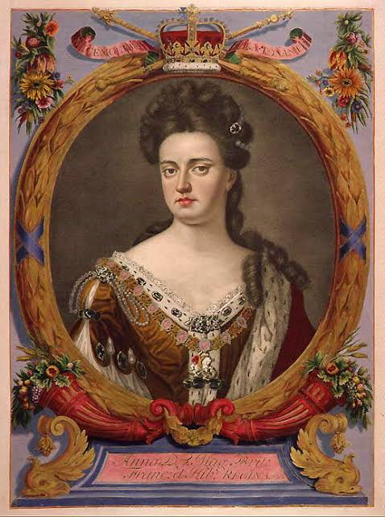
INTRODUCTION
The period from 1700A.D to1785 A.D commonly referred to as Pseudo classical or Neo –classical age.
During this time first Queen Anne and then three Georges ruled over England.
Matthew Arnold refers to the period as “Our admirable and indispensable 18th century” for the age saw the rise of social essay and the novel and development of modern prose style.
Even the poetry was also prosaic.
As during the Restoration Era ,in this age the French influence pre-dominated and neo-classicism became more rigid and stringent.

Slide 4
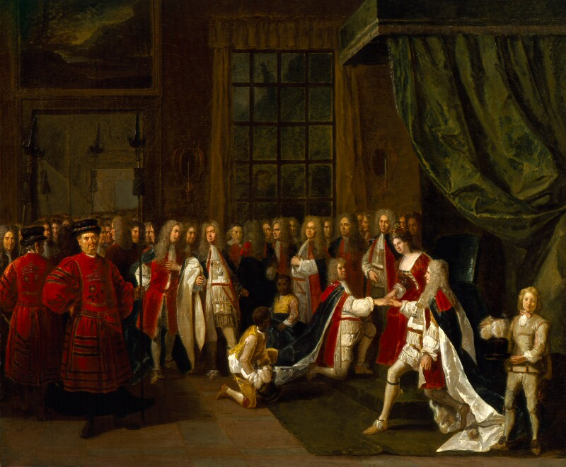
The rise of two political parties the Whig and the Tory
There was a number of political clubs and coffee houses which became the centre of fashionable and public life. The coffee-houses were entirely dominated by the party, people gathered there to show their ‘Wit’ .
Women were treated with scant respect and their social status in general was low.\
It was an Age of immorality and corruption. The new class of Readers:-There was a rapid expansion in the field of education. There emerged a new class of readers consisting of traders, manufacturers, and even domestic servant.

Slide 5
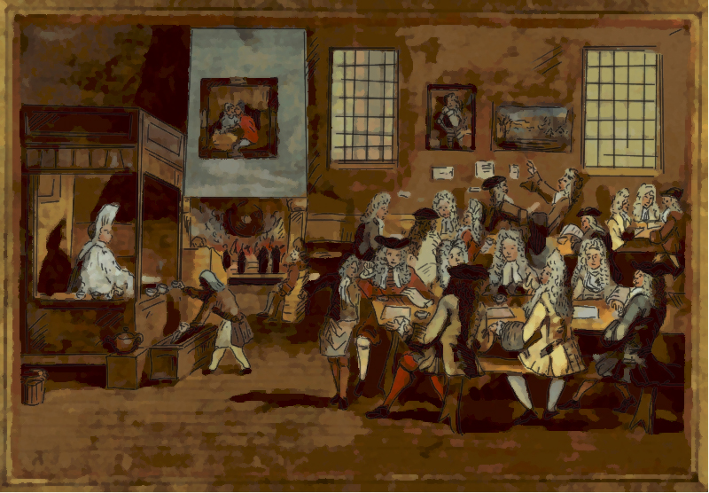
AGE OF PROSE AND REASON.
Matthew Arnold called the 18th century “the age of prose and reasons” because no good poetry was written at that age and poetry itself became ‘prosaic’. The new interest of the age , arising from the changed political and social conditions ,demanded expression through pamphlets , magazines and news papers. The age also witnessed the rise of periodical press and the novel and a marked development of English essay .Satire played a major role in 18th c. England as to correct the faults in the society.The greatest names in the period are-Addison , Steele ,Swift ,Pope, Defoe , Gibbon , etc.

Slide 6
DIFFERENT NAMES AND REASONS
The Augustan Age :- The poet Goldsmith was the first to call it “Augustan Age”, just the reign of king Augustus in Italy was the golden age of Latin literature, so also the early part of the 18th c. was the golden age of English literature.
Age of Pope:-The early half, from 1700 to 1745 may be called the age of pope for pope was the leading poet and man of letters of the period.
Age of Dr. Johnson:- The later half of the century from 1745 to 1785 may be called the age of Dr. Johnson . He was the leading literary figure.

Slide 7
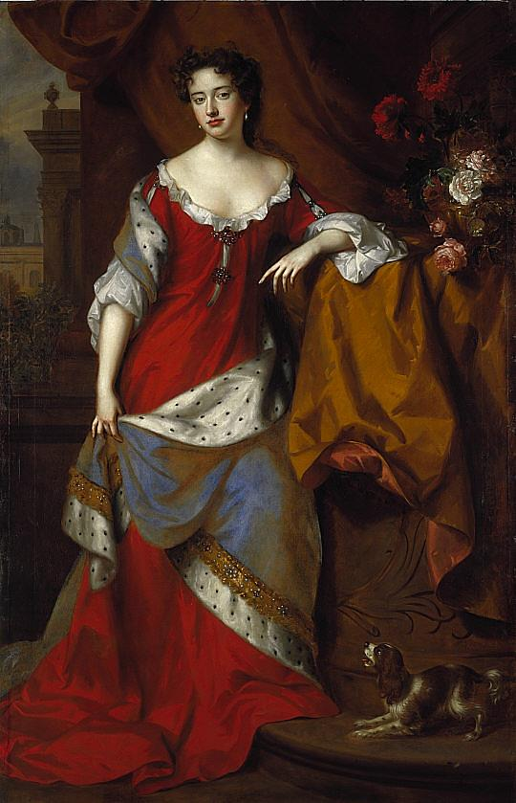
Age of Transition:- The later half of 18th century is an age of reaction, an age of transition, an age in which there is a marked conflict between the old and the new there was a reaction against classicism and reason and a search for new models of poetry. The period was affected by the French Revolution , the American Revolution and the Industrial Revolution. The age is also known as Pre- Romantiasm
The Pseudo Classical or Neo classical age:- The writers of the age tried to imitate the style of Romans and Greeks once again.

Slide 8

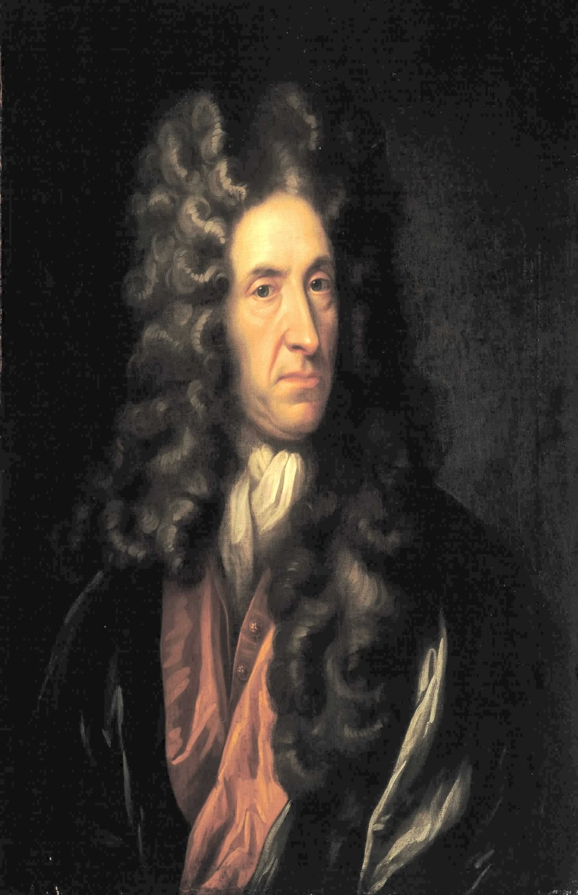
DANIEL DEFOE (1660-1731)
Born as Daniel Foe, into a middle class dissenting family
Father intended him to become a minister, and Defoe received a excellent education at a Dissenting academy.
Becomes a merchant at age 20 , marries, and eventually has many children . Engages in trade sporadically throughout his life
Participates in failed rebellion to depose JamesII after James is deposed in 1688, Defoe becomes a journalist pamphleteer, occasional secret agent and drifts in out of political and occasional secret agent and drifts in and out of political favors
Defoe writes conduct books PAMPHELETS ,A TRADEMAN’S GUIDE, A TRAVEL GUIDE , SATIRICAL VERSE
And many other texts in addition to his major works; ROBINSON CRUSEO in his first novel published when he is 60 years old.

Slide 9
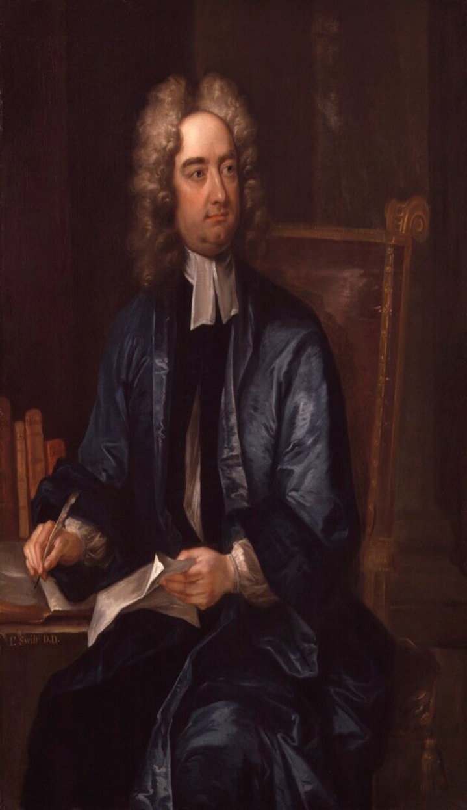
JONATHAN SWIFT ( 1667 – 1745)
Jonathan swift was an Anglo-Irish satirist ,essayist, political Pamphleteers ,poet and cleric who became Dean of St Patrick’s Cathedral ,Dublin.
Swift is remembering for works such as A TALES OF TUB (1704) ,AN ARGUMENT AGAINST ABOLISHING CHRISTANINTY(1712), GULIVER’S TRAVEL (1726) , and A MODEST PROPOSAL(1729). He is regarded by the Encyclopedia Britannica as foremost prose satirist in English language and is well known for his poetry . He is originally published all his work under pseudonyms – such as Lemuel Guliver,Issac Bickerstaff , the Drapier-or anonymously. He was a master of two styles of satire, the Horatian and Juvenalian styles
His deadpan ,ironic writing style , particularly in A MODEST PROPOSAL ,Has led to such satire being subsequently termed “SWIFTIAN”

Slide 10
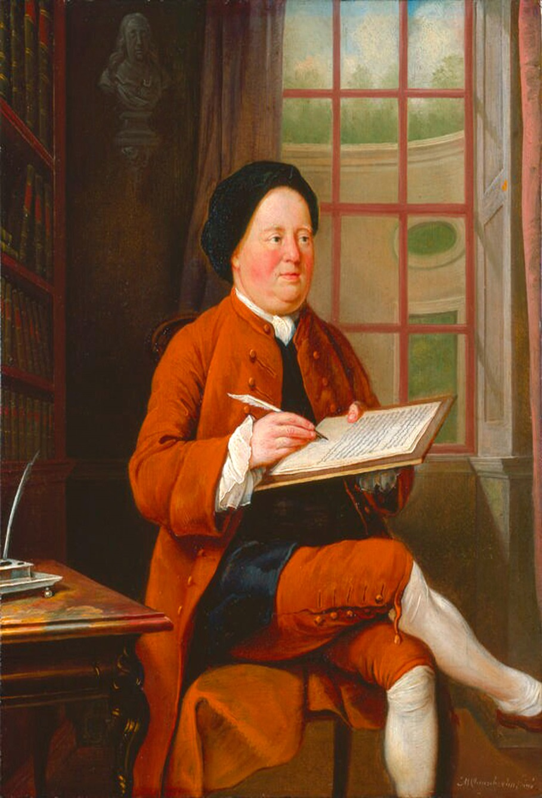
SAMUEL RICHARDSON (1689- 1761)
Samuel Richardson (baptized 19 August 1689 – 4 July 1761) was an English writer and printer. He is best known for his three epistolary novels: Pamela; or, Virtue Rewarded (1740), Clarissa: Or the History of a Young Lady (1748) and The History of Sir Charles Grandison (1753). Richardson was an established printer and publisher for most of his life and printed almost 500 different works, including journals and magazines. He was also known to collaborate closely with the London bookseller Andrew Millar on several occasions.^{[2]}
Work continued to improve, and Richardson printed the Daily Journal between 1736 and 1737, and the Daily Gazetteer in 1738. During his time printing the Daily Journal, he was also printer to the "Society for the Encouragement of Learning", a group that tried to help authors become independent from publishers, but collapsed soon after.^{[5]:15} In December 1738, Richardson's printing business was successful enough to allow him to lease a house in Fulham.

Slide 11
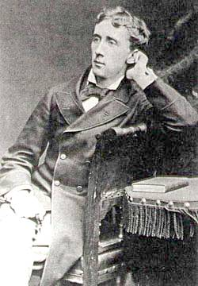
HENRY FIELDING (1704-54)
Henry Fielding was born on April 22nd in Sharpham England.
Beginning his writing career as a playwright and decor of satirical publications, he found hit footing by penning JOSHEP ANDREWS and parodies.
Fielding finished his first play in 1728 .
Unable to find a meaningful work fielding began studying law at middle temple and became a barrister.
In 1740, Samuel Richardson published PAMELA or VIRTUE REWARDED which was an instant success .however Fielding found the work objectionable and wrote a parody of it , called an apology for the life of Mr. Shamuel Andrew (1741).
His future writings were Joseph Andrew(1742),the history of the life an Mr. Jonathan wild the great (1743) and A Journey from this world to the next (1743).
In late 1740’s he was appointed justice of the peace for Westminster and then magistrate of middle sex.
Then he wrote his final novel the Somber Amelia in 1751.
He devoted significant energy to combating crime, Fielding delivered his greatest TOM JONES in 1749.

Slide 12
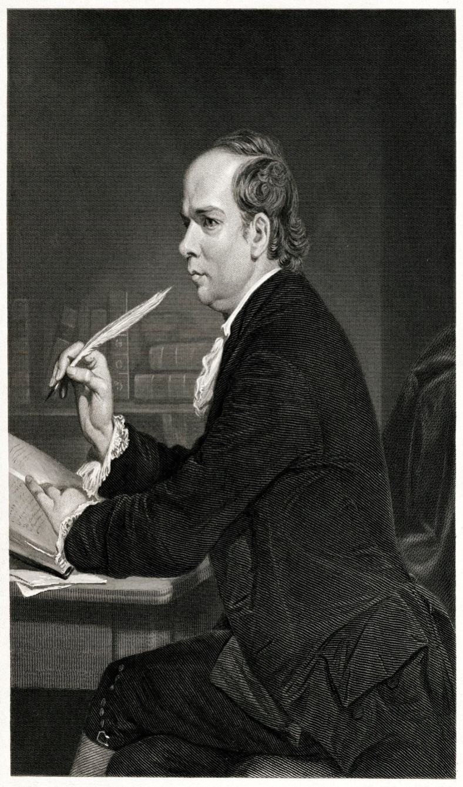
OLIVER GOLDSMITH (1728-174)
Oliver goldsmith was one of the most popular 18th century English writers
Goldsmith was born something between 1728 and 1731 to poor Irish family .he was one of seven children .
Amongst his literary output. In this period are contribution to TOBIAS SMOLLETE’S CRITICAL REVIEW and AN INQUIRY TO THE PRESENT STATE OF POLITE LEARING IN EUROPE IN 1759.
His master works were The Vicar of wakefield.
His writing appeared in THE BUSY BODY ,THE BRITISH MAGAZINE AND THE LADY’S MAGAZINE.
Goldsmith suddenly died on 4th April 1774 from a kidney disease that he refused to treat properly.
His works THE HAUNCH OF VENSION was published in 1776.

Slide 13
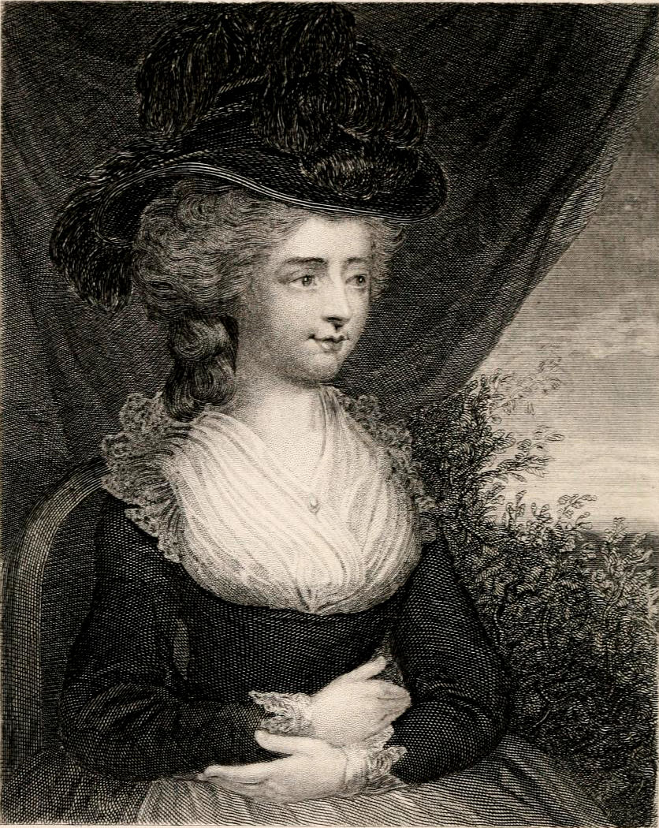
FANNY BURNEY (1752- 1840)
Fanny Burney was born on 13TH June 1752 in Lynn Refis England .
She educated herself by reading vor aciously from the family collection and started writing when she was around ten.
In 1778 her first novel EVELINA published by Thomas Lowndes . The novel went on to be a critical success and receives praise from individuals like Edmund burke .
In 1728 published CECILIA OR MEMOIRS OF AN HEIRES. The novel cast lasting influence on Jane Austen who was inspired to focus on writing
In 1785 Queen Charlotte offered her the post of KEEOER OF ROBES .she later resigned from the post in 1791 as she was unable to focus on writing.
She later began working on the last novel THE WANDEROER OR FEMALE DIFFICULTIES IN 1790’S . It was finally published in 1814.
Later she got married and had a child. In 1796 she published CAMILA OR PICTURE OF YOUTH ,a story of frustrated love and impoverishment.

Slide 14
PERIODICAL ESSAYS
The periodical essay is a genre that flourished only in a first year between 1709 to 1759 .
The rise of genre begins with JOHN DUNTON’S ATHENIAN GAZETTE.
Its maturity arrives part away through Addison and Steele’s Tales.
In between the genre searches the full flowering in Addison and stele's spectator.
Other periodical essays by Steele were:-
THE GUARDIAN.
THE ENGLISHMAN
THE READERS
THE PLEBIAN
Tattles(1709)-appeared thrice a week contribution and Addison= 42 number contribution of Steele= 188

Slide 15
The spectator(1711):- issued daily Addison contribution =224, Steele’s contribution=236
In all ,we thus have from Addison’s pen nearly 400 essays.
The Rambler(1750-52) by SAMUEL JOHNSON. It appeared twice a week ,are full of deep thought and observation ,but they lack the elegance of the spectator.
More than most genre the periodical essay was subject of unscrupuios competition:-imitation, piracy, forgery and plagiarism.

Slide 16
MISCELLANEOUS PROSE WRITERS
BIOGRAPHERS AND LETTER WRITERS:-
18TH Century produced a number of biographers, autobiographers.|
Boswell’s biography of Dr. Johnson has immortalized him as well as the great doctor
GIBBON
LORD HARVEY
JOHN WESLEY
Some of the famous letter writers of the 18th century
LADY MARY WORLEY MONTAGU
HORACE WALPOLE
COWPER
CHESTERFIELD
GILBERT WHITE
Lord Chesterfield's letter to his son had a universal interest
Dr. Johnson letter to Lord Chesterfield which gave a knock out blow to the system of prearrange

Slide 17
CONCLUSION
18TH century was an important age for English Literature.
As always literature reflected the life of the times ; the intellectual climate of the period veered more towards the development of the prose genres.
Writers now concentrated on addressing society and not individuals.
It was an age of satirical and didactic verses and essays of criticism.
It was an age of classical revival of Greece and Rome.
18th century was basically known as the “age of Prose and Reason “, because prose, flourished in this age . Even poetry became prosaic.
Satire was main weapon of writers to improve the society.
Many important prose writers like DANIEL DEFOE,JONATHAN SWIFT,SAMUEL RICHARDSON, JOSEPH ADDISON, RICHARD STEELE etc. flourished in this age .
Periodical essays played a vital role and a revolution of this genre started in this period. It was welcomed by masses as it was a light literature.
Thus , Augustan Age is the backbone in the history of English Literature as it gave many important genres like satires, periodical essays, biographies and most important NOVELS .

Slide 18
THANK
YOU

