Slide 1
RESTORATION
AND
REFORMATION
-Dr. Santoshi Bhawani Mishra
ASSISTANT Professor
Department of English
Magadh Mahila COLLEGE

Slide 2


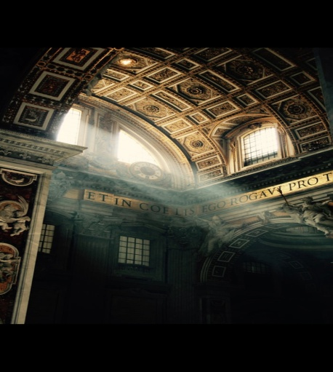

THE REFORMATION
A 16th Century Movement
In Western Europe
Establishment of the PROTESTANT CHURCHES
Also referred to as the “Protestant Revolution” and “Lutheran Reformation”
Contd….

Slide 3
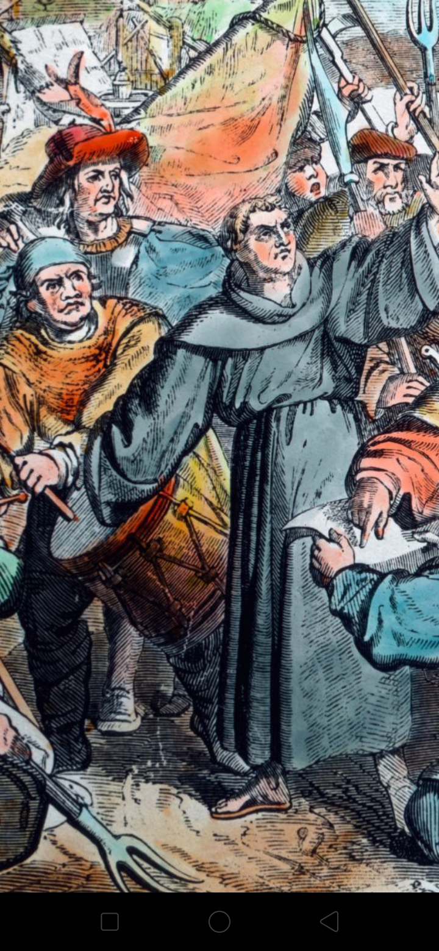
Reformation of some doctrines and practices of the Roman Catholic Church like
> Abuse of power and corruption
> Pope corrupted by power
> Loss of spirituality
> Selling Indulgences

Slide 4
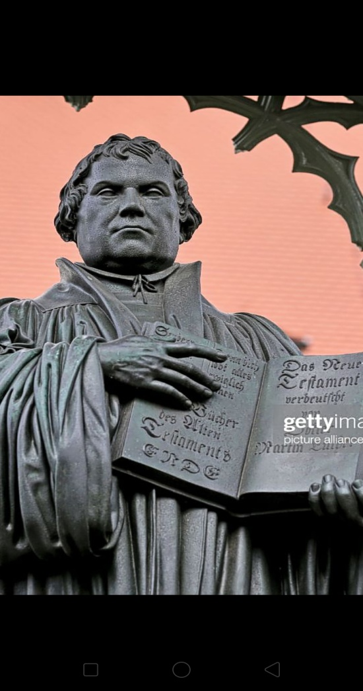
MARTIN LUTHER
Ordained as priest in 1507
Professor at the university of Wittenberg, Germany, in 1508
Disillusioned with the views and practices of the Church
Published 95 theses on October 31, 1517, criticizing the practice of selling indulgences
He was later excommunicated

Slide 5
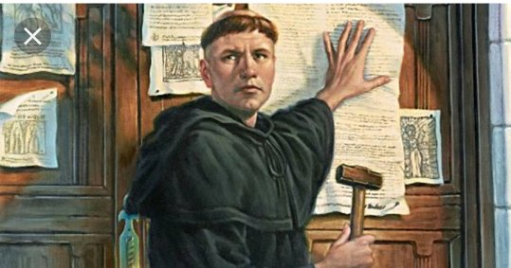
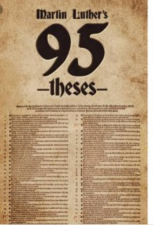
IDEAS OF LUTHER
Purgatory was a false doctrine
Salvation was through faith alone
The Bible alone should be the
final authority for truth
Only two Sacraments
( ‘Baptism’ and ‘Last Supper’)
were valid on accounts of Scriptural Support.

Slide 6
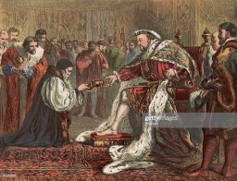
impact
Other reformers were Calvin and Zwingli
Role of Printing Press
Reforms also began in Switzerland, Scotland and Hungary
Separation of the Church of England, under Henry VIII in 1529
Instead of a single Church Reform, this movement caused a division in the Church

Slide 7
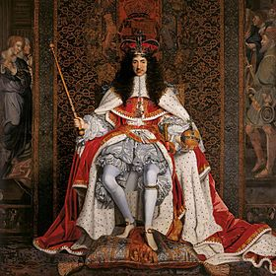
RESTORATION
1660-1700, (Age of DRYDEN)’
Restoration of Charles II on English Throne
England, Whales and Scotland united to form Great Britain
Theatres reopened
Restoration of Church of England as the National Church
Emergence of WHIGS and TORIES

Slide 8
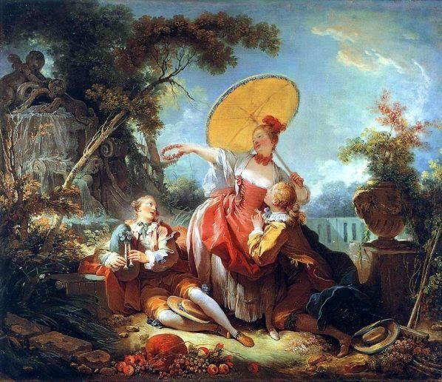
FEATURES
Romanticism replaced by Neo-Classicism
Imitation of the ancients
Imitation of the French
Realism and Formalism
Correctness and appropriateness
Moral laxity and Licentiousness

Slide 9
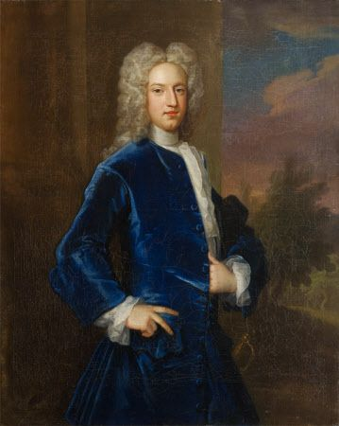
LITERARY FIGURES
DRYDEN
1ST Poet Laureate
Playwright, Poet and Satirist
Popularized Heroic Couplet
Some of his works :
Aureng-Zebe
All For Love
Others
William Wycherley
William Congreve
John Bunyan
Nathaniel Lee

Slide 10
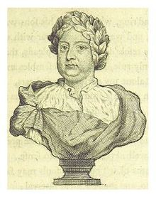
POETRY
Satirical and Realistic
Moderate
Emphasized on Precision
Irony, Overstatement
Criticism and Reason
Heroic Couplet
Mock Epic
Mac Flecknoe (Dryden)
Hudibras (Samuel Butler)

Slide 11
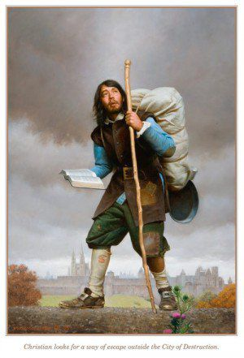
PROSE
Transition from Antiquity to Modernity
Clarity and Simplicity
Precision and Critical interest
Loss of Ornamentation
Christian Religious Writings
Piligrim`s Progress (John Bunyan)

Slide 12
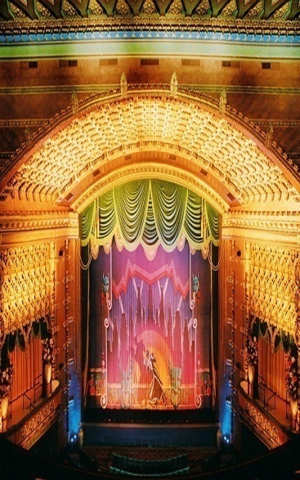
DRAMA
Indoor Theatres
Horse-shoe shaped
Smaller than Elizabethan Theatres
Middle and Upper Class Audience
Commercial Aspect
Attention lost from Artistic Aspect
Introduction of women actresses

Slide 13
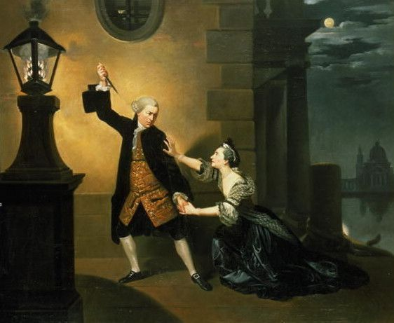
TRAGEDY
Heroic Tragedy
Love and honour
Heroic couplets and Blank Verses
Elaborate dialogues
Noble Heroes and Heroines
Dominating Villains
All For Love (Dryden)
The Orphan (Thomas Otway)

Slide 14
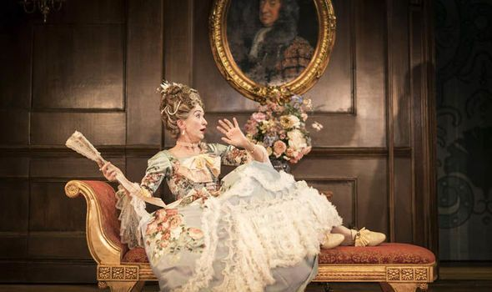
COMEDY
Comedy Of Manners
Mirrors manners of Upper Class
Unemotional treatment of sex
Heroine more important
Immorality, Vitality
Cynical Spirit
Wit and Satire more important than plot
Way Of The World (Congreve)
Country Wife (Wycherley)

Slide 15

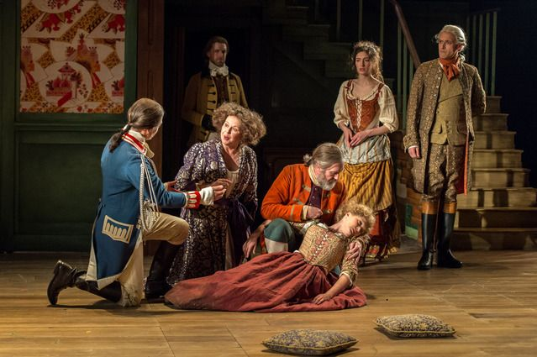

conclusion
End of Puritan Government
leading to excess immorality
Drama, prose and poetry restored
Paved the way for The Age Of Prose And Reason
Popularized Satires and Mock Epics

Slide 16


