Slide 1


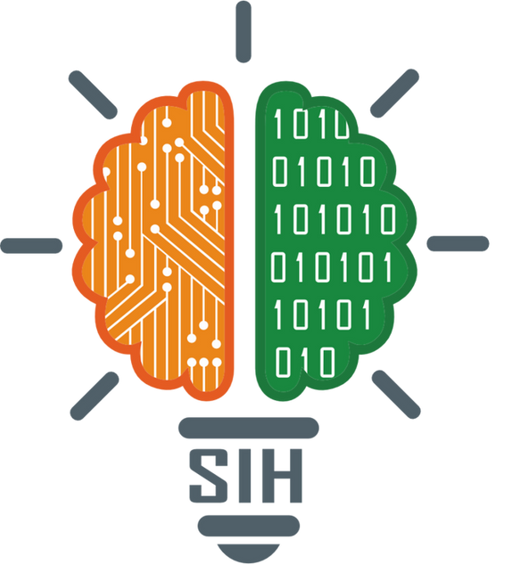
SMAR T INDIA HACKATHON 2025
Problem Statement ID – 25117
Problem Statement tittle- Student Innovation: Atmanirbhar Bharat - Robotics and Drones
Swadeshi for
Theme- robotics & drones
PS Category- Hardware TEAM ID- TID128
TEAM Name- Ourobonics

Slide 2
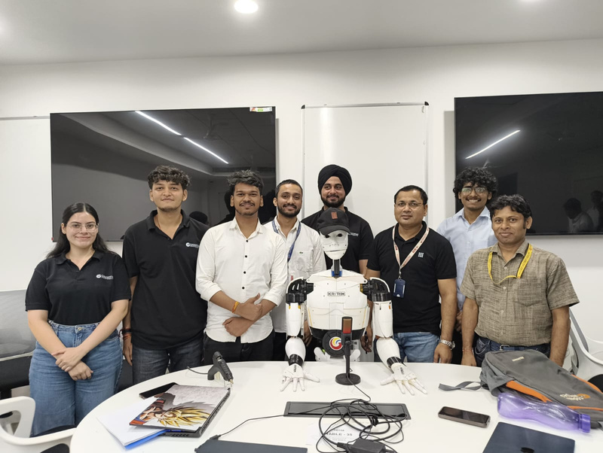
AI-Driven Modular Humanoid Robot for MSME
Empowerment & High risk work environment
MSMEs face staff shortages, high turnover, inconsistent service.
High-risk sites (radiology, chemical plants, industries) expose workers to radiation/chemicals.
Existing humanoids are too expensive (₹20–60 lakh), non-modular, hard to repair.
We propose Kritrim – Modular Snap-and-Fit Humanoid
1. Indigenous humanoid using snap-and-fit modular architecture.
2. Parts can be replaced/repair/customized quickly without technical skills.
Service environments: receptions, libraries, public desks, MSMEs → Customer service.
High-risk environments: radiology rooms, chemical zones, industrial sites → assists safely, handles documents, guides patients, works where humans face health risks.
Kritrim also allows material customization based on deployment needs making it a highly versatile and cost-effective solution.
Kritrim’s uniqueness lies in its combination of modular hardware, snap-and-fit functionality, material flexibility, affordability, and adaptability for both service and hazardous environments. This makes it a truly scalable solution that supports India’s goals of Digital India and Atmanirbhar Bharat by providing a practical, safe, and cost-effective humanoid robot tailored to real Indian needs.
Ourobonics

Slide 3
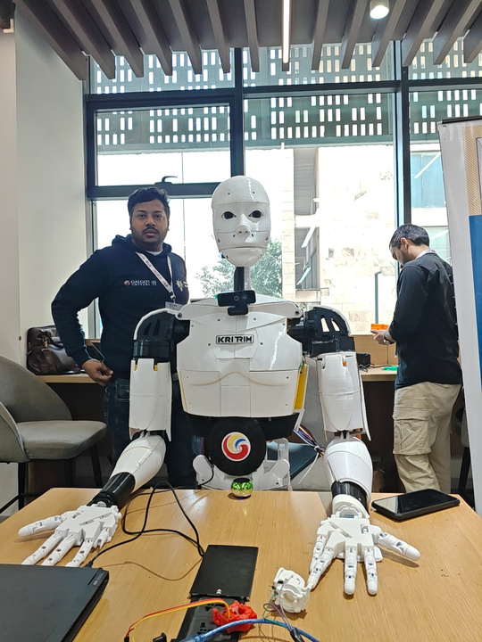
Ourobonics
TECHNICAL APPR OCH
TECHNOLOGIES USED
Hardware: Raspberry Pi, Arduino, Webcam, Servo(Deao DS,60kg), MG 90s Servos
Software/Frameworks: Python
APIs: Speech-to-Text (Google), Google Cloud
, LIVEkit
AI VISION & Object Recognition – Detects customers and surroundings.
Speech-to-TEXT & NLP – Understands queries
Robotics Control System – Performs gestures, movements, and tasks.
Cloud & On-Device Machine Learning – Learns from interactions and
improves performance.
Preview link – https://youtu.be/SfIbuJaK5dU?si=pInQTNrInSaJUY6u.

Slide 4

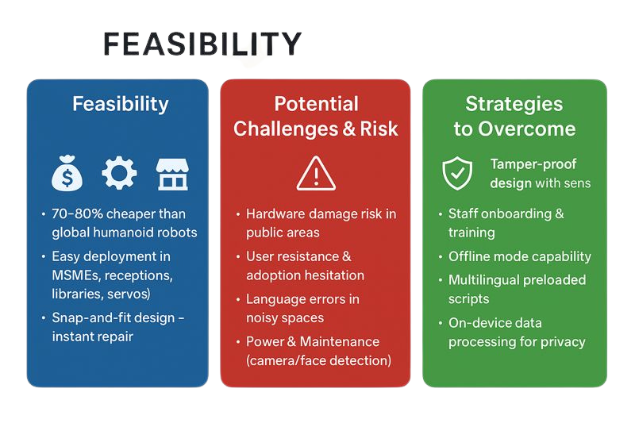
Ourobonics
FEASIBILITY AND VIABILITY

Slide 5
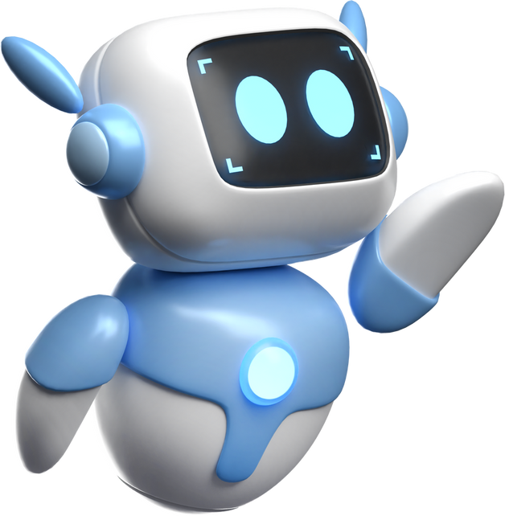
Ourobonics
IMP ACT & BENEFITS
Improved Safety in High-Risk Environments
By deploying radiation-resistant or chemical-resistant modules, the robot protects workers in radiology rooms, chemical plants, and industrial zones—reducing human exposure to harmful conditions.
Operational Efficiency
Kritrim handles repetitive tasks—greetings, guidance, document handling—allowing human staff to focus on complex, decision making work.
Major Cost Reduction Through Modularity
Snap-and-fit parts make maintenance extremely simple and inexpensive . Instead of replacing the entire robot, MSMEs can replace only the damaged module → cutting service costs dramatically.Overall, the robot remains 70–80% cheaper than global humanoids.
MSME Empowerment Through Customizable Material & Design
Businesses can choose the material (lightweight, durable, radiation-safe, chemical-safe) based on their needs, making advanced robotics affordable and practical even for small enterprises.
Scalability Across Multiple Sectors
Thanks to modularity, the same robot can be configured for:
MSMEs
Hospitality & receptions
Libraries & public service desks
Hospitals / radiology zones
Chemical or industrial plants
Education institutes
A single platform adapts to many industries.

Slide 6
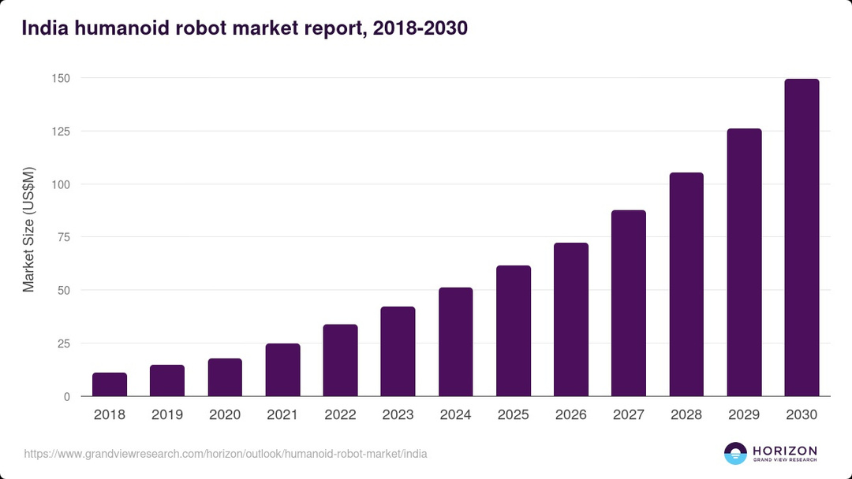
Ourobonics
RESEARCH AND REFERENCES
A survey on modularity and distributivity in series-parallel hybrid robots
Modularity in humanoid robot design
for flexibility in system structure and application
Advancements in Humanoid Robots: A Comprehensive Review and Future Prospects by IEEE
India Humanoid Robot Market Size & Outlook, 2024-2030

