Slide 1

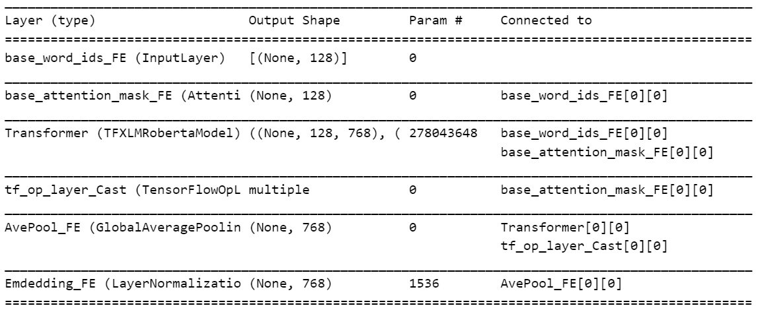
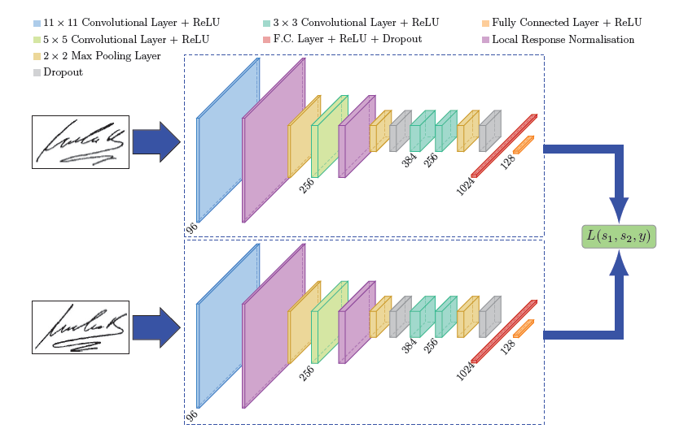
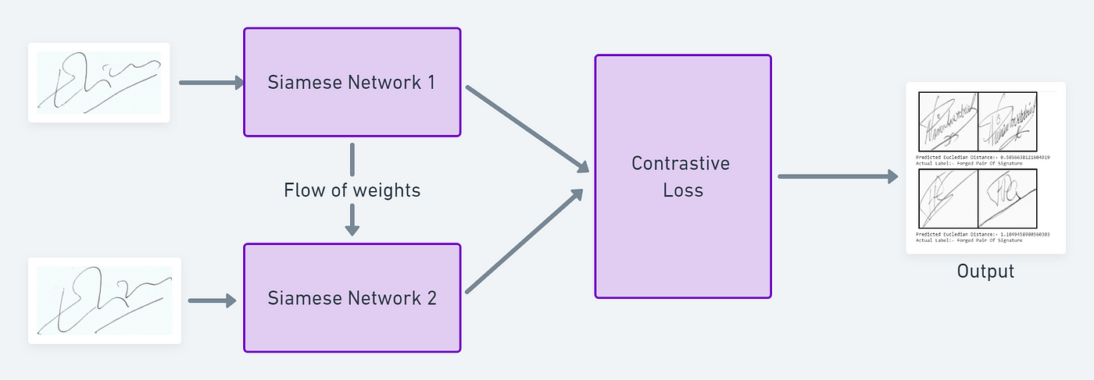
Multilingual Toxicity Detection
Abhijeet Anand, Ankit Gautam, Manan Chugh, Samridh Girdhar
Indraprastha Institute of Information Technology Delhi
Introduction
Approach
Unique Contributions
Architecture and Findings
The internet's integral role in daily life includes communication via networking platforms, facilitating rapid information exchange. However, toxic comments disrupt this experience, sparking tensions and controversies. Early models used manual rules and basic classifiers, while recent advancements leverage deep learning, particularly CNNs and RNNs, for improved toxic comment classification. However, these models struggle with multilingual comments. BERT, fine-tuned with data, outperforms previous methods but faces challenges in handling multilingualism. Addressing this issue requires further research to enhance BERT's generality across languages for effective toxic comment classification in diverse online environments.
The Siamese network architecture, widely employed in various tasks including identifying toxic comments, consists of two parallel branches of a neural network, each with identical weights. In the context of toxicity detection, the Siamese network leverages this architecture to effectively learn and compare semantic features of text inputs. Initially, the network employs powerful language models like XLM-Roberta to extract semantic features from two texts, producing embeddings that encapsulate the texts' meanings. Subsequently, the network calculates the Euclidean distance between these embeddings, effectively measuring the similarity between the texts. This distance computation is crucial for discerning toxic from non-toxic comments; pairs of toxic comments are expected to exhibit closer embeddings, indicating similarity in toxicity, while pairs of non-toxic comments are anticipated to have farther embeddings. This approach allows the Siamese network to discern subtle semantic nuances and accurately classify text inputs, making it a robust architecture for tasks such as toxicity detection.
(i) Uses a large-scale dataset for a language other than English, that was created with the aim to reduce demographic biases,
(ii) experiment with multilingual approaches, including transfer learning and zero-shot-learning so that the embedding can be utilized through transferable learning methods,
(iii) perform an analysis of the amount of data needed to train reliable Siamese models which to the best of our knowledge have not been yet used for such task and,
(iv) experiment with multilabel classification, providing first insights into this challenge task.
The model architecture begins with tokenizing input text using XLM-Roberta's tokenizer, then passes them through the shared transformer model for embedding extraction, aided by an AttentionMaskLayer. Siamese datasets are constructed for training, incorporating pairs of texts in multiple languages with varying labels. Global Average Pooling condenses embeddings to single vectors, normalized via G Layer Normalization. A custom Lambda layer calculates Euclidean distance between normalized embeddings for similarity determination. Training utilizes Adam optimizer with triangular cyclic learning rate. Callbacks, such as early stopping and model checkpoint, manage overfitting and save the best models. This comprehensive architecture facilitates robust text similarity learning.
A larger dataset aids model generalization across languages and biases. Transfer Learning & Zero-shot Learning hold promise for cross-language prediction, vital for underrepresented languages. Siamese models, rarely used for toxic comment classification, may excel in understanding comment similarity and toxicity across languages. Multilingual classification complexity underscores the challenge, offering initial insights for resolution strategies.
Dataset
Future Work
The JIGSAW dataset on Kaggle forms the backbone of toxic comment classification, with each comment tagged as toxic (1) or non-toxic (0). Using functions like load_train_set and load_test_set, CSV parsing extracts crucial attributes like text content, language identification, and toxicity labels. This structured approach facilitates systematic data handling, allowing tailored processing for each linguistic context. Segregating data by language enables nuanced comprehension, enhancing model accuracy. Such a framework adeptly navigates multilingual communication online, ensuring robust toxic comment classification across diverse linguistic terrains.
Research directions in contrastive learning for toxicity detection span from enhancing embeddings for diverse languages to bolstering cross-lingual transfer capabilities. Domain-specific adaptation and data augmentation aim to tailor models to varied platforms and address data scarcity. Leveraging semi-supervised methods enhances robustness via unlabeled data, while pre-training on multilingual corpora fosters universality. Moreover, addressing adversarial attacks and biases ensures equitable toxicity understanding. Integrating multimodal data and interactive learning environments further enrich model comprehension and performance, ushering in a comprehensive approach to toxicity detection across linguistic and cultural landscapes.
Copyright © IIITD 2024, ALL RIGHTS RESERVED

