Slide 1
Next.js
CS-554 – WEB PROGRAMMING

Slide 2
What is Next.js?
Next.js is a universal JavaScript framework that runs in the browser and the server. It offers developers an easy way to get started, and as it uses React.js for templating.
It is also a straightforward way for developers with React experience to get productive fast.
The advantages of this approach is to be able to create Rich User experiences in a uniform way, without compromising Search Engine Optimization (SEO) factors that are key to good ranking on Google and other search engines.
Source: https://reactjs.org/docs/handling-events.html
Notes:
Even still, there's a high learning curve before you can build a proper application. That's because you need to learn about client-side routing, page layout, and so on. If you'd like to perform server-side rendering for faster page loads, things can become even more difficult.
So, we need something simple but customizable.
Think about how webapps are created with PHP. You create some files, write PHP code, then simply deploy it. We don't have to worry about routing much, and the app is rendered on the server by default.

Slide 3
What is Next.js?
Here are some other cool features Next.js brings to the table:
Server-rendered by default
Automatic code splitting for faster page loads
Simple client-side routing (page based)
Webpack-based dev environment which supports Hot Module Replacement(HMR)
Able to implement with Express or any other Node.js HTTP server
Customizable with your own Babel and Webpack configurations
Source: https://reactjs.org/docs/handling-events.html
Notes:
Even still, there's a high learning curve before you can build a proper application. That's because you need to learn about client-side routing, page layout, and so on. If you'd like to perform server-side rendering for faster page loads, things can become even more difficult.
So, we need something simple but customizable.
Think about how webapps are created with PHP. You create some files, write PHP code, then simply deploy it. We don't have to worry about routing much, and the app is rendered on the server by default.

Slide 4
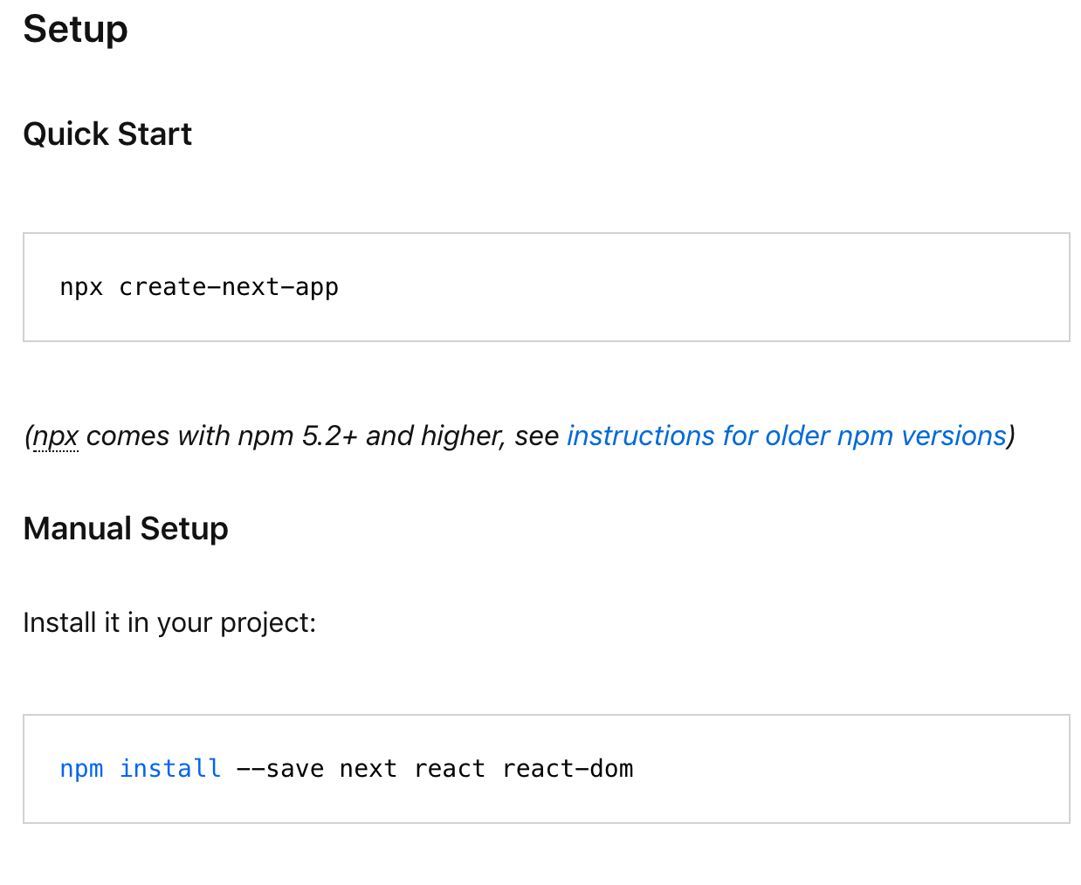
Installing Next.js
Source: https://reactjs.org/docs/handling-events.html
Notes:
Even still, there's a high learning curve before you can build a proper application. That's because you need to learn about client-side routing, page layout, and so on. If you'd like to perform server-side rendering for faster page loads, things can become even more difficult.
So, we need something simple but customizable.
Think about how webapps are created with PHP. You create some files, write PHP code, then simply deploy it. We don't have to worry about routing much, and the app is rendered on the server by default.

Slide 5
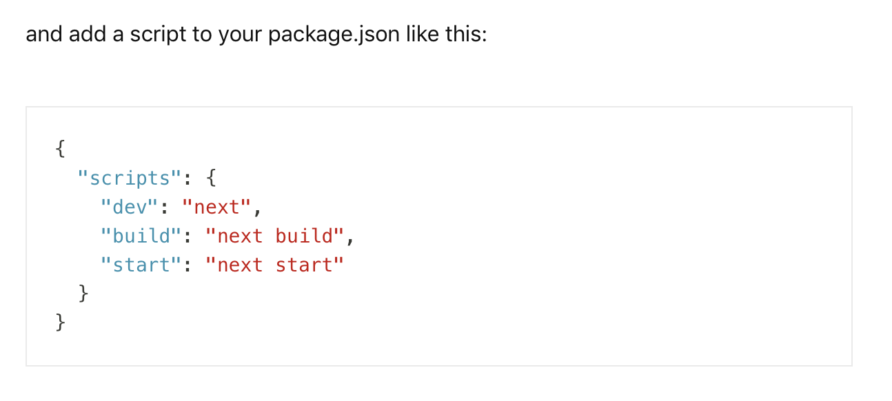
Installing Next.js
Source: https://reactjs.org/docs/handling-events.html
Notes:
Even still, there's a high learning curve before you can build a proper application. That's because you need to learn about client-side routing, page layout, and so on. If you'd like to perform server-side rendering for faster page loads, things can become even more difficult.
So, we need something simple but customizable.
Think about how webapps are created with PHP. You create some files, write PHP code, then simply deploy it. We don't have to worry about routing much, and the app is rendered on the server by default.

Slide 6
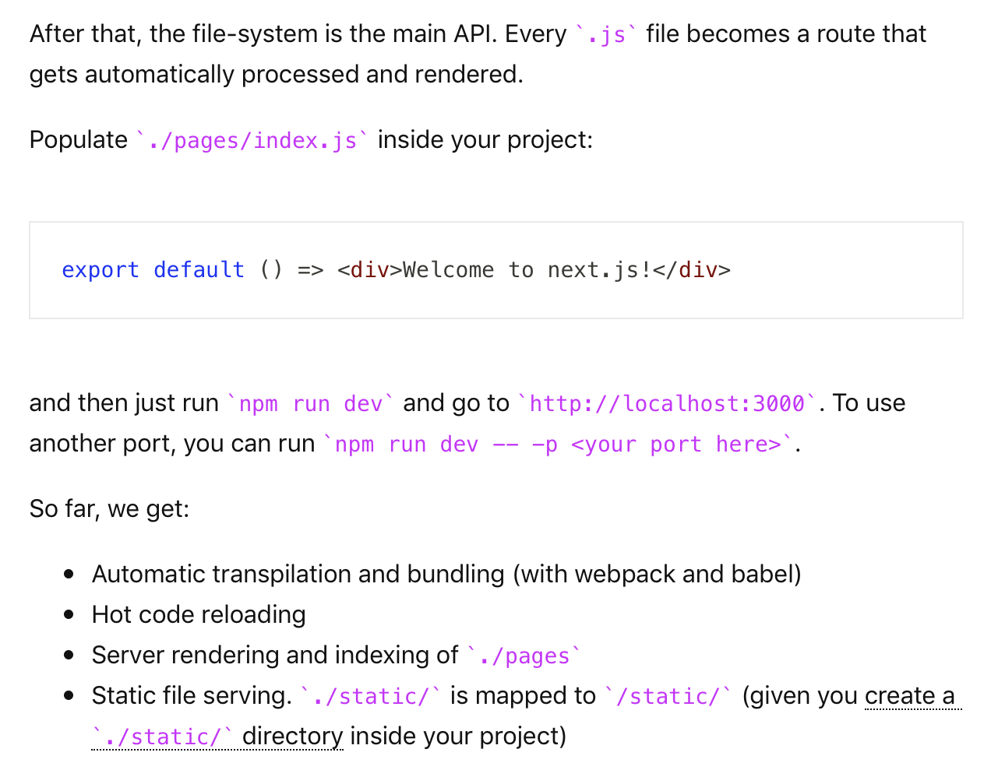
Installing Next.js
Source: https://reactjs.org/docs/handling-events.html
Notes:
Even still, there's a high learning curve before you can build a proper application. That's because you need to learn about client-side routing, page layout, and so on. If you'd like to perform server-side rendering for faster page loads, things can become even more difficult.
So, we need something simple but customizable.
Think about how webapps are created with PHP. You create some files, write PHP code, then simply deploy it. We don't have to worry about routing much, and the app is rendered on the server by default.

Slide 7
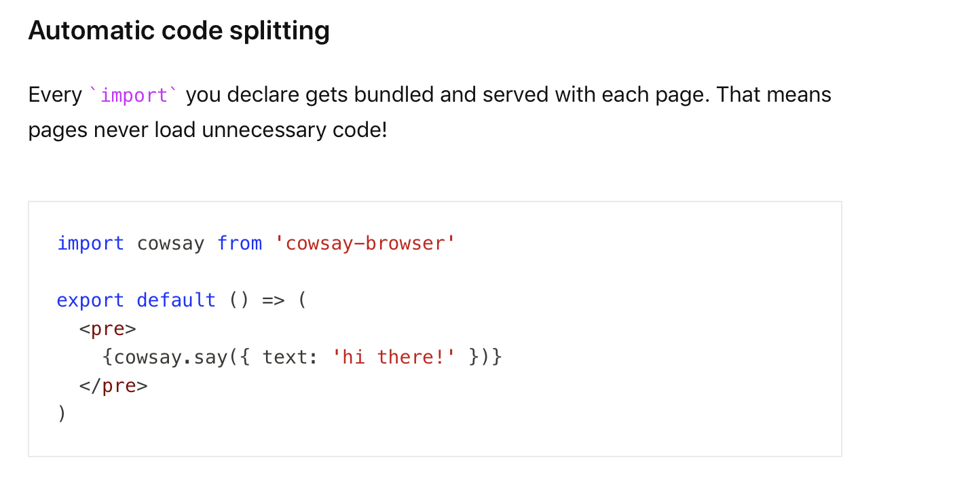
Automatic Code Splitting
Source: https://reactjs.org/docs/handling-events.html
Notes:
Even still, there's a high learning curve before you can build a proper application. That's because you need to learn about client-side routing, page layout, and so on. If you'd like to perform server-side rendering for faster page loads, things can become even more difficult.
So, we need something simple but customizable.
Think about how webapps are created with PHP. You create some files, write PHP code, then simply deploy it. We don't have to worry about routing much, and the app is rendered on the server by default.

Slide 8
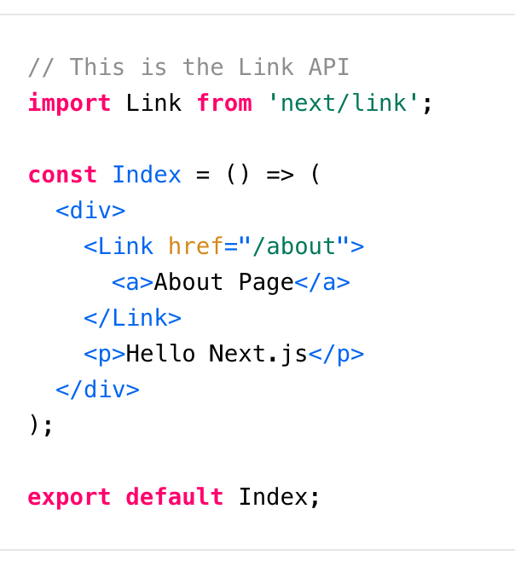
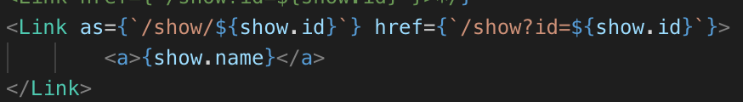
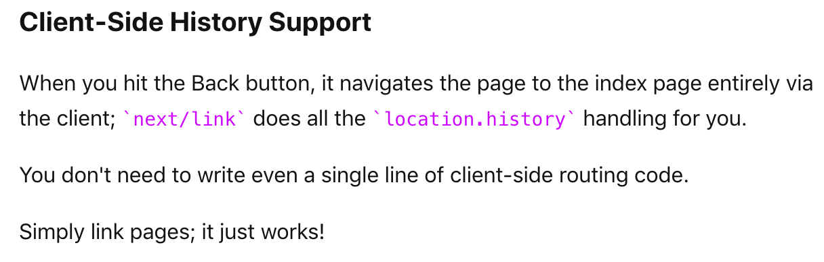
Navigating Between Pages
You can also use the as attribute to show a prettier link (more for dynamic URLs)
Source: https://reactjs.org/docs/handling-events.html
Notes:
Even still, there's a high learning curve before you can build a proper application. That's because you need to learn about client-side routing, page layout, and so on. If you'd like to perform server-side rendering for faster page loads, things can become even more difficult.
So, we need something simple but customizable.
Think about how webapps are created with PHP. You create some files, write PHP code, then simply deploy it. We don't have to worry about routing much, and the app is rendered on the server by default.

Slide 9
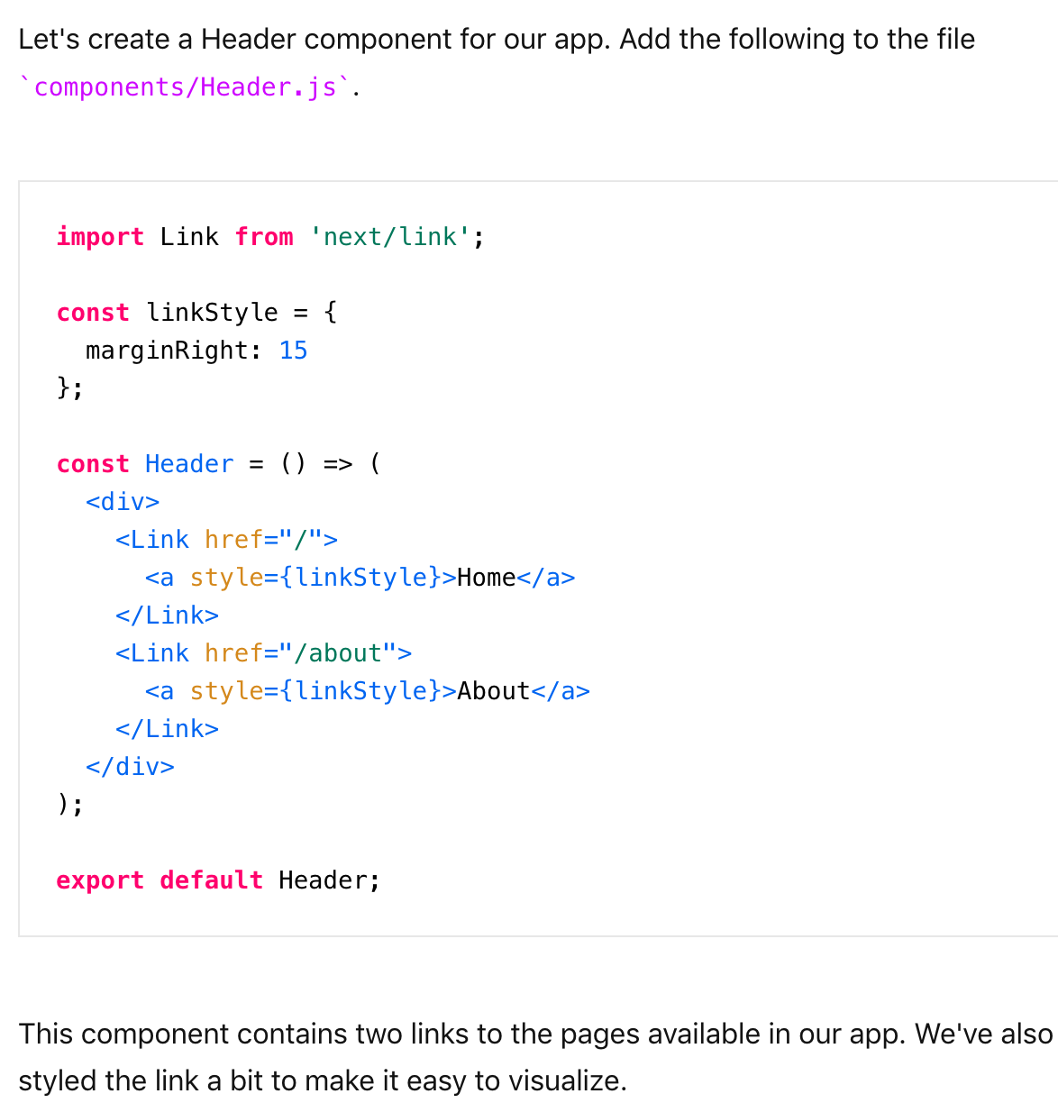
Using Shared Components
Source: https://reactjs.org/docs/handling-events.html
Notes:
Even still, there's a high learning curve before you can build a proper application. That's because you need to learn about client-side routing, page layout, and so on. If you'd like to perform server-side rendering for faster page loads, things can become even more difficult.
So, we need something simple but customizable.
Think about how webapps are created with PHP. You create some files, write PHP code, then simply deploy it. We don't have to worry about routing much, and the app is rendered on the server by default.

Slide 10
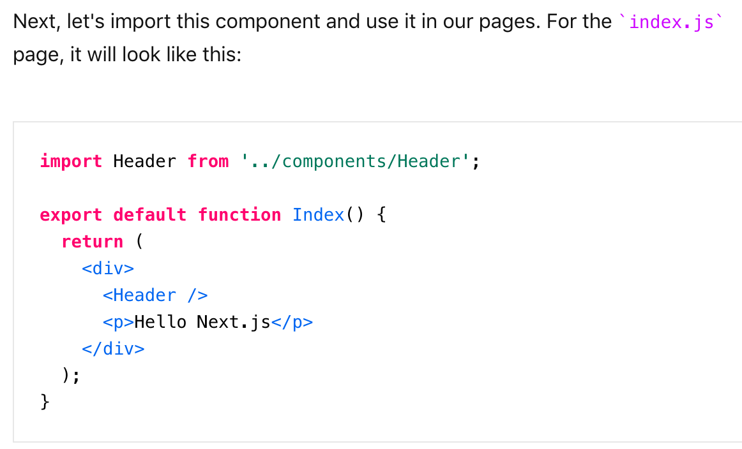
Using the Header Component
Source: https://reactjs.org/docs/handling-events.html
Notes:
Even still, there's a high learning curve before you can build a proper application. That's because you need to learn about client-side routing, page layout, and so on. If you'd like to perform server-side rendering for faster page loads, things can become even more difficult.
So, we need something simple but customizable.
Think about how webapps are created with PHP. You create some files, write PHP code, then simply deploy it. We don't have to worry about routing much, and the app is rendered on the server by default.

Slide 11
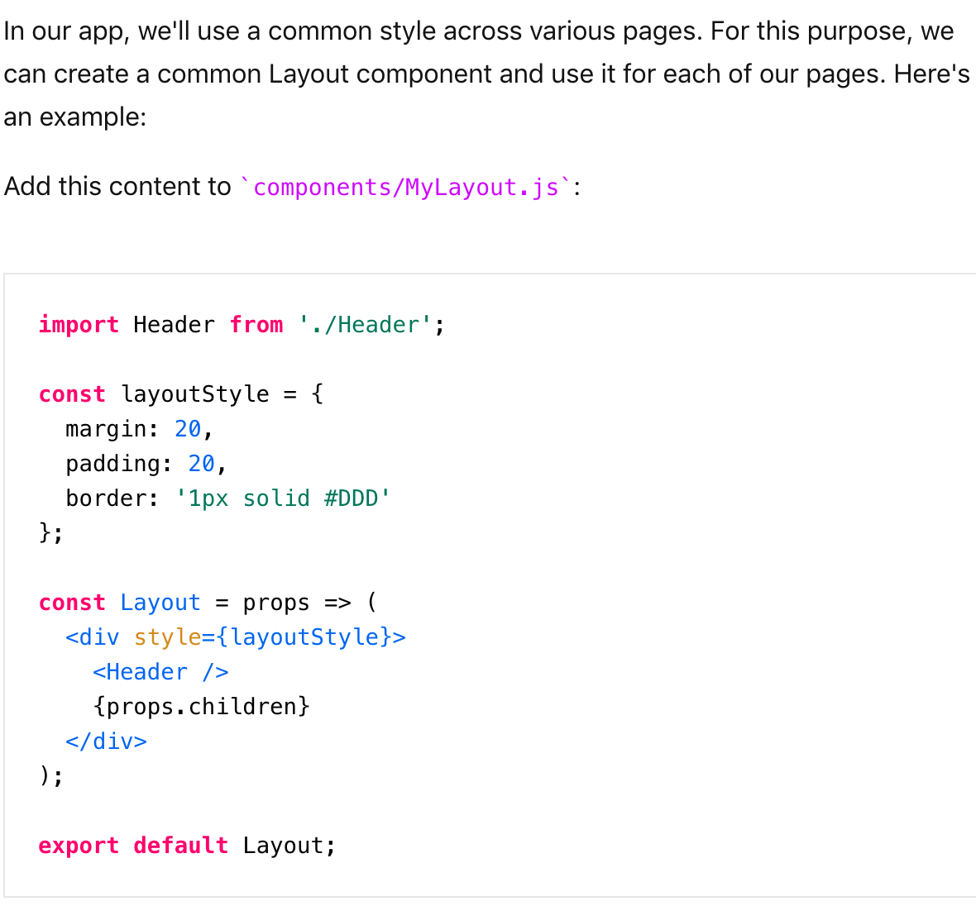
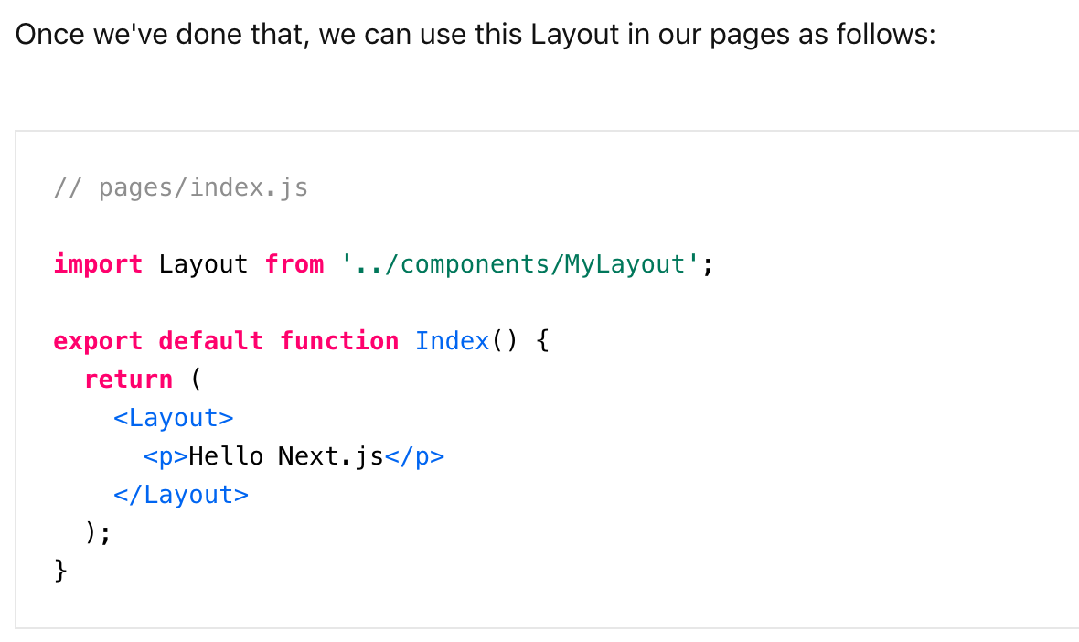
Layout Component
Note: If you remove {props.children}, the Layout cannot render the content we put inside the Layout
Source: https://reactjs.org/docs/handling-events.html
Notes:
Even still, there's a high learning curve before you can build a proper application. That's because you need to learn about client-side routing, page layout, and so on. If you'd like to perform server-side rendering for faster page loads, things can become even more difficult.
So, we need something simple but customizable.
Think about how webapps are created with PHP. You create some files, write PHP code, then simply deploy it. We don't have to worry about routing much, and the app is rendered on the server by default.

Slide 12
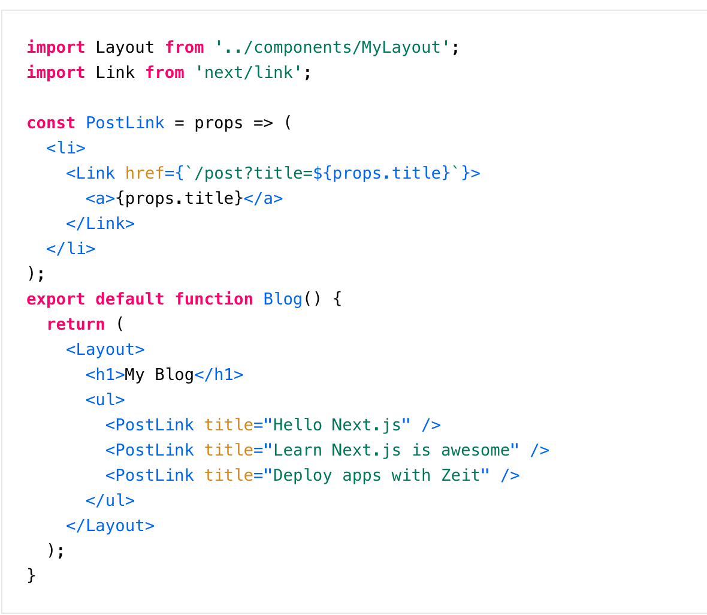
Create Dynamic Pages
Source: https://reactjs.org/docs/handling-events.html
Notes:
Even still, there's a high learning curve before you can build a proper application. That's because you need to learn about client-side routing, page layout, and so on. If you'd like to perform server-side rendering for faster page loads, things can become even more difficult.
So, we need something simple but customizable.
Think about how webapps are created with PHP. You create some files, write PHP code, then simply deploy it. We don't have to worry about routing much, and the app is rendered on the server by default.

Slide 13
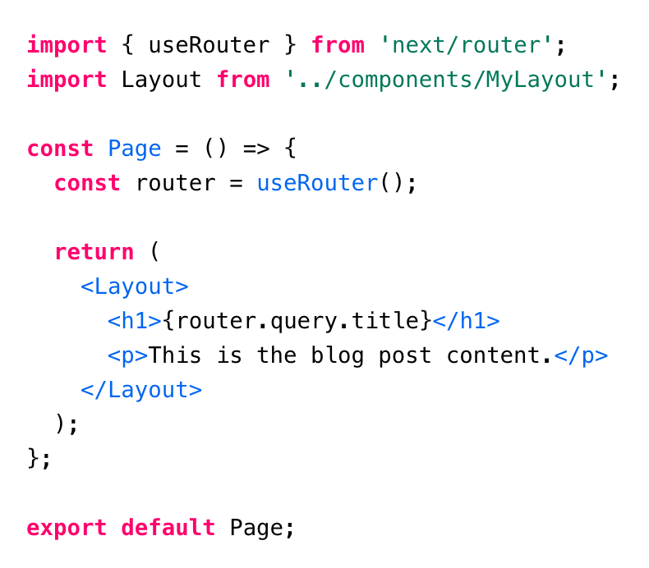
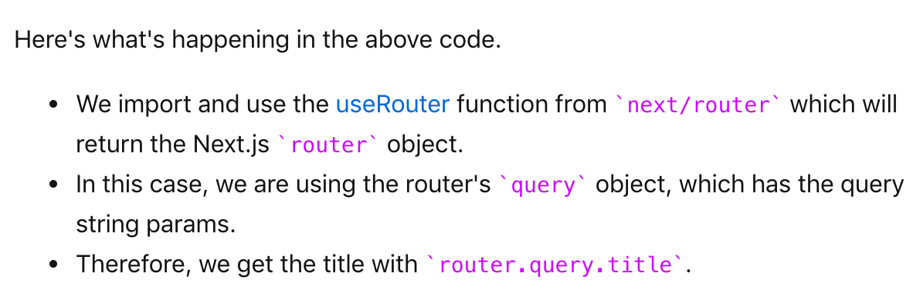
Create Dynamic Pages
Source: https://reactjs.org/docs/handling-events.html
Notes:
Even still, there's a high learning curve before you can build a proper application. That's because you need to learn about client-side routing, page layout, and so on. If you'd like to perform server-side rendering for faster page loads, things can become even more difficult.
So, we need something simple but customizable.
Think about how webapps are created with PHP. You create some files, write PHP code, then simply deploy it. We don't have to worry about routing much, and the app is rendered on the server by default.

Slide 14
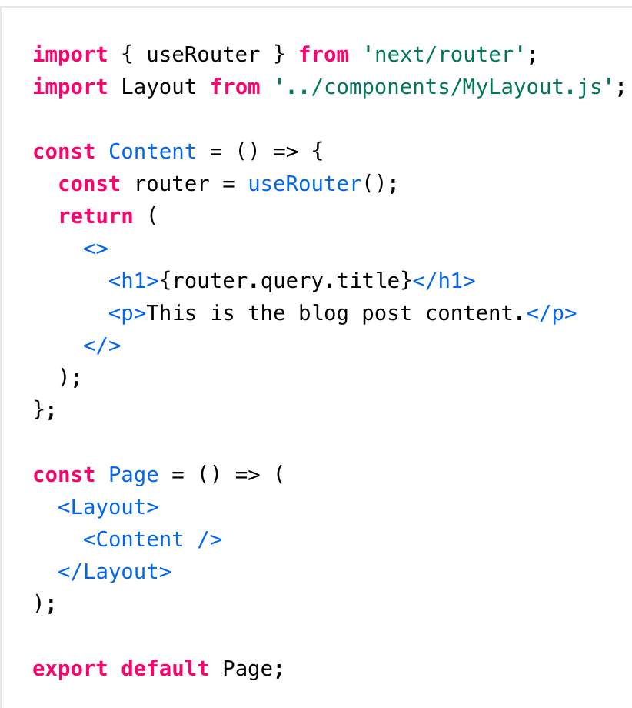
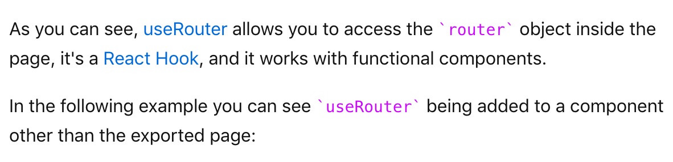
useRouter
Source: https://reactjs.org/docs/handling-events.html
Notes:
Even still, there's a high learning curve before you can build a proper application. That's because you need to learn about client-side routing, page layout, and so on. If you'd like to perform server-side rendering for faster page loads, things can become even more difficult.
So, we need something simple but customizable.
Think about how webapps are created with PHP. You create some files, write PHP code, then simply deploy it. We don't have to worry about routing much, and the app is rendered on the server by default.

Slide 15
Clean URL’s with Dynamic Routing
we learned how to create dynamic pages with query strings. As shown in the example:
http://localhost:3000/post?title=Hello%20Next.js
But that URL doesn't look as clean as something like this:
http://localhost:3000/p/hello-nextjs
We are going to use the Dynamic Routing feature of Next.js, it allows you to handle dynamic routes in /pages
Let’s look at a dynamic route by adding a new page to pages/p/[id].js, notice that you need to add the folder /p inside /pages first, and that the page is called [id].js.
Source: https://reactjs.org/docs/handling-events.html
Notes:
Even still, there's a high learning curve before you can build a proper application. That's because you need to learn about client-side routing, page layout, and so on. If you'd like to perform server-side rendering for faster page loads, things can become even more difficult.
So, we need something simple but customizable.
Think about how webapps are created with PHP. You create some files, write PHP code, then simply deploy it. We don't have to worry about routing much, and the app is rendered on the server by default.

Slide 16
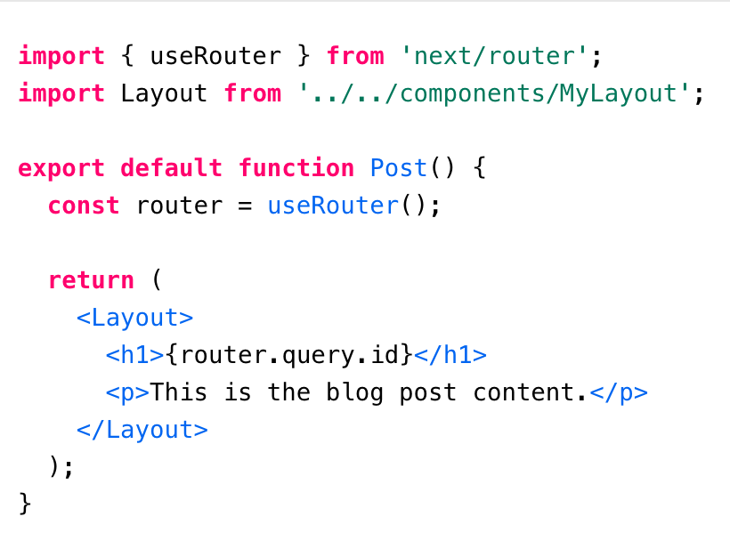
Clean URL’s with Dynamic Routing
[id].js
This page is special, instead of handling a static route like /about, it will handle routes that come after /p/. For example, /p/hello-nextjs will be handled by this page. Although, /p/post-1/another will not.
Having brackets ([]) in the page name makes it a dynamic route. Currently, you can not make part of a page name dynamic only the full name. For example, /pages/p/[id].js is supported but /pages/p/post-[id].js is not currently.
When creating the dynamic route we added id between the brackets ([]). This is the name of the query param received by the page, so for /p/hello-nextjs the query object will have { id: 'hello-nextjs'}, and we can access it with useRouter().
Source: https://reactjs.org/docs/handling-events.html
Notes:
Even still, there's a high learning curve before you can build a proper application. That's because you need to learn about client-side routing, page layout, and so on. If you'd like to perform server-side rendering for faster page loads, things can become even more difficult.
So, we need something simple but customizable.
Think about how webapps are created with PHP. You create some files, write PHP code, then simply deploy it. We don't have to worry about routing much, and the app is rendered on the server by default.

Slide 17
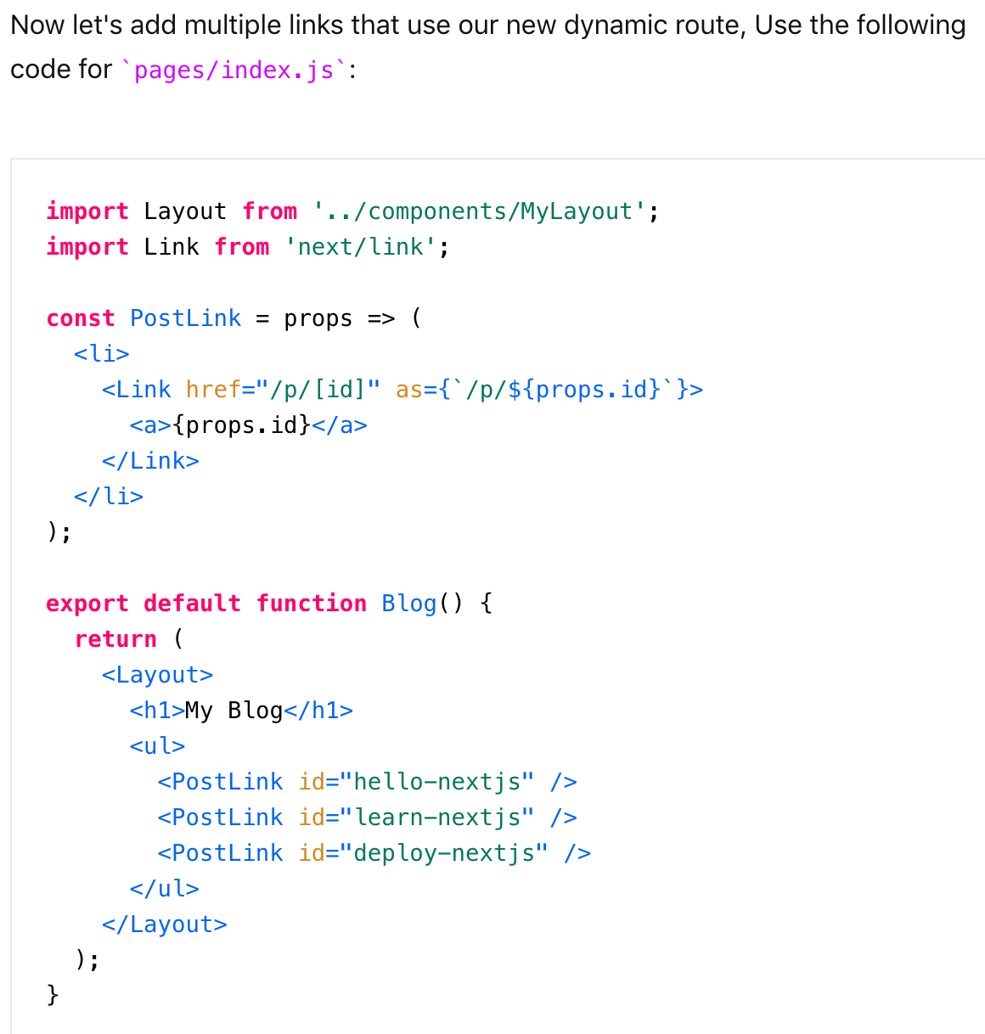
Clean URL’s with Dynamic Routing
In the <Link> element, the href prop is now the path of the page in the pages folder and as is the URL to show in URL bar of the browser.
Dynamic routing works pretty nicely with the browser history, all you have to do is to add the as prop to the link component.
Source: https://reactjs.org/docs/handling-events.html
Notes:
Even still, there's a high learning curve before you can build a proper application. That's because you need to learn about client-side routing, page layout, and so on. If you'd like to perform server-side rendering for faster page loads, things can become even more difficult.
So, we need something simple but customizable.
Think about how webapps are created with PHP. You create some files, write PHP code, then simply deploy it. We don't have to worry about routing much, and the app is rendered on the server by default.

Slide 18
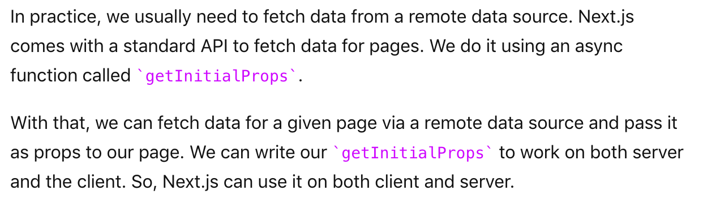
Fetching Data
Source: https://reactjs.org/docs/handling-events.html
Notes:
Even still, there's a high learning curve before you can build a proper application. That's because you need to learn about client-side routing, page layout, and so on. If you'd like to perform server-side rendering for faster page loads, things can become even more difficult.
So, we need something simple but customizable.
Think about how webapps are created with PHP. You create some files, write PHP code, then simply deploy it. We don't have to worry about routing much, and the app is rendered on the server by default.

Slide 19
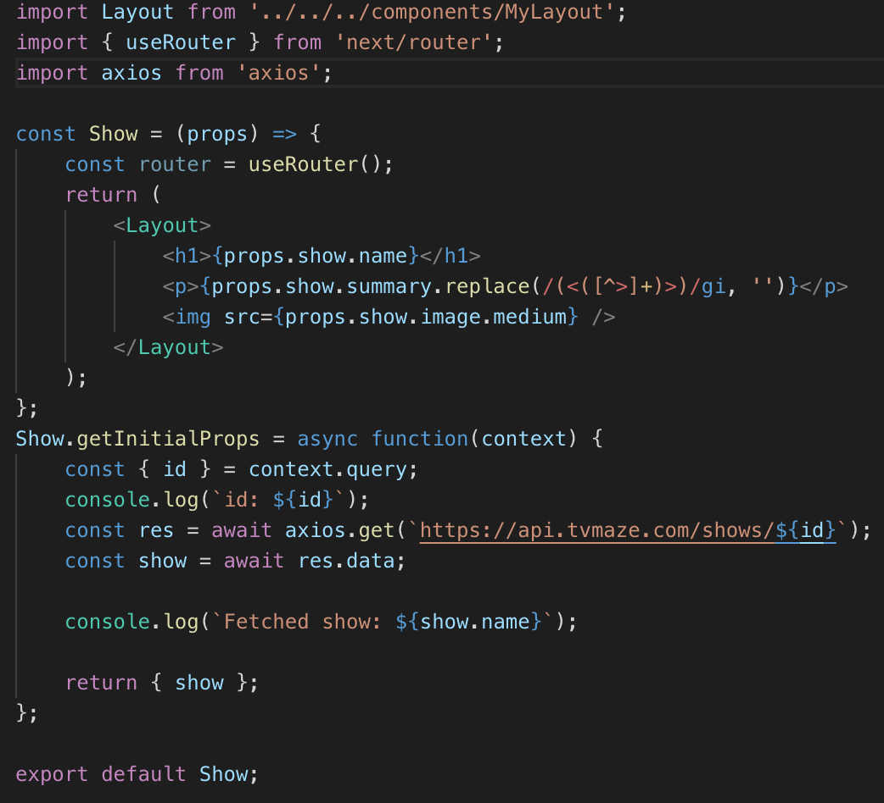
Fetching Data
Source: https://reactjs.org/docs/handling-events.html
Notes:
Even still, there's a high learning curve before you can build a proper application. That's because you need to learn about client-side routing, page layout, and so on. If you'd like to perform server-side rendering for faster page loads, things can become even more difficult.
So, we need something simple but customizable.
Think about how webapps are created with PHP. You create some files, write PHP code, then simply deploy it. We don't have to worry about routing much, and the app is rendered on the server by default.

Slide 20
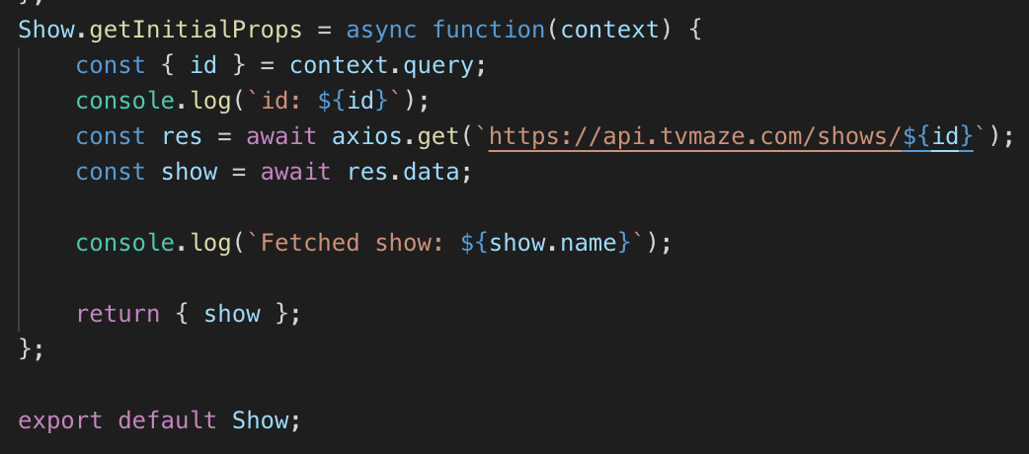
Fetching Data - getInitialProps
Static async function you can add into any page in your app. Using that, we can fetch data and send them as props to our page.
The first argument of the function is the context object. It has a query object that we can use to fetch information.
In our example, we picked the show ID from query and used it to fetch the show data from the TVMaze API.
Source: https://reactjs.org/docs/handling-events.html
Notes:
Even still, there's a high learning curve before you can build a proper application. That's because you need to learn about client-side routing, page layout, and so on. If you'd like to perform server-side rendering for faster page loads, things can become even more difficult.
So, we need something simple but customizable.
Think about how webapps are created with PHP. You create some files, write PHP code, then simply deploy it. We don't have to worry about routing much, and the app is rendered on the server by default.

Slide 21
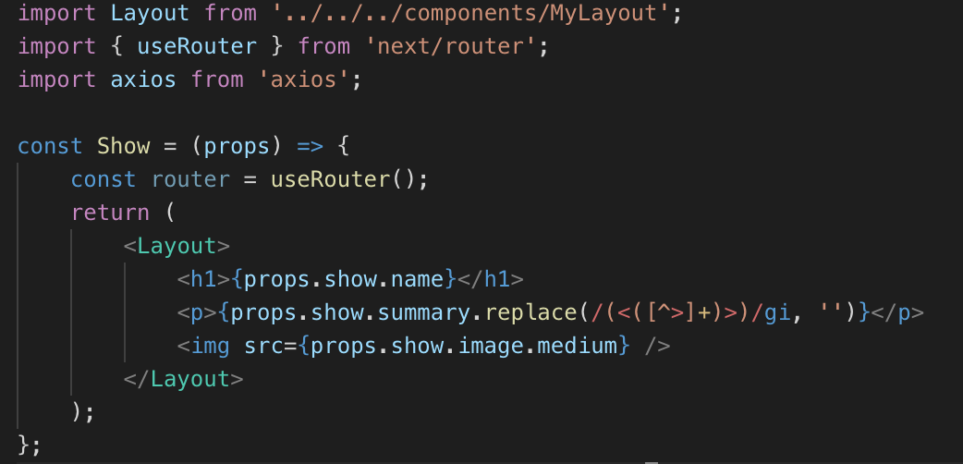
Fetching Data – Reading the Data
Source: https://reactjs.org/docs/handling-events.html
Notes:
Even still, there's a high learning curve before you can build a proper application. That's because you need to learn about client-side routing, page layout, and so on. If you'd like to perform server-side rendering for faster page loads, things can become even more difficult.
So, we need something simple but customizable.
Think about how webapps are created with PHP. You create some files, write PHP code, then simply deploy it. We don't have to worry about routing much, and the app is rendered on the server by default.

Slide 22
CSS
There are two ways to style our Next React components.
1. Traditional CSS-file-based styling (including SASS, PostCSS etc)
2. CSS in Js styling
Consequently, there are a bunch of practical issues to consider with traditional CSS-file-based styling (especially with SSR), so the folks at Next.js suggest avoiding this method when styling for Next.js.
Instead they recommend CSS in JS, which you can use to style individual components rather than importing CSS files.
Next.js comes preloaded with a CSS in JS framework called styled-jsx, specifically designed to make your life easier. It allows you to write familiar CSS rules for your components; rules will have no impact on anything other than the components (not even child components). That means, your CSS rules are scoped.
Source: https://reactjs.org/docs/handling-events.html
Notes:
Even still, there's a high learning curve before you can build a proper application. That's because you need to learn about client-side routing, page layout, and so on. If you'd like to perform server-side rendering for faster page loads, things can become even more difficult.
So, we need something simple but customizable.
Think about how webapps are created with PHP. You create some files, write PHP code, then simply deploy it. We don't have to worry about routing much, and the app is rendered on the server by default.

Slide 23
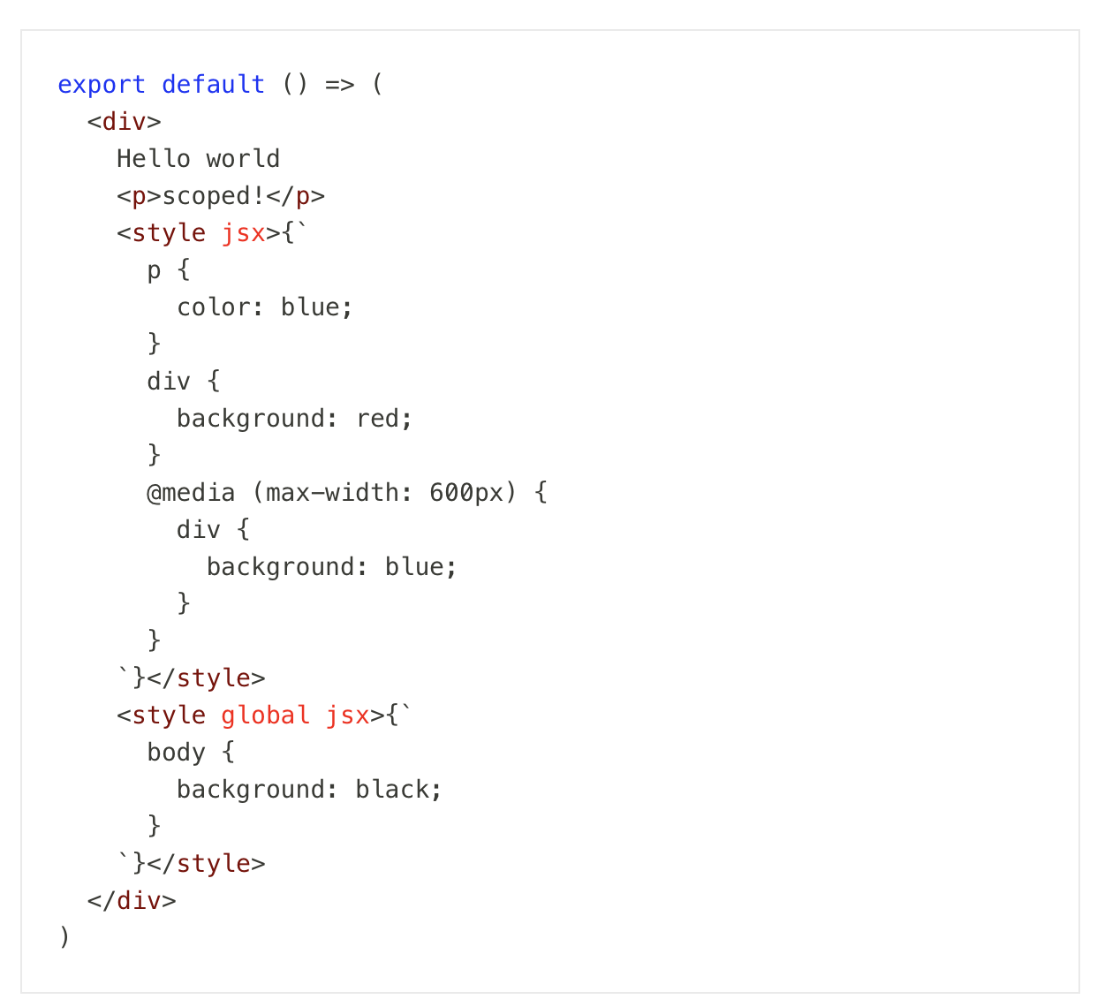
CSS
Example of styled-jsx
Styled jsx works as a babel plugin. It will parse all of the CSS and apply it in the build process. (With that our styles get applied without any overhead time)
It also supports having constraints inside styled-jsx. In the future, you will be able to use any dynamic variable inside styled-jsx. That is why CSS needs to go inside of a template string. ({``})
Source: https://reactjs.org/docs/handling-events.html
Notes:
Even still, there's a high learning curve before you can build a proper application. That's because you need to learn about client-side routing, page layout, and so on. If you'd like to perform server-side rendering for faster page loads, things can become even more difficult.
So, we need something simple but customizable.
Think about how webapps are created with PHP. You create some files, write PHP code, then simply deploy it. We don't have to worry about routing much, and the app is rendered on the server by default.

Slide 24
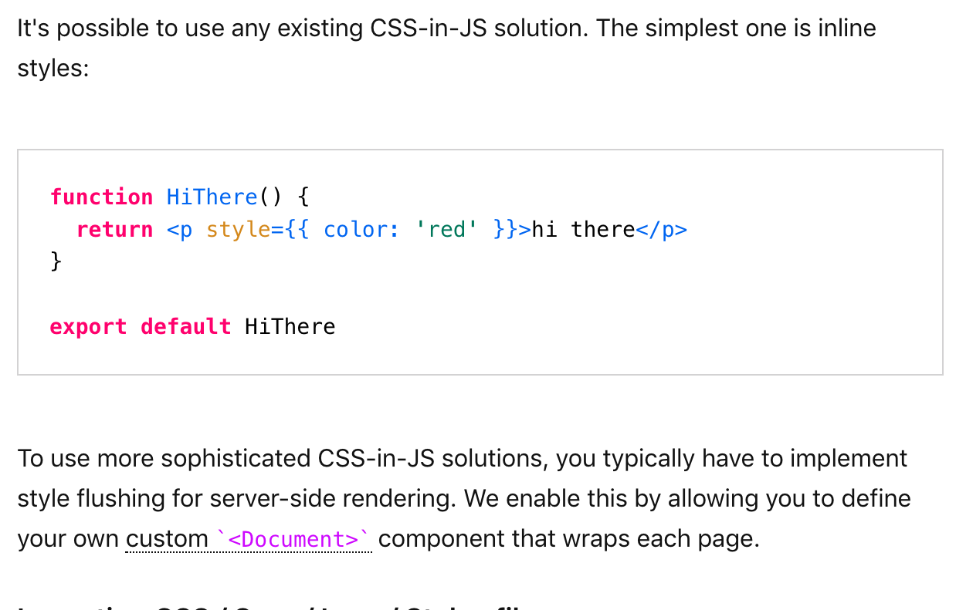
CSS
Source: https://reactjs.org/docs/handling-events.html
Notes:
Even still, there's a high learning curve before you can build a proper application. That's because you need to learn about client-side routing, page layout, and so on. If you'd like to perform server-side rendering for faster page loads, things can become even more difficult.
So, we need something simple but customizable.
Think about how webapps are created with PHP. You create some files, write PHP code, then simply deploy it. We don't have to worry about routing much, and the app is rendered on the server by default.

Slide 25
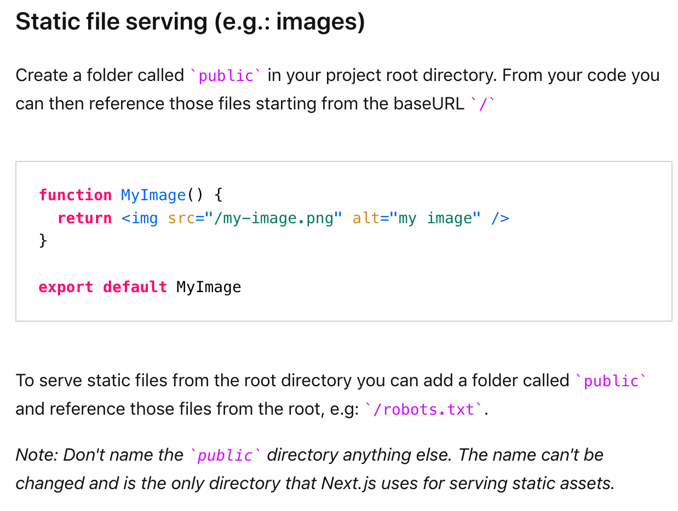
Static Files
Source: https://reactjs.org/docs/handling-events.html
Notes:
Even still, there's a high learning curve before you can build a proper application. That's because you need to learn about client-side routing, page layout, and so on. If you'd like to perform server-side rendering for faster page loads, things can become even more difficult.
So, we need something simple but customizable.
Think about how webapps are created with PHP. You create some files, write PHP code, then simply deploy it. We don't have to worry about routing much, and the app is rendered on the server by default.

