Slide 1
Greedy Algorithms

Slide 2
Greedy Technique
Constructs a solution to an optimization problem piece by piece through a sequence of choices that are:
feasible
locally optimal
irrevocable
For some problems, yields an optimal solution for every instance.
For most, does not but can be useful for fast approximations.

Slide 3
Applications of the Greedy Strategy
Optimal solutions:
  change making for “normal” coin denominations
  Fractional knapsack problem
  Huffman codes
  minimum spanning tree (MST)
  single-source shortest paths
  simple scheduling problems

Slide 4
Change-Making Problem
Given unlimited amounts of coins of denominations d₁ > … > d_{m} ,
give change for amount n with the least number of coins
Example: d₁ = 25c, d₂ =10c, d₃ = 5c, d₄ = 1c and n = 48c
Greedy solution: optimal for any amount and “typical’’ set of denominations
not optimal for all coin denominations …

Slide 5
Change-Making Problem
Greedy not optimal for all sets of denominations:
Consider 1, 3, 4
For what value does greedy algorithm fail?

Slide 6
Fractional Knapsack Problem
Knapsack capacity: W
There are n items: the i-th item has value v_{i} and weight w_{i}
Goal:
  find x_{i} such that for all 0 ≤ x_{i} ≤ 1, i = 1, 2, .., n
  ∑ w_{i}x_{i} ≤ W and
  ∑ x_{i}v_{i} is maximum

Slide 7
Fractional Knapsack - Example
50
20
---
30
50
E.g.:
$80
+
Item 3
Item 2
30
20
$100
+
Item 1
20
10
10
$60
$60
$100
$120
$240
$6/pound
$5/pound
$4/pound

Slide 8
Fractional Knapsack Problem
Greedy strategy 1:
  Pick the item with the maximum value
E.g.:
  W = 1
  w₁ = 100, v₁ = 2
  w₂ = 1, v₂ = 1
  Taking from the item with the maximum value:
  Total value taken = v₁/w₁ = 2/100
  Smaller than what the thief can take if choosing the other item
  Total value (choose item 2) = v₂/w₂ = 1

Slide 9
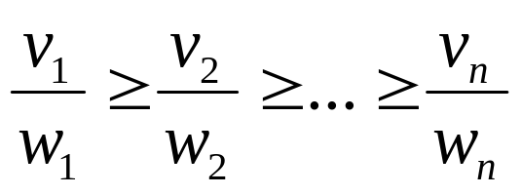
Fractional Knapsack Problem
Greedy strategy 2:
Pick the item with the maximum value per pound v_{i}/w_{i}
If the supply of that element is exhausted and the thief can carry more: take as much as possible from the item with the next greatest value per pound
It is good to order items based on their value per pound

Slide 10
Fractional Knapsack Problem
Alg.: Fractional-Knapsack (W, v[n], w[n])
While w > 0 and as long as there are items remaining
pick item with maximum v_{i}/w_{i}
x_{i} ← min (1, w/w_{i})
remove item i from list
w ← w – x_{i}w_{i}
w – the amount of space remaining in the knapsack (w = W)
Running time: Θ(n) if items already ordered; else Θ(nlgn)

Slide 11
Huffman Code Problem
Huffman’s algorithm achieves data compression by finding the best variable length binary encoding scheme for the symbols that occur in the file to be compressed.

Slide 12
Huffman Code Problem
The more frequent a symbol occurs, the shorter should be the Huffman binary word representing it.
The Huffman code is a prefix-free code.
  No prefix of a code word is equal to another codeword.

Slide 13
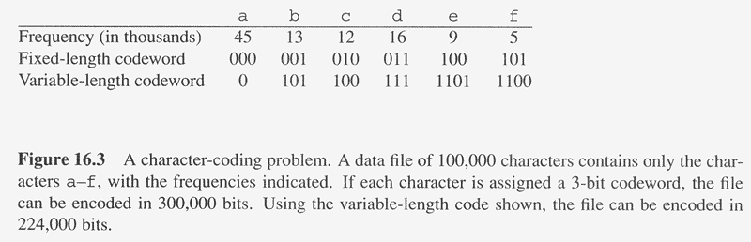
Overview
Huffman codes: compressing data (savings of 20% to 90%)
Huffman’s greedy algorithm uses a table of the frequencies of occurrence of each character to build up an optimal way of representing each character as a binary string
C: Alphabet

Slide 14
Example
Assume we are given a data file that contains only 6 symbols, namely a, b, c, d, e, f With the following frequency table:
Find a variable length prefix-free encoding scheme that compresses this data file as much as possible?

Slide 15
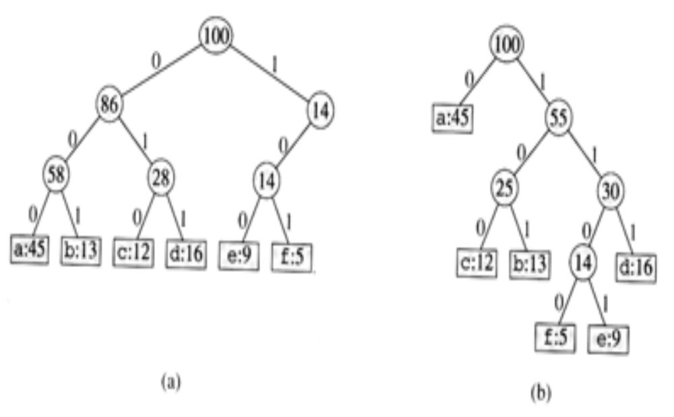
Huffman Code Problem
Left tree represents a fixed length encoding scheme
Right tree represents a Huffman encoding scheme

Slide 16
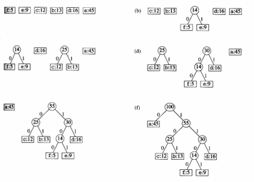
Example

Slide 17
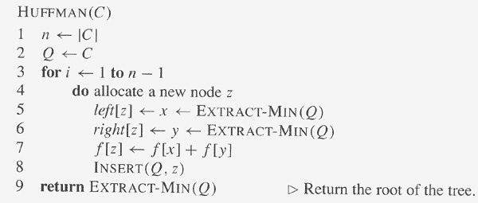
Constructing A Huffman Code
// C is a set of n characters
// Q is implemented as a binary min-heap
O(n)
Total computation time = O(n lg n)
O(lg n)
O(lg n)
O(lg n)

Slide 18
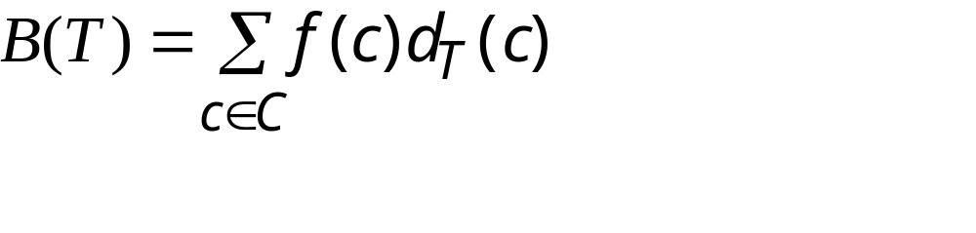
Cost of a Tree T
For each character c in the alphabet C
  let f(c) be the frequency of c in the file
  let d_{T}(c) be the depth of c in the tree
    It is also the length of the codeword. Why?
Let B(T) be the number of bits required to encode the file (called the cost of T)

Slide 19
Huffman Code Problem
In the pseudocode that follows:
we assume that C is a set of n characters and that each character c €C is an object with a defined frequency f [c].
The algorithm builds the tree T corresponding to the optimal code
A min-priority queue Q, is used to identify the two least-frequent objects to merge together.
The result of the merger of two objects is a new object whose frequency is the sum of the frequencies of the two objects that were merged.

Slide 20
Running time of Huffman's algorithm
The running time of Huffman's algorithm assumes that Q is implemented as a binary min-heap.
For a set C of n characters, the initialization of Q in line 2 can be performed in O(n) time using the BUILD-MINHEAP
The for loop in lines 3-8 is executed exactly n - 1 times, and since each heap operation requires time O(lg n), the loop contributes O(n lg n) to the running time. Thus, the total running time of HUFFMAN on a set of n characters is O(n lg n).

Slide 21
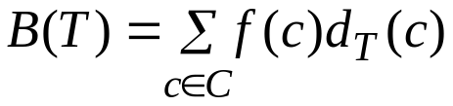
Prefix Code
Prefix(-free) code: no codeword is also a prefix of some other codewords (Un-ambiguous)
  An optimal data compression achievable by a character code can always be achieved with a prefix code
  Simplify the encoding (compression) and decoding
    Encoding: abc ➔ 0 . 101. 100 = 0101100
    Decoding: 001011101 = 0. 0. 101. 1101 ➔ aabe
      Use binary tree to represent prefix codes for easy decoding
An optimal code is always represented by a full binary tree, in which every non-leaf node has two children
  |C| leaves and |C|-1 internal nodes Cost:
Depth of c (length of the codeword)
Frequency of c

Slide 22
Huffman Code
Reduce size of data by 20%-90% in general
If no characters occur more frequently than others, then no advantage over ASCII
Encoding:
  Given the characters and their frequencies, perform the algorithm and generate a code. Write the characters using the code
Decoding:
  Given the Huffman tree, figure out what each character is (possible because of prefix property)

Slide 23
Application on Huffman code
Both the .mp3 and .jpg file formats use Huffman coding at one stage of the compression

Slide 24
Minimum Spanning Trees
Given: Connected, undirected, weighted graph, G
Find: Minimum - weight spanning tree, T
Example:
b
7
c
5
Acyclic subset of edges(E) that connects all vertices of G.
a
1
-3
3
11
d
e
f
0
2
b
c
5
a
1
3
-3
d
e
f
0

Slide 25
Generic Algorithm
“Grows” a set A.
A is subset of some MST.
Edge is “safe” if it can be added to A without destroying this
invariant.
A := ∅;
while A not complete tree do
find a safe edge (u, v);
A := A ∪ {(u, v)}
od

Slide 26
Definitions
no edge in the set crosses the cut
cut respects the edge set {(a, b), (b, c)}
5
7
a light edge crossing cut
(could be more than one)
a
b
c
3
1
-3
11
cut partitions vertices into
disjoint sets, S and V – S.
d
e
f
0
2
this edge crosses the cut
one endpoint is in S and the other is in V – S.
Comp 122, Fall 2003

Slide 27
Theorem 23.1
Theorem 23.1: Let (S, V-S) be any cut that respects A, and let (u, v)
be a light edge crossing (S, V-S). Then, (u, v) is safe for A.
Proof:
Let T be a MST that includes A.
Case: (u, v) in T. We’re done.
Case: (u, v) not in T. We have the following:
edge in A
(x, y) crosses cut.
Let T´ = T - {(x, y)} ∪ {(u, v)}.
Because (u, v) is light for cut,
w(u, v) ≤ w(x, y). Thus,
w(T´) = w(T) - w(x, y) + w(u, v) ≤ w(T).
Hence, T´ is also a MST.
So, (u, v) is safe for A.
x
y
cut
u
shows edges
in T
v
Comp 122, Fall 2003

Slide 28
Corollary
In general, A will consist of several connected components.
Corollary: If (u, v) is a light edge connecting one CC in (V, A)
to another CC in (V, A), then (u, v) is safe for A.
Comp 122, Fall 2003

Slide 29
Kruskal’s Algorithm
Starts with each vertex in its own component.
Repeatedly merges two components into one by choosing a light edge that connects them (i.e., a light edge crossing the cut between them).
Scans the set of edges in monotonically increasing order by weight.
Uses a disjoint-set data structure to determine whether an edge connects vertices in different components.
Comp 122, Fall 2003

Slide 30
Prim’s Algorithm
Builds one tree, so A is always a tree.
Starts from an arbitrary “root” r .
At each step, adds a light edge crossing cut (V_{A}, V - V_{A}) to A.
  V_{A} = vertices that A is incident on.
Comp 122, Fall 2003

Slide 31
Prim’s Algorithm
Uses a priority queue Q to find a light edge quickly.
Each object in Q is a vertex in V - V_{A}.
Key of v is minimum weight of any edge (u, v), where u ∈ V_{A}.
Then the vertex returned by Extract-Min is v such that there exists u ∈ V_{A} and (u, v) is light edge crossing (V_{A}, V - V_{A}).
Key of v is ∞ if v is not adjacent to any vertex in V_{A}.
Comp 122, Fall 2003

Slide 32
Prim’s Algorithm
Q := V[G];
for each u ∈ Q do
key[u] := ∞
od;
key[r] := 0;
π[r] := NIL;
while Q ≠ ∅ do
u := Extract - Min(Q);
for each v ∈ Adj[u] do
if v ∈ Q ∧ w(u, v) < key[v] then
π[v] := u;
key[v] := w(u, v)
fi
od
od
Complexity:
Using binary heaps: O(E lg V).
Initialization – O(V).
Building initial queue – O(V).
V Extract-Min’s – O(V lgV).
E Decrease-Key’s – O(E lg V).
Using Fibonacci heaps: O(E + V lg V).
(see book)
⇦ decrease-key operation
Note: A = {(v, π[v]) : v ∈ v - {r} - Q}.
Comp 122, Fall 2003

Slide 33
Example of Prim’s Algorithm
Not in tree
a/0
5
b/∞
7
c/∞
1
-3
Q = a b c d e f
0 ∞ ∞
11
3
d/∞
0
e/∞
2
f/∞
Comp 122, Fall 2003

Slide 34
Example of Prim’s Algorithm
a/0
5
b/5
c/1
3
1
-3
d/0
0
e/3
f/-3
Comp 122, Fall 2003

Slide 35
Example of Prim’s Algorithm
a/0
5
b/5
7
c/∞
1
-3
Q = b d c e f
5 11 ∞ ∞
11
3
d/11
0
e/∞
2
f/∞
Comp 122, Fall 2003

Slide 36
Example of Prim’s Algorithm
a/0
5
b/5
7
c/7
1
-3
Q = e c d f
3 7 11 ∞
11
3
d/11
0
e/3
2
f/∞
Comp 122, Fall 2003

Slide 37
Example of Prim’s Algorithm
a/0
5
b/5
7
c/1
1
-3
Q = d c f
0 1 2
11
3
d/0
0
e/3
2
f/2
Comp 122, Fall 2003

Slide 38
Example of Prim’s Algorithm
a/0
5
b/5
7
c/1
1
-3
Q = c f
1 2
11
3
d/0
0
e/3
2
f/2
Comp 122, Fall 2003

Slide 39
Example of Prim’s Algorithm
a/0
5
b/5
7
c/1
1
-3
Q = f
-3
11
3
d/0
0
e/3
2
f/-3
Comp 122, Fall 2003

Slide 40
Example of Prim’s Algorithm
a/0
5
b/5
7
c/1
1
-3
Q = ∅
11
3
d/0
0
e/3
2
f/-3
Comp 122, Fall 2003

Slide 41
Shortest paths – Dijkstra’s algorithm
Single Source Shortest Paths Problem: Given a weighted
connected graph G, find shortest paths from source vertex s to each of the other vertices
Dijkstra’s algorithm: Similar to Prim’s MST algorithm, with a different way of computing numerical labels: Among vertices not already in the tree, it finds vertex u with the smallest sum
d_{v} + w(v,u)
Where v is a vertex for which shortest path has been already found on preceding iterations (such vertices form a tree)
d_{v} is the length of the shortest path form source to v
w(v,u) is the length (weight) of edge from v to u

Slide 42
Example
b
4
c
3
6
7
2
5
4
a
d
d
e
Tree vertices Remaining vertices
a(-,0) b(a,3) c(-,∞) d(a,7) e(-,∞)
4
b
c
3
2
6
5
a
7
d
4
e
b(a,3) c(b,3+4) d(b,3+2) e(-,∞)
b
4
c
3
6
2
5
a
7
d
4
e
d(b,5) c(b,7) e(d,5+4)
b
4
c
3
6
2
5
a
7
d
4
e
c(b,7) e(d,9)
4
b
c
3
6
2
5
a
7
d
4
e
e(d,9)

Slide 43
Notes on Dijkstra’s algorithm
Doesn’t work for graphs with negative weights
Applicable to both undirected and directed graphs
Efficiency
  O(|V|²) for graphs represented by weight matrix and array implementation of priority queue
  O(|E|log|V|) for graphs represented by adj. lists and min-heap implementation of priority queue
Don’t mix up Dijkstra’s algorithm with Prim’s algorithm!

Slide 44
An Activity-Selection Problem
Suppose A set of activities S={a₁, a₂,…, a_{n}}
  They use resources, such as lecture hall, one lecture at a time
  Each a_{i}, has a start time s_{i}, and finish time f_{i}, with 0≤ s_{i}< f_{i}<∝.
  a_{i} and a_{j} are compatible if [s_{i}, f_{i}) and [s_{j}, f_{j}) do not overlap
Goal: select maximum-size subset of mutually compatible activities.
Start from dynamic programming, then greedy algorithm, see the relation between the two.

Slide 45

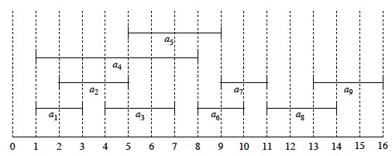

Slide 46
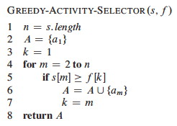

Slide 59
Dynamic Programming vs. Greedy Algorithms
Dynamic programming
  We make a choice at each step
  The choice depends on solutions to subproblems
  Bottom up solution, from smaller to larger subproblems
Greedy algorithm
  Make the greedy choice and THEN
  Solve the subproblem arising after the choice is made
  The choice we make may depend on previous choices, but not on solutions to subproblems
  Top down solution, problems decrease in size

