Slide 1
Backtracking
Suppose you have to make a series of decisions, among various choices, where
You don’t have enough information to know what to choose
Each decision leads to a new set of choices
Some sequence of choices (possibly more than one) may be a solution to your problem
Backtracking is a methodical way of trying out various sequences of decisions, until you find the correct one that “works”.

Slide 2
Backtracking (animation)
dead end
?
dead end
dead end
?
start
?
?
dead end
dead end
?
success!

Slide 3

Backtracking: Idea
Backtracking is a technique used to solve problems with a large search space, by systematically trying and eliminating possibilities.
A standard example of backtracking would be going through a maze.
At some point, you might have two options of which direction to go:
Portion A
Junction
Portion B

Slide 4
Backtracking
Junction
One strategy would be to try going through Portion A of the maze.
If you get stuck before you find your way out, then you "backtrack" to the junction.
At this point in time you know that Portion A will NOT lead you out of the maze,
so you then start searching in Portion B
Portion B
Portion A

Slide 5

Backtracking
Clearly, at a single junction you could have even more than 2 choices.
The backtracking strategy says to try each choice, one after the other,
if you ever get stuck, "backtrack" to the junction and try the next choice.
If you try all choices and never found a way out, then there IS no solution to the maze.
Junction
C
B
A

Slide 6
Backtracking
Dealing with the maze:
From your start point, you will iterate through each possible starting move.
From there, you recursively move forward.
If you ever get stuck, the recursion takes you back to where you were, and you try the next possible move.
Make sure you don't try too many possibilities,
Mark which locations in the maze have been visited already so that no location in the maze gets visited twice.
If a place has already been visited, there is no point in trying to reach the end of the maze from there again.

Slide 7
Backtracking
The neat thing about coding up backtracking is that it can be done recursively, without having to do all the bookkeeping at once.
Instead, the stack of recursive calls does most of the bookkeeping
(i.e., keeps track of which locations we’ve tried so far.)

Slide 8
Backtracking
Backtracking is used to solve problems in which a sequence of objects is chosen from a specified set so that the sequence satisfies some criterion.
Backtracking is a modified depth-first search of a tree.
It is the procedure whereby, after determining that a node can lead to nothing but dead nodes, we go back (“backtrack”) to the node’s parent and proceed with the search on the next child.

Slide 9
Backtrack Algorithm
Based on depth-first recursive search
Approach
Tests whether solution has been found
If found solution, return it
Else for each choice that can be made
Make that choice
Recursive
If recursion returns a solution, return it
If no choices remain, return failure
Some times called “search tree”

Slide 10
Improving Backtracking
Search pruning will help us to reduce the search space and hence get a solution faster.
The idea is to avoid those paths that may not lead to a solutions as early as possible by finding contradictions so that we can backtrack immediately without the need to build a hopeless solution vector.

Slide 11
Backtracking examples
The backtracking can be used in this cases:
Solving a maze
N queens problem etc.,
Hamiltonian Circuit Problem
Subset Sum Problem
Graph Coloring Problem

Slide 12
Backtracking EXAMPLE—N Queens Problem
The N-queens problem is a classical combinatorial problem in which it is required to place N queens on an N x N chessboard so no two Queens can attack each other.
A queen can attack another queen if it exists in the same row, column or diagonal as the queen.

Slide 13
What is the maximum number of queens that can be placed on an N x N chessboard such that no two Queens attack one another?
The answer is n queens, which gives eight queens for the usual 8x8 board

Slide 14
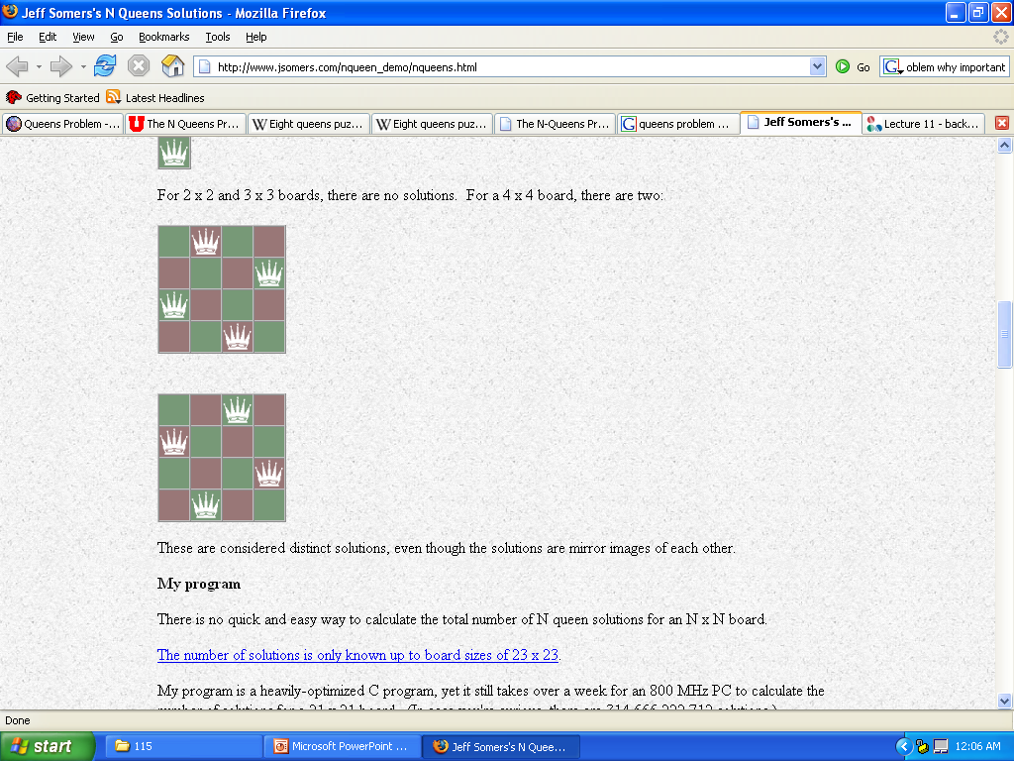
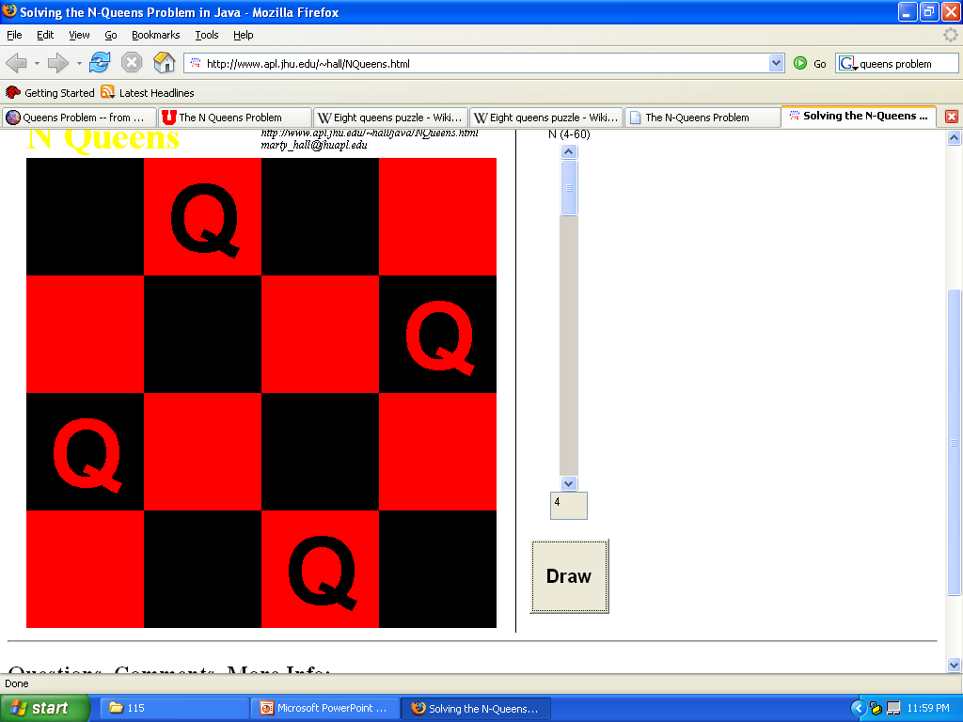
Problems N < 4
N < 4
Cannot use N Queens
3
2
1

Slide 15
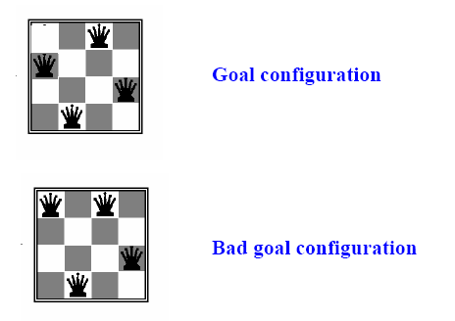
N-queens problem
Find a configuration of n queens not attacking each other

Slide 16
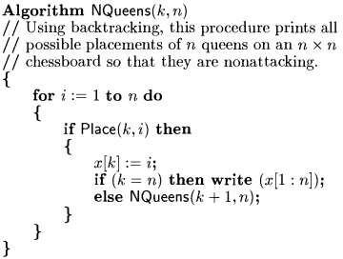
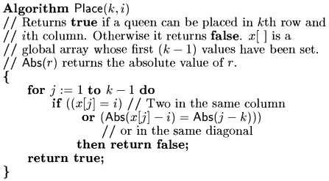

Slide 17

Backtracking EXAMPLE—8 Queens Problem(cont…)
It is an empty 8 x 8 chess board. We have to place the queens in this board.

Slide 18
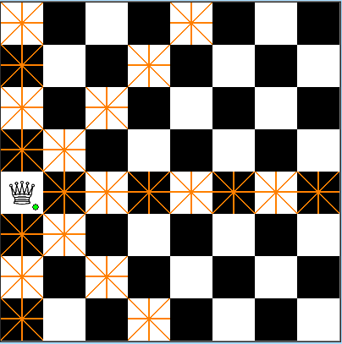
Backtracking EXAMPLE—8 Queens Problem(cont…)
We have placed the first queen on the chess board

Slide 19

Backtracking EXAMPLE—8 Queens Problem(cont…)
Then we have placed the second queen on the board.
The darken place should not have the queens because they are horizontal, vertical, diagonal to the placed queens.

Slide 20

Backtracking EXAMPLE—8 Queens Problem(cont…)
We have placed the third queen on board.

Slide 21
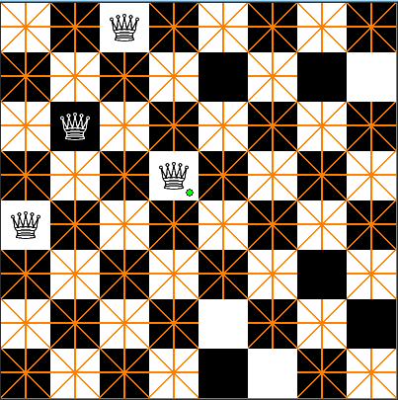
Backtracking EXAMPLE—8 Queens Problem(cont…)
We have placed the 4th queen on the board.
We have placed that in the wrong spot, so we backtrack and change the place of that one.

Slide 22

Backtracking EXAMPLE—8 Queens Problem(cont…)
In this way, we have to continue the process untill our goal is reached ie., we must place 8 queens on the board.

Slide 23
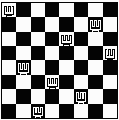
Backtracking EXAMPLE—8 Queens Problem
This problem can be solved by trying to place the first queen, then the second queen so that it cannot attack the first, and then the third so that it is not conflicting with previously placed queens.

Slide 24
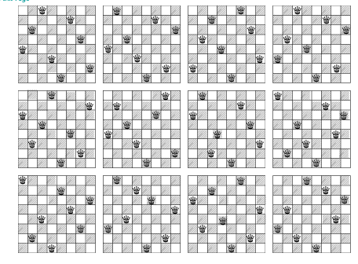
12 Unique Solutions 8-Queens Problem

Slide 25
8-Queens Problem
There are 92 distinct solutions
There are 12 unique solutions discounting symmetrical answers (rotatations/reflections)
How many solutions for 4-Queens? N-Queens?
Wikipedia.org

Slide 26
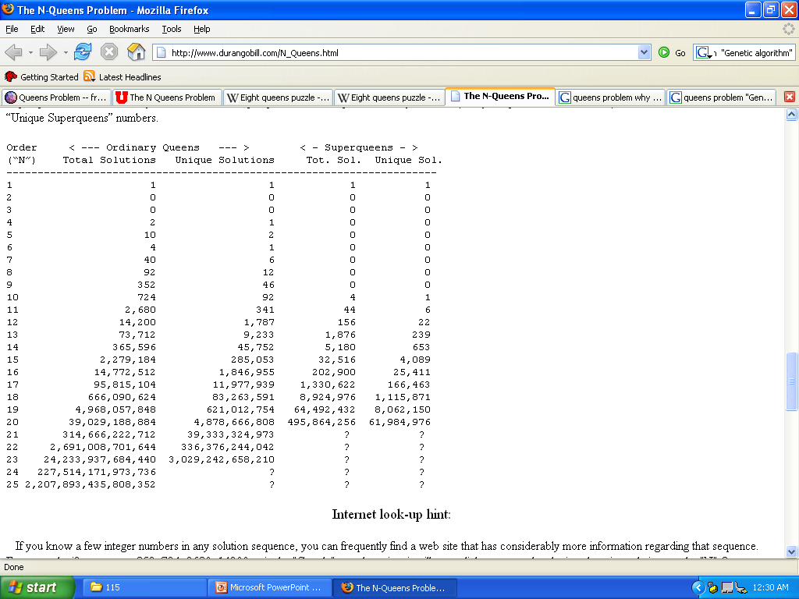
Time is an issue
difficult for a search algorithm such as depth-first search with backtracking to find a solution for the N-queens problem in an acceptable amount of time.
It took over 11 days to get the results for N = 20

Slide 27
Computational Considerations
Computer solutions to the N-Queens problem are basically the same as the method you would use by hand. It is simply a brute force trial and error method.
The amount of time required to find all solutions for any order “N” is roughly proportional to “N” Factorial.
It took over 11 days to get the results for “N” = 20.
If we increase “N” to 21, it would take about 4 months for the program to run.
For higher orders of “N”, the problem has to be broken into parts with each part delegated to a separate computer. Thus, dozens and more likely, hundreds of computers are needed to solve problems with “N” in the low 20's. With present computing power, it is unlikely that the total number of solutions will be found when “N” equals 30 or higher.

Slide 28
Why is this important?
In and of itself, the N queens problem is not important.
However, the problem works as an interesting optimization testbed
there are many, many solutions to this problem on the web, but few of them are fast.
Also, techniques used to speed up this code can be used in other areas, such as a chess-playing program or a unit path-finding algorithm for a game.

Slide 29
Hamiltonian Cycles
A Hamiltonian path (also called traceable path) is a path that visits each vertex exactly once.
A Hamiltonian cycle (also called Hamiltonian circuit, vertex tour or graph cycle) is a cycle that visits each vertex exactly once, except for the starting vertex.

Slide 30
Hamilton’s Around the World Game
The objective was to make what we just called a hamiltonian cycle.
The game was not a commercial success.
But the mathematics of hamiltonian cycles is very popular today.

Slide 31
Hamilton’s Around the World Game

Slide 32
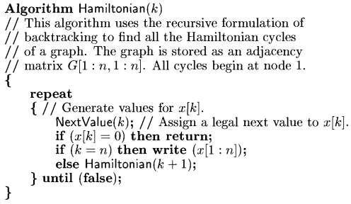
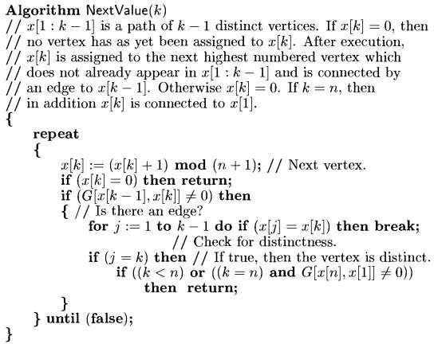

Slide 33
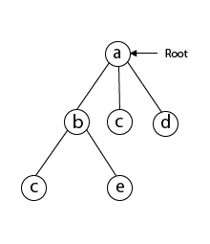
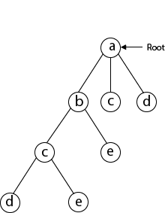
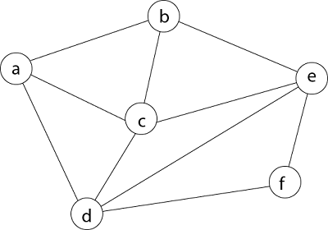
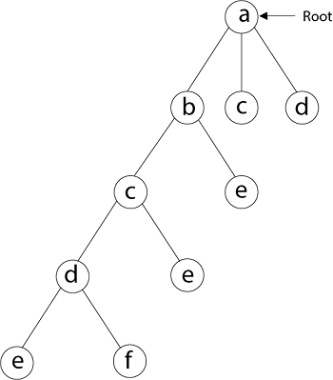
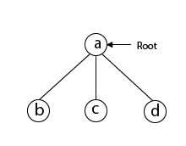
Example: Consider a graph G = (V, E) shown below. We have to find a Hamiltonian circuit using Backtracking method

Slide 34
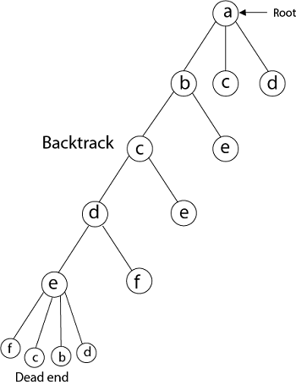
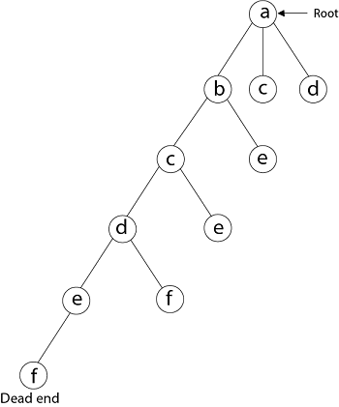

Slide 35
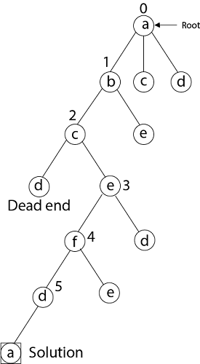
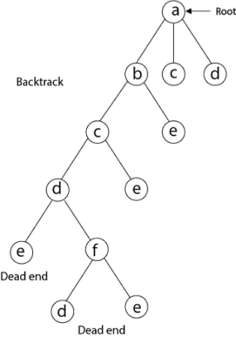

Slide 36
Complexity
N!

Slide 37
Sum of subsets problem

Slide 38
Problem definition: Find a subset of a given set A = {a1, . . . , an} of n positive integers whose sum is equal to a given positive integer d.
For example, for A = {1, 2, 5, 6, 8} and d = 9, there are two solutions: {1, 2, 6} and {1, 8}. Of course, some instances of this problem may have no solutions.
is convenient to sort the set’s elements in increasing order. So, we will assume that
a1< a2< . . . < an.
The state-space tree can be constructed as a binary tree like that in Figure shown below for the instance A = {3, 5, 6, 7} and d = 15.
The number inside a node is the sum of the elements already included in the subsets represented by the node. The inequality below a leaf indicates the reason for its termination.

Slide 39
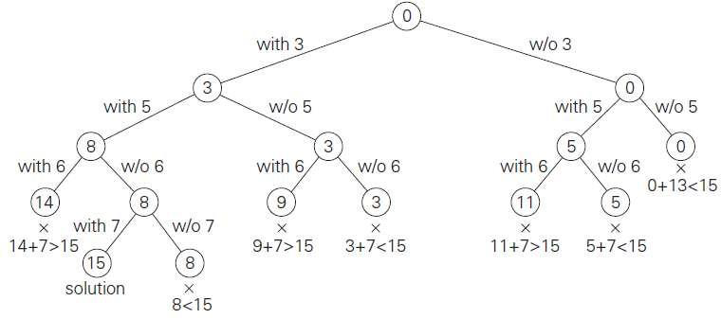

Slide 40
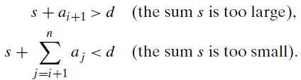
Algorithm
The root of the tree represents the starting point, with no decisions about the given elements made as yet. Its left and right children represent, respectively, inclusion and exclusion of a1 in a set being sought.
2. Similarly, going to the left from a node of the first level corresponds to inclusion of an element while going to the right corresponds to its exclusion, and so on.
3. Thus, a path from the root to a node on the ith level of the tree indicates which of the first in numbers have been included in the subsets represented by that node.
4. We record the value of s, the sum of these numbers, in the node. If s is equal to d, we have a solution to the problem. We can either report this result and stop or, if all the solutions need to be found, continue by backtracking to the node’s parent. If s is not equal to d, we can terminate the node as non-promising if either of the following two inequalities holds:

Slide 41
Complexity
2^{n}

Slide 42
Graph Coloring problem

Slide 43
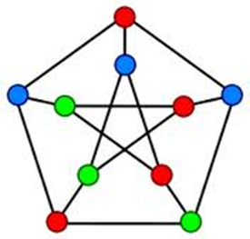
Backtracking
The goal is to color vertices in a graph G={V,E} so that no 2 adjacent vertices have the same color. Partial 3-coloring problem means only 3 colors are considered.
Direct approach builds the tree of ALL possibilities in exponential time.

Slide 44
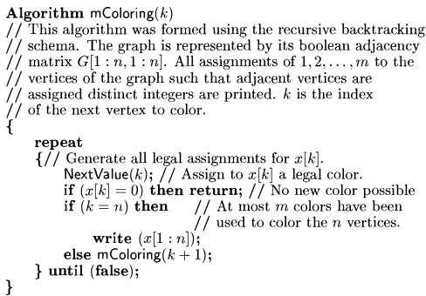
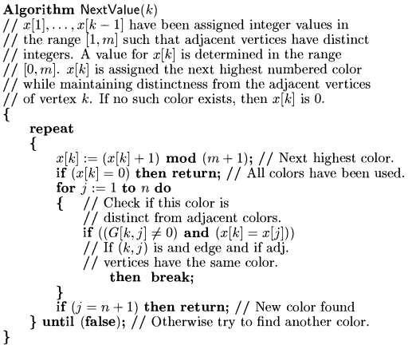

Slide 45
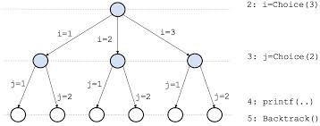
Backtracking
Partial 3-coloring (3 colors) is solved by the following method:
Color first vertex with 1st color, color next vertex with the next color, check if those two vertices are adjacent, if not - coloring is legal, proceed to next vertex, if yes and color is the same – coloring is illegal, try next color for second vertex. If all colors tried and all colorings are illegal, backtrack, try next color for previous vertex etc.
Note: sometimes solution is impossible.
Exponential O(3^n) complexity is reduced to O(n) on average.

Slide 46

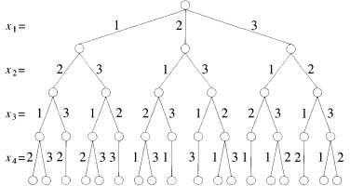

Slide 47
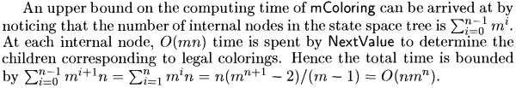
Analysis

Slide 48
Branch and Bound

Slide 49
Recall that the central idea of backtracking, discussed in the previous section, is to cut off a branch of the problem’s state-space tree as soon as we can deduce that it cannot lead to a solution. This idea can be strengthened further if we deal with an optimization problem.
An optimization problem seeks to minimize or maximize some objective function (a tour length, the value of items selected, the cost of an assignment, and the like), usually subject to some constraints. An optimal solution is a feasible solution with the best value of the objective function (e.g., the shortest Hamiltonian circuit or the most valuable subset of items that fit the knapsack).

Slide 50
Compared to backtracking, branch-and-bound requires two additional items:
a way to provide, for every node of a state-space tree, a bound on the best value of the objective function on any solution that can be obtained by adding further components to the partially constructed solution represented by the node
2. the value of the best solution seen so far

Slide 51
In general, we terminate a search path at the current node in a state-space tree of a branch- and-bound algorithm for any one of the following three reasons:
The value of the node’s bound is not better than the value of the best solution seen so far.
2. The node represents no feasible solutions because the constraints of the problem are already violated.
3. The subset of feasible solutions represented by the node consists of a single point (and hence no further choices can be made)—in this case, we compare the value of the objective function for this feasible solution with that of the best solution seen so far and update the latter with the former if the new solution is better.

Slide 52
Assignment Problem

Slide 53
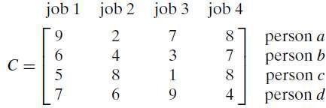
Let us illustrate the branch-and-bound approach by applying it to the problem of assigning n people to n jobs so that the total cost of the assignment is as small as possible.
An instance of the assignment problem is specified by an n × n cost matrix C so that we can state the problem as follows: select one element in each row of the matrix so that no two selected elements are in the same column and their sum is the smallest possible. We will demonstrate how this problem can be solved using the branch-and-bound technique by considering the small instance of the problem. Consider the data given below.

Slide 54
We can do this by several methods. For example, it is clear that the cost of any solution, including an optimal one, cannot be smaller than the sum of the smallest elements in each of the matrix’s rows. For the instance here, this sum is 2 + 3+ 5+ 4 = 14.
We can and will apply the same thinking to partially constructed solutions. For example, for any legitimate selection that selects 9 from the first row, the lower bound will be 9 + 3 + 5 + 4 = 21.

Slide 55
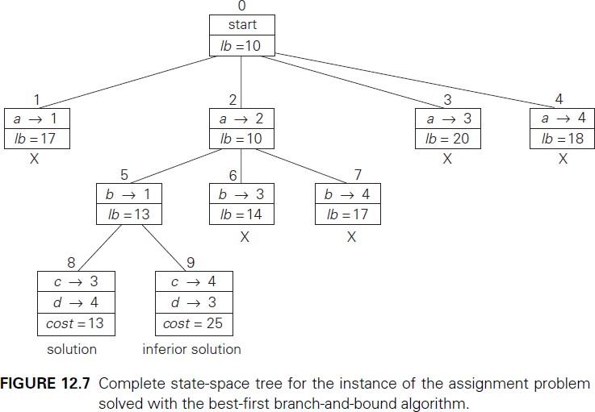

Slide 56
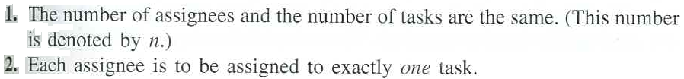
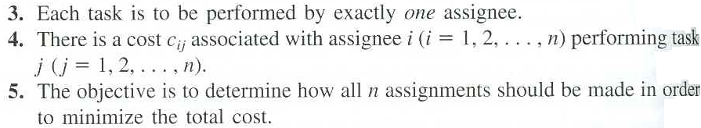
The assignment problem is a special type of linear programming problem where assignees are being assigned to perform tasks. Assigning people to tasks is a common application of the assignment problem. However, the assignees need not be people. They also could be machines, or vehicles, or plants, or even time slots to be assigned tasks.
To fit the definition of an assignment problem, these kinds of applications need to be formulated in a way that satisfy the following assumptions.

Slide 57
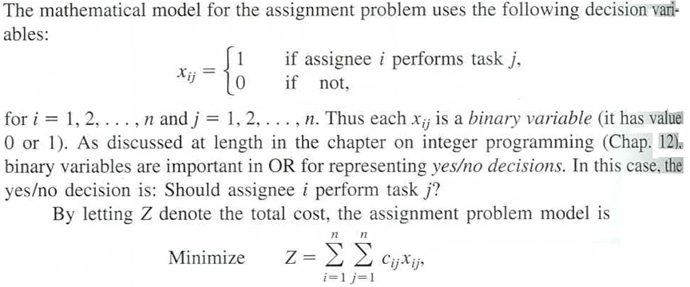
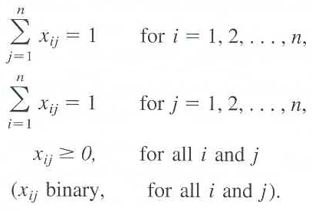
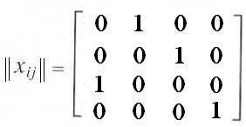
The Assignment Problem Model
A feasible solution for the translation example is

Slide 58
Example
We must determine how jobs should be assigned to machines to minimize setup times, which are given below:
 |  | Job 1 | Job 2 | Job 3 | Job 4
Machine 1 |  | 14 | 5 | 8 | 7
Machine 2 |  | 2 | 12 | 6 | 5
Machine 3 |  | 7 | 8 | 3 | 9
Machine 4 |  | 2 | 4 | 6 | 10

Slide 59
Hungarian Algorithm
Step 1: (a) Find the minimum element in each row of the cost matrix. Form a new matrix by subtracting this cost from each row. (b) Find the minimum cost in each column of the new matrix, and subtract this from each column. This is the reduced cost matrix.

Slide 60
Example: Step 1(a)
 |  | Job 1 | Job 2 | Job 3 | Job 4
Machine 1 |  | 14 | 5 | 8 | 7
Machine 2 |  | 2 | 12 | 6 | 5
Machine 3 |  | 7 | 8 | 3 | 9
Machine 4 |  | 2 | 4 | 6 | 10
 |  | Job 1 | Job 2 | Job 3 | Job 4
Machine 1 |  | 9 | 0 | 3 | 2
Machine 2 |  | 0 | 10 | 4 | 3
Machine 3 |  | 4 | 5 | 0 | 6
Machine 4 |  | 0 | 2 | 4 | 8
Row Reduction

Slide 61
Example: Step 1(b)
 |  | Job 1 | Job 2 | Job 3 | Job 4
Machine 1 |  | 9 | 0 | 3 | 2
Machine 2 |  | 0 | 10 | 4 | 3
Machine 3 |  | 4 | 5 | 0 | 6
Machine 4 |  | 0 | 2 | 4 | 8
 |  | Job 1 | Job 2 | Job 3 | Job 4
Machine 1 |  | 9 | 0 | 3 | 0
Machine 2 |  | 0 | 10 | 4 | 1
Machine 3 |  | 4 | 5 | 0 | 4
Machine 4 |  | 0 | 2 | 4 | 6
Column Reduction

Slide 62
Hungarian Algorithm
Step 2: Draw the minimum number of lines that are needed to cover all the zeros in the reduced cost matrix. If m lines are required, then an optimal solution is available among the covered zeros in the matrix. Otherwise, continue to Step 3.
How do we find the minimum number of lines?!

Slide 63
Example: Step 2
 |  | Job 1 | Job 2 | Job 3 | Job 4
Machine 1 |  | 9 | 0 | 3 | 0
Machine 2 |  | 0 | 10 | 4 | 1
Machine 3 |  | 4 | 5 | 0 | 4
Machine 4 |  | 0 | 2 | 4 | 6
We need 3<4 lines, so continue to Step 3

Slide 64
Hungarian Algorithm
Step 3: Find the smallest nonzero element (say, k) in the reduced cost matrix that is uncovered by the lines. Subtract k from each uncovered element, and add k to each element that is covered by two lines. Return to Step 2.

Slide 65
Example: Step 3
 |  | Job 1 | Job 2 | Job 3 | Job 4
Machine 1 |  | 9 | 0 | 3 | 0
Machine 2 |  | 0 | 10 | 4 | 1
Machine 3 |  | 4 | 5 | 0 | 4
Machine 4 |  | 0 | 2 | 4 | 6
 |  | Job 1 | Job 2 | Job 3 | Job 4
Machine 1 |  | 10 | 0 | 3 | 0
Machine 2 |  | 0 | 9 | 3 | 0
Machine 3 |  | 5 | 5 | 0 | 4
Machine 4 |  | 0 | 1 | 3 | 5

Slide 66
Example: Step 2 (again)
Zero Assignment
 |  | Job 1 | Job 2 | Job 3 | Job 4
Machine 1 |  | 10 | 0 | 3 | 0
Machine 2 |  | 0 | 9 | 3 | 0
Machine 3 |  | 5 | 5 | 0 | 4
Machine 4 |  | 0 | 1 | 3 | 5
Need 4 lines, so we have the optimal assignment and we stop

Slide 67
Example: Final Solution
 |  | Job 1 | Job 2 | Job 3 | Job 4
Machine 1 |  | 10 | 0 | 3 | 0
Machine 2 |  | 0 | 9 | 3 | 0
Machine 3 |  | 5 | 5 | 0 | 4
Machine 4 |  | 0 | 1 | 3 | 5
Optimal assignment
How did we know which 0’s to choose?!

Slide 69
The Travelling Salesman Problem (TSP)

Slide 70
A Salesman wishes to travel around a given set of cities, and return to the beginning, covering the smallest total distance
Easy to State
Difficult to Solve

Slide 71
A route returning to the beginning is known as a Hamiltonian Circuit
A route not returning to the beginning is known as a Hamiltonian Path
Essentially the same class of problem

Slide 72
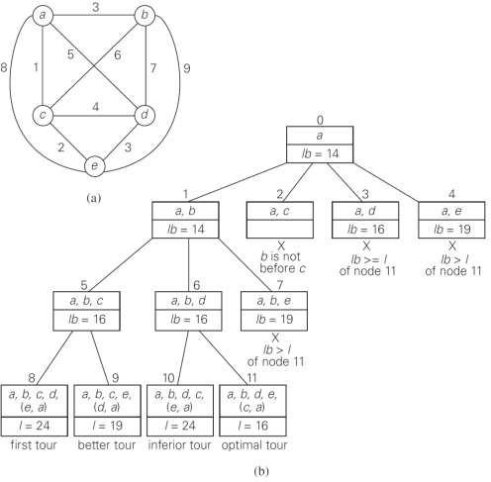

Slide 73
Applications of the TSP
Routing around Cities
Computer Wiring - connecting together computer components using minimum wire length
Archaeological Seriation - ordering sites in time
Genome Sequencing - arranging DNA fragments in
sequence
Job Sequencing - sequencing jobs in order to minimise total set-up time between jobs
Wallpapering to Minimise Waste
NB: First three applications generally symmetric
Last three asymmetric

Slide 74
Major Practical Extension of the TSP
Vehicle Routing - Meet customers demands within given time windows using lorries of limited capacity
10am-1pm
7am-8am
3am-5am
4pm-7pm
6pm-7pm
Depot
8am-10am
6am-9am
2pm-3pm
Much more difficult than TSP

Slide 75
On to Complexity theory!

Slide 76
Algorithms vs. Lower bounds
Algorithmic Theory
What we can compute
I can solve problem X with resources R
Proofs are almost always to give an algorithm that meets the resource bounds
Lower bounds
How do we show that something can’t be done?

Slide 77
The Universe
NP-Complete
NP
P

Slide 78
Polynomial Time
P: Class of problems that can be solved in polynomial time
Corresponds with problems that can be solved efficiently in practice
Right class to work with “theoretically”

Slide 79
What is NP?
Problems solvable in non-deterministic polynomial time . . .
Problems where “yes” instances have polynomial time checkable certificates

Slide 80
Certificate examples
Hamiltonian Circuit Problem
A cycle including all of the vertices
K-coloring a graph
Assignment of colors to the vertices

Slide 81
Polynomial time reductions
Y is Polynomial Time Reducible to X
Solve problem Y with a polynomial number of computation steps and a polynomial number of calls to a black box that solves X
Notations: Y <_{P} X

Slide 82
NP-Completeness
A problem X is NP-complete if
X is in NP
For every Y in NP, Y <_{P} X
X is a “hardest” problem in NP
If X is NP-Complete, Z is in NP and X <_{P} Z
Then Z is NP-Complete

Slide 83
The P versus NP problem (informally)
Can every problem whose solution can be quickly verified by a computer also be quickly solved by a computer?
Notes:
What do we mean by quickly here?

Slide 84
What is an efficient algorithm?
Is an O(n) algorithm efficient?
How about O(n log n)?
polynomial time
O(n^{c}) for some
constant c
O(n²) ?
O(n¹⁰) ?
O(n^{log n}) ?
non-polynomial
time
O(2^{n}) ?
O(n!) ?

Slide 85
The Class P (polynomial time)
Binary Search
Dijkstra’s Algorithm
Breadth-First Search
P
Sorting Algorithms
Notes:
the class of problems that can be solved and whose solutions can be verified in polynomial time

Slide 86
NP (Nondeterministic Polynomial Time)
Hamilton Cycle
NP
Sudoku
Binary Search
SAT
P
Dijkstra’s Algorithm
Breadth-First Search
…
Sorting Algorithms
…
Notes:
The class of all sets that can be verified in polynomial time (if solution is fast to verify, can try all solutions with nondeterministic paths).
It can be solved in polynomial time with a non-deterministic algorithm (deterministic algorithm can only follow one path when presented with a choice, non-deterministic can choose multiple paths)

Slide 87
The P versus NP problem
Is one of the biggest open problems in computer science (and mathematics) today
It’s currently unknown whether there exist polynomial time algorithms for NP-complete problems
We know P ⊆ NP, but does P = NP?
People generally believe P ≠ NP, but no proof yet
What do these NP problems look like?
Notes:
P is a problem that can be solved in polynomial time
NP is a problem that can be verified in polynomial time (non deterministic polynomial time)

Slide 88
The P versus NP problem (informally)
Can every problem whose solution can be verified in polynomial time by a computer also be solved in polynomial time by a computer?
Notes:
phrase a problem as a yes/no question
a problem is in NP if in polynomial time we can prove any yes instance is correct

Slide 89
To check if a problem is in NP
Phrase the problem as a yes/no question
If we can prove any yes instance is correct (in polynomial time), it is in NP
If we can also answer yes or no to the problem (in polynomial time) without being given a solution, it is in P
Notes:
frame as decision problems
with
Sets of solutions (yes instances)

Slide 90
The Class P
The class of all sets that can be verified in polynomial time.
AND
The class of all decision problems that can be decided in polynomial time.
Binary Search
Dijkstra’s Algorithm
Breadth-First Search
P
Sorting Algorithms

Slide 91
NP
The class of all sets that can be verified in polynomial time.
Hamilton Cycle
NP
Sudoku
Binary Search
SAT
P
Dijkstra’s Algorithm
Breadth-First Search
…
Sorting Algorithms
…

Slide 92
Hamilton Cycle
Given a graph G = (V,E), is there a cycle that visits all the nodes exactly once?
YES if G has a Hamilton cycle
NO if G has no Hamilton cycle
The Set “HAM”
HAM = { graph G | G has a Hamilton cycle }
Notes:
Does it have a cycle? is in NP
Prove it doesn’t have a cycle is not in NP
phrase a problem as a yes/no question
a problem is in NP if in polynomial time we can prove any yes instance is correct

Slide 93
Circuit-Satisfiability
Input: A circuit C with one output
Output:
YES if C is satisfiable
NO if C is not satisfiable
AND
NOT
The Set “SAT”
SAT = { all satisfiable circuits C }
AND
Notes:
Boolean satisfiability: problem of determining if there exists an interpretation that satisfies a boolean formula
can you give an input so the circuit evaluates to true
First problem shown to be NP-complete!
every problem in NP can be solved in polynomial time using a nondeterministic computer/Turing machine

Slide 94
Verifying Membership
Is there a short “proof” I can give you to verify that:
G ∈ HAM?
G ∈ Sudoku?
G ∈ SAT?
Yes: I can just give you the cycle, solution, circuit

Slide 95
The Class NP
The class of sets for which there exist “short” proofs of membership (of polynomial length) that can “quickly” verified (in polynomial time).
Recall: The algorithm doesn’t have to find the proof; it just needs to be able to verify that it is a “correct” proof.
Fact: P ⊆ NP

Slide 96
Summary: P versus NP
NP: “proof of membership” in a set can be verified in polynomial time.
P: in NP (membership verified in polynomial time)
AND membership in a set can be decided in polynomial time.
Fact: P ⊆ NP
Question: Does NP ⊆ P ?
i.e. Does P = NP?
People generally believe P ≠ NP, but no proof yet

Slide 97
Why Care?

Slide 98
NP Contains Lots of Problems We Don’t Know to be in P
Classroom Scheduling
Packing objects into bins
Scheduling jobs on machines
Finding cheap tours visiting a subset of cities
Finding good packet routings in networks
Decryption
…
OK, OK, I care...

Slide 99
How could we prove that NP = P?
We would have to show that every set in NP has a polynomial time algorithm…
How do I do that?
It may take a long time!
Also, what if I forgot one of the sets in NP?

Slide 100
How could we prove that NP = P?
We can describe just one problem L in NP, such that if this problem L is in P, then NP ⊆ P.
It is a problem that can capture all other problems in NP.
The “Hardest” Set in NP
We call these problems NP-complete
Notes:
every problem in NP is reducible to an NP-complete problem

Slide 101
Theorem [Cook/Levin]
SAT is one problem in NP, such that if we can show SAT is in P, then we have shown NP = P.
SAT is a problem in NP that can capture all other languages in NP.
We say SAT is NP-complete.

Slide 102

Poly-time reducible to each other
Answer
Takes polynomial time
Instance of problem Y
Map instance of Y into instance of X
Oracle for problem Y
Oracle for problem X
Answer
can be reduced (in polytime to)
an instance of
can be reduced (in polytime to)
an instance of
Any problem in NP
SAT
Sudoku
hence SAT is NP-complete
hence Sudoku is NP-complete

Slide 103
NP-complete: The “Hardest” problems in NP
Sudoku
Clique
SAT
Independent-Set
3-Colorability
HAM
These problems are all “polynomial-time equivalent”
i.e., each of these can be reduced to any of the others in polynomial time
If you get a polynomial-time algorithm for one, you get a polynomial-time algorithm for ALL.
(you get millions of dollars, you solve decryption, … etc.)

Slide 104
Sudoku
Input: n x n x n sudoku instance
Output:
YES if this sudoku has a solution
NO if it does not
The Set “SUDOKU”
SUDOKU = { All solvable sudoku instances }

Slide 105
Decision Problems
Theory developed in terms of yes/no problems
Independent set
Given a graph G and an integer K, does G have an independent set of size at least K
Vertex cover
Given a graph G and an integer K, does the graph have a vertex cover of size at most K.

Slide 109
Branch and Bound

