Slide 1




Optimizing Supply Chain Efficiency Using Data Analytics Excel | Python | SQL | Power BI Presentation by Abhijeet Singh Data Analyst Intern

Slide 2
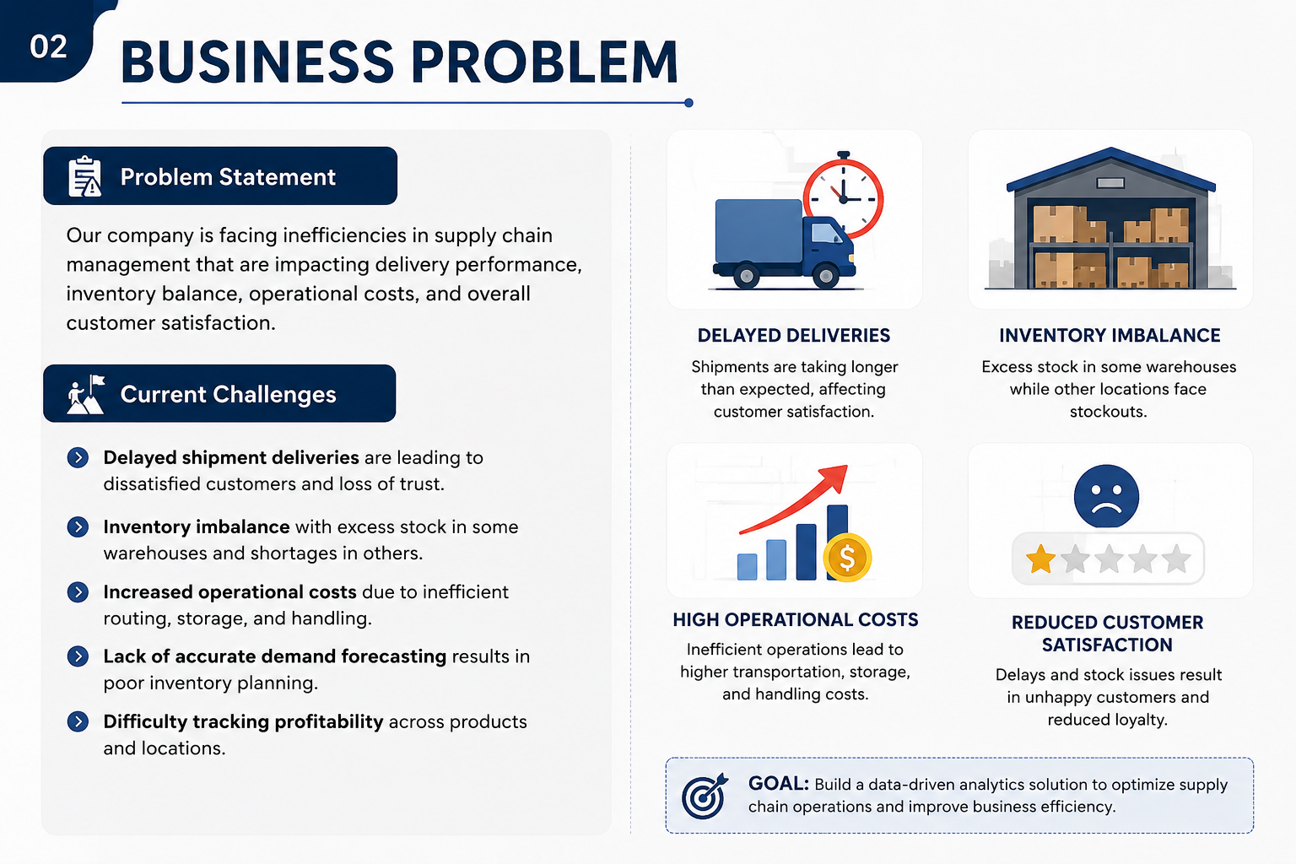
Project analysis slide 3
Business Problem
PROBLEM STATEMENT
Our company is experiencing inefficiencies in supply chain management, resulting in delayed deliveries, inventory imbalances (excess stock in some warehouses and shortages in others), higher operational costs, and reduced customer satisfaction.
DELAYED DELIVERIES
Shipments are talking longer than expected, affecting customer satisfaction
INVENTORY IMBALANCE
Excess stock in some warehouse while other locations face stockouts.
HIGH OPERATIONAL COSTS
Inefficient operations lead to higher transportation, storage, and handling costs.
REDUCED CUSTOMER SATISFACTION
Delays and stock issues result in unhappy customers and reduced loyalty.

Slide 3




Project analysis slide 3
Project Objective
MINIMIZE DELIVERY
DEALAYS
Identify warehouse with prolonged shipping times and optimize delivery routes.
Analyze warehouse delivery performance.
Identify shipment bottlenecks.
Improve route efficiency.
ENHANCE INVENTORY MANAGEMENT
Balance inventory levels across warehouses based on demand trends and stock availability.
Reduce overstock and stock shortages.
Improve inventory visibility.
Maintain optimal stock levels.
IMPROVE DEMAND FORECASTING
Use historical sales and demand data to predict future demand accurately.
Analyze demand patterns.
Forecast future inventory needs.
Support better planning decisions
MAXIMIZE PROFIT MARGIN
Analyze product and location-based profitability to improve revenue generation.
Identify high-profit products.
Evaluate regional profitability.
Optimize operational efficiency.
OVERALL
GOAL
Develop a data-driven analytics solution to optimize delivery performance, balance inventory, forecast demand accuracy and maximize probability.

Slide 4



Project analysis slide 3
Tools and Technologies Used
Python
EDA, Data Transformation, Feature Engineering
SQL
Data Analysis and Querying
Power BI
Data Visualization & Dashboarding which provides real-time insights and help stakeholders make data-driven decision
Excel/ CSV
Raw Data Source that serves as the primary data source for analysis and reporting.

Slide 5
Project analysis slide 3
Key Insights
Delivery Delays
Delayed deliveries account for 50.40% of total shipments, indicating significant inefficiencies in the current supply chain and delivery process.
Inventory Imbalance
Some warehouses had excess inventory while others frequently faced stock shortages.
Warehouse Performance
Certain warehouses showed low sales performance along with excess inventory levels.
Insight: Out of 1.36M total stock, 45.39% of the total stock is excess inventory, causing inventory imbalance and higher storage costs.
Insight: Indicates the need for better demand forecasting, stock redistribution, and operational optimization.
Insight: Atlanta region warehouses show the highest delays
Profitability
Profitability varies as product and region.
Demand Patterns
Demand varied significantly across products and regions for the given month.
Customer Satisfaction
Delays in stock unavailability are the top reason for low customer satisfaction.
Insight: Apparel category recorded the highest sales and demand, indicating strong customer preference and revenue contribution.
Insight: Focus on high-margin products and high-performing regions.
Insight: Improve inventory availability and delivery reliability.

Slide 6
Project analysis slide 3
Business Impact
Improved Delivery Performance
Identified delivery delay bottlenecks and delay-prone warehouses, then optimized delivery routes to improve operational efficiency and reduce delays.
Optimized Inventory Management
Optimized inventory management by balancing stock across warehouses using demand forecasting with a 20% safety buffer.
Cost Reduction
Implemented a cost optimization strategy by reducing operational expenses through efficient workforce and resource allocation.
Impact: Increased on time delivery rate by 15%, leading to higher customer satisfaction
Impact: helping reduce excess inventory and stock shortages.
Impact: Reduced total costs by $1.37M.
Increased Profitability
Identified high-profit product and warehouses, focusing on profitable areas and optimizing operations.
Better Demand Forecasting
Improved demand prediction using trends and enabled proactive planning and better allocation of resources.
Enhanced Customer Satisfaction
Faster deliveries and better product availability
Impact: This optimization Increased profit margin from 75.30% to 76.33%
Impact: Reallocated employees based on sales performance and operational efficiency.
Impact: Stronger customer relationships and brand loyalty.

Slide 7
Thank You

