Slide 1
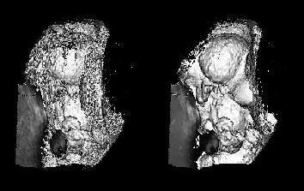
Pectoral muscle segmentation on digital mammograms by Non Linear Diffusion Filtering
Authors
H.MIRZAALIAN, M.R. AHMADZADEH, S. SADRI
Published : 2007 IEEE Pacific Rim Conference on Communications, Computers and Signal Processing |Date: 22-24 Aug.2007|Page no.: 581-584
Presented by:
Abhijeet Singh
1301CH01
Aman Prakash Singh
1301EE02
1

Slide 2
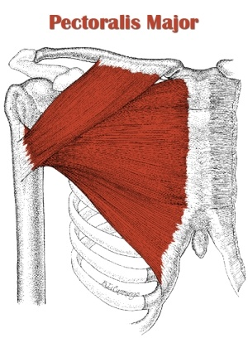
Mammograms and Pectoral Muscles
X ray picture of breast
It is used to check for breast cancer in women who have no signs or symptoms of the disease
Pectoral Muscle is the largest Muscle in the human chest region
The author used MLO ( Medio Lateral Oblique) views of the mammograms
2

Slide 3
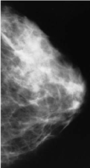
Why Pectoral Muscle Segmentation
The pectoral muscle represents a predominant density region in the most Medio-Lateral Oblique (MLO) views of mammograms
It can affect the results of the image processing of the digital mammograms
Existence of the pectoral muscle in the image data being processed may bias the detection procedures
3

Slide 4
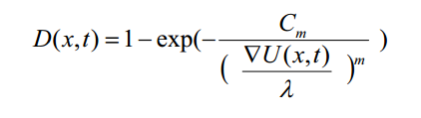
Non Linear Diffusion filters
De-noising by low-pass filtering not only reduces the noise but also blurs import edges
On the contrary nonlinear diffusion is smoother which is an edge preserving
The Diffusion function used by the author in this paper is
4

Slide 5
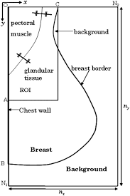
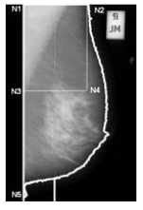
Areas of Focus in Segmentation
5

Slide 6


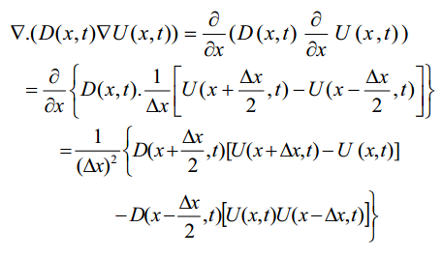

Mathematics of Non Linear Diffusion Filters
To implement it computer program , discritizing the LHS and RHS
6

Slide 7
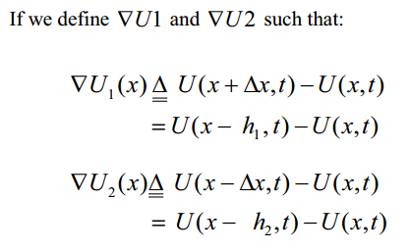
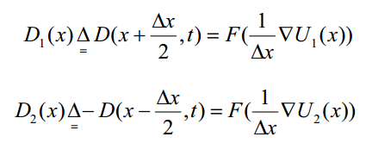
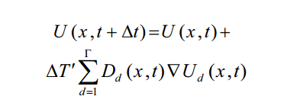
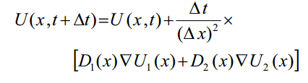
Mathematics of Non Linear Diffusion Filters
7

Slide 8
Implementation
U=ROI;
t=0 ;
y(t)=U;
Iteration=30;
Convolve y(t)with Gaussian Filter with sigma=1
y(t)=conv2(y(t).gauss);
Calculate gradient of y(t)
g=gradient (y(t));
Diffusion function
d(g)=1-exp(-Cm/(g/k)^m),
The constant Cm is calculated to make the flux(g*d(g)))ascending for g<k and descending for g>=k
Final contour
dy/dt=div(d(g),g);
Y(t+1)=y(t)+200*dy/dt
t=t+1
Thresholding Image
With
T=0.6
t<Iteration
8

Slide 9
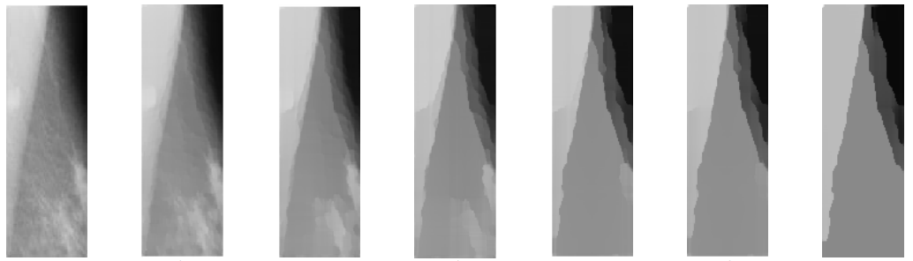
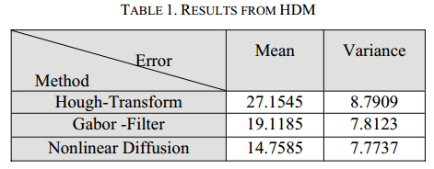
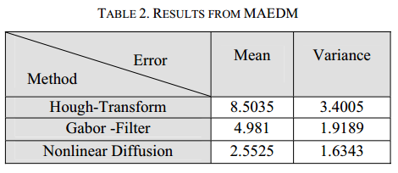
Results and Conclusions
9

Slide 10
Thank You
10

