Slide 1
ShopSphere E-commerce Analysis
By Abhijeet Singh Parihar

Slide 2
Business Problem
ShopSphere is a fictional e-commerce and retail company that sells a variety of products to customers across different regions. The company has sales data covering customers, products, orders, sales, discounts and profit.
The business needs a clearer view of its sales and profit performance to identify problem areas and opportunities for improvement.

Slide 3


Scope & Objective
Understand overall sales and profitability performance.
Identify important patterns across products, categories, customers and regions.
Find areas for improvement and provide practical recommendations.
Sales and profit analysis
Customer and product performance
Category and regional performance
Discount and shipping analysis

Slide 4

Data & Tools
Dataset: Historical e-commerce sales data
Orders, customers, products, sales, quantity, discount, profit, shipping and regional information
Excel- Data Cleaning and Prepartion
MySQL: SQL analysis
Tableau: Dashboards and data visualization
Microsoft Word: Project documentation
Microsoft PowerPoint : Project presentation
GitHub: Project portfolio and file storage

Slide 5
KEY Performance Indicator
Total Sales | 2,297,201.07
Total Orders | 9,994
Total Distinct Orders | 5,009
Total Customers | 793
Total Units Sold | 37,873
Total Profit | 286,397.79
Profit Margin | 12.47%
Average Order Value | 458.61

Slide 6
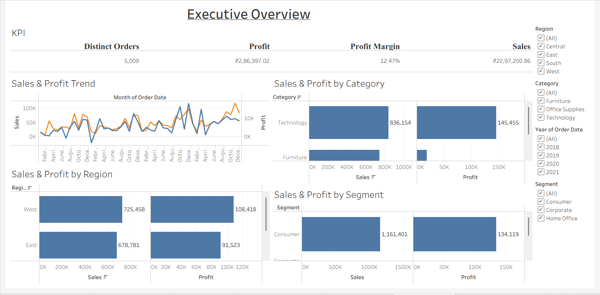
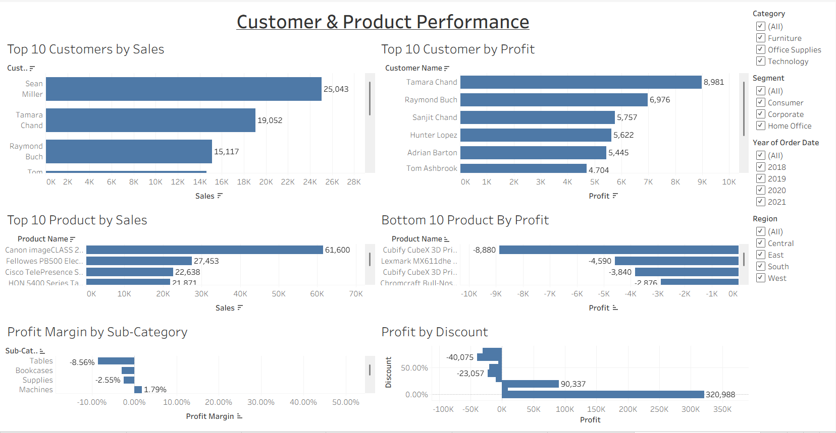
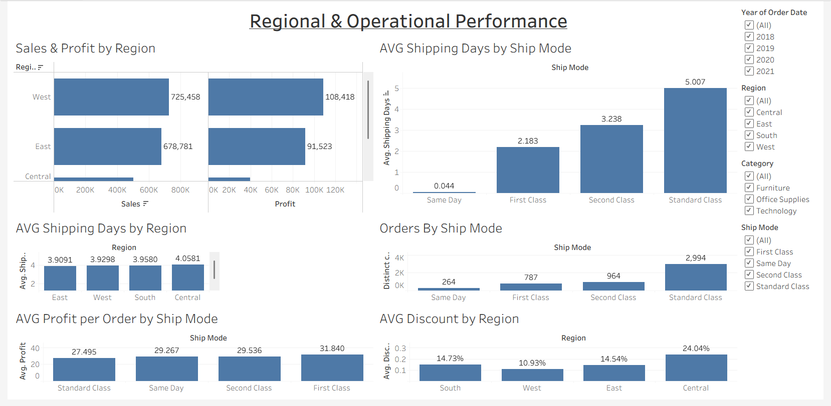
Dashboard

Slide 7
KEY Findings
Furniture has the weakest profitability — profit margin of 2.49%.
Central region has the lowest profit margin — 7.92%.
Standard Class has the longest average shipping time — about 5 days.
Some products generate significant losses, including the Cubify CubeX 3D Printer.
Tables, Bookcases and Supplies have negative profit margins.
Higher discounts are linked with lower profitability, with several high-discount levels producing losses.

Slide 8
Recommendations
Review pricing and discounts for low-margin categories, especially Furniture.
Investigate the reasons for weak profitability in the Central region.
Review consistently loss-making products and sub-categories.
Improve control over high discount levels.
Look for ways to improve Standard Class delivery efficiency.

Slide 9
Conclusion
The analysis showed that ShopSphere has strong overall sales, but profitability varies across products, categories, regions and discount levels. The findings highlight several areas where the business can focus on improving profitability and performance.

Slide 10
THANK YOU

