Slide 1
Employee Attrition Insights
HR Employee Attrition Analysis and Power BI Dashboard
Built with: Python (Pandas, NumPy), EDA | SQL | Power BI (DAX)

Slide 2
Project Objectives
1
Find out why employees leave the company and measure the attrition rate
2
Compare employees who left with those who stayed across demographics, pay, career stage and work conditions
3
Identify the key drivers and the highest-risk employee groups
4
Build an interactive Power BI dashboard for HR to track attrition
5
Recommend practical actions to improve retention

Slide 3
Dataset Overview
1,470
35
16.1%
Employees
Columns
Attrition rate (237 left)
What the data contains
Preparation
HR Analytics dataset
Personal: age, gender, marital status, education
Job: department, role, level, overtime, travel
Pay: income, salary hike, stock options
Experience, tenure and satisfaction scores
Target column: Attrition (Yes / No)
Dropped 4 constant or ID columns
Split into 17 categorical and 14 continuous columns
No missing values found

Slide 4
Tools Used
Python
SQL
Power BI (DAX)
Pandas and NumPy for cleaning and analysis; EDA with univariate and bivariate analysis; Matplotlib and Seaborn for charts
Querying and summarising the data; attrition counts and rates by department, job role and other segments
DAX measures such as Attrition Rate % and High Risk Active; 4-page interactive dashboard with slicers

Slide 5
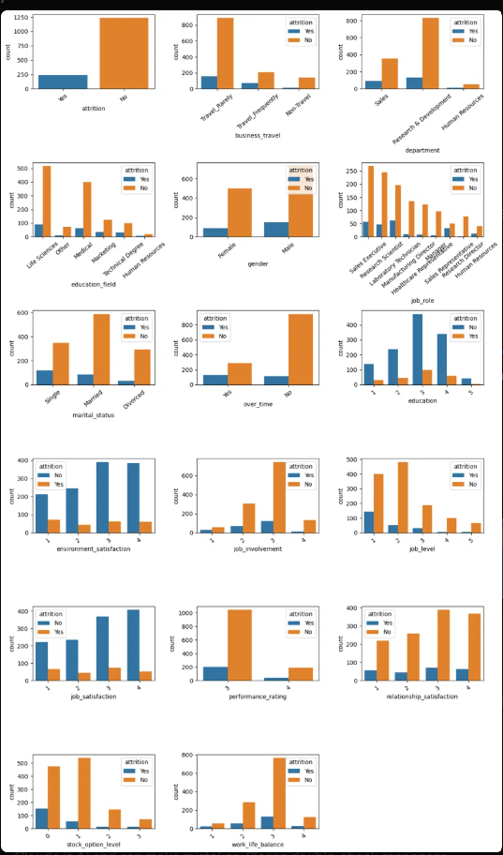
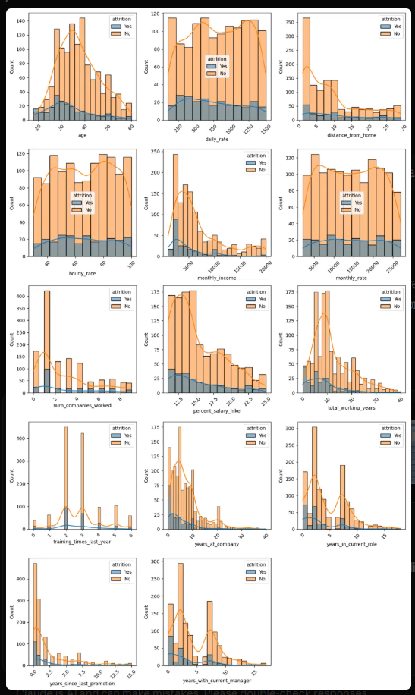
Exploratory Data Analysis (Python)
Countplots for categorical columns, histograms for continuous columns, split by Attrition
Compared attrition rates, not just counts, because larger groups always show more leavers
Chi-square and Mann-Whitney tests checked which columns really relate to attrition
Little or no link: gender, performance rating, hourly and monthly rate
Categorical columns
Continuous columns

Slide 6
Key Insights and Findings
30.5% vs 10.4%
36.4%
Overtime is the biggest driver
People leave early
Overtime staff leave 3 times as often. They are 28% of employees but 54% of all leavers.
Under 1 year at the company: 36.4%. Under 5 years of experience: 32.9%. It falls to about 7% at 20 to 30 years.
28.6%
39.8%
Low pay and low job level
Sales Representatives are the hot spot
Income up to 3,000 a month: 28.6% (5.6% above 12,000). Job level 1 accounts for 143 of 237 leavers.
Highest job role. Sales is also the highest department at 20.6%.

Slide 7
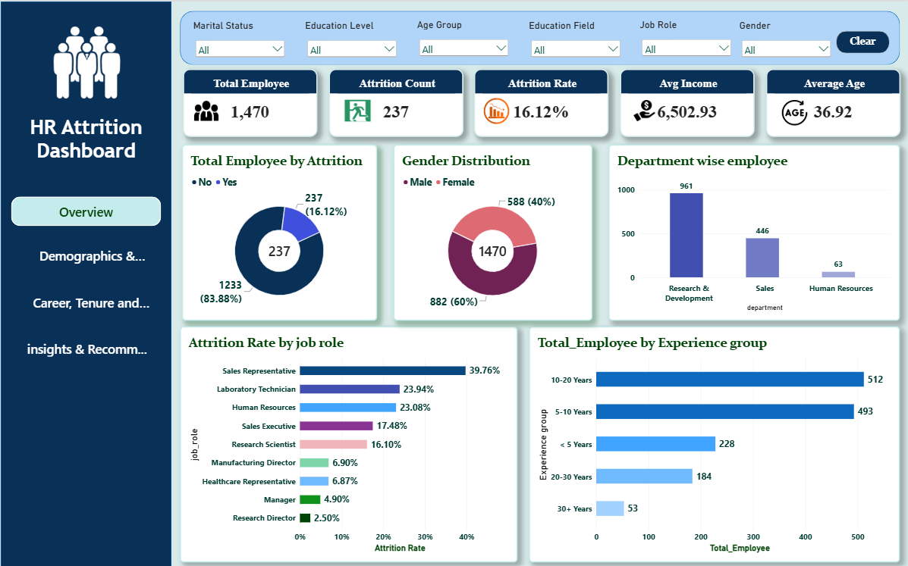
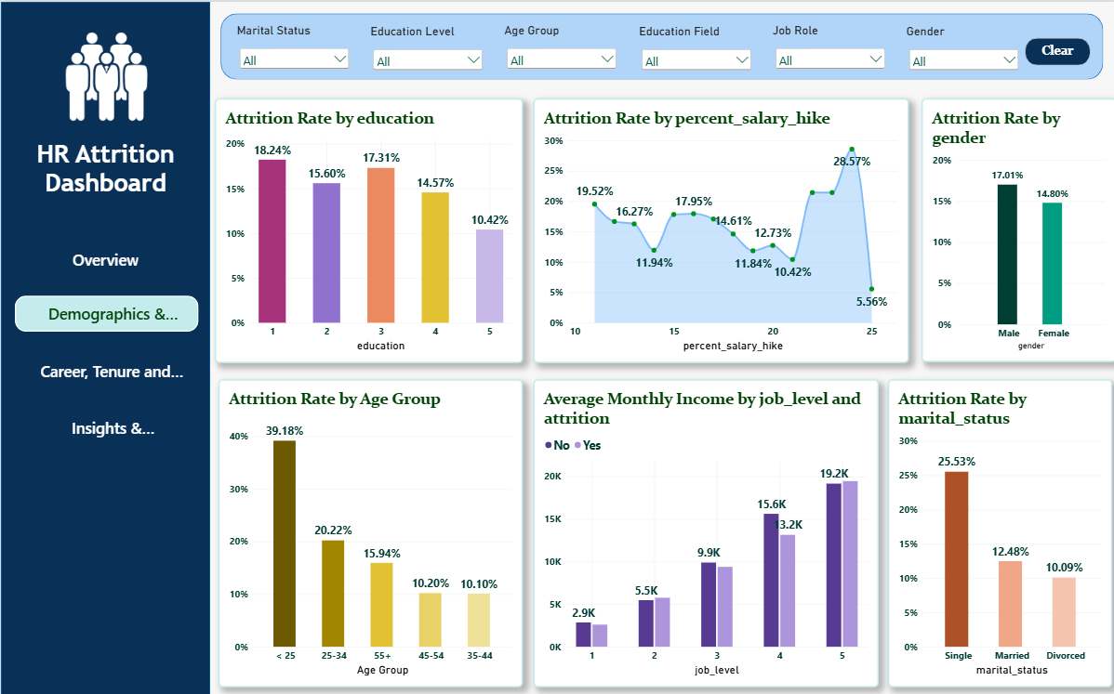
Dashboard Visuals: Overview and Demographics
Page 1: Overview
Page 2: Demographics and Compensation
1,470 employees, 237 left (16.12%). Sales Representative has the highest job-role attrition at 39.76%.
Attrition is highest under age 25 (39.18%) and for single employees (25.53%). Gender makes little difference.

Slide 8
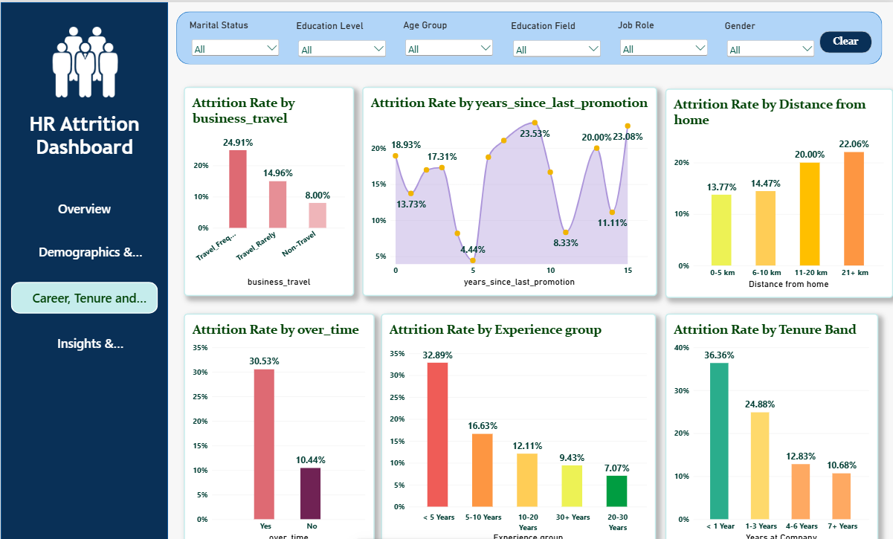
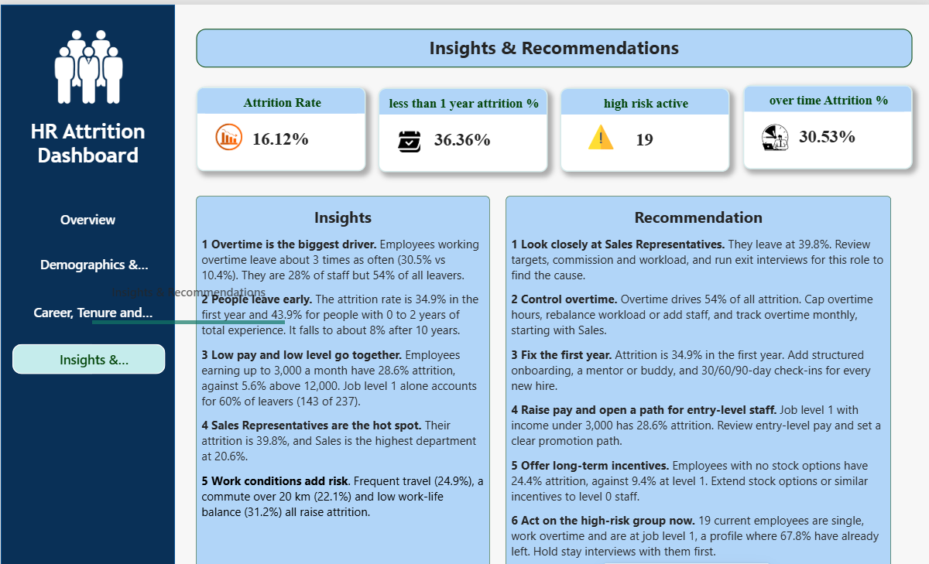
Dashboard Visuals: Career and Insights
Page 3: Career, Tenure and Work Environment
Page 4: Insights and Recommendations
Overtime (30.53%), frequent travel (24.91%) and the first year (36.36%) show the highest attrition.
KPI cards, key insights and actions in one place, with 19 high-risk employees still active.

Slide 9
Final Recommendations
Control overtime
Fix the first year
1
2
Cap hours, rebalance workload and track it monthly, starting with Sales.
Structured onboarding, a mentor and 30/60/90-day check-ins for new hires.
Raise entry-level pay
Review Sales Representative roles
3
4
Review job level 1 pay (under 3,000) and set a clear promotion path.
Check targets, commission and workload; run exit interviews.
Offer long-term incentives
Act on the high-risk group
5
6
Extend stock options to level 0 staff (24.4% attrition vs 9.4% at level 1).
19 current employees are single, on overtime and at job level 1. Hold stay interviews now.

