Slide 1
Business Analyst Case Study Analysis
Prepared By: Abhijeet Kedar

Slide 2
Project Overview
Objective: Analyze sales and glance data to identify insights and opportunities.
Sales Records: 41,115
Glance Records: 40,745
SKUs: 465
Categories: 10
Subcategories: 24

Slide 3
Question 1 – Most Expensive SKU
SKU: C03CBL[721
Average ASP: 973.93
Revenue: 575,044.59
Units Sold: 501
Highest ASP observed.

Slide 4
Question 2 – SKU Performance
Revenue-generating SKUs: 365
Revenue-generating rate: 78.49%
Stopped-selling analysis completed.

Slide 5
Question 3 & 4 – Sale Event Analysis
Sale Event Dates: 15-Jul-2019 and 16-Jul-2019
Revenue spikes observed.
No strong evidence of severe post-event cannibalization.

Slide 6
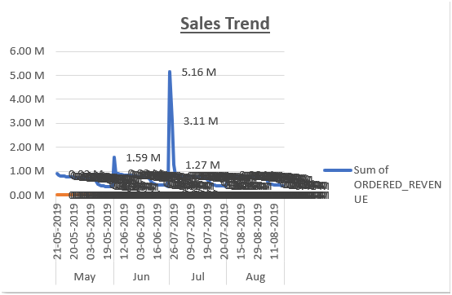

Slide 7
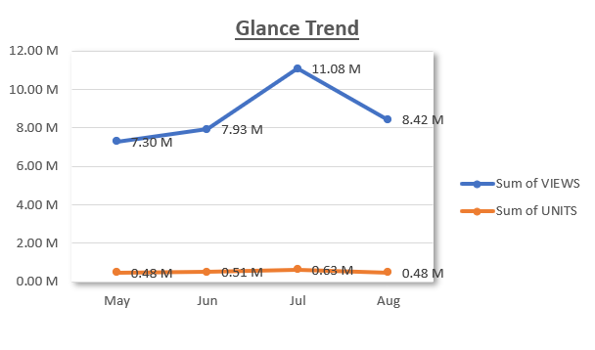

Slide 8
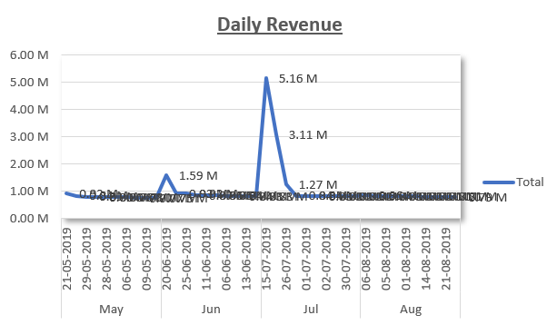

Slide 9
Question 5 – Category Growth
Most Concerning Subcategory: Keyboards - DELETED
Category Growth: 64.30%
Subcategory Growth: -99.20%

Slide 10
Question 6 – Data Quality Issues
Zero-unit records
Discontinued or Inactive Subcategories
Presence of "DELETED" in Product Hierarchy
Difference Between Sales and Glance Records
Unusually High Growth Rates

Slide 11
Question 7 – ASP vs Conversion
SKU: C120[H:8NV
Correlation: 0.006345
No meaningful relationship between ASP and conversion.

Slide 12
Business Recommendations
Investigate underperforming subcategories
Improve data quality controls
Monitor sale events
Focus on demand drivers beyond pricing

Slide 13
Executive Summary
Sale event identified.
No significant cannibalization.
Keyboards - DELETED requires attention.
ASP had negligible impact on conversion.

Slide 14
Thank You
Prepared By: Abhijeet Kedar

