Slide 1
PROJECT:
Movie Ticket Management System
NAME=ABHIJEET PANWAR
SAP ID= 590026303
SUBJECT=PROGRAMMING IN C (PROJECT)

Slide 2
Purpose of the Project
- To create a menu-driven movie ticket booking system.
- To demonstrate the use of structures, file handling, and functions.
- To provide a real-world simulation of ticket booking.
Constraints
- Only one movie record displayed at a time.
- Limited number of tickets.
- Input validation required.
- Basic text-based interface (CLI).

Slide 3
Introduction
This project is a simple Movie Ticket Management System developed using C programming. It allows users to book movie tickets, view movie details, and manage ticket information.

Slide 4
Syntax Concepts Used
- Structures (struct)
- File handling (fopen, fwrite, fread)
- Functions
- Conditional statements
- Switch-case menu
- Loops (for, while)

Slide 5
Keywords Used
struct, FILE, fopen, fclose, fwrite, fread, if, else, switch,
case, return, char, int, void

Slide 6
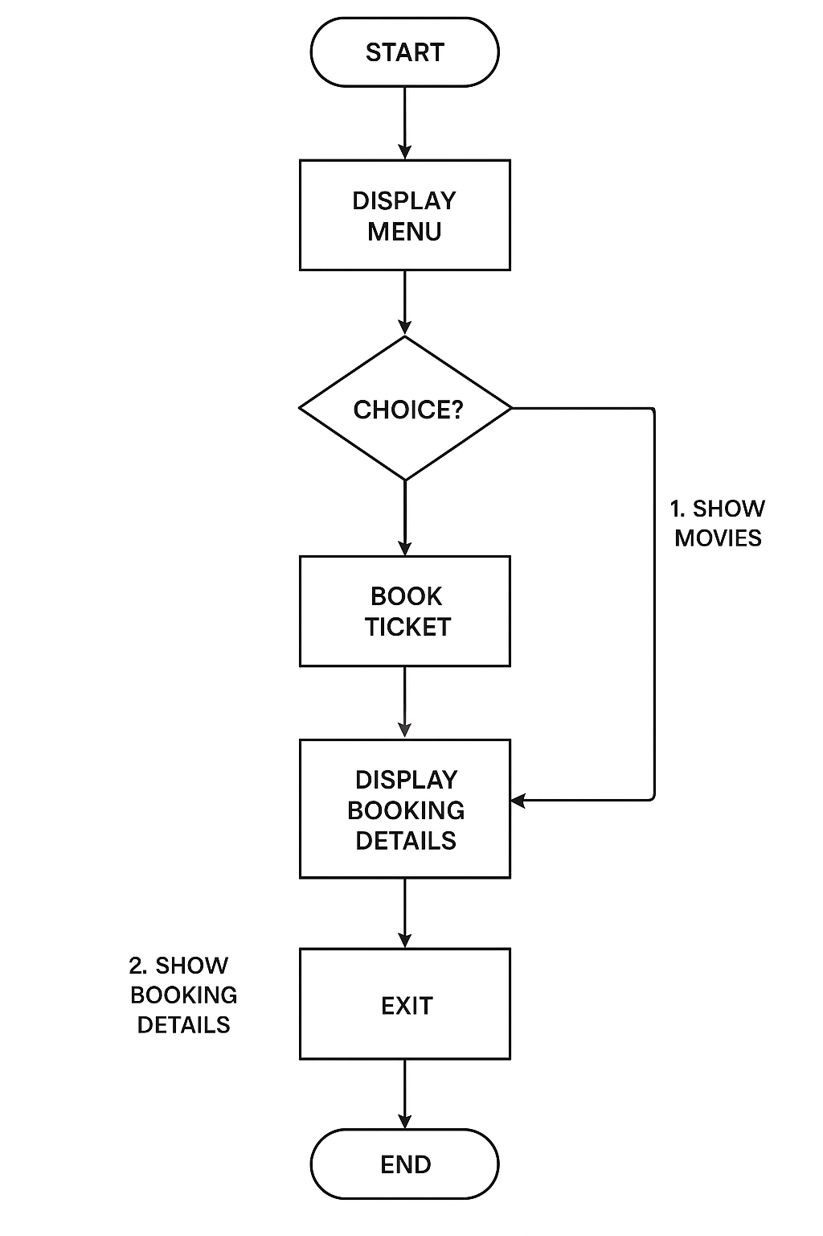
Flowchart:

Slide 7
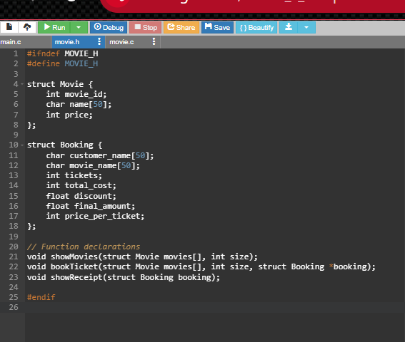
PROGRAM: (header file)

Slide 8
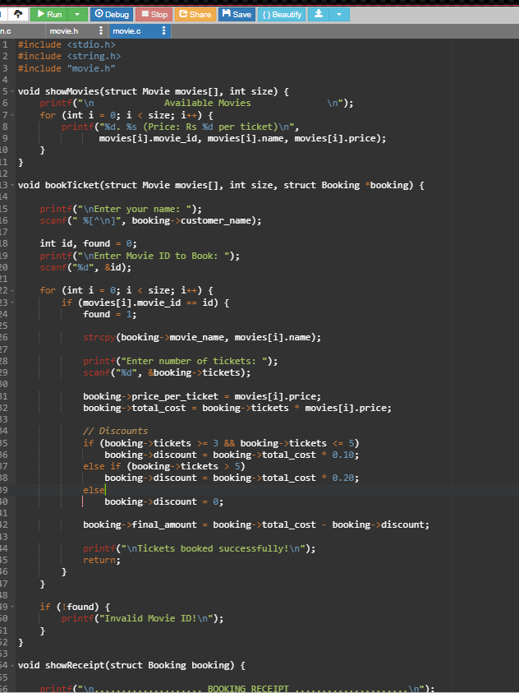
(function file):

Slide 9
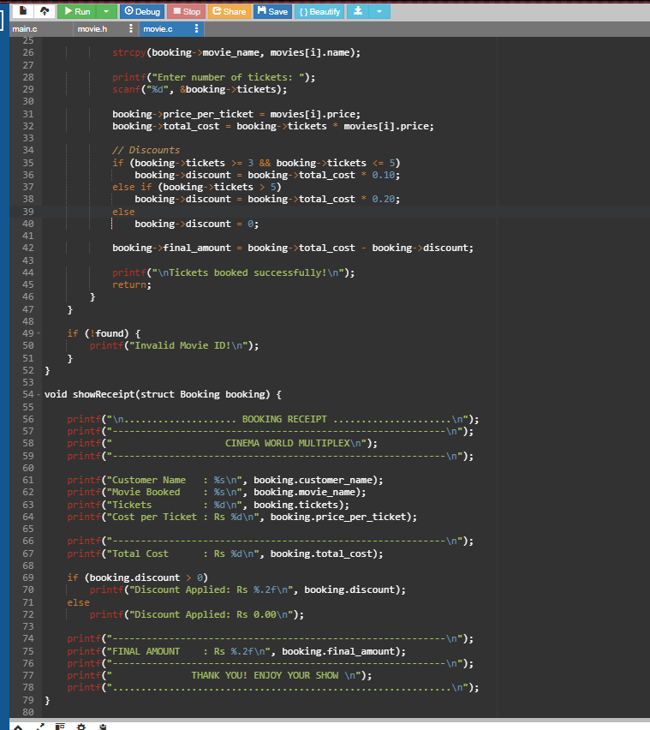

Slide 10
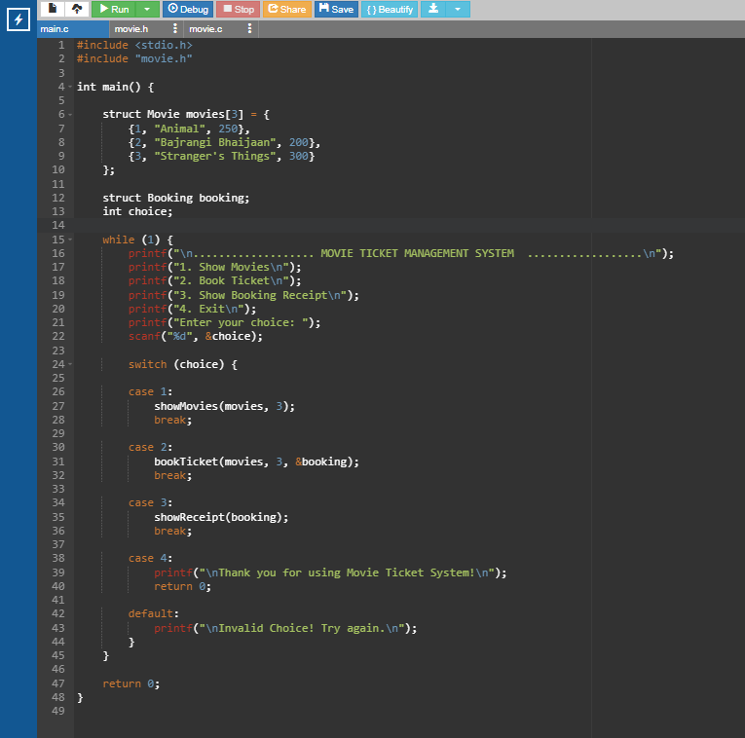
(main file):

Slide 11
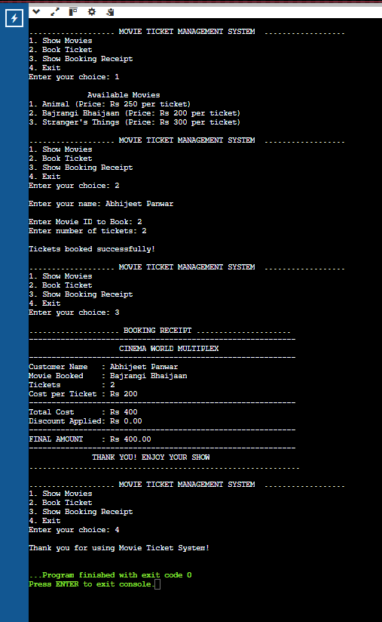
OUTPUT:

Slide 12
Conclusion
This project demonstrates a basic implementation of a Movie Ticket Management System. It shows the use of file handling, structures, user-defined functions, and menu-driven programming.

