Slide 1
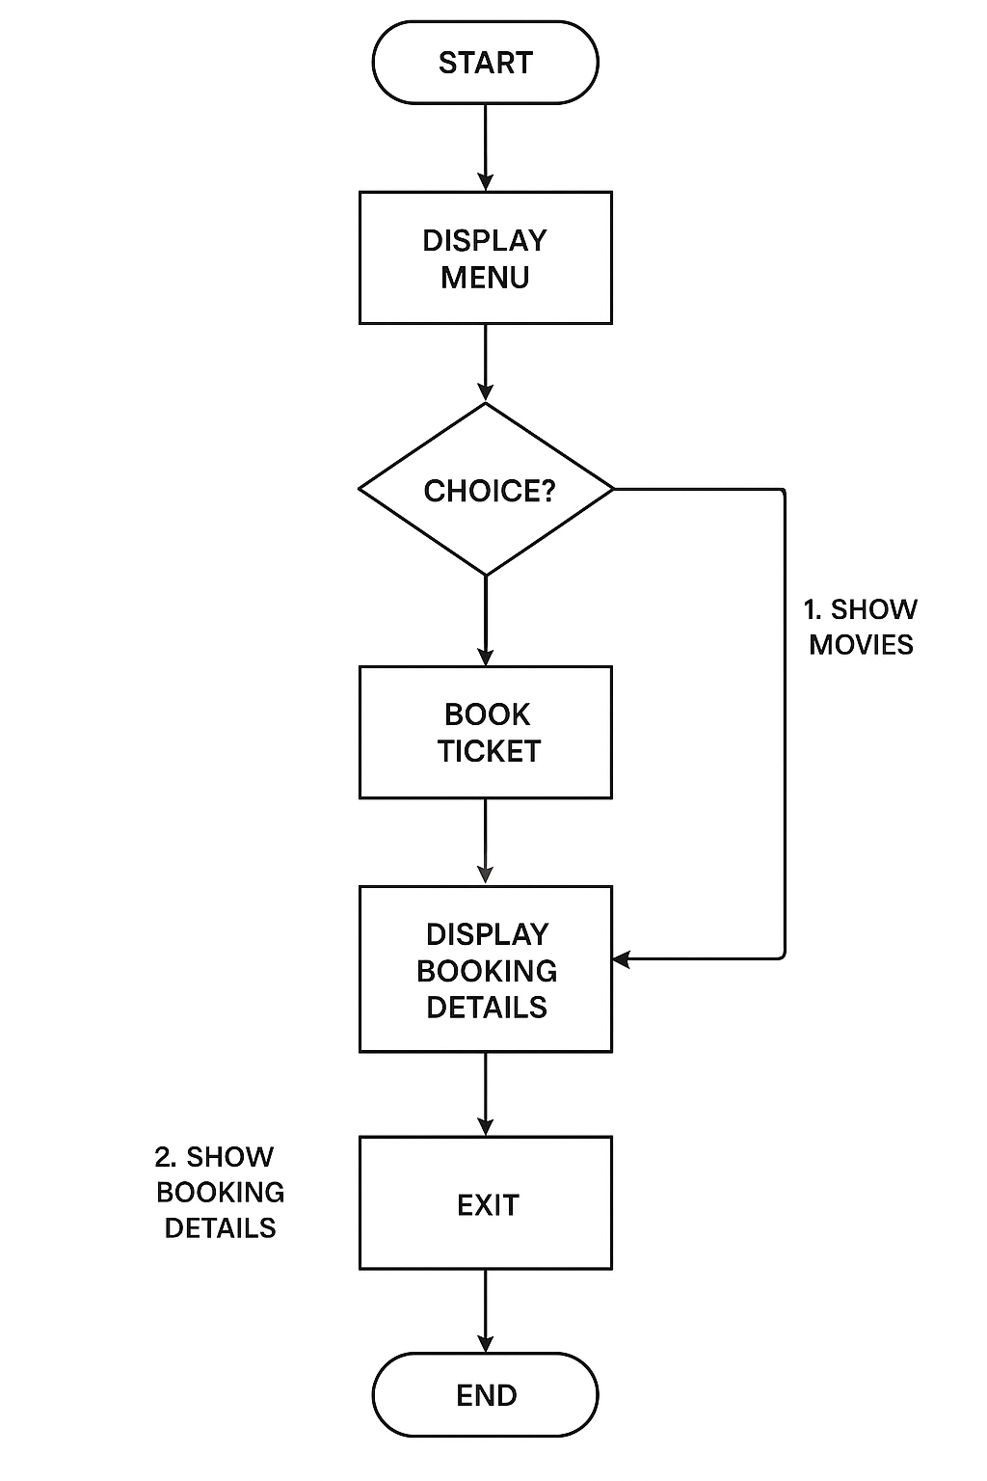
FLOWCHART:

