Slide 1
Retail Sales Analysis Project
By Abhijeet Suryawanshi
Tool Used: MySQL

Slide 2
Project Overview
Goal: Analyze retail sales data to generate actionable business insights
Data Source: Store-level transactional data
Tool Used: MySQL for data analysis
Output: Insights + Dashboard (in progress)

Slide 3
Business Questions Answered
1. What is the total sales, cost, and profit?
2. Which month had the highest sales?
3. Which product category generated the most revenue?
4. Which gender contributed more to total sales?
5. What is the average purchase amount by age group?
6. What are the top hours for sales?
7. Which day of the week has the highest sales?
8. Which age group spent the most overall?

Slide 4
Total Sales & Profit
Total Sales: ₹908,230
Total Cost: ₹189,114
Total Profit: ₹719,116
Profit Margin: 79.18%

Slide 5
Top Performing Months
1. December 2022 - ₹71,880
2. April 2022 - ₹28,535
3. August 2022 - ₹21,075
4. January 2022 - ₹22,635
5. February 2022 - ₹16,110

Slide 6
Top Product Category
Electronics had the highest sales
Total Sales from Electronics: ₹311,445

Slide 7
Sales by Gender
Female customers contributed the most to sales
Total Sales by Female: ₹463,110

Slide 8
Average Purchase by Age
Younger age groups (18-30) show lower average purchase amounts
Higher purchase averages seen in age 35+
Custom age group insights show age 46+ are top spenders

Slide 9
Top Hours for Orders
Most orders placed at:
7 PM - 232 orders
5 PM - 213 orders
8 PM - 211 orders
6 PM - 206 orders

Slide 10
Sales by Day of Week
Sunday: ₹152,800
Monday: ₹147,575
Saturday: ₹141,400
Thursday: ₹122,585
Friday: ₹120,605

Slide 11
Top Spending Age Group
Age Group 46+ had the highest overall spend
Total Sales by 46+: ₹358,735

Slide 12
Key Insights Summary
High profit margin (79%) indicates good cost management
Electronics is the most profitable category
Female customers and 46+ age group are top buyers
Sales peak during evenings and weekends

Slide 13
Next Steps
Develop interactive dashboard to visualize insights
Explore customer segmentation (e.g., RFM analysis)
Trend analysis for future predictions
Include AI visuals in Power BI (future upgrade)

Slide 14
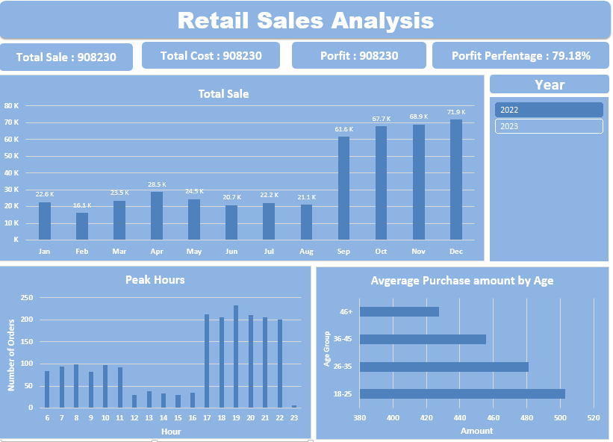

Slide 15
Thank You!
Abhijeet Suryawanshi
Retail Sales Analysis | MySQL

