Slide 1
New Features of Angular 18
By Manoj Kumar

Slide 2
What are Signals
Signals are a reactive data model that provides a simple way to manage and track changes in state within an application. A Signal in Angular is a variable whose value can change over time and any change to this value will automatically propagate to the parts of the application that depend on it.

Slide 3
Key Concept
Signals: A reactive primitive that holds a value and notifies subscribers when the value changes.
Effects: Functions that automatically re-run when the signals they depend on change effects can be used to trigger side effects based on signal changes.
Signal Equality Functions: These are functions that compare the new values of a signal to its previous value to determine whether an update should trigger a re-run or effects or re-rendering.
Effect Cleanup Functions: Functions that are called to clean up any side effects or resources when an effect re-runs or when the component is destroyed.

Slide 4
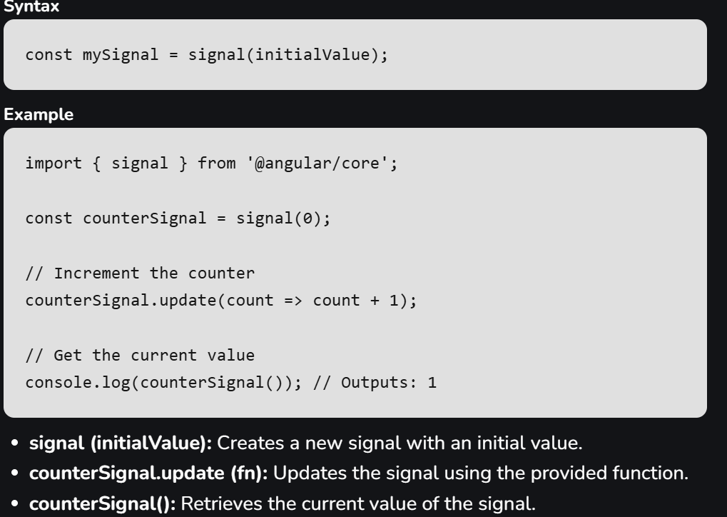
Creating Signals using the signal function
Notes:
The signal function is used to create a reactive data source. This data source can be used in templates or component logic and It automatically updates whenever the signals value changes.

Slide 5
Computed Signals
The computed function is used to create a signal that delivers its value other signals and It automatically recalculates whenever any of the dependent signals change.

Slide 6
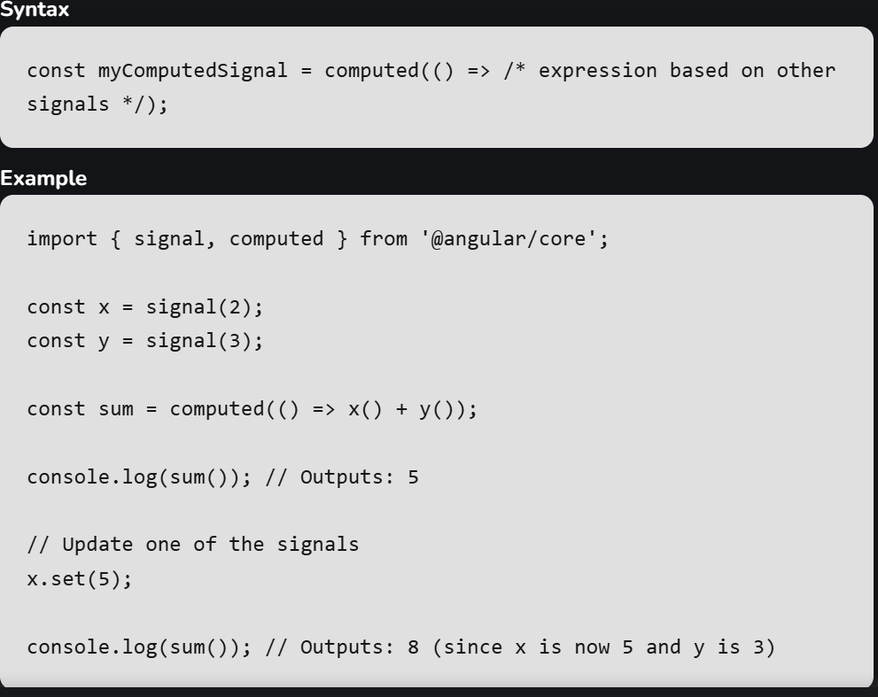

Slide 7
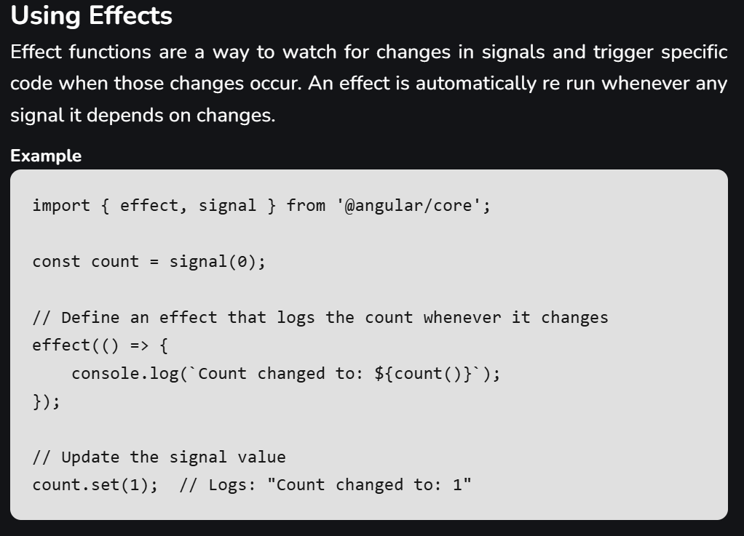

Slide 8
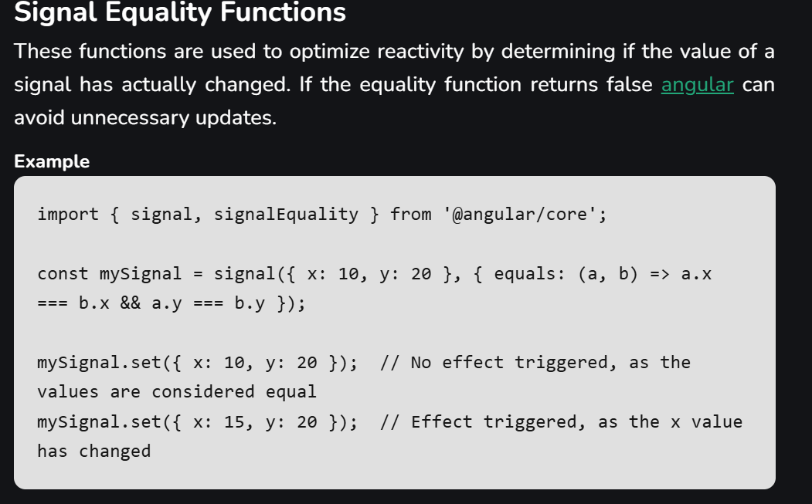

Slide 9
Effect Cleanup Functions
When an effect function is re run due to a change in one of its signals a cleanup function can be used to clean up resources or side effects from the previous run before the new effect is executed.

Slide 10
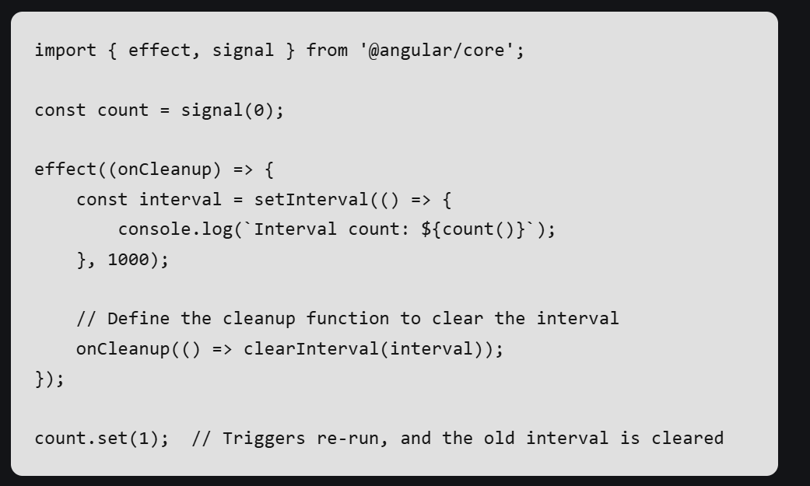

Slide 11
1. Zoneless Change Detection with Signals
One of the most significant changes in Angular 18 feature contains introduction of zoneless change detection with signals. Previously, Angular relied on Zone.js for change detection, which could introduce overhead and complexity. Zoneless change detection offers a more lightweight and efficient approach, potentially leading to performance improvements in your applications.
Zoneless Setup: Traditionally, Angular uses Zone.js to track asynchronous operations and trigger change detection. With the zoneless setup, Angular handles state changes and UI updates directly through signals, bypassing the need for Zone.js

Slide 12
Example :
import { Component, signal } from '@angular/core';
@Component({
selector: 'app-counter',
template: `
<button (click)="increment()">Increment</button>
<p>Counter: {{ counter() }}</p>
`,
})
export class CounterComponent {
counter = signal(0);
increment() {
this.counter.update(value => value + 1);
}
}

Slide 13
2. Observable Router and Redirects
Angular 18 presents multiple new elements and upgrades, one of which is the "Observable Router and Redirects." This feature builds upon Angular's extant routing skills, offering more flexibility and control over navigation within Angular applications.
Observable Router
The Observable Router feature introduces the thought of observables into Angular's router events. In earlier versions of Angular, router events were released as easy events that components could subscribe to using event handlers. With Angular 18, these events are now observable streams, permitting developers to control the full power of RxJS observables for more complex handling of routing events.

Slide 14
Redirects Using Observables
Angular 18 also enriches the redirect utility by constructing it observable-based. Redirects are normally used to navigate users from one route to another based on exact conditions or events. With Observable Redirects, developers can now return an observable from a route guard or resolver to dynamically resolve the target route or delay the navigation up to definite terms are accomplished.

Slide 15
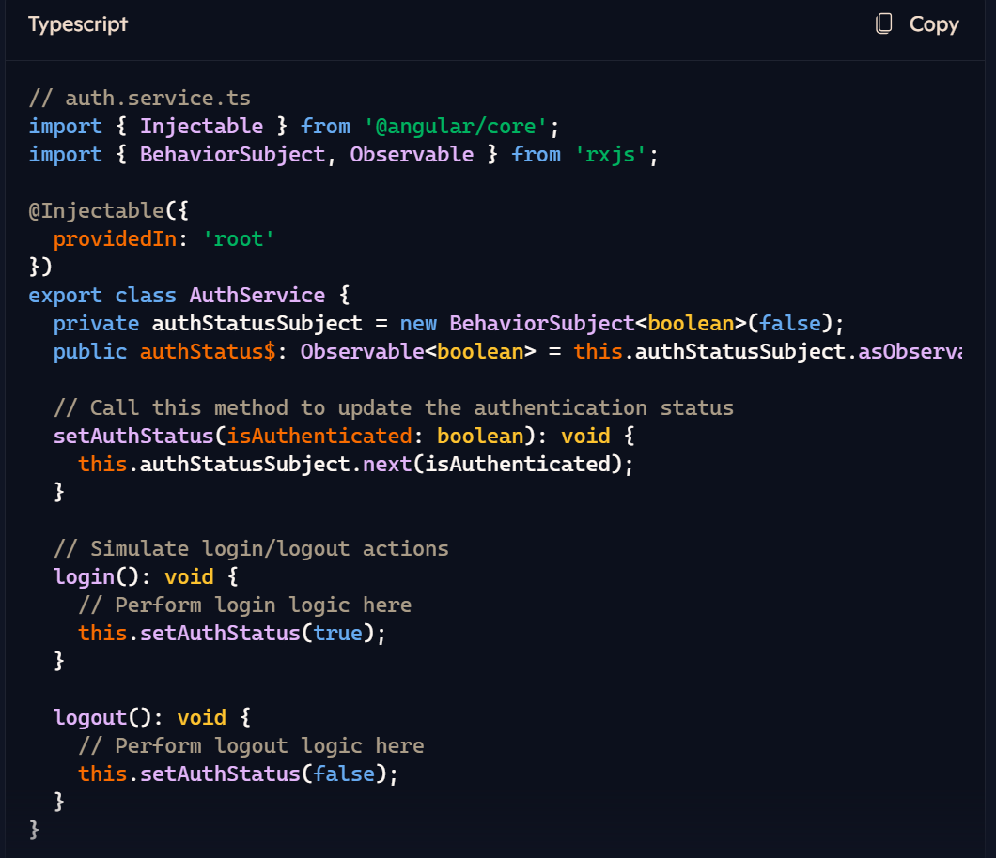

Slide 16
3. Improved Developer Tooling
This Angular 18 feature brings enhancements to the developer experience through improved tooling. The Angular DevTools extension now offers better insights into application performance, dependency management, and state changes. This can significantly aid developers in debugging and optimizing their applications.
Enhanced Developer Tools: Angular DevTools now provides better insights into application performance, dependency management, and state changes. This helps developers identify and address issues more efficiently.
Improved CLI Integration: The Angular CLI has been updated to support standalone components fully. This enables seamless scaffolding, testing, and deployment workflows.
Control Flow Syntax: The new control flow syntax integrates directly into Angular’s template compiler, simplifying template management. This reduces the need for traditional structure directives like ngIf, ngFor, ngSwitch.

Slide 17
Fallback for ng-content Forms Events
In Angular, the directive is used to embed content from a parent component into a child component. This is called as content projection.
The new feature "Fallback Content for ng-content" in Angular 18 boosts this by providing you to clarify default content that will be shown if no content is passed from the parent component. This means that although the parent component does not present any content, the child component will still show some predefined content, confirming it ever looks good and works well.

Slide 18
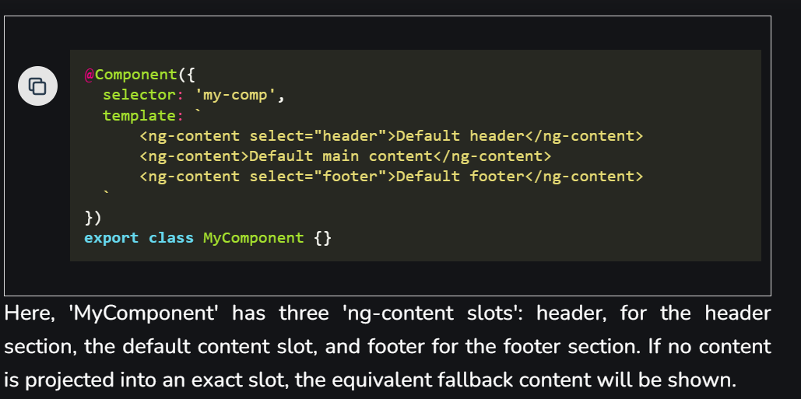

Slide 19
4 . Enhanced Angular Material and CDK
Angular Material, a popular library for building UI components with Angular, and the Angular CDK (Component Dev Kit), a collection of utility directives and behaviors, have received stability updates in Angular 18. This ensures that these libraries are now fully compatible and optimized for use with Angular 18.
Angular Material
Improved Theming System: A new theming mechanism provides more flexibility and consistency in styling applications. You can now define custom themes more easily and manage them more efficiently.
Component Enhancements: Many existing components have been updated for better performance and usability. For example, the Datepicker, Input, Slider, and Button components now offer more configuration options and improved accessibility.
Internationalization Support: Angular Material now offers better support for various languages and locales, making it easier to build global applications.
Component Harnesses: These provide a robust way to test Angular Material components, ensuring they behave as expected

Slide 20
Component Dev Kit (CDK)
The CDK is a toolkit for building custom components without being tied to Material Design's visual patterns. Here are some of its recent enhancements:
Virtual Scrolling: This allows efficient rendering of large lists by only rendering the visible items, reducing the load on the browser.
Drag-and-Drop Module: The CDK now includes a built-in drag-and-drop feature, enabling complex drag-and-drop interactions.
Accessibility Features: The CDK provides tools for building accessible components, such as creating focus traps and managing keyboard interactions.
Overlay Module: This offers a flexible way to position floating elements, like pop-ups and dialogs, anywhere on the screen.

Slide 21
5. Server-Side Rendering (SSR) Enhancements
Angular 18 introduces notable updates to its Server-Side Rendering (SSR) skills, focusing to better execution, developer experience, and the entire efficiency of rendering Angular applications on the server.
Key Features
Faster Primary Page Load: The SSR process has been refined to deliver faster primary page loads. This is achieved by decreasing the JavaScript bundle size and using capable server-side rendering techniques, ensuring users can see content immediate even on slower network connections.
Incremental Hydration: Incremental hydration is a new technique that permits Angular to systematically make parts of the application interactive.

Slide 22
Enhanced Developer Tools: New and advanced tooling for SSR covers better debugging support, detailed performance profiling, and efficient methods for developing and testing SSR applications.
Enhanced Caching Mechanisms: Angular 18 introduces high-tech caching methods to store pre-rendered pages and fragments, decreasing the server load and progressing response times for repeat visitors.

Slide 23
6. Improved Internationalization (i18n) Support
Building applications that cater to a global audience requires robust internationalization support. Angular 18 introduces a new @angular/localize package, simplifying the process of managing translations and formatting dates, currencies, and numbers according to different locales.
Automatic Extraction: Angular now supports automatic extraction of translation strings from your templates. This reduces manual effort and ensures consistency across the application
Runtime i18n: Angular supports runtime translation, allowing developers to load translation files dynamically based on the user's locale. This means you can switch languages without reloading the entire application.
Integration with Third-Party Libraries: Angular’s i18n support seamlessly integrates with libraries like ngx-translate , providing additional flexibility and features.

Slide 24
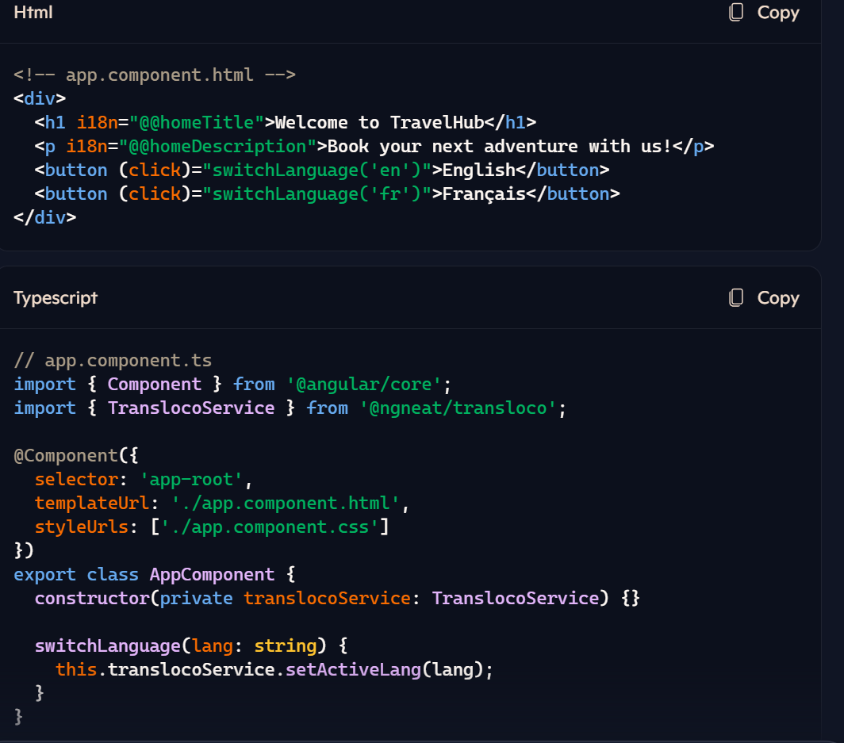

Slide 25
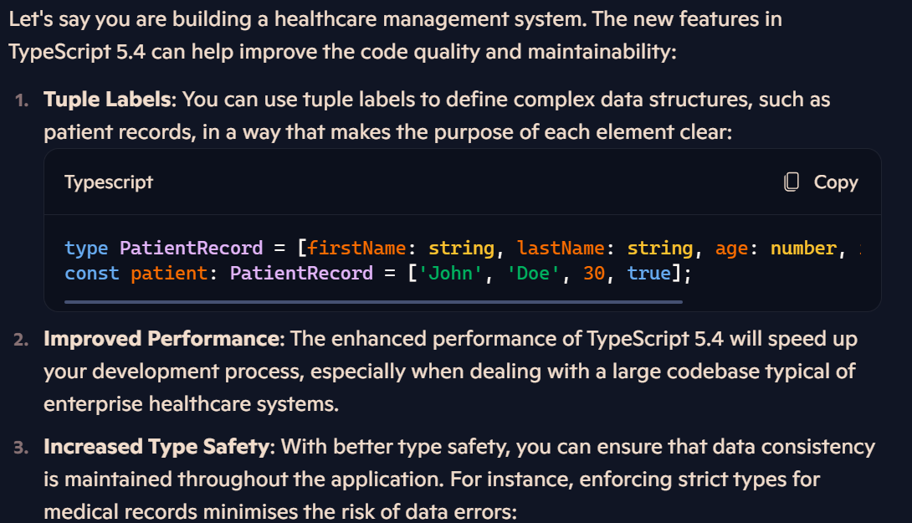
7. TypeScript 5.4 Support

Slide 26
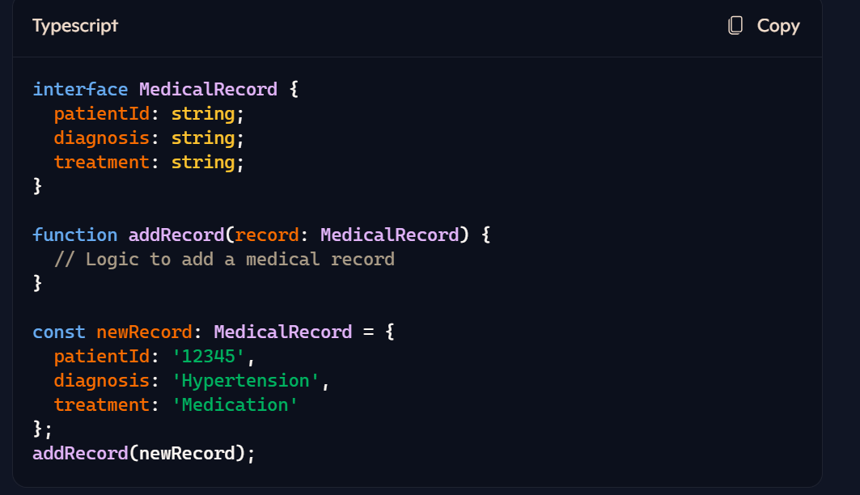

Slide 27
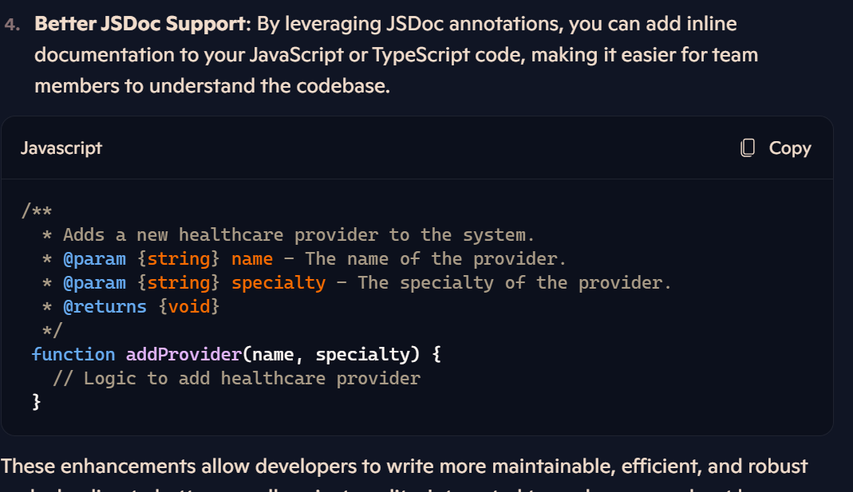

Slide 28
8. Template Enhancements with 'let-user'
In Angular 18, there is a current feature called "Template Enhancements with 'let-user'" that forms writing templates clearer and more intense.
Before Angular 18: When you preferred to pass data into a template, you usually had to write more code to coordinate the context or variables, which could make your template look clumped and tough to read.
With Angular 18: The "let-user" feature clarifies this process. It permits you to create and use variables instantly among the template in a cleaner way.

Slide 29
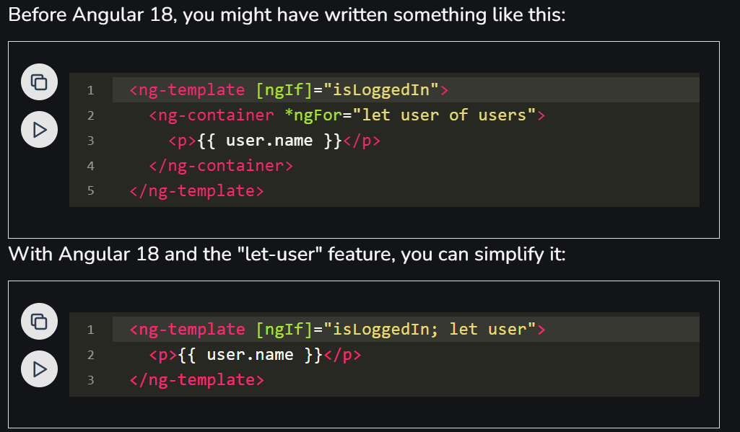

Slide 30
Key Features
Cleaner Code: By approving direct declaration and use of variables within the template, your code becomes more readable.
Easy Syntax: The let-user syntax lowers the need for extra elements like ng-container, forming the template simpler to grasp at a look.
Enriched Usability: With less boilerplate code, it is simpler to keep and renew your templates.

Slide 31
Improvements in Angular 18
1. Deprecation of HttpClientModule
One of the important changes in Angular 18 is the disapproval of the HttpClientModule. This module has been a basis for forming HTTP requests in Angular applications, but it has now been renewed with more modern and skilled manner. The new HTTP Client API gives more supple and powerful way to handle HTTP communications.
Key Features
Optimized Error Handling: The new HTTP Client API gives more precise handle over error handling, building it simpler to handle various types of HTTP errors.

Slide 32
Bettered Interceptors: The interceptors in the new API are more optimized, enabling for simpler change of requests and responses.
Better Performance: The new API is improved for better performance, cutting the spending linked with HTTP requests and responses.

Slide 33
2. New Builder Package
Angular 18 presents a new builder package that clarifies the process of forming and operating Angular projects. This new package displaces the older Angular CLI build system, giving more perceptive and robust way to build, test, and deploy applications.
Key Features:
Changeable Build Pipelines: The new builder package lets developers modify their build pipelines with relief, permitting more resilience in how projects are made and refined.
Progressive Builds: This property essentially cuts build times by only renewing parts of the application that have modified, boosting developer output.
Plugin Support: The builder package assists a vast range of plugins, providing for more features to be simply merged into the develop process.

Slide 34
3. Enhanced Debugging Tools
Debugging is a key element of development, and Angular 18 forms valuable progress in this area with the introduction of enriched debugging tools. These tools give developers with intense clarity into their applications, developing it simpler to determine and fix issues.
Key Features:
Advanced Stack Traces: Advanced stack traces give more complete information about errors, covering the true location in the source code where error occurred.
Enriched Debugging Information: More context is given for debugging, such as the state of variables and the execution flow, supporting developers learn the root cause of issues more fast.
Merging with Popular Debugging Tools: Angular 18's debugging tools merge easily with well-liked debugging environments and tools, such as Chrome DevTools, upgrading the entire debugging experience.

Slide 35
4. Improved Internationalization Support
Global networking is more and more important in web applications, and Angular 18 handles this needs with enriched internationalization (i18n) support. These expansions make it less difficult to create applications that support to a global audience, supporting several languages and cultural contexts.
Key Features:
Basic Translation Workflow: The translation workflow has been optimized, forming it easier to handle and merge translations into the application.
Boosted Locale Support: Angular 18 offers elevate support for many locales, including high-tech facets like pluralization, date, and number formatting specific to different cultures.
Runtime Updates: Developers can now update translations and locale-specific data at runtime without wanting to restore the whole application, forming it simpler to sustain and renew applications with dynamic content.

