Slide 1
Twitter Sentiment Analysis

Slide 2
Problem Statement
To evaluate if the tweet expressed were positive, negative, or no emotion towards a product/brand.

Slide 3
About the dataset
The train dataset consists of records of roughly 7274 tweets and 4 types of sentiments. There are tweets of various brands and devices and 1 target that describes the sentiments related to them.

Slide 4
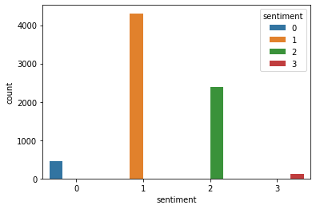
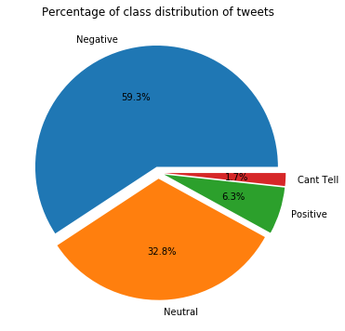
Dataset Imbalance

Slide 5
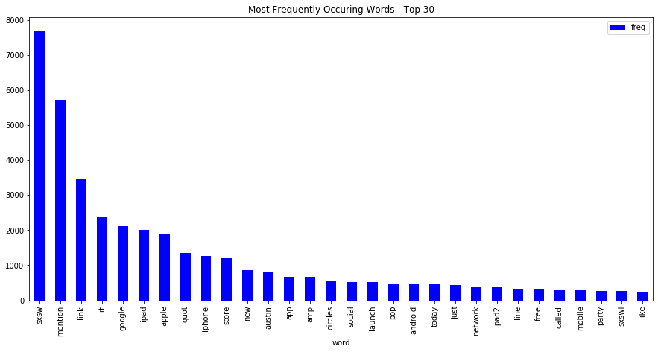
Most Frequent words

Slide 6
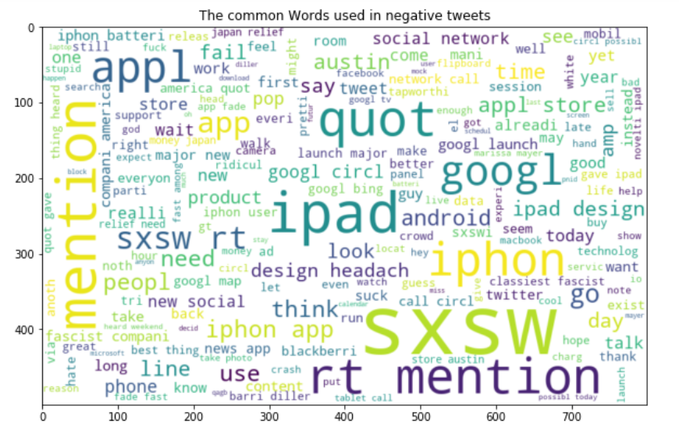
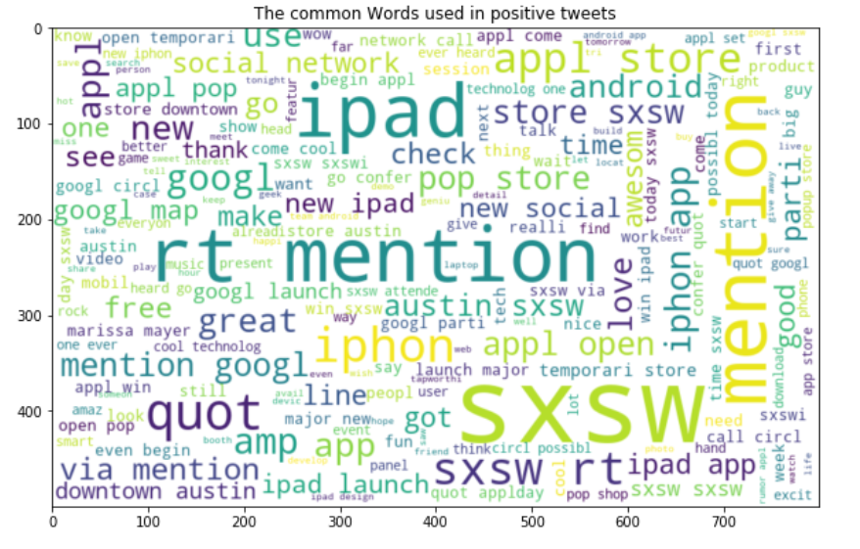
Common words used
in negative tweets
Common words used
in positive tweets

Slide 7
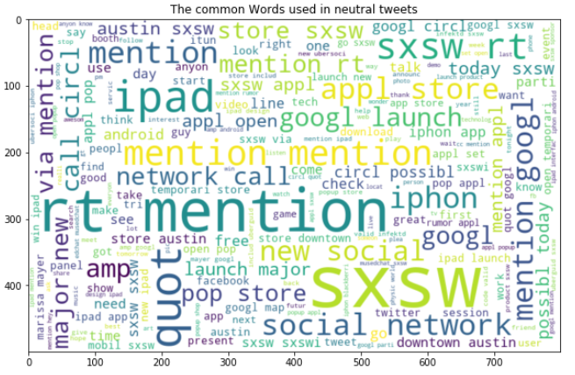
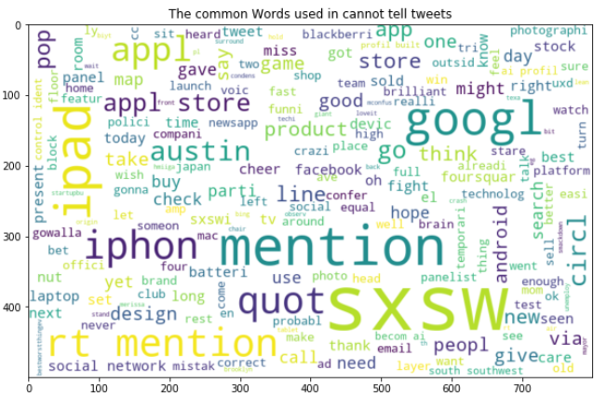
Common words used
in neutral tweets
Common words used
in can’t tell tweets

Slide 8
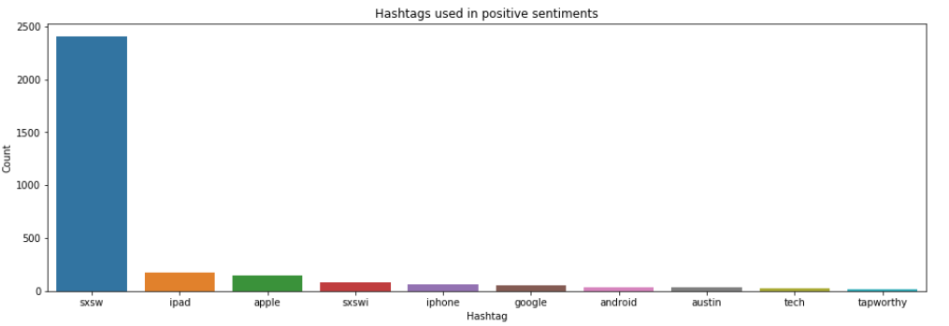
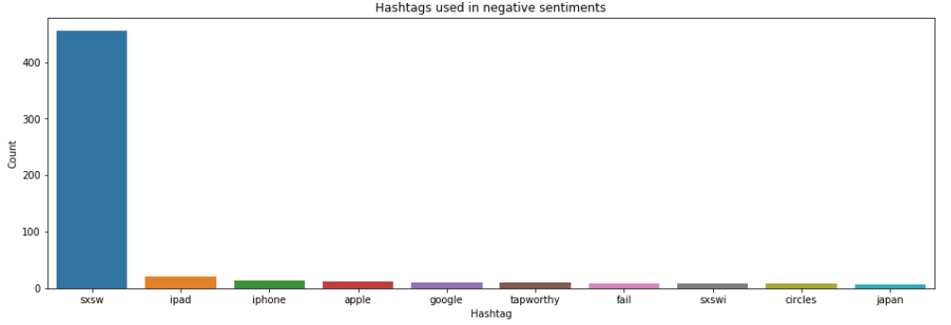
Hashtags used in positive & Negative tweets

Slide 9
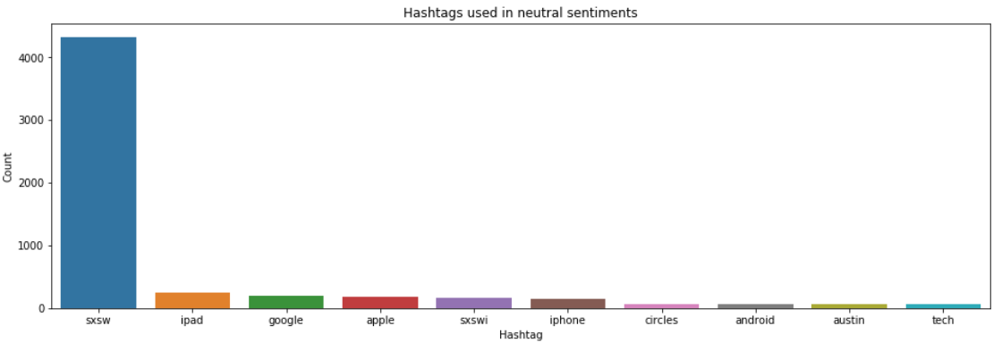
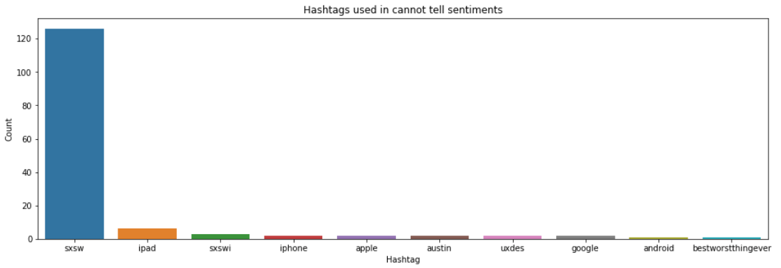
Hashtags used in neutral & cannot tell tweets

Slide 10
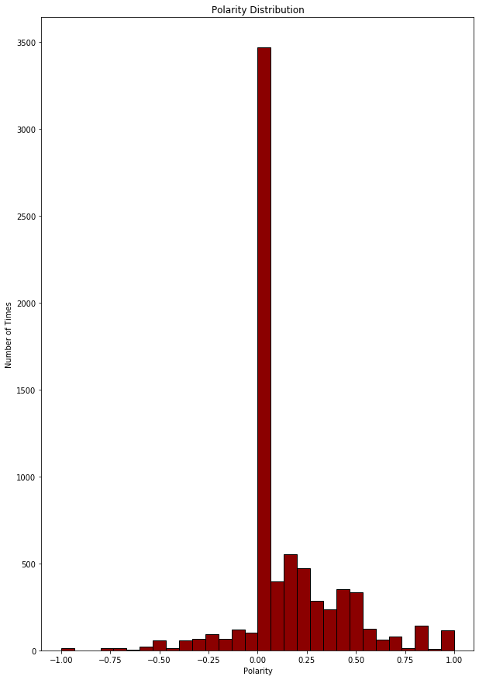
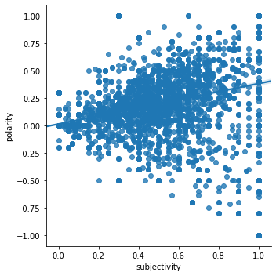
Polarity and Subjectivity
Covariance – 0.1342
Notes:
<number>

Slide 11
Nature of words in corpus
Tokens | Positive_CDF_hmean
free | 0.790322
amp | 0.772433
link | 0.771014
pop | 0.763344
austin | 0.760740
network | 0.760515
launch | 0.757861
party | 0.755904
today | 0.755858
store | 0.754118
possibly | 0.751617
new | 0.748656
opening | 0.747267
social | 0.746798
mobile | 0.746483
tokens | Negative_CDF_hmean
because | 0.971815
headaches | 0.958190
fail | 0.955057
fascist | 0.919909
america | 0.911274
company | 0.886592
battery | 0.868516
design | 0.860613
hate | 0.846015
button | 0.842743
diller | 0.838978
why | 0.823195
tag | 0.821412
classiest | 0.820185
tapworthy | 0.818217

Slide 12
Word2Vec most similar words
 | america | fascist | hate | company
0 | volunteer | classiest | beard | America
1 | Used | elegant | Someone | fascist
2 | XOOMs | America | flannel | elegant
3 | Motorola | existence | Bah | pagemaker
4 | Found | continued | shit | Explanation

Slide 13
Most similar words
 | apple | blackberry | Motorola | Android | iphone | ipad
0 | sxswpopup | ittttt | Jalen | Iphone | android | ip
1 | sold | Laptop | Thingsthatdontgotogether | Liking | Bannka | brisk
2 | Pulling | Turn | XOOMs | Tuesday | groupme | planted
3 | closed | Screen | Rose | Schedule | Handy | kiosk
4 | perhaps | BACK | Sosososo | Bannka | mapquest | tripping

Slide 14
Models and Approaches
Model | F1_Score | Accuracy
Logistic Regression | 0.66 | 0.68
Random Forest Classifier | 0.63 | 0.66
XG Boost | 0.64 | 0.68

Slide 15
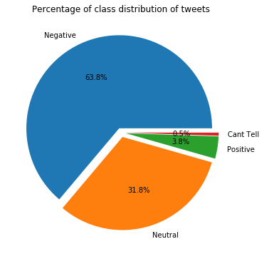
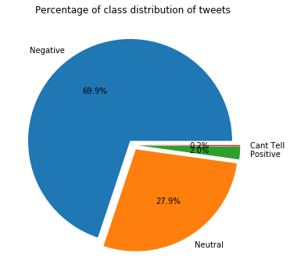
Model Tuning
Following methods are used for Improving Model Accuracy:
Random Oversampling
SMOTE
Random Oversampling SMOTE

Slide 16
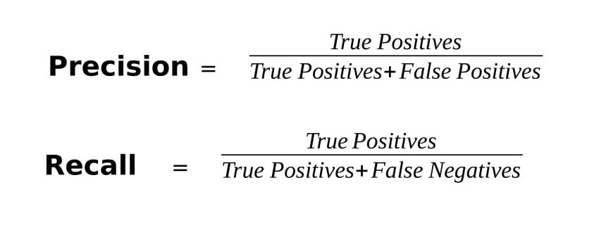

Evaluation Metrics-I: Precision , Recall and F1 score
Precision basically tells us that out of the results classified as positive by our model, how many were actually positive.
Recall tells us how many true positives (points labelled as positive) were recalled or found by our model.
F1-score is a metric which takes into account both ,precision and recall as we can’t always evaluate both and then take the higher one for our model. It is the harmonic mean of precision and recall. It tells us about the balance that exists between precision and recall.

Slide 17
Results
Model | F1_Score | Accuracy
Logistic Regression | 0.77 | 0.76
Random Forest Classifier | 0.83 | 0.82
XG Boost | 0.70 | 0.73

Slide 18
Insights & Decisions
Marketing Campaign at the SXSW
Offers on tickets
Endorsement

Slide 19
This work is licensed under a Creative Commons Attribution-ShareAlike 3.0 Unported License. It makes use of the works of Mateus Machado Luna.

