Slide 1
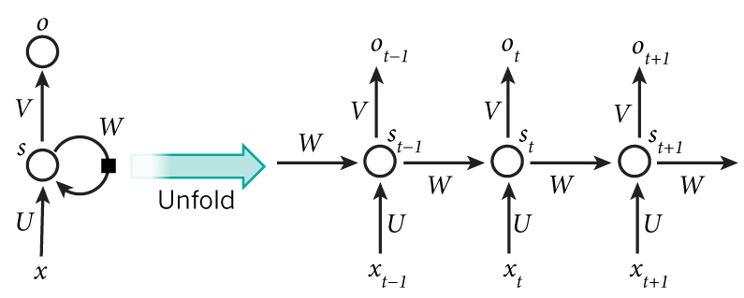
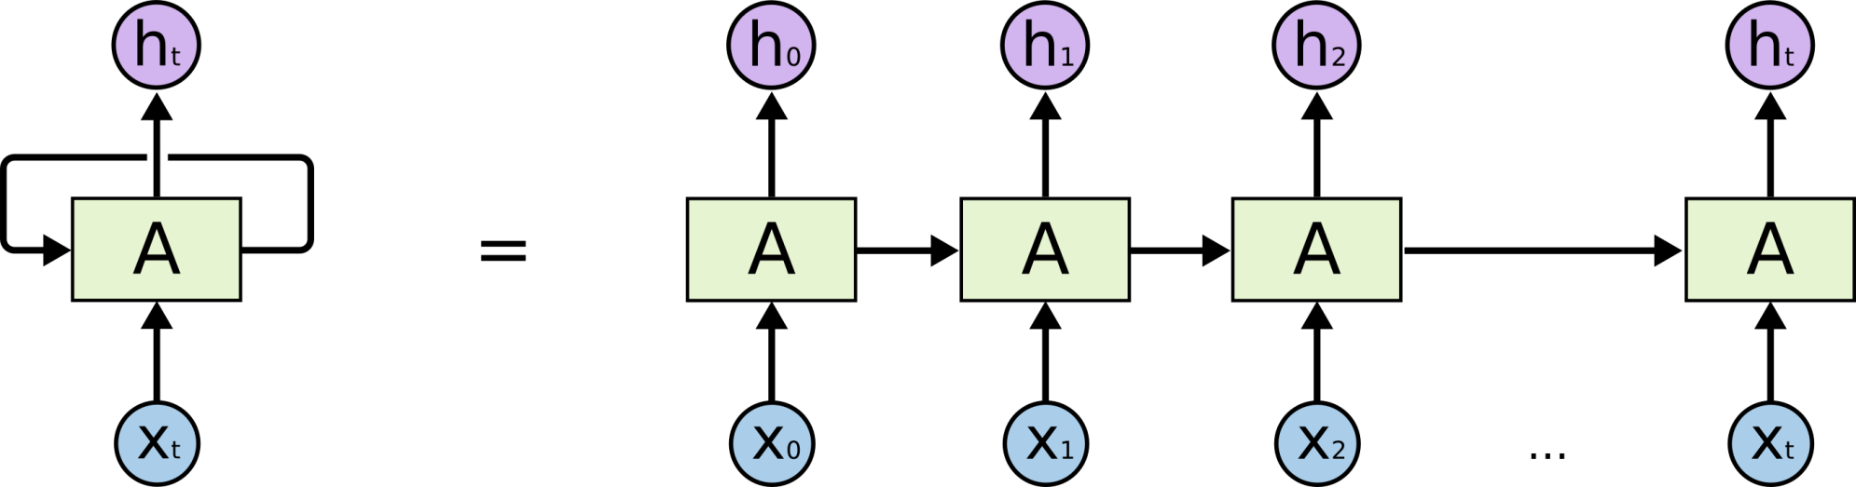
Recurrent Neural Network

Slide 2
How does RNN reduce complexity?
Given function f: h’,y=f(h,x)
h and h’ are vectors with the same dimension
y¹
y²
y³
h⁰
f
h¹
f
h²
f
h³
……
x¹
x²
x³
No matter how long the input/output sequence is, we only need one function f. If f’s are different, then it becomes a feedforward NN. This may be treated as another compression from fully connected network.

Slide 3

Deep RNN
h’,y = f₁(h,x), g’,z = f₂(g,y)
…
…
…
z¹
z²
z³
g⁰
f₂
g¹
f₂
g²
f₂
g³
……
y¹
y²
y³
h⁰
f₁
h¹
f₁
h²
f₁
h³
……
x¹
x²
x³

Slide 4
Bidirectional RNN
y,h=f₁(x,h)
z,g = f₂(g,x)
x¹
x²
x³
g⁰
f₂
g¹
f₂
g²
f₂
g³
z¹
z²
z³
p¹
p²
p³
p=f₃(y,z)
f₃
f₃
f₃
y¹
y²
y³
h⁰
f₁
h¹
f₁
h²
f₁
h³
x¹
x²
x³

Slide 5
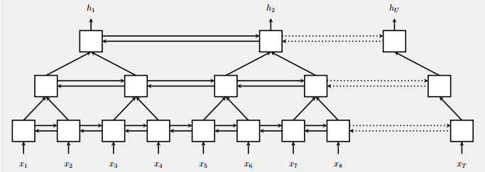
Pyramid RNN
Significantly speed up training
Reducing the number of time steps
Bidirectional
RNN
W. Chan, N. Jaitly, Q. Le and O. Vinyals, “Listen, attend and spell: A neural network for large vocabulary conversational speech recognition,” ICASSP, 2016

Slide 6
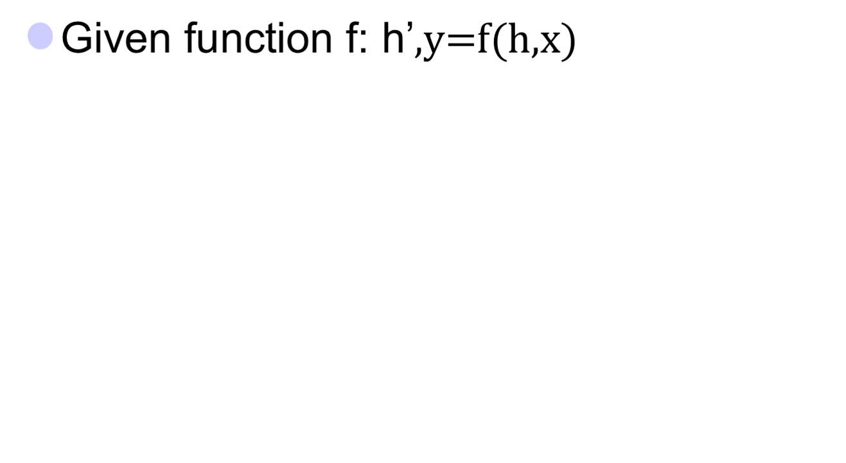


Naïve RNN
y
h'
W^{h}
^{h}
W^{i}
x
h
f
h'
y
Wº
^{h’}
Note, y is computed
from h’
x
softmax
We have ignored the bias

Slide 7
Problems with naive RNN
When dealing with a time series, it tends to forget old information. When there is a distant relationship of unknown length, we wish to have a “memory” to it.
Vanishing gradient problem.

Slide 8
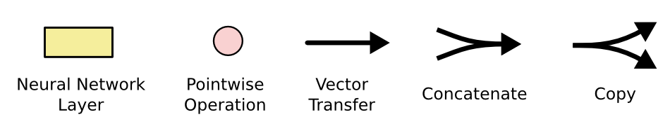
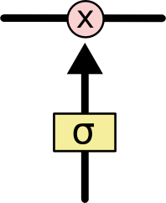
The sigmoid layer outputs numbers between 0-1 determine how much
each component should be let through. Pink X gate is point-wise multiplication.

Slide 9
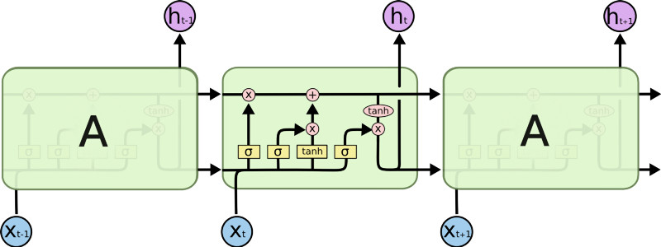
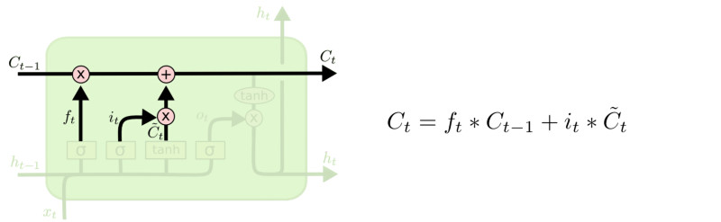
LSTM
This decides what info
Is to add to the cell state
Output gate
Controls what
goes into output
This sigmoid gate
determines how much
information goes thru
C_{t-1}
h_{t-1}
Why sigmoid or tanh:
Sigmoid: 0,1 gating as switch.
Vanishing gradient problem in
LSTM is handled already.
ReLU replaces tanh ok?
Forget input
gate gate
The core idea is this cell state C_{t}, it is changed slowly, with only minor linear interactions. It is very easy for information to flow along it unchanged.

Slide 10
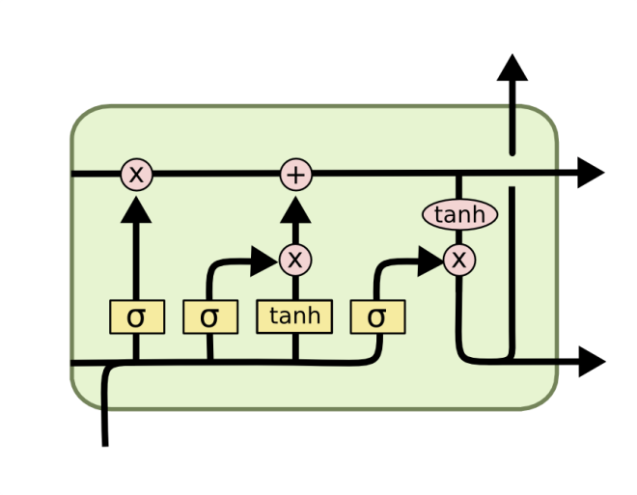
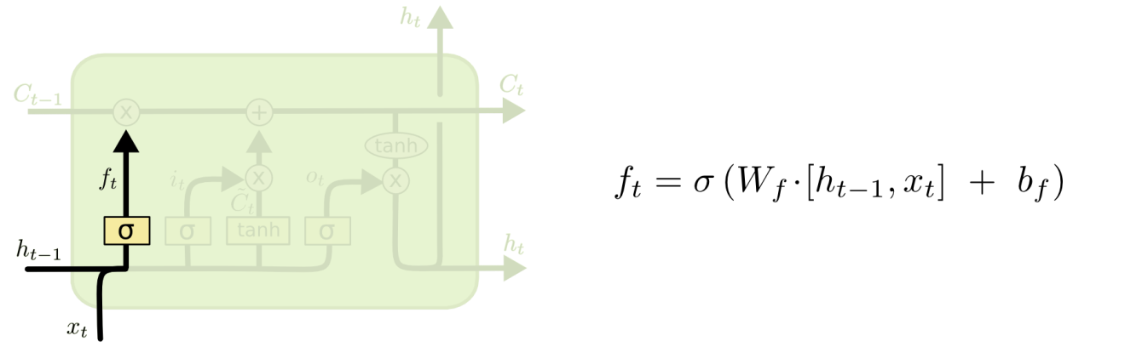
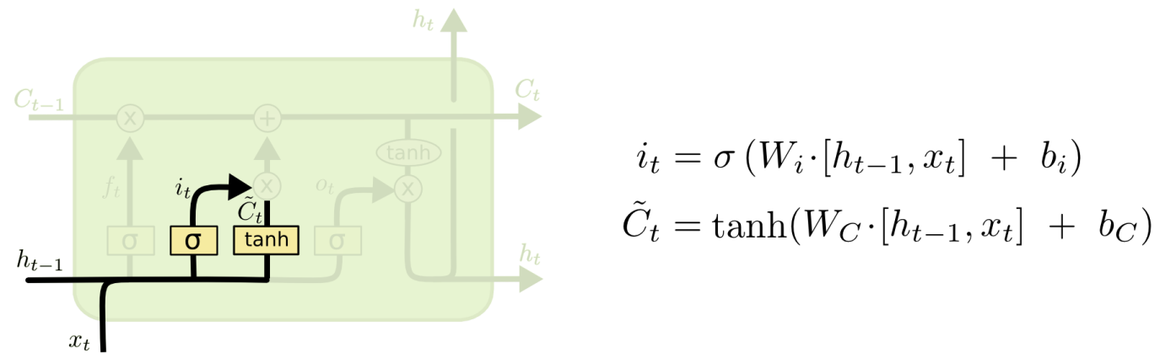
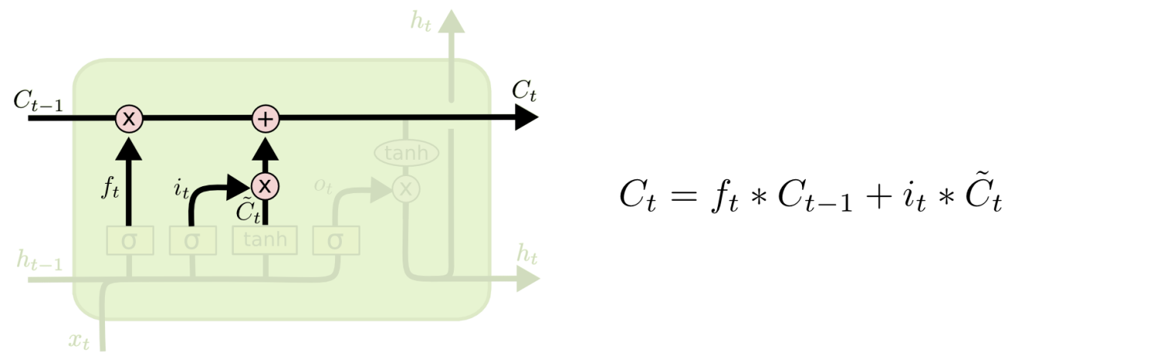
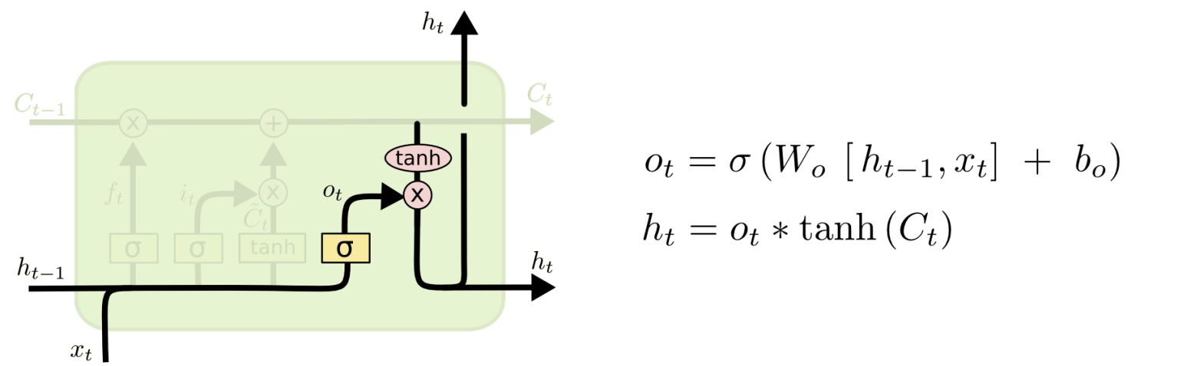
i_{t} decides what component
is to be updated.
C’_{t} provides change contents
Updating the cell state
Decide what part of the cell
state to output

Slide 11
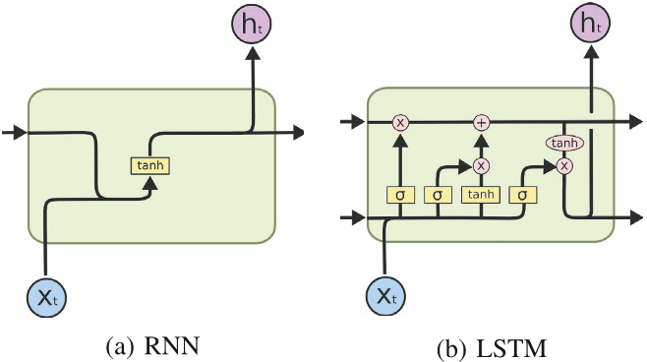
RNN vs LSTM

Slide 12
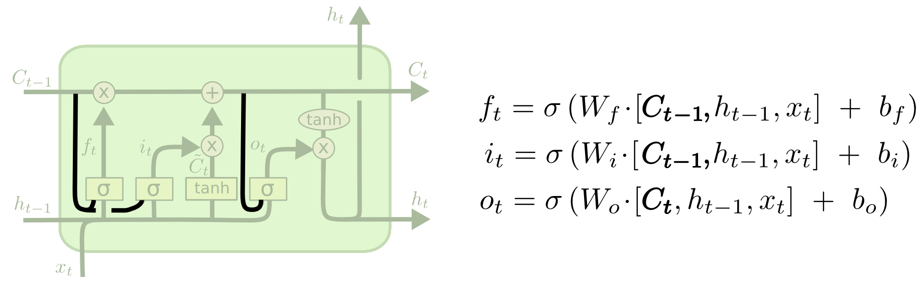
Peephole LSTM
Allows “peeping into the memory”

Slide 13
Naïve RNN vs LSTM
y^{t}
LSTM
c^{t}
y^{t}
c^{t-1}
Naïve
RNN
h^{t}
h^{t}
h^{t-1}
h^{t-1}
x^{t}
x^{t}
c changes slowly
c^{t} is c^{t-1} added by something
h changes faster
h^{t} and h^{t-1} can be very different

Slide 14
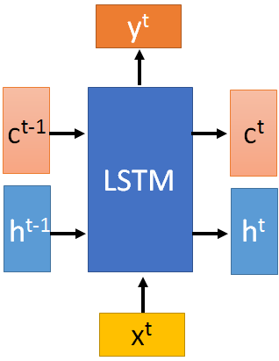





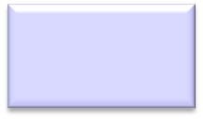









These 4 matrix
computation should
be done concurrently.
x^{t}
z
W
h^{t-1}
c^{t-1}
x^{t}
z^{i}
W^{i}
= σ( )
h^{t-1}
Controls
forget gate
Controls
input gate
Updating
information
Controls
Output gate
W^{f}
x^{t}
z^{f}
= σ( )
h^{t-1}
z^{f}
z^{i}
z
zº
x^{t}
zº
Wº
= σ( )
h^{t-1}
x^{t}
h^{t-1}
Information flow of LSTM

Slide 15






x^{t}
z
W
h^{t-1}
=tanh( )
c^{t-1}
c^{t-1}
diagonal
“peephole”
zº
z^{f}
z^{i}
obtained by the same way
z^{f}
z^{i}
z
zº
h^{t-1}
x^{t}
Information flow of LSTM

