Slide 1
Which issue should be investigated first?
Question: after validating the data, which issue comes first, what is the exposure, how confident are we, and what records are needed before acting?
Answer: turbine R80711, 26–28 July 2015, 42.5 hours.
Potential shortfall 36.8–37.6 MWh. Illustratively €1,842–4,513 at €50–120/MWh.
All three methods agree. Confidence: medium — the ceiling, because no operational record exists.
Potential shortfall is not confirmed recoverable energy.
Next step: request event codes and work orders for the interval.
Independent project. Public data: ENGIE La Haute Borne, Etalab Open Licence 2.0, via OpenOA. No Clir Renewables data, software or methodology used.

Slide 2
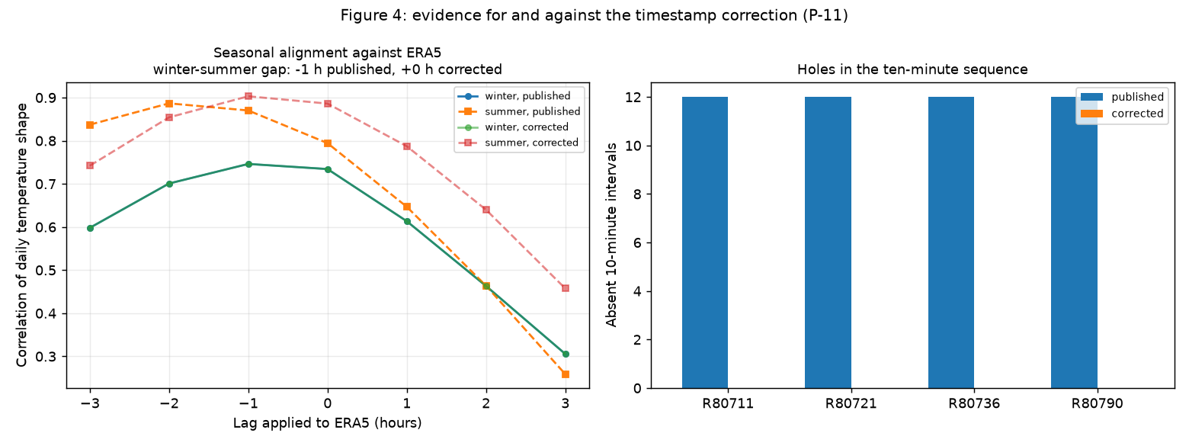
What trusting the raw data would have missed
The timestamps looked reliable and were wrong.
They carry proper daylight-saving offsets. But every local day held exactly 144 ten-minute records, including both clock-change days — which a daylight-saving logger cannot produce.
The logger's clock never moved: every summer record sat one hour early, about seven months a year. Correcting it removed all 48 duplicate and 48 absent intervals and closed a one-hour seasonal gap against independent reanalysis.
The meter series is synthetic, derived from SCADA by the publisher. That removes the only external cross-check, so all verification here is internal.
Missing data is never zero. Gaps run up to 132.8 hours; 388 are moments when no turbine reported at all. Filling them would invent days of false outage.
Independent project. Public data: ENGIE La Haute Borne, Etalab Open Licence 2.0, via OpenOA. No Clir Renewables data, software or methodology used.

Slide 3
Validated energy accounting, 2015
Gross positive residual shortfall: 671.6 MWh
Inside persistent reviewable events: 380.8 MWh
Non-persistent short dips: 290.8 MWh
Energy lost during missing data: unknown, not zero
Records that cannot be assessed: 2,771
Only 57% of the gross figure sits inside reviewable events.
The rest is scattered across thousands of dips that never persist for an hour — as likely turbulence, sensor noise or curve approximation as anything operational.
Reporting the headline as if it were all actionable would be the easiest mistake available here.
Independent project. Public data: ENGIE La Haute Borne, Etalab Open Licence 2.0, via OpenOA. No Clir Renewables data, software or methodology used.

Slide 4
The first investigation, and the next action
R80711, 26 July 15:10 – 28 July 09:30 UTC (42.5 hours).
Observed: 97.6% of records at or below zero against an expected 901 kW, while all three neighbours produced continuously at 724–840 kW in the same 5–12 m/s wind. The turbine ran normally in the preceding 48 hours.
Ranked first because it is large, flagged by all three methods, discrete, carries no data-quality qualifications, and one record request can resolve it.
Five explanations fit equally well: planned maintenance, an unplanned fault stop, grid curtailment, a controller lockout, or a communications loss while the turbine was running. Nothing in this dataset can choose between them.
Qualification: removing this one event drops R80711 from 5.35% to 4.46%, below R80790. Its fleet ranking is event-driven, not a persistent pattern.
Independent project. Public data: ENGIE La Haute Borne, Etalab Open Licence 2.0, via OpenOA. No Clir Renewables data, software or methodology used.

Slide 5
Transparent baseline against ML — and why ML is not the headline
A each turbine against its own history · B the same method pooled across the fleet · C a constrained pooled gradient-boosted challenger.
Pooling is the finding. A judges R80711 against a bar 11–19 kW below its neighbours. Correcting that moves it from apparently best-behaved to largest shortfall. Two thirds of the detection gain came from the model, one third from pooling — but only pooling changed a decision.
The challenger passed the registered experimental benchmark (recovery 0.771 → 0.818), but its approximately 41% apparent alert burden means it is not ready for automated operational alerting. Neither is A at 38% or B at 40%.
The acceptance rule constrained only the relative increase in burden, not the absolute level. That was an incomplete rule, and it is recorded, not patched.
C agrees with B on only 44.7% of flagged records. B is the decision method; C is a qualified second opinion.
Independent project. Public data: ENGIE La Haute Borne, Etalab Open Licence 2.0, via OpenOA. No Clir Renewables data, software or methodology used.

Slide 6
Limitations, and what transfers
No event codes, work orders or curtailment records. Every operational explanation is a hypothesis. Nothing here reaches 'validated finding'.
No independent meter validation — the supplied meter is synthetic.
Four turbines, 2015 data. A site-wide problem would be invisible to every method used. Nothing describes the site today.
The synthetic benchmark is an upper bound; clean artificial steps are the easiest possible detection case.
What transfers to solar and portfolio data standardisation — discipline, not solar expertise: timestamp alignment; missing data against downtime; degrading reference sensors (nacelle anemometer → irradiance sensor soiling); unit standardisation; peer comparison; event taxonomy; separating clipping from curtailment; and confidence grading before anything reaches a client.
Independent project. Public data: ENGIE La Haute Borne, Etalab Open Licence 2.0, via OpenOA. No Clir Renewables data, software or methodology used.

