Slide 1
OUTSIDE-IN DATA BUSINESS ANALYSIS CASE STUDY
Fair Comparisons for a
Fast-Growing Network
Outside-in disclaimer
Built only from public information and synthetic data.
Does not claim that Specsavers' reporting is inadequate or that any stakeholder reviewed this work.
Every number in the prototype is fictional.
Targets, thresholds and definitions are illustrative proposals.
No patient-identifiable data, diagnoses or individual performance.
Store ramp-up and partner performance intelligence — a proposed reporting product for Specsavers Canada
What I did Researched public evidence, analysed stakeholders, wrote requirements and KPI rules, designed the data model, generated a synthetic dataset, built and tested a three-page prototype, and planned UAT.
Evidence labels used throughout
FACT
INFERENCE
ASSUMPTION
SYNTHETIC
ILLUSTRATIVE
Portfolio case study for the Data Business Analyst role · Specsavers Canada, Burnaby, BC · September 2026
Notes:
This is an outside-in portfolio case study for the Data Business Analyst role. My contribution is the whole chain: public research with an evidence log, stakeholder analysis, business and functional requirements, a KPI dictionary with explicit calculation rules, a conceptual data model, user stories, traceability, risks, an MVP, a synthetic dataset I generated and validated, a three-page prototype I built and tested, and a UAT plan. Nothing here claims internal knowledge, and no Specsavers stakeholder has reviewed it. The coloured labels show the evidence status of each claim.

Slide 2
SPECSAVERS CANADA CONTEXT — PUBLIC EVIDENCE, DATED
2
Rapid, geographically diverse growth
Partnership operating model
FACT
111
270+
Optometry Partner
Independent optometry corporation · clinical leader
Retail Partner
Specsavers retail corporation · store leader
in-grocery locations announced in Jul 2025 and reported open during 2025 (release of 22 Jun 2026)
locations across nine provinces and one territory, as reported in Mar and Jun 2026
Central support services
Procurement · supply chain · marketing and patient recall · IT and patient-record systems · training · finance · business development
FACT
EV-01, EV-17
FACT
EV-02, EV-17
≈ half
20%
Each business is owned "in accordance with provincial regulations" (prospectus, EV-04)
of the network opened in 2025: 130+ openings of 270+ stores (Mar 2026) — my arithmetic on lower bounds
of stores were open under six months at the 100-store milestone (Feb 2024)
Access challenge (Specsavers-commissioned survey, n = 2,022, Feb 2025)
1 in 3 adults overdue for an eye exam · 51% cite cost · 61% of people who qualify for provincial coverage don't think they are covered
INFERENCE
EV-02
FACT
EV-06
COMMISSIONED SURVEY
Sources: Loblaw releases (30 Jul 2025; 22 Jun 2026); Specsavers releases via Newswire (7 Feb 2024; 9 Oct 2025; 11 Mar 2026); partnership prospectus (Oct 2025). Links: Appendix A1.
Notes:
Four public figures frame the opportunity, each with its date. The July 2025 Loblaw announcement said 111 Specsavers locations would open inside Loblaw grocery stores; the June 2026 PC Optimum release confirms those 111 opened during 2025. Specsavers reported more than 270 stores in March 2026, and the June 2026 release repeats more than 270 locations across nine provinces and one territory. The 'roughly half' figure is my own arithmetic — more than 130 openings in 2025 out of more than 270 stores — so it is an inference on two lower bounds, not a company statement. Specsavers itself tracked the share of stores under six months old in 2024. The ownership model has two partner corporations plus central support services. The access survey was commissioned by Specsavers, so I treat it as context, not independent research. Full links are in Appendix A1.

Slide 3
BUSINESS DECISION AND HYPOTHESIS
3
Unadjusted store comparisons could mislead in a network like this
Decision the product supports: “Which stores warrant attention relative to comparable stores, which candidate factors should be investigated, and which business team should follow up?”
Hypothesis: partners and support-office teams may benefit from a consistent, fair way to monitor ramp-up and compare like-for-like stores.
INFERENCE
1
Maturity mix
2
Structural diversity
3
Two entities
4
Many owners
Many stores are young; volume grows with age.
Province, regulation and host format differ.
Clinical and retail activity may sit in different systems.
Supply chain, marketing and finance each own part of the picture.
Why now
What the evidence does not show
A large 2025 opening cohort is ramping up through 2026
New provinces with little historical baseline
PC Optimum earning from Jun 2026: a future data stream, outside the MVP
Burnaby data hiring shows investment — not proof of a reporting gap
No public evidence says current reporting is inadequate. Discovery would start with what exists today.
Synthetic illustration (all 26 weeks): New stores average 66 exams per store-week vs 150 for Mature — an unadjusted comparison mixes store age with performance.
SYNTHETIC
Sources: EV-01, EV-02, EV-08, EV-09, EV-17 (Appendix A2). Illustration: synthetic dataset (Appendix A8).
Notes:
The hypothesis rests on four mechanisms, each an inference from public facts rather than a known problem: a young network, structural diversity, two ownership entities whose data may sit in different systems, and many central functions. I reframed the decision in triage language — which stores warrant attention and what to investigate — so the product never implies it can explain causes. The synthetic illustration shows why age matters: in my fictional data New stores average far fewer exams than Mature stores, so any unadjusted comparison mixes age with performance. I have no evidence that current reporting is poor; that is the first thing discovery would test.

Slide 4
STAKEHOLDERS, DECISIONS AND DISCOVERY APPROACH
4
Eighteen stakeholder groups, four core decisions
Keep satisfied
Manage closely
Who | Decision the product must support
Regional Retail Manager | Which stores do I contact this week, and about what?
Retail and Optometry Partners | Where should my team focus? Are we ramping like similar stores?
Retail Operations lead | Where to direct support; approve peer and cohort rules
Privacy Officer | What may be shown, to whom, at what aggregation?
Finance · Privacy / Governance · Partnership Advisory Committee · Executive leadership
Retail Operations (sponsor, assumed) · Product Owner · Retail and Optometry Partners · Regional Retail Managers (title TBC) · Data Delivery Manager
Influence ↑
Discovery approach
Monitor
Keep informed and involved
Validate problem
KPI workshops
Data & privacy
Prototype tests
Endorse
Source-system owners (until data access is needed)
Marketing · Supply Chain · Business Development · Clinical Services · Data engineers and analysts
Sample stores across maturity, province and format · hear Retail and Optometry Partners separately · 35 discovery questions (Appendix A3)
Tensions to surface early
Peer visibility vs partner commercial confidentiality
Conversion framed as sales pressure on clinical care
Point-of-sale revenue vs finance ledger as the source of truth
Interest →
FACT
Partner roles, Privacy Officer, data roles
ASSUMPTION
Other titles
Stakeholder IDs SH-01 to SH-18, RACI and engagement plan: Appendix A3. Titles are proposals, not confirmed Specsavers positions; none of these groups has reviewed the work.
Notes:
I evaluated thirteen proposed groups and added five, including the Partnership Advisory Committee, which the partnership site confirms exists, and Business Development, the likely owner of store opening dates — the field the whole maturity concept depends on. I found no public evidence for a 'Retail Performance Manager' title, so I used Regional Retail Manager, title to be validated. Partners are consulted rather than approvers, with endorsement through the advisory committee. Three tensions stand out, and I would surface them in the first workshops rather than at UAT.

Slide 5
REQUIREMENTS, KPI RULES AND TRADE-OFFS
ILLUSTRATIVE
5
Five judgments that make comparisons fair and safe
7
12
18
34
12
10
24
Business
objectives
Business
requirements
Functional
requirements
NFR · data ·
privacy · security
Governed
KPIs
User
stories
UAT
scenarios
1
Compare like with like
2
Flag areas, not causes
3
Withhold rather than guess
4
Protect small numbers
5
Separate clinical and commercial
Choice
Peers share maturity cohort (as at each week) and format; fall back to the whole cohort; hide below 5 stores.
Choice
Rule (a): below comparable stores. Rule (b): worse than the store's own 8-week baseline for 3 weeks. Prompts name a follow-up team.
Choice
Red data quality: no values, no flags, excluded from peers. Amber: provisional.
Choice
Counts 1–4 shown as "<5"; rates hidden when the numerator is 1–4 or the denominator under 5.
Choice
Revenue per exam is restricted context, never a flag. Conversion for Optometry Partners stays an open decision (U-41).
Trade-off
Fairness vs small groups: some young stores get no peer comparison.
Trade-off
Explainable flags vs subtle signals; thresholds need pilot tuning.
Trade-off
Gaps in trends vs unfair conversations.
Trade-off
Less detail for young stores; complementary suppression still open (U-39).
Trade-off
Partner transparency vs clinical independence.
Rules: KPI dictionary v0.2 and exception rule set v0.2 (Phases 6 and 13), all illustrative. Full catalogue, dictionary and traceability: Appendix A4, A5, A7.
Notes:
The requirements chain is traceable from seven objectives to twenty-four UAT scenarios. Rather than list them, here are the five judgments that do most of the work. First, compare like with like — same maturity cohort and format as at each week — and accept that some young stores will have no peer comparison rather than an unfair one. Second, flags are areas to investigate: rule (a) compares with peers, rule (b) with the store's own recent history, and the text says which. Third, when data quality is Red the product withholds values and flags instead of guessing. Fourth, small counts are protected: a count from one to four shows as less than five, and a rate is hidden if it would reveal that count. Fifth, clinical and commercial views stay separate: revenue is restricted context, and whether Optometry Partners see conversion is an open decision, not something I have decided for Specsavers.

Slide 6
ASSUMED DATA ARCHITECTURE, GOVERNANCE AND QUALITY
ASSUMPTION
6
Aggregate before reporting: a privacy boundary by design
Store master
Scheduling
Raw landing
Immutable extracts and load metadata · restricted
Standardise and link
Conform store_id · pseudonymise · exam↔purchase linkage · restricted
Aggregated zone
Store-week facts · store-level KPI, peer and flag tables computed once
Semantic model
Selected-week aggregates · RLS · OLS on a revenue table
3 report pages
Network · Benchmarking · Diagnostic and data quality
PMS / EMR
Point of sale
Order management
Marketing / recall
Prototype lesson: compute windows, peers and flags once upstream; the report only aggregates, so one rule set also works under RLS.
Finance
PRIVACY BOUNDARY
store-week aggregates only
Generic source categories
Data-quality checkpoints
Master data and ownership
Governance and privacy
Completeness and freshness per source
Opening-date and store-code checks
Arithmetic invariants
Privacy scan blocks publishing
Opening date → Business Development (to confirm)
Converted or relocated stores flagged (open, TQ-12)
Effective-dated region and format
User-to-store access mapping
No identifiers, diagnoses or individual performance
Revenue in a separate table secured with OLS
Anonymous peers; minimum group of 5
Versioned KPIs, rules and prompts
No Specsavers platforms or schemas are asserted; postings reference PMS/EMR, POS, ERP, Power BI, SQL and Databricks as categories (EV-09). Model detail: Appendix A6.
Notes:
This is an assumed, generic architecture — I have not named any Specsavers platform. The key choice is a privacy boundary: patient-level linkage, such as connecting an exam to an eyewear purchase, happens only in restricted upstream zones, and only store-week aggregates reach reporting. Building the prototype taught me a second principle: calculate rolling windows, peer groups and exception flags once, upstream, and let the report only aggregate. That keeps one implementation of the rules — my Python engine and the dashboard logic are reconciled by tests — and it works under row-level security, because each store's row already carries its peer statistics. Revenue sits in its own table so object-level security can hide it from roles that should not see it. Converted or relocated stores are an open master-data question.

Slide 7
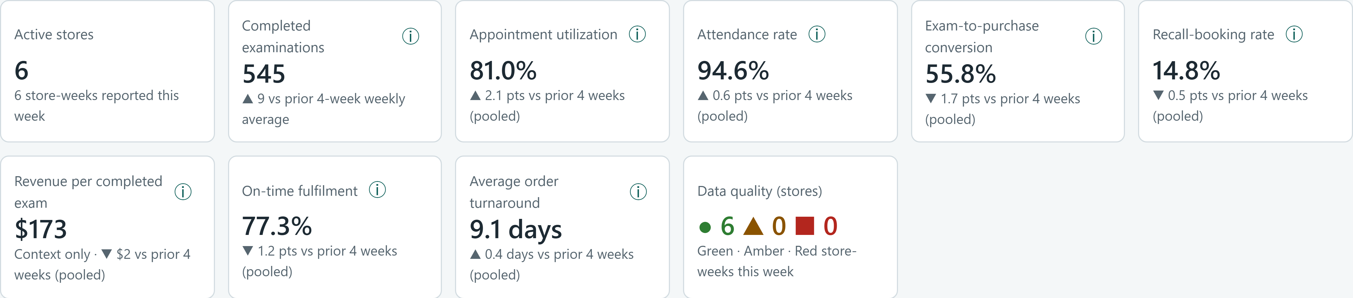
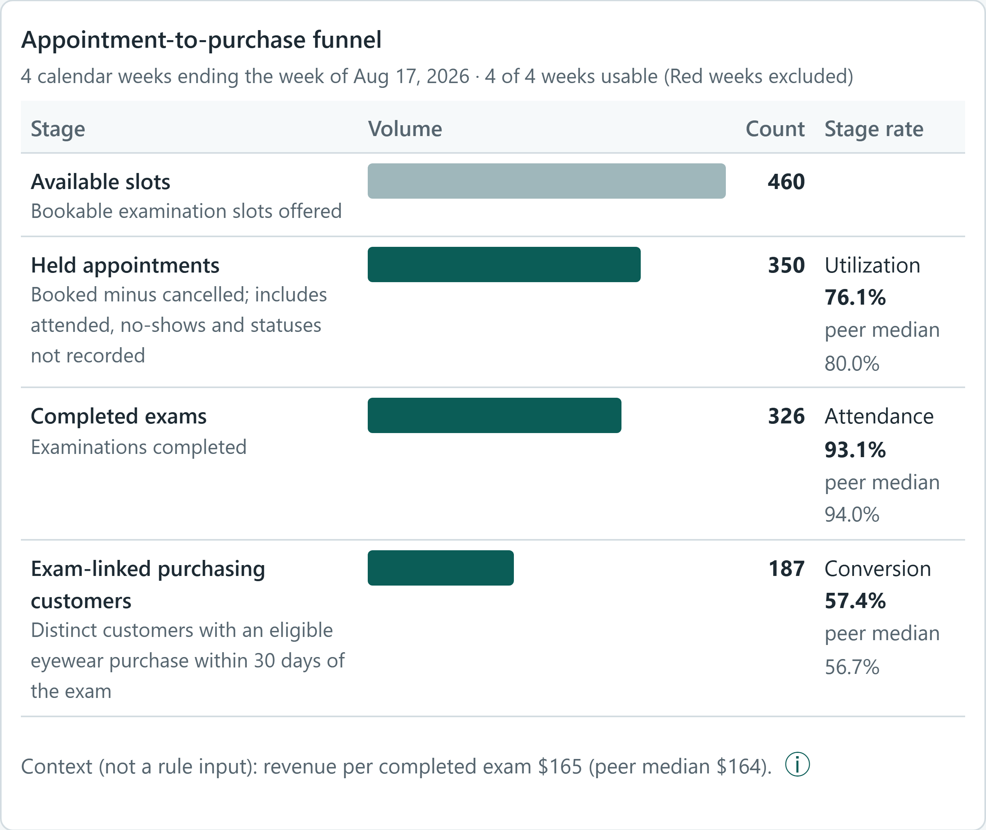
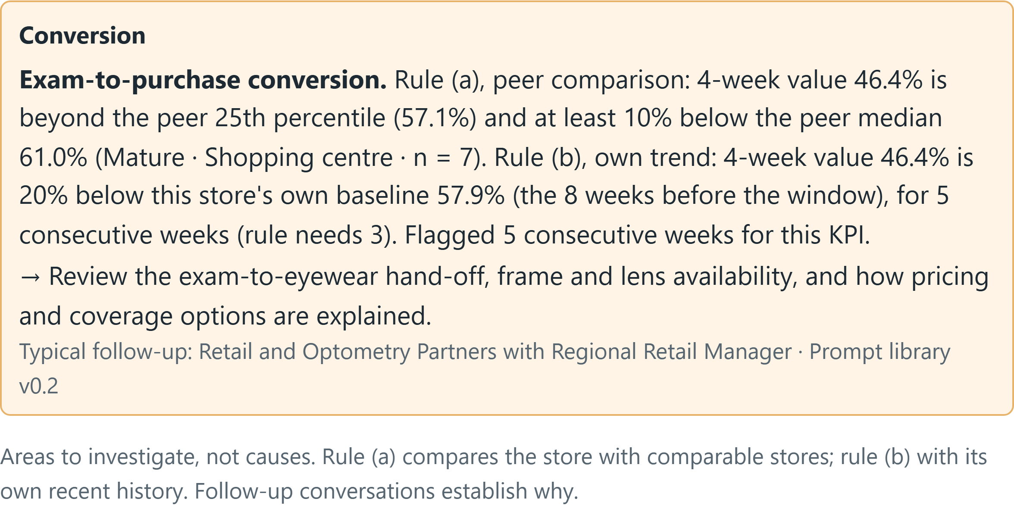
DEMONSTRATION ON SYNTHETIC DATA
7
SYNTHETIC
What a regional manager would see this week
Regional Overview · Atlantic (simulated role view) · week of 17 Aug 2026
Walkthrough
1
Scope first
The Atlantic manager sees 6 stores and 545 exams; the banner shows 0 Amber because both Amber stores are elsewhere.
2
One shared pattern
SYN-025 to SYN-028 are flagged on on-time and turnaround. Atlantic turnaround 8.9 days vs 6.0–6.1 elsewhere (last 4 weeks) → one Supply Chain conversation.
Funnel · SYN-014 · 4 weeks ending 17 Aug 2026
Rule (b) explanation · SYN-005 · week of 25 May 2026
Fair for young stores
SYN-014 has ramp index 102 against 7 same-age peers: on track despite low volume.
3
4
Trust gate
SYN-022's Red week (25 May 2026) shows no values and no flags, only a data-quality prompt.
5
Own-trend rule
SYN-005's conversion is 15%+ below its own baseline (11 May – 8 Jun 2026) — an area to investigate, not a cause.
SYNTHETIC DATA: 30 fictional stores × 26 weeks; unrelated to Specsavers results. Screens from dashboard-mockup.html. Roles are simulated, not secured. Periods as labelled.
Notes:
This is the prototype, running on my synthetic data, as a regional manager in the Atlantic region would see it in the week of 17 August 2026. Step one: scope comes first — every card, chart and the data-quality banner count only the 6 Atlantic stores; the network's two Amber stores are outside the region, so the banner shows zero. Step two: four Atlantic stores are flagged on both on-time and turnaround against comparable stores, and the region's turnaround is 8.9 days over the last four weeks against about six elsewhere, so the right action is one conversation with Supply Chain rather than four store conversations. Step three: SYN-014, a young grocery-hosted store, looks small on volume but its ramp index is about 100 against stores at the same age. Step four: for a week with Red data quality the product shows no values and no flags. Step five: SYN-005 is flagged by the own-trend rule, and the explanation says so rather than implying a peer difference. The role switch is a simulated view; the page embeds all synthetic data and is not security.

Slide 8
MVP PLAN, UAT AND WHAT WAS ACTUALLY TESTED
8
A three-page pilot, and a prototype tested before any user sees it
MVP: three pages · store-week aggregates · 12 governed KPIs · like-for-like peers · non-causal prompts · visible data quality · role-based access. Pilot: 2–3 Regional Retail Managers and 12–16 opt-in stores in two regions. Excludes patient-level data, profitability, forecasting and PC Optimum analytics.
Illustrative 12-week build-to-pilot plan
ILLUSTRATIVE
What I built and tested (prototype, synthetic data)
Sprint 0
Sprints 1–3 build
UAT
4-week pilot → evaluate
32/32
30
10 user stories with Given/When/Then and negative scenarios
24 UAT scenarios · 7 reconciliation · 10 access · 8 accessibility checks
Sign-off order: privacy → reconciliation → stories → business → release
structural and seeded-pattern data checks
calculation regression tests (Python)
15
83/83
logic tests, incl. Python ↔ JavaScript reconciliation
rendered-page checks: 4 roles, 3 pages, 5 widths, keyboard
NOT EXECUTED
UAT with business users, reconciliation to control totals, security testing, usability and accessibility audits have not happened. They are the plan for an internal team, not results.
Fixed before sign-off: regional scope, Red-week values, suppression via chart positions, dropped flag reasons (issue register: 45 items)
Automated checks on synthetic data and simulated roles — not UAT, not Power BI, not an accessibility audit
Timeline, pilot size and thresholds are illustrative proposals. Plans: Phase 11 and Appendix A9. Test evidence: evidence/test-report.md and evidence/test-results.md.
Notes:
The MVP is deliberately small: three pages, store-week aggregates and twelve governed KPIs, piloted with two or three regional managers and twelve to sixteen opt-in stores within an illustrative twelve weeks. On the left is the plan for an internal team — stories, twenty-four UAT scenarios and a sign-off order with privacy first. None of that has been executed, and I label it that way. On the right is what I actually did: 32/32 data checks, 30 calculation tests, 15 logic tests that reconcile the dashboard's JavaScript against the Python engine, and 83/83 rendered-page checks across simulated roles, pages, screen widths and real key presses. Testing found real defects in my first prototype — the regional view used network figures, Red weeks still showed values, and a chart revealed suppressed counts — and I fixed and regression-tested them. These are prototype checks on synthetic data, not user acceptance.

Slide 9
LIMITATIONS, VALIDATION NEEDED AND NEXT STEPS
9
Honest limits, and what I would ask first
Value to test (not monetised)
Limitations
Open decisions I did not make
Pilot users rate comparisons as fair
Stores needing attention found sooner
Flags get a named follow-up owner
Data quality visible before action
Public, largely company-authored sources
Synthetic data; roles simulated, not secured
No Power BI build; DAX unexecuted
No UAT, usability study or accessibility audit
U-38: can managers see other regions?
U-39: is complementary suppression needed?
U-41: should Optometry Partners see conversion?
Opening dates for converted or relocated stores
First steps inside the business
Questions for Specsavers
1. Review today's reports; interview managers and partners
2. Agree KPI definitions, owners and peer rules
3. Confirm data access, store crosswalk and linkage custody
4. Privacy review; test the prototype with 5+ users
How do teams judge today whether a new store is on track?
Which event defines a store's opening date, and who owns it?
How, and under whose custody, are exams and purchases connected?
What peer-comparison principles would partners support?
No financial ROI is claimed. Measures and thresholds are illustrative and need baselines and internal validation. Registers: Appendix A10; status of every feature: feature-status-matrix.md.
Notes:
I have not claimed any financial ROI. The value I would test is fairness, speed of finding stores that need attention, follow-up ownership and visible data quality. The limitations are real: public sources, synthetic data, simulated roles rather than security, no Power BI build, and no user testing or accessibility audit. Three policy decisions are deliberately left open because they belong to Specsavers — regional visibility, complementary suppression and whether Optometry Partners see conversion — and the prototype labels its assumptions for each. My first steps would be to validate that the problem exists, agree definitions and rules, confirm data access and privacy, and put the prototype in front of users.

Slide 10
APPENDIX A1
Sources (accessed 13 September 2026) — titles are links
Evidence | Source (select to open) | Date | Access note
EV-01 | Loblaw — Specsavers to open 111 new optical locations in Loblaw grocery stores | 30 Jul 2025 | Read
EV-02 | Specsavers appoints Jane Hoban as Managing Director (Newswire copy) | 11 Mar 2026 | Canonical specsavers.ca page returned 403
EV-03–05, 10, 11, 16 | Specsavers Canada partnership prospectus (PDF) | Oct 2025 | Read (text extracted)
EV-03, 15 | Specsavers partnership — Retail partnership page | Accessed 13 Sep 2026 | Read
EV-06 | Specsavers surpasses 100-store milestone in Canada (Newswire copy) | 7 Feb 2024 | Canonical page 403
EV-07 | Canada Eyecare Report 2025 — national vision gap (Newswire copy) | 9 Oct 2025 | Commissioned survey
EV-08, 17 | Loblaw — Specsavers joins PC Optimum program | 22 Jun 2026 | Re-read 13 Sep 2026
EV-09a | Data Business Analyst, Burnaby (jid-13707) | Live at access | Hiring evidence
EV-09b | Data Analyst, Burnaby (jid-13749) | Live at access | Hiring evidence
EV-09c | Data Delivery Manager, Burnaby (jid-13764) | Live at access | Hiring evidence
EV-09d | Product Owner — PMS/EMR application, Burnaby (jid-13803) | Live at access | Hiring evidence
EV-12 | Specsavers Canada candidate privacy policy | Accessed 13 Sep 2026 | Read
EV-13 | Retail Regional Manager, Burnaby (jid-8803) | Closed posting | HTTP 404; snippet only
EV-14 | Regional Training Manager, Burnaby (jid-3691) | Closed posting | HTTP 404; snippet only
Power BI | Microsoft Learn — Set and use date tables in Power BI Desktop | Accessed 13 Sep 2026 | Design reference
Power BI | Microsoft Learn — Tabular model object-level security | Accessed 13 Sep 2026 | Design reference
Notes:
Full source references:
EV-01 — Loblaw — Specsavers to open 111 new optical locations in Loblaw grocery stores (30 Jul 2025). https://www.loblaw.ca/en/specsavers-to-open-111-new-optical-locations-in-loblaw-grocery-stores-across-canada/ — Read.
EV-02 — Specsavers appoints Jane Hoban as Managing Director (Newswire copy) (11 Mar 2026). https://www.newswire.ca/news-releases/specsavers-appoints-jane-hoban-as-managing-director-to-lead-next-phase-of-canadian-expansion-873853796.html — Canonical specsavers.ca page returned 403.
EV-03–05, 10, 11, 16 — Specsavers Canada partnership prospectus (PDF) (Oct 2025). https://specsaverspartnership.ca/wp-content/uploads/2025/10/vx250312_03_Specsavers-Canada-Prospectus_8-2677x5-8268_EN_x1a-trim-6.pdf — Read (text extracted).
EV-03, 15 — Specsavers partnership — Retail partnership page (Accessed 13 Sep 2026). https://specsaverspartnership.ca/retail-partnership/ — Read.
EV-06 — Specsavers surpasses 100-store milestone in Canada (Newswire copy) (7 Feb 2024). https://www.newswire.ca/news-releases/specsavers-surpasses-100-store-milestone-in-canada-805965501.html — Canonical page 403.
EV-07 — Canada Eyecare Report 2025 — national vision gap (Newswire copy) (9 Oct 2025). https://www.newswire.ca/news-releases/specsavers-canada-highlights-national-vision-gap-one-third-of-canadians-are-overdue-for-an-eye-exam-848439853.html — Commissioned survey.
EV-08, 17 — Loblaw — Specsavers joins PC Optimum program (22 Jun 2026). https://www.loblaw.ca/en/specsavers-joins-pc-optimum-program/ — Re-read 13 Sep 2026.
EV-09a — Data Business Analyst, Burnaby (jid-13707) (Live at access). https://join.specsavers.com/ca/job/data-business-analyst-in-burnaby-british-columbia-canada-jid-13707 — Hiring evidence.
EV-09b — Data Analyst, Burnaby (jid-13749) (Live at access). https://join.specsavers.com/ca/job/data-analyst-in-burnaby-british-columbia-canada-jid-13749 — Hiring evidence.
EV-09c — Data Delivery Manager, Burnaby (jid-13764) (Live at access). https://join.specsavers.com/ca/job/data-delivery-manager-in-burnaby-british-columbia-canada-jid-13764 — Hiring evidence.
EV-09d — Product Owner — PMS/EMR application, Burnaby (jid-13803) (Live at access). https://join.specsavers.com/ca/job/product-owner-in-burnaby-british-columbia-canada-jid-13803 — Hiring evidence.
EV-12 — Specsavers Canada candidate privacy policy (Accessed 13 Sep 2026). https://join.specsavers.com/ca/candidate-privacy-policy/ — Read.
EV-13 — Retail Regional Manager, Burnaby (jid-8803) (Closed posting). https://join.specsavers.com/ca/job/retail-regional-manager-in-burnaby-british-columbia-canada-jid-8803 — HTTP 404; snippet only.
EV-14 — Regional Training Manager, Burnaby (jid-3691) (Closed posting). https://join.specsavers.com/ca/job/regional-training-manager-in-burnaby-british-columbia-canada-jid-3691 — HTTP 404; snippet only.
Power BI — Microsoft Learn — Set and use date tables in Power BI Desktop (Accessed 13 Sep 2026). https://learn.microsoft.com/en-us/power-bi/transform-model/desktop-date-tables — Design reference.
Power BI — Microsoft Learn — Tabular model object-level security (Accessed 13 Sep 2026). https://learn.microsoft.com/en-us/analysis-services/tabular-models/object-level-security?view=sql-analysis-services-2025 — Design reference.
Where specsavers.ca pages blocked automated access, I verified the same releases on Newswire or Loblaw and recorded both URLs in evidence-log.md.

Slide 11
APPENDIX A2
Evidence log — facts, inferences and corrections
ID | Verified claim (summary, dated) | Class | Correction / note
EV-01 | 30 Jul 2025: 111 in-grocery locations announced; network projected above 260; six new provinces or territories | Fact | Announcement and projection, not outcome
EV-02 | 11 Mar 2026: more than 270 stores; more than 130 opened in 2025; "number one" ambition | Company statement | Cite as "reported Mar 2026"
EV-17 | 22 Jun 2026: the 111 in-grocery locations opened in 2025; 270+ locations, nine provinces and one territory | Fact | Added in repair pass; completes EV-01
Inference | ≈ half of stores opened in 2025 (130+ of 270+) | Inference | Author's arithmetic on lower bounds
EV-03/04 | Optometry and retail corporations; owned per provincial regulations | Fact / statement | Prospectus is the citation
EV-05 | Nine support services incl. patient recall and patient-record systems | Fact | Training and recruitment separate
EV-06 | 7 Feb 2024: 100th store; 20% under six months old | Historical | Revenue figures not verified
EV-07 | 1 in 3 overdue; 51% cost; 61% coverage misunderstanding | Commissioned research | "or never" wording removed
EV-08 | PC Optimum at all locations, 10 points per $1 (22 Jun 2026) | Fact | Excluded from MVP
EV-09 | Data postings: Power BI, SQL, Databricks; PMS/EMR product owner | Hiring evidence | Shows categories, not architecture
EV-11 | Prospectus shows 151 Canadian stores (2024/25) | Historical | Stale — model only
EV-12 | Named Privacy Officer; PIPA/PIPEDA referenced | Fact | Team structure unknown
EV-13/14 | Retail Regional Manager; Regional Training Manager (closed) | Indirect | Low confidence
EV-15/16 | Partnership Advisory Committee; support-office roles | Company statement | Remit unknown
Notes:
The evidence log separates facts, company statements, commissioned research, hiring evidence and my own inferences. The repair pass added EV-17, which confirms that the 111 in-grocery locations announced in July 2025 opened during 2025, and it dates every network count.

Slide 12
APPENDIX A3
Stakeholder analysis — evidence status, influence and roles
ID | Stakeholder | Evidence | Infl. | Int. | Requirements, approval and UAT role (proposed)
SH-01 | Retail Partners | Confirmed | High* | High | Store needs · endorsement via SH-14 · pilot testers
SH-02 | Optometry Partners | Confirmed | High | Med–High | Clinical wording and privacy · consulted · clinic view tests
SH-03 | Regional Retail Managers (title TBC) | Assumed / indirect | Med–High | High | Exception and workflow needs · core UAT testers
SH-04 | Retail Operations leadership | Function confirmed | High | High | Sponsor (assumed) · peer rules · business sign-off
SH-05 | Marketing | Function confirmed | Medium | Medium | Recall KPI owner · recall reconciliation
SH-06 | Supply Chain | Function confirmed | Medium | Medium | Fulfilment KPI owner · fulfilment reconciliation
SH-07 | Finance | Function confirmed | High | Medium | Revenue definitions · revenue reconciliation
SH-08 | Product Owner (data) | Role type confirmed | High | High | Backlog and story acceptance · co-signs UAT
SH-09 | Data Business Analyst | Confirmed | Medium | High | Elicitation, requirements, mapping, RTM · UAT lead
SH-10/11 | Data Engineers · Visualization Analysts | Confirmed | Med–High | High | Feasibility, model, report build · defect fixes
SH-12 | Data Delivery Manager | Confirmed | High | High | Release readiness · UAT gates
SH-13 | Governance / Privacy / Security | Privacy Officer confirmed | High | Med–High | Privacy and access approval · witnesses access tests
SH-14 | Partnership Advisory Committee | Confirmed exists | High | Medium | Comparison principles · endorsement
SH-15 | Business Development / openings | Function confirmed | Medium | High | Opening-date master data owner (TBC)
SH-16/17/18 | Clinical Services · System owners · Executive | Indirect / confirmed | Varies | Varies | Clinical wording · data access · informed
*Collectively. RACI (19 activities) and the 8-stage engagement plan: phase-02-stakeholders.md. All roles are proposals; no stakeholder has reviewed them.
Notes:
Stakeholder evidence status is explicit — for example, the Privacy Officer role is publicly confirmed but a dedicated governance team is not.

Slide 13
APPENDIX A4
Requirements catalogue (summary)
Business objectives
Functional requirements
BO-01 Fair like-for-like assessment (Must)
BO-02 Surface stores earlier, esp. ramp-up (Must)
BO-03 Trusted, governed KPIs (Must)
BO-04 Better-targeted follow-up (Must)
BO-05 Balanced access and commercial view (Should)
BO-06 Privacy and confidentiality by design (Must)
BO-07 Reduce manual effort — if validated (Could)
MVP: FR-01 overview · FR-02 filters · FR-03 maturity · FR-04 peers · FR-05 drill-through · FR-06 exceptions · FR-07 definitions · FR-08 data quality · FR-10 access · FR-13 ramp-up · FR-14 funnel · FR-15 prompts · FR-16 small groups
If low effort: FR-09 landing views · FR-11 exports · FR-12 persistent filters
Deferred: FR-17 annotations · FR-18 action log
Prototype status of each: feature-status-matrix.md (FR-10 simulated; FR-11 deferred)
Business requirements
BR-01 Network monitoring (M) · BR-02 Maturity-aware comparison (M)
BR-03 Candidate factors to investigate (S) · BR-04 Governed KPIs (M)
BR-05 Visible data quality (M) · BR-06 Partner information (M)
BR-07 Regional patterns (S) · BR-08 Protect sensitive information (M)
BR-09 Support action (M) · BR-10 → constraint CON-01
BR-11 Access indicators (S) · BR-12 Reduce manual compilation (C)
Non-functional, data, privacy and security (targets illustrative)
NFR-01–08: ≤5 s interactions · weekly refresh · 99% availability · WCAG 2.1 AA target · SUS ≥70 · 400-store scale · supportability · mobile
DR-01–10: lineage · versioning · retention · completeness · freshness · store-week grain · store master · reconciliation · null vs zero · as-at-week cohort
PR-01–08: no identifiers or diagnoses · peer floor 5 · small-count rule v0.2 · no individual performance · privacy review · partner confidentiality · synthetic non-production
SR-01–08: least privilege · RLS · OLS · audit · export limits · recertification · SSO/MFA · environments (specified, not built)
Notes:
Full statements, rationale, owners, measures and validation questions are in the Phase 3, 4 and 5 documents. The feature-status matrix shows which are implemented in the prototype, simulated, specified only or deferred.

Slide 14
APPENDIX A5
KPI dictionary v0.2 (proposed definitions — not Specsavers definitions)
ID | KPI | Formula (store-week; re-aggregated from sums) | Proposed owner | Key rule
KPI-01 | Available capacity | Σ bookable exam slots | Retail Ops | Excludes blocked or closed slots; null ≠ 0
KPI-02 | Appointment utilization | (Booked − cancelled) ÷ slots | Retail Ops | No-shows count as held
KPI-03 | Attendance rate | Completed ÷ (booked − cancelled) | Retail Ops | Unrecorded statuses shown, not hidden
KPI-04 | Completed examinations | Count of completed exam appointments | Clinical Services | No clinician dimension
KPI-05 | Exam-to-purchase conversion | Distinct exam-linked purchasers (≤30 days) ÷ completed | Retail Ops | Customers, not transactions; linkage upstream
KPI-06 | Revenue per completed exam | Net eligible eyewear revenue ÷ completed | Finance | Context only; restricted; negative weeks valid
KPI-07 | Average order turnaround | Σ (ready − placed days) ÷ orders ready | Supply Chain | Prototype assumes all placed orders ready
KPI-08 | On-time fulfilment | Ready by promised date ÷ orders placed | Supply Chain | Excludes cancelled orders
KPI-09 | Recall-booking rate | Recall bookings (≤30 days) ÷ recall contacts | Marketing | n/a before programme; 1–4 shown as <5
KPI-10 | Store ramp index | 100 × store 4-week exams ÷ median of peers at same weeks since opening | Retail Ops | ≥5 peers; trigger <80 for 4 weeks
KPI-11 | Data completeness | Mean of per-source received ÷ expected (equal weight) | Governance | ≥98 Green · 90–98 Amber · <90 Red
KPI-12 | Data freshness | Current / Delayed / Stale by load age | Data team | Worst source wins; Stale withholds
All rates: 4 calendar weeks ending the selected week, ≥3 usable weeks, unavailable if the selected week is Red. Cohorts: New 0–26 · Developing 27–104 · Mature 105+ weeks. Change log: phase-06-kpi-dictionary.md.
Notes:
Each KPI has fifteen documented fields in the full dictionary. Version 0.2 clarifies the rolling window and Red-week rule, extends small-count suppression to rates with a small numerator, chooses one completeness method, and states two synthetic simplifications. No KPI IDs changed.

Slide 15
APPENDIX A6
ASSUMPTION
Conceptual data model — star schema with as-at-week cohort
DIM_STORE
store_id · format · host banner · opening date and type · effective dates
Cohort and geography are resolved as at each fact week, so a store can move from New to Developing mid-period. Conversion (exam week) and revenue (transaction week) are separate facts.
DIM_DATE
contiguous daily calendar · week start · published flag
FACT_APPOINTMENT
store × week
FACT_EXAMINATION
store × week
FACT_EXAM_CONVERSION
store × exam week
FACT_SALES_REVENUE
store × transaction week
FACT_ORDER_FULFILMENT
store × placed week
FACT_RECALL_CAMPAIGN
store × contact week
FACT_DATA_QUALITY
store × week × source
DIM_GEOGRAPHY
province · region (effective-dated)
DIM_MATURITY_COHORT
New / Developing / Mature / Unclassified · version
Supporting: store-level KPI, peer and exception tables · ramp index · KPI dictionary · rule and prompt tables · user-store access (security only)
Notes:
Separate facts load and reconcile independently; the prototype flattens them into one store-week CSV. The repair pass split the earlier FACT_SALES into exam-week conversion and transaction-week revenue, because two independent weekly aggregates cannot share a row without defining its meaning. Source-to-target mapping (23 rows), checkpoints and master-data responsibilities are in phase-07-data-model-and-flow.md.

Slide 16
APPENDIX A7
Traceability matrix (summary) and gap findings
BR | FR | KPI | User stories | UAT | Release
BR-01 Network monitoring | FR-01, 02, 05, 09 | KPI-01–09 | US-01, US-02 | 01, 02, 05, 14–16, 23 | MVP
BR-02 Maturity comparison | FR-03, 04, 13, 16 | KPI-04, 10 | US-03, US-10 | 03, 04, 18, 22 | MVP
BR-03 Candidate factors | FR-04, 14, 15, (17) | KPI-02, 03, 05, 07–09 | US-04 | 06, 21, 24 | MVP
BR-04 Governed KPIs | FR-07 | KPI-01–12 | US-05 | 07, 15–17 | MVP
BR-05 Data quality | FR-08 | KPI-11, 12 | US-06 | 08, 15 | MVP
BR-06 Partner information | FR-04, 09, 10, 12 | KPI-02–06, 10 | US-03, 04, 07 | 09, 19, 23, 24 | MVP
BR-07 Regional patterns | FR-02, 05, 06 | KPI-02, 05, 07, 08 | US-02 | 02, 05, 17 | MVP (Should)
BR-08 Protect information | FR-10, 11, 16 | KPI-06, 09 | US-07, 08, 10 | 09–12, 18 | MVP
BR-09 Support action | FR-06, 15, (18) | KPI-02, 03, 05, 07, 10 | US-04 | 06, 21 | MVP
BR-10 → CON-01 | — by design | — | US-09 | 20 | Constraint
BR-11 Access indicators | FR-01, 14 | KPI-03, 04, 09 | US-01, 04 | 01, 06 | MVP
BR-12 Manual compilation | FR-11 | — | US-08 | 12 | Could
Gap findings (25 logged)
BO-07 weakly supported: no Must-level requirement or baseline
FR-12, FR-17, FR-18 have no user story
KPI-01 and KPI-06 weakly tied to a decision
US-02, US-10 not Ready until U-38 and U-39 are decided
KPI-05 visibility for Optometry Partners open (U-41)
Repair pass (RTM-18–25): the first prototype did not meet several traced requirements — scope, Red weeks, suppression, flag reasons — until fixed and tested
Notes:
I reported gaps rather than engineering a perfect matrix. The repair pass added a lesson: an ID-level traceability matrix can be complete while the product still fails the requirement, so behaviour tests are linked back to the requirement IDs.

Slide 17
APPENDIX A8
SYNTHETIC
Synthetic-data methodology and validation
Generation
Validation and tests
Pattern | Synthetic evidence (period)
P1 New stores improve | All 11 New-at-start stores improve utilization and exams (first vs last 4 weeks)
P2 Regional turnaround | Atlantic 8.7 vs 6.0 days (all weeks); 5 of 6 above median
P3 High demand, low attendance | SYN-012 / SYN-019 ≈ 94% utilization, ≈ 84% attendance (all weeks)
P4 Mature conversion decline | SYN-005 62.9% → 42.9% (weeks 1–6 vs last 8); exams flat
P5 Data-quality warnings | 5 Amber and 4 Red store-weeks; Red weeks withheld, no flags
P6 Cohort differences | Exams per store-week 66 / 102 / 150 (all weeks)
Rule coverage | 228 stage flags (8.8/week); ramp index available 36%; 216 weekly counts shown as <5
30 fictional stores (SYN-001–030), 26 weeks from 23 Feb 2026; 761 rows, 24 columns
8 provinces, 4 synthetic regions, 3 formats; generic host banners
Cohort as at each week; 3 stores open mid-window
Ramp-up curve drives capacity, utilization and conversion
Reproducible: seed 20260913 (byte-identical rerun tested)
Simplifications: snapshot treated as final; all orders reach ready; completeness simulated; no converted stores
32/32
Structure, keys, arithmetic, null semantics
Each deliberate pattern tested
30 calculation tests: windows, Red weeks, peers, suppression, rules, ramp
15 logic tests reconcile JavaScript with Python
83/83 rendered-page checks
Issues fixed: 3 in the data, 4 in the calculation engine (repair pass)
Fictional data, unrelated to Specsavers stores, partners, patients or results. Files: data/synthetic_store_weekly.csv · data/validation-results.md · build/*.py · tests/
Notes:
The dataset is designed to test the rules — small peer groups, suppression, null versus zero, Red data weeks — not just to produce nice charts. The repair pass found four defects in my own calculation engine, fixed them in the engine rather than the outputs, and added regression tests for each.

Slide 18
APPENDIX A9
NOT EXECUTED
UAT plan (summary) — a plan, not results
Area | Scenarios | Expected results (synthetic test data)
Core pages | UAT-01–06, 22, 23 | Default latest week; ratio of sums; SYN-014 changes cohort 20 Jul 2026; SYN-025–028 flagged on on-time and turnaround
Definitions and data quality | UAT-07, 08 | Dictionary version shown; SYN-022 Red weeks withheld in the week itself, no flags, excluded from peers
Security and privacy | UAT-09–12, 18 | Partner sees only SYN-014; Atlantic manager sees 6 stores, 545 exams, no out-of-region names; <5 rule
Reconciliation | UAT-15–17 | Exams ±0.5% · revenue ±1.0% · orders ±0.5% vs control totals (illustrative)
Quality attributes | UAT-13, 14, 19, 24 | WCAG checks; ≤5 s interactions; persistent filters; 80% complete triage task ≤3 min
Interpretation and sign-off | UAT-20, 21 | 0 prohibited causal terms; ≥80% comprehension; sign-off order recorded
Level | Status
Data and pattern checks | Executed (32/32)
Calculation and reconciliation | Executed (30 + 15)
Rendered-page regression | Executed (83/83)
Power BI (DAX, RLS, OLS) | Not executed
UAT with business users | Not executed
Entry and exit
Entry: stories done · test environment · role accounts · privacy review · no Sev 1
Exit: 100% Must scenarios run · ≥95% pass · 0 Sev 1–2 · access tests witnessed
Pilot: 4 weeks · office hours · pulse surveys · evaluation workshop
Notes:
Expected results reference deterministic synthetic test cases, so every scenario is reproducible. The status table separates what I executed on the prototype from what only an internal team can execute.

Slide 19
APPENDIX A10
Risk and assumption registers (highlights)
ID | Risk | P×I | Mitigation | Early warning
R-01 | Conflicting KPI definitions | 16 High | Domain workshops; governed dictionary | Two or more definitions surface
R-02 | Unfair store comparisons | 15 High | Cohort × format peers; comprehension tests | Fairness score <80%
R-04 | Missing or delayed data | 16 High | Checkpoints; withholding; publish gate | Red store-weeks >5%
R-11 | Incorrect causal interpretation | 16 High | Rule-specific text; UAT-21; training | Flags quoted as causes
R-14 | Source-system integration | 16 High | Sprint 0 access; ready sources first | No access by end of Sprint 0
R-15 | Master-data inconsistency | 16 High | Crosswalk; opening-date owner | Unmapped store codes
R-05 | Privacy exposure | 10 (critical) | Privacy boundary; PR-01–04; review | Identifier-like fields in scan
R-22 | Prototype mistaken for secured or production-ready | 9 Medium | Simulated-role note; status matrix | Prototype called "secured" or "tested with users"
Lowest-confidence assumptions
A-06 Aggregated exam counts can be shown to retail users
A-17 Partnership Advisory Committee suits endorsement
A-19 Manual compilation exists today
A-26 Finance can provide weekly control totals
A-31 / A-33 Exam↔purchase linkage without exposing identifiers
A-46 Optometry Partners see conversion (demonstration only, U-41)
Registers: 22 risks · 47 assumptions · 9 constraints · 12 dependencies · 42 open questions (phase-10-raid-registers.md).
Notes:
Six risks rate High. The lowest-confidence assumptions are the ones I would test first in discovery. The repair pass added R-22: a polished prototype can be mistaken for a secured or user-tested product, so every page and document states its status.

