Slide 1
SMART INDIA HACKATHON 2026
TRAJECTORY
PROBLEM STATEMENT ID
SIH26153
PROBLEM STATEMENT TITLE
AI based Network Attack Forecasting from Network Traffic Data
AI-Based Network Attack Forecasting from Network Traffic Data
ORGANIZATION
National Technical Research Organisation (NTRO)
An offline, explainable temporal cyber-defence system that forecasts likely attack progression before compromise is complete.
THEME
Blockchain & Cybersecurity
PS CATEGORY
Software
TEAM ID
Network Telemetry
Current State
Future Forecast
Earlier Response
[ADD OFFICIAL TEAM ID]
TEAM NAME
[ADD OFFICIAL TEAM NAME]
INSTITUTE
[ADD OFFICIAL INSTITUTE NAME]
Forecasts are probabilities with evidence; Trajectory supports analyst decisions and does not block traffic.

Slide 2
Solution Overview & Prototype
TRAJECTORY | SIH26153 | 2/6
From static alerts to predictive attack intelligence
Trajectory ingests flow CSV and PCAP-derived packet data, converts them into ordered network states, and forecasts likely attack progression over K future windows: risk, predicted stage, affected assets, confidence and supporting evidence in an offline analyst dashboard (Web/desktop).
PROTOTYPE VISUALS
1. Data Workspace
CSV/PCAP input | event count, time range | feature-coverage indicators
SOC Analyst
Incident Responder
Security Lead / Evaluator
• Load CSV flows / PCAP captures
• Risk timeline over time windows
• Next likely stage + affected assets
• Evidence behind every forecast
• Predicted vs actual replay
• Prioritize hosts/segments at risk
• Confidence + insufficient-evidence flags
• Decision support, not auto-blocking
• Export reproducible forecast record
• Temporal model vs logistic baseline
• Precision, recall, F1, FPR, calibration
• Forecast lead time
• Deterministic, seed-fixed replay
• Fully local; no cloud AI
2. Forecast Dashboard
Risk over K windows | Current / Forecast / Actual replay | stage + confidence
3. Evidence View
Driving features | Server-03, failed-auth burst, destination diversity | source events
Project Status
Why We Stand Out
• Phase: ingestion + temporal-data foundation done
• CSV & PCAP ingestion, flow + packet features
• Timestamped overlapping state windows
• Transition targets, leakage-safe splits
• 15 tests passing; baseline model is next
• Predictive, not retrospective
• K-step future-state simulation
• Temporal context instead of per-flow labels
• Evidence + assets with every forecast
• Offline-first; honest baseline comparison
ILLUSTRATIVE OUTPUT
Current state: Suspicious reconnaissance
Predicted stage: Lateral movement (+3 windows)
Likely asset: Server-03 Confidence: 0.72
Evidence: failed-auth burst, new internal connections, rising destination diversity
Replace mockup panels with screenshots and the illustrative output with model output before submission.

Slide 3
Backend Architecture & Technical Approach
TRAJECTORY | SIH26153 | 3/6
Local, reproducible, evidence-first forecasting pipeline
INPUT
Flow CSV | PCAP captures -> normalization + packet feature extraction
TECHNICAL APPROACH FLOW
Ingest
Normalize
Window
Prepare
DATA
Unified events -> timestamped windows -> state store | labels, transition targets, split manifests
Learn
Simulate
Explain
Display
MODEL
Logistic Regression baseline (current window) | GRU/LSTM temporal model + K-step rollout
Security lead configures scenario & evaluation -> Analyst loads telemetry & inspects forecast -> Responder validates evidence & acts
AI COMPONENTS
OUTPUT
Risk timeline | attack stage | assets | evidence | confidence + warnings
Component | Technique | Function
Static baseline | Logistic Regression | Fair reference from the current window
Temporal forecaster | GRU / LSTM (proposed) | Learn dependencies across ordered states
Future simulation | Recursive K-step rollout | Likely future states, risk trajectory
Stage mapping | Documented rules / classifier | MITRE ATT&CK-oriented stage label
Explanation | Attribution + event retrieval | Driving features and traffic evidence
Calibration | Reliability analysis | Useful confidence values
UI
Offline analyst dashboard (Streamlit/Flask + Plotly)
Security & Privacy
Input Fallback Logic
• Local-first; no external AI service
• Anonymized identifiers in demos
• No secrets/captures committed
• Provenance, versions, checksums
• Human-in-the-loop; no auto-blocking
• PCAP -> flow + packet features
• CSV only -> flow features + packet-coverage warning
• Data missing -> validation error, no fabricated forecast
• All paths run offline
No Kafka/cloud gateway/microservices are claimed: the prototype runs on local files and model artifacts. Docker only if packaged before submission.

Slide 4
Feasibility, Viability & Challenges
TRAJECTORY | SIH26153 | 4/6
Feasible with open data, local compute and controlled deployment
CHALLENGES -> TECHNICAL RESPONSES
Technical
Operational
Challenge | Technical response
Rare, imbalanced attacks | Class weighting, per-class metrics, PR analysis
Temporal leakage | Scenario / campaign / time-held-out evaluation
Dataset shift | Secondary-dataset tests, per-site recalibration
Missing packet features | Coverage report + reduced-context warning
Recursive forecast drift | Short K horizon, calibration, uncertainty display
Ambiguous stage labels | Documented mapping; insufficient-evidence state
False-positive fatigue | Baseline comparison, threshold tuning, FPR reporting
Black-box predictions | Attribution, source-event evidence, asset context
Sensitive telemetry | Local processing, anonymization, restricted artifacts
Enterprise integration | File-based MVP first; adapters/APIs later
• Public flow & PCAP datasets available
• Open-source parsers + ML frameworks
• GRU/LSTM practical on dev hardware
• Scenario-safe splits, baseline defined
• Runs beside IDS / SIEM / EDR
• Analyst owns response decisions
• Deterministic replay for demos & audit
• Local processing for sensitive sites
Economic
Regulatory & Privacy
• Open-source stack, low prototype cost
• Software-only MVP, no custom hardware
• Augments existing tools
• Pilot-first phased adoption
• Synthetic / public / anonymized demo data
• Licences & access restrictions recorded
• Captures and model artifacts stay local
• Human approval; no autonomous enforcement
Market growth (illustrative shape)
Viability: feasible as an offline prototype on public datasets and open-source tools. Production use needs environment-specific validation, integration, calibration, access control and security review.
Base
Y+1
Y+2
Y+3
Y+4
CAGR: [ADD VERIFIED VALUE]% Source: [ADD REPORT, PUBLISHER, YEAR, URL]
Chart shape is illustrative until a verified market source is inserted; state geography and product scope with the figure.

Slide 5
Impacts, Benefits & Stakeholder Scenario
TRAJECTORY | SIH26153 | 5/6
Earlier, evidence-backed decisions can reduce attack impact
SUSTAINABLE DEVELOPMENT GOALS
Economic
Social
Environmental
Operational
SDG 9
Industry, Innovation & Infrastructure
• Analyst time on likely paths
• Less manual correlation
• Earlier intervention, lower downtime cost
• No stack replacement
• Resilient public services & CII
• Clearer incident context
• Humans keep the decision
• Accountable AI use
• Runs on ordinary hardware
• Reuses existing telemetry
• No mandatory cloud transfer
• Software-only, no devices
• Forecast before next stage
• Stage + asset + horizon + evidence
• Repeatable replay for audit
• Layer on existing controls
Resilience of digital and critical infrastructure via predictive security analytics
SDG 16
Peace, Justice & Strong Institutions
Safer digital public systems; accountable, evidence-backed security operations
SAMPLE SCENARIO: RECONNAISSANCE -> LATERAL MOVEMENT
Use official icons only where template/UN guidance permits.
Workstation-17 contacts many new destinations
Trajectory correlates recon + failed-auth burst
SOC analyst: early forecast toward Server-03
Responder validates evidence, acts
Security lead audits forecast vs outcome
Success criteria: forecast appears before the target stage is observable; evidence names real patterns and entities; predicted vs actual are visually distinct; replay is reproducible from the same configuration.
QUANTITATIVE TARGET IMPACT
Forecast lead time = t(target stage observable) - t(warning threshold crossed)
Time saved / incident = mean investigation time (current) - mean time with evidence panel
Analyst-hours recovered / year = valid incidents per year x time saved per incident
[ADD X] min median forecast lead time
[ADD Y]% investigation-time reduction (controlled user test)
[ADD Z] analyst-hours recovered / year | basis: [ADD DATASET / SCENARIOS / METHOD]
Do not convert model accuracy into financial savings without an explicit operational assumption.

Slide 6
Research, Market Sizing & Business Model
TRAJECTORY | SIH26153 | 6/6
Research-backed; scalable from offline pilot to enterprise integration
MARKET SIZING (BOTTOM-UP)
FIRST-YEAR REVENUE (ESTIMATE)
Official & Domain
Tier | Definition | Estimate
TAM | Orgs with network-security teams in target geography x annual value | [ADD N1 x A = TAM]
SAM | Reachable with offline product + supported integrations | [ADD N2 x A = SAM]
SOM | Realistic customers in first 3 years | [ADD N3 x A = SOM]
Licences [ADD L] x Rs[licence] = Rs[R1]
Deploys [ADD D] x Rs[deploy] = Rs[R2]
Support [ADD S] x Rs[support] = Rs[R3]
Training [ADD T] x Rs[training] = Rs[R4]
--------------------------------------
Total (business estimate) = Rs[ADD TOTAL]
• SIH 2026 PS: sih.gov.in/sih2026PS
• MITRE ATT&CK: attack.mitre.org | CAPEC: capec.mitre.org
• NVD: nvd.nist.gov | NCIIPC: nciipc.gov.in
Datasets
• CIC-IDS2017/2018, UNSW-NB15, CTU-13, CICIoT2023, LANL auth
• URLs: [ADD VERIFIED DATASET URLS]
• Only with documented licence, access, checksums
State: geography & sectors, org-count source, scope of annual value, adoption rationale, tax/support inclusion.
PROOF DOCUMENTS
• Source repo: [ADD GITHUB URL]
• Architecture: ARCHITECTURE.md
• Status: IMPLEMENTATION_STATUS.md
• Evaluation report: [ADD LINK AFTER BENCHMARKS]
• Demo video: [ADD FINAL VIDEO LINK]
• Consolidated research: [ADD FOLDER LINK]
• Reproducibility: README.md + uv.lock
REVENUE & HARDWARE
AI / ML Research
Component | Unit | Pricing basis
Platform licence | Per org / env / year | [ADD VALIDATED PRICE]
Deployment & integration | One-time per env | Data sources + SIEM effort
Model calibration | Per env / telemetry change | Data prep + threshold tuning
Support & updates | Annual | % of licence or tier
Hardware | Not required for MVP | Customer workstation/server
• GRU/LSTM sequence forecasting; recursive multi-step + uncertainty
• Calibration; feature attribution / XAI; scenario-held-out IDS evaluation
• Papers: [ADD 2-4 AUTHOR, TITLE, VENUE, YEAR, DOI]
Software
• PyTorch | scikit-learn | Scapy | NetworkX | Plotly | Streamlit
Trajectory adds a predictive layer to existing cyber defence: what may happen next, where, and why the analyst should look.

Slide 7

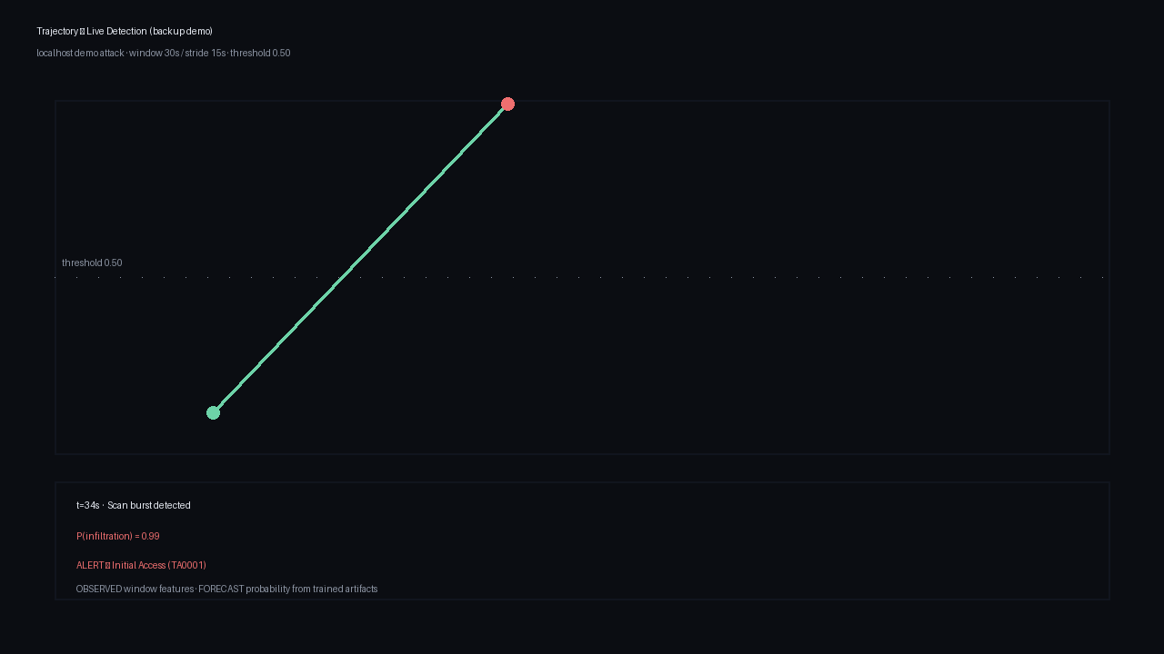
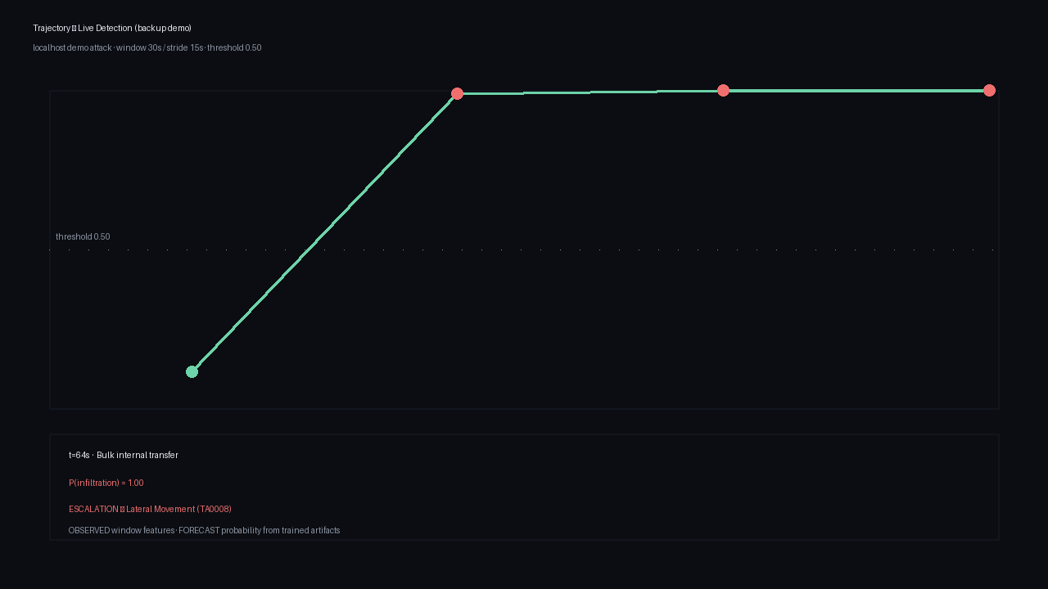
Live Demo — Watch the AI Detect an Attack
TRAJECTORY | SIH26153 | 7/6
Real-time detection on a localhost attack simulation; deterministic and rehearsed
Stage Storyline (measured in rehearsal)
• 0:00 — Train the models live (~3 seconds, deterministic seed)
• 0:10 — Press Start: benign chatter begins
• 0:19 — Quiet window: P(infiltration) = 0.12, no false alarms
• 0:34 — ALERT: scan burst detected at P = 0.99
• Stage: Initial Access — MITRE ATT&CK TA0001
• 0:49 — Failed logins: P = 1.00, evidence panel grows
• 1:04 — ESCALATION: Lateral Movement — MITRE TA0008
• Same trained artifacts as the offline benchmark
• Sources: demo attack, CIC-IDS2017 replay, live capture
t=19s — benign, P=0.12
t=34s — ALERT, P=0.99
t=64s — Lateral Movement
Backup if live infra fails: deliverables/backup_demo/backup_demo.gif (animated) — same numbers as the live run.

