Slide 1



Industrial Power Electronics
Simulation of Power Electronics Circuits using Python
Abhijit Patra

Slide 2
-:CONTENTS:-
Objective
01
Introduction
02
Requirements
03
04
Code
04
05
Result Analysis
05
06
Conclusion
07
References

Slide 3
-:OBJECTIVE:-
Electrical engineers and students may undergo challenges in developing and simulating electrical circuits.
python is a general-purpose open-source tool that supports circuit simulation for power electronics .
Using this we can simply observe the waveform without crating circuit diagram, we simply set the values according to that we observe our wave form.
If we want to check a DC-DC converter wave form then we create circuit using MATLAB and simulate then it take little bit more time but if we check it in our GUI then it is take less time.

Slide 4
-:INTRODUCTION:-
The main aim of this tool is to provide a sophisticated platform for simulating large systems using several power converters.
The modules and libraries are developed using python language for free distribution. Generally, the power electronics projects involve more usage of complex mathematical functions.
Python makes this complicated task into an easy one by providing in-built pre-defined functions for user benefit. So, it is easy to learn and analyze generated waveforms from power circuits.
Using this we simulate circuits like Single phase half wave-controlled rectifier, single phase fully controller rectifier, Single Phase Sine PWM inverter, Single Phase AC voltage regulator, DC-DC converter.
For this project we use Anaconda Python is a collection of a number of very useful Python development packages as well as an interpreter.

Slide 5

-:REQUIREMENTS:-
Software & system requirements:-
Linux environment: Installations have been tested on Red Hat Enterprise Linux/CentOS 6.7, 7.3, 7.4, and 7.5, and Ubuntu 12.04+. Verify Linux version.
Client environment may be Windows, macOS or Linux.
Ubuntu users may need to install cURL. Verify cURL access.
MongoDB version 2.6+ installed as root and running. Versions through 3.6 are supported. Verify MongoDB installation.
bzip2. Verify bzip2 installation.
Hardware requirements:-
CPU: 2 x 64-bit 2.8 GHz 8.00 GT/s CPUs
RAM: 32 GB (or 16 GB of 1600 MHz DDR3 RAM)
Storage: 100 GB, or at least 1 TB for an air gapped environment.

Slide 6
-:PYTHON PACKAGES:-
In our project we use this packages
NumPy
support for large, multi-dimensional arrays and matrices
Pip install NumPy
Tkinter
GUI library for Python.
provides a powerful object-oriented interface to the Tk GUI toolkit.
Matplot lib
provides an object-oriented API for embedding plots into applications using general-purpose GUI toolkits
SciPy
open-source Python library used for scientific computing and technical computing.
contains modules for optimization, linear algebra, integration, interpolation, special functions, FFT, signal etc.
Math
It provides us access to some common math functions and constants in Python
The library is a built-in Python module; therefore, you don't have to do any installation to use it.

Slide 7

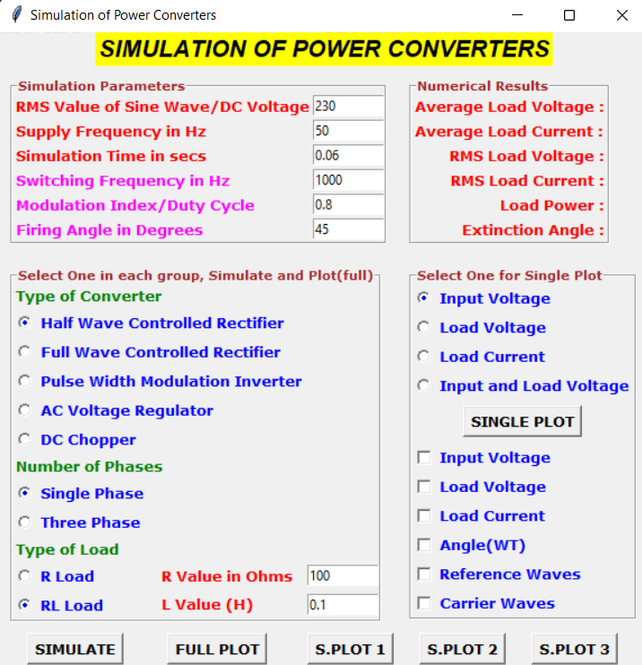
-:CODE:-
Importing Packages
import numpy as np
import tkinter as tk #GUI library for Python
import matplotlib.pyplot as plt
import math
from pylab import * #object-oriented plotting library
from scipy.optimize import *
win =tk.Tk()
win.title("Simulation of Power Converters")
win.minsize(300, 570)

Slide 8
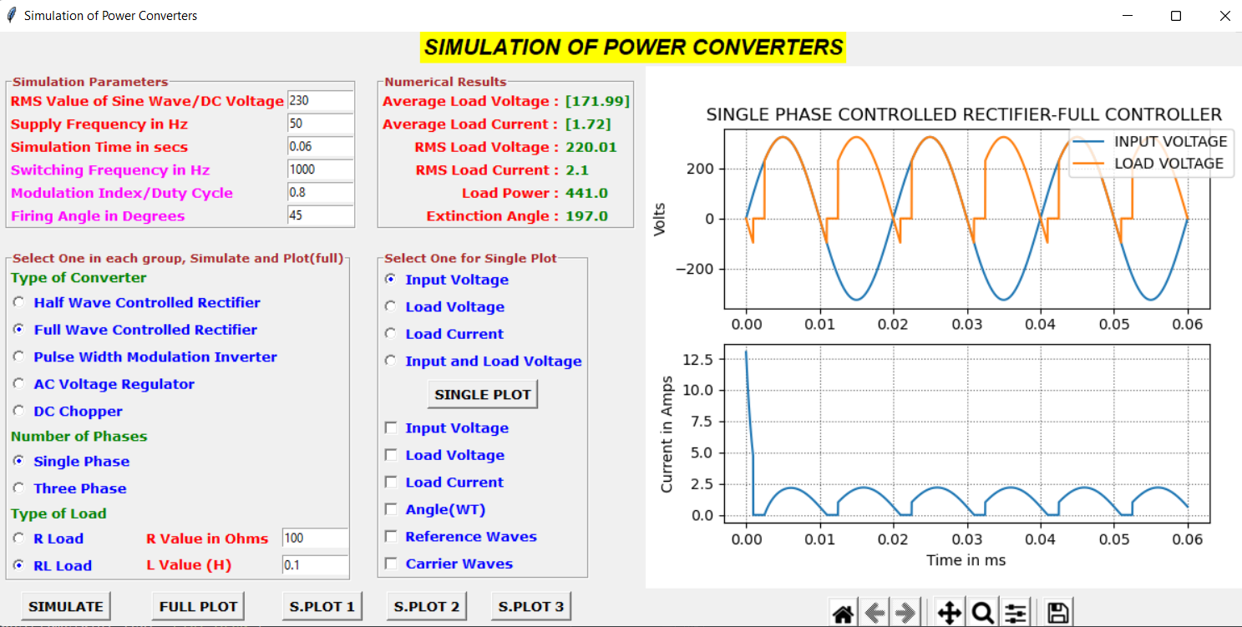
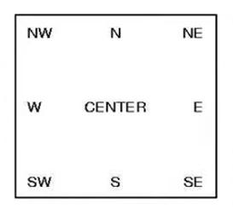
a_title= tk.Label(win,text="SiMULATION OF POWER CONVERTERS", fg = "black",bg = "yellow",font= "Helvetica 16 bold italic")
a_title.grid(column=0, row=0, columnspan=3)
simpara = tk.LabelFrame(win,text=" Simulation Parameters", fg = "brown", font= "Verdana 8 bold")
simpara.grid(column=0, row=1, sticky=tk.W+tk.N, padx=10, pady=10)
Column:-0
Column:-1
Column:-2
Row:-0
Row:-1
Row:-2
Row:-3

Slide 9
contypes = tk.LabelFrame(win, text='Select One in each group, Simulate and Plot(full)', fg= "brown",font = "Verdana 8 bold")
contypes.grid(column=0, row=2, sticky=tk.W+tk.N, padx=10, pady=10)
numres = tk.LabelFrame(win, text= "Numerical Results" , fg = "brown",font = "Verdana 8 bold")
numres.grid(column=1, row=1, sticky=tk.W+tk.N, padx=10, pady-10)
plttype = tk.LabelFrame(win, text='Select One for Single Plot' ,fg = "brown",font = "Verdana 8 bold")
plttype.grid(column=1, row=2, sticky=tk.W+tk.N, padx=10, pady=10)
Column:-0
Column:-1
Column:-2
Row:-0
Row:-1
Row:-2
9
Row:-3
9

Slide 10
res = tk.LabelFrame(win, text='Plot Area')
res.grid(column=2, row=1, rowspan=3)
Column:-0
Column:-1
Column:-2
Row:-0
Row:-1
Row:-2
Row:-3
10

Slide 11
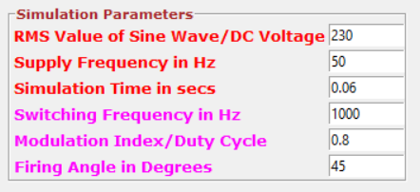
a_input = tk.Label(simpara, text="RMS Value of Sine Wave", font = "Verdana 10 bold",fg = "red")
a_input.grid(column=0, row=0, sticky=tk.W)
peamp = tk.Entry(simpara,width=10)
peamp.insert(0,"230")
peamp.grid(column=1, row=0)
a_supply = tk.Label(simpara, text="Supply Frequency in Hz",font = "Verdana 10 bold", fg = "red",justify=tk.LEFT)
a_supply.grid(column=0, row=1, sticky=tk.W)
freq = tk.Entry(simpara,width=10)
freq.insert(0,"50")
freq.grid(column=1, row=1)
a_time= tk.Label(simpara, text="Simulation Time in secs", font= "Verdana 10 bold",fg = "red")
a_time.grid(column=0, row=2, sticky=tk.W)
simtime = tk.Entry(simpara,width=10)
simtime.insert(0,"0.06")
simtime.grid(column=1, row=2)
a_freq = tk.Label(simpara, text="Switching Frequency in Hz",
font = "Verdana 10 bold", fg = "magenta")
a_freq .grid(column=0, row=3, sticky=tk.W)
sf = tk.Entry(simpara,width=10)
sf.insert(0,"1000")
sf.grid(column=1, row=3)
C0
C1
R0
R1
R2
R3
R4
R5

Slide 12
a_mi = tk.Label(simpara, text="Modulation Index",font = "Verdana 10 bold",fg = "magenta", justify=tk.LEFT)
a_mi.grid(column=0, row=4, sticky=tk.W)
m = tk.Entry(simpara,width=10)
m.insert(0,"0.8")
m.grid(column=1, row=4)
a_fire = tk.Label(simpara, text="Firing Angle in Degrees",font = "Verdana 10 bold",fg = "magenta")
a_fire.grid(column=0, row=5, sticky=tk.W)
alpha = tk.Entry(simpara,width=10)
alpha.insert(0,"45")
alpha.grid(column=1, row=5)

Slide 13
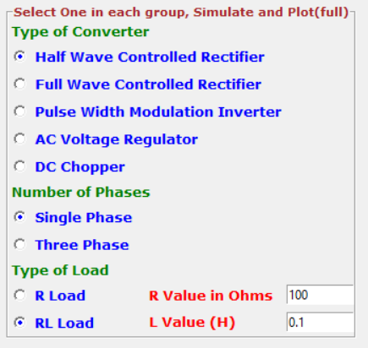
tconvt = tk.Label(contypes,text="Type of Converter",font= "Verdana 10 bold",fg = "green").grid(column=0, row=0, sticky=tk.W)
convtype = tk.IntVar()
rad1 = tk.Radiobutton (contypes,text='Half Wave Controlled Rectifier',value=1, variable=convtype, font = "Verdana 10 bold", fg = "blue")
rad2 = tk.Radiobutton(contypes,text='Full Wave Controlled Rectifier',value=2, variable=convtype,font= "Verdana 10 bold",fg = "blue")
rad3 = tk.Radiobutton(contypes,text='Pulse Width Modulation Inverter',value=3, variable=convtype,font= "Verdana 10 bold",fg = "blue")
rad4 = tk.Radiobutton(contypes,text='AC Voltage Regulator', value=4,variable=convtype, font= "Verdana 10 bold", fg= "blue")
rad5=tk.Radiobutton(contypes,text='DC Chopper', value=5,variable=convtype,font= "Verdana 10 bold", fg = "blue")
R0
R1
R2
R3
R4
R5
R6
R7
R8
R9
R10
R11
C0
C1

Slide 14
tconvt= tk.Label(contypes,text="Type of Converter", font= "Verdana 10 bold",fg = "green").grid(column=0, row=0, sticky=tk.W)
convtype = tk.IntVar()
rad1.grid(column=0, row=1, sticky=tk.W)
rad2.grid(column=0, row=2, sticky=tk.W)
rad3.grid(column=0, row=3, sticky-tk.W)
rad4.grid(column=0, row=4, sticky-tk.W)
rad5.grid(column=0, row=5, sticky=tk.W)
convtype.set(1)
R0
R1
R2
R3
R4
R5
R6
R7
R8
R9
R10
R11
C0
C1

Slide 15
nphases = tk.Label(contypes,text="Number of Phases",font = "Verdana 10 bold", fg = "green").grid(column=0, row=6, sticky=tk.W)
phasechoice= tk.IntVar()
phase1= tk.Radiobutton(contypes,text='Single Phase', value=1, variable=phasechoice,font= "Verdana 10 bold", fg ="blue")
phase3=tk.Radiobutton(contypes,text='Three Phase',value=2, variable=phasechoice,font = "Verdana 10 bold", fg ="blue")
phase1.grid(column=0, row=7, sticky=tk.W)
phase3.grid(column=0, row=8, sticky=tk.W)
phasechoice.set(1)
R0
R1
R2
R3
R4
R5
R6
R7
R8
R9
R10
R11
C0
C1

Slide 16

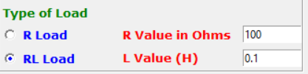
Itype = tk.Label(contypes,text="Type of Load",font = "Verdana 10 bold", fg = "green").grid(column=0, row=9, sticky=tk.W)
load1 = tk.Radiobutton(contypes,text='R Load', value=1,variable=loadchoice, font= "Verdana 10 bold",fg= "blue",command=sel)
load2 = tk.Radiobutton(contypes,text='RL Load', value=2,variable=loadchoice,font= "Verdana 10 bold", fg="blue",command=sel)
load1.grid(column=0, row=10, sticky=tk.W)
load2.grid(column=0, row=11, sticky=tk.W)
loadchoice.set(2)
R0
R1
R2
R3
R4
def sel():
global l
l= int(loadchoice.get())
if l==1:
lvalue.config(state='disabled')
else:
lvalue.config(state='normal')
R5
R6
R7
R8
R9
R10
R11
C0
C1

Slide 17
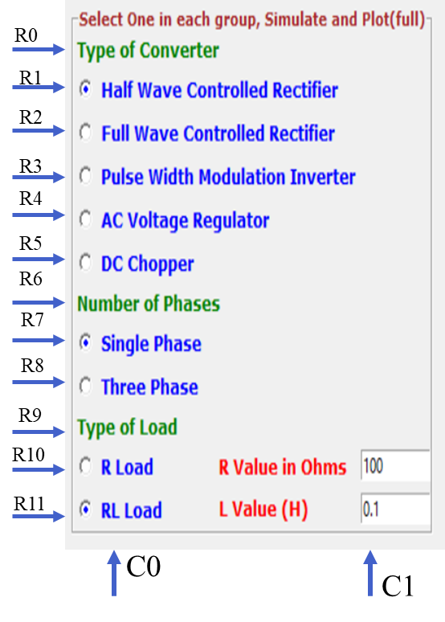
Itype = tk.Label(contypes,text="Type of Load", font = "Verdana 10 bold", fg = "green").grid(column=0, row=9,sticky=tk.W)
r_input = tk.Label(contypes, text="R Value in Ohms", font = "Verdana 10 bold", fg = "red")
r_input.place(x=130,y=250)
rvalue = tk.Entry(contypes,width=10)
rvalue.insert(0,"100")
rvalue.grid(column=1, row=10)
l_input = tk.Label(contypes, text="L Value (H) ",font = "Verdana 10 bold", fg = "red")
l_input.place(x=130,y=275)
lvalue = tk.Entry(contypes, width=10)
lvalue.insert(0,"0.1")
lvalue.grid(column=1, row=11)

Slide 18
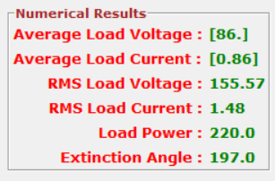
lvnv= tk.Label(numres, text="Average Load Voltage:",font = "Verdana 10 bold", fg = "red")
lvnv.grid(column=0, row=0, sticky=tk.W)
lcnv = tk.Label(numres, text="Average Load Current :",font = "Verdana 10 bold",fg = "red")
lcnv.grid(column=0, row=1, sticky=tk.W)
rlvnv = tk.Label(numres, text="RMS Load Voltage:",font = "Verdana 10 bold", fg= "red")
rlvnv.grid(column=0, row=2, sticky=tk.NE)
rlcnv= tk.Label(numres, text="RMS Load Current :",font = "Verdana 10 bold", fg = "red")
rlcnv.grid(column=0, row=3, sticky=tk.NE)
lpow=tk.Label(numres, text="Load Power :",font = "Verdana 10 bold", fg = "red")
lpow.grid(column=0, row=4, sticky=tk.NE)
ea = tk.Label(numres, text="Extinction Angle :",font = "Verdana 10 bold", fg = "red")
ea.grid(column=0, row=5, sticky=tk.NE)
R0
R1
R2
R3
R4
R5

Slide 19
lvavl = tk.StringVar()
lcavl = tk.StringVar()
rmsvl = tk.StringVar()
rmscl = tk.StringVar()
lpowl = tk.StringVar()
evavl = tk.StringVar()
lav= tk.Label(numres, textvariable=lvavl, font = "Verdana 10 bold", fg = "green")
lav.grid(column=1, row=0, sticky=tk.W)
lvavl.set(np.round(lvav,2))
lcurrav= tk.Label(numres, textvariable=lcavl, font = "Verdana 10 bold",fg = "green")
lcurrav.grid(column=1, row=1, sticky=tk.W)
lcavl.set(np.round(lcav,2)
rmsvv = tk.Label(numres, textvariable=rmsvl, font = "Verdana 10 bold",fg = "green")
rmsvv.grid(column=1, row=2, sticky=tk.W)
rmsvl.set(np.round(rmsv,2))
rmscv = tk.Label(numres, textvariable=rmsd, font = "Verdana 10 bold", fg = "green")
rmscv.grid(column=1, row=3, sticky=tk.W)
rmscl.set(np.round(rmsc,2))
lpowl = tk.Label(numres, textvariable=lpowl, font ="Verdana 10 bold", fg = "green")
lpowl.grid(column=1, row=4, sticky=tk.Ww)
lpowl.set(np.round(lpowv,0))
eav = tk.Label(numres, textvariable=evavl, font = "Verdana 10 bold",fg = "green")
eav.grid(column=1, row=5, sticky=tk.W)
evavl.set(np.round(math.degrees(beta),0))
R0
R1
R2
R3
R4
R5

Slide 20
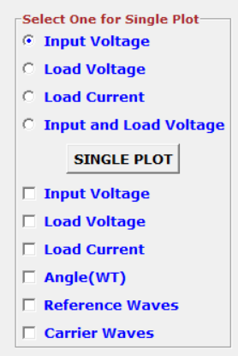
oneplt = tk.IntVar()
ipplt = tk.Radiobutton(plttype,text='Input Voltage', value=1, variable=oneplt,font= "Verdana10 bold", fg = "blue",)
lvplt= tk.Radiobutton(plttype,text='Load Voltage', value=2, variable=oneplt,font="Verdana 10 bold",fg = "blue",)
lcplt = tk.Radiobutton(plttype,text='Load Current', value=3, variable=oneplt,font="Verdana 10 bold", fg = "blue",)
ilvplt= tk.Radiobutton(plttype,text='Input and Load Voltage', value=4, variable=oneplt,font="Verdana 10 bold",fg = "blue",)
ipplt.grid(column=0, row=0, sticky=tk.W)
lvplt.grid(column=0, row=1, sticky=tk.W)
lcplt.grid(column=0, row=2, sticky=tk.W)
ilvplt.grid(column=0, row=3, sticky=tk.W)
oneplt.set(1)
R0
R1
R2
R3
R4
R5
R6
R7
R8
R9
R10

Slide 21
R0
R1
R2
R3
R4
ivc = tk.IntVar()
lvc = tk.IntVar()
lcc = tk.IntVar()
ac =tk.IntVar()
rv= tk.IntVar()
cv = tk.IntVar()
fullplt = tk.Button(plttype, text="SINGLE PLOT", command=fplt,font = "Verdana 10 bold")
fullplt.grid(column=0, row=4, sticky=tk.N, padx=10, pady=5)
tk.Checkbutton(plttype, text="Input Voltage", variable=ivc,font ="Verdana 10 bold",fg="blue",).grid(column=0, row=5, sticky=tk.W)
tk.Checkbutton(plttype, text="Load Voltage", variable=lvc,font= "Verdana 10 bold", fg ="blue",).grid(column=0, row=6, sticky= tk.W)
tk.Checkbutton(plttype, text="Load Current", variable=lcc,font="Verdana bold" fg="blue",). grid(column=0, row=7, sticky=tk.W)
tk.Checkbutton(plttype, text="Angle(wT)", variable =ac,font= "Verdana 10 bold",fg = "blue",).grid(column=0,row=8, sticky =tk.W)
tk.Checkbutton(plttype, text="Reference Waves", variable=rv,font ="Verdana 10 bold", fg="blue",).grid(column=0, row=9, sticky=tk.W)
tk.Checkbutton(plttype, text="Carrier Waves", variable=cv,font="Verdana 10 bold", fg="blue",).grid(column=0, row=10, sticky=tk.W)
R5
R6
R7
R8
R9
R10

Slide 22
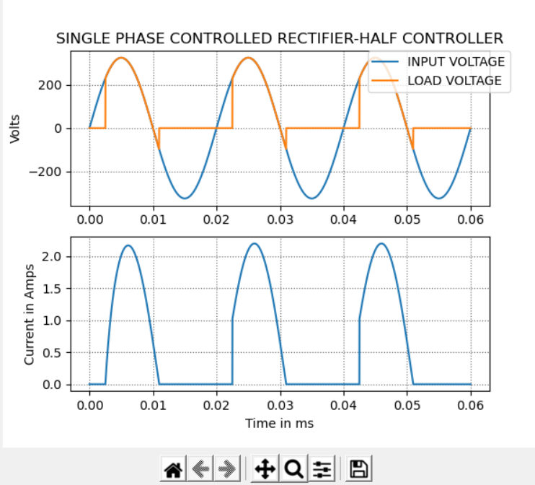
fig = Figure(figsize=(6, 5), dpi=100)
al = fig.add_subplot(211)
a1.plot(time, amplitude2,label="INPUT VOLTAGE")
a1.plot(time, amplitude3, label="LOAD VOLTAGE")
a1.set title('SINGLE PHASE CONTROLLED RECTIFIER-HALF CONTROLLER')
a1.set_ylabel('Volts')
a1.legend(bbox_to_anchor=(1.05, 1), loc='upper right', borderaxespad=0.)
al.grid(b=True, which='major', color='#666666', linestyle=':')
a3 = fig.add_subplot(212)
a3.plot(time, lcurrent, label="Load Current")
a3.set_xlabel('Time in ms')
a3.set_ylabel('Current in Amps')
a3.grid(b=True, which='major', color="#666666", linestyle=':')

Slide 23


def func(b):
k = int(loadchoice.get())
al=math.radians(int(alpha.get())) #value of alpha
fr=int(freq.get()) #frequency
L1=float(lvalue.get()) #inductance value
R1=float(rvalue.get()) #Resistance value
if k==1:
langle = (math.atan(2*math.pi*fr*0/R1))
else:
langle = (math.atan(2*math.pi*fr*L1/R1))
r1=(a1-b)/math.tan(langle)
return math.sin(langle-b)-(math.sin(langle-a1)*math.exp(r1))
beta = (fsolve(func, 3.14))

Slide 24
btn = tk.Button(win, text="SIMULATE", command=simulate, font = "Verdana 10 bold")
btn.place(x=25, y=550, anchor="w")
btn1 = tk.Button(win, text="FULL PLOT", command=plt1, font = "Verdana 10 bold")
btn1.place(x=150, y=550, anchor="w")
btn2 = tk.Button(win, text="S.PLOT 1", command=Splt1,font ="Verdana 10 bold")
btn2.place(x=275, y=550, anchor="w")
btn3 = tk.Button(win, text="S.PLOT 2", command=Splt2,font = "Verdana 10 bold")
btn3.place(x=375, y=550, anchor="w")
btn4 = tk.Button(win, text="S.PLOT 3", command=Splt3,font = "Verdana 10 bold")
btn4.place(x=475, y=550, anchor="w")
fullplt = tk.Button(plttype, text="SINGLE PLOT", command=fplt,font "Verdana 10 bold")
fullplt.grid(column=0, row=4, sticky=tk.N, padx=10, pady=5)

Slide 25
def simulate():
global s, l,pch, time, VR, VY, VB, LV, LC, ANG,R1,R2,C1, P1,P2,lcurrent, lvav, lcav, rmsv, rmsc,lpowv
s= int(convtype.get())
l= int(loadchoice.get())
tt = float(simtime.get())
V= float(peamp.get()) #rms
f1=int(freq.get())
a=float(alpha.get())
L=float(lvalue.get())
R=float(rvalue.get())
m1=float(m.get())
f2 = int(sf.get())
pch = int(phasechoice.get())
time= np.arange(0, tt, 0.00001);
g=len(time)
TT = np.ones(g)
beta = (fsolve(func, 3.14))
if l==1:
langle (math.atan(2*math.pi*f1*0/R))
else:
langle = (math.atan(2*math.pi*f1*L/R))

Slide 26

if s==1 and pch==1:
P=2/f1
ANG=(360* (P-abs((time*2%P)-P)))/P
VR= V*math.sqrt(2)*(np.sin(2*math.pi*f1*time)) #input voltage
LV=V*sqrt(2)*(np.sin(2*math.pi*f1*time)) #load voltage
Z= math.sqrt((R*R)+(2*math.pi*f1*2*math.pi*f1*L*L})
ad = math.radians(a) #convert degree to radian
x1 = sin((2*math.pi*f1*time)-langle) #load current
x2 = math.sin(langle-ad)
el = -((2*math.pi*f1*time)-ad)/math.tan(langle)
x3 = np.exp(e1)
LC = (V*sqrt(2)/Z)*((x2*x3)+x1)

Slide 27
if l==1:
lvav = ((1+cos(ad))/(2*math.pi))*(V*sqrt(2))
lcav = lvav/R
rmsv = math.sqrt((math.pi-ad)+((math.sin(2*ad))/2))*(V*sqrt(2)/(2*math.sqrt(math.pi)))
rmsc = rmsv/R
lpowv = (rmsc*rmsc)*R
else:
lvav = (((cos(ad)-cos(beta)))/(2*math.pi))*(V*sqrt(2))
lcav = lvav/R
rmsv = math.sqrt((beta-ad)-(((math.sin(2 beta))-(math.sin(2*ad)))/2))*(V*sqrt(2)*V*sqrt(2)/(4*math.pi))
rmsc = rmsv/math.sqrt(R*R)+(2*math.pi*f1*2*math.pi*f1*L*L))
lpowv = (rmsc*rmsc)*R
i=0
while i<g:
if ANG[i] >= a and ANG[i] <= math. degrees(beta):
LV[i]=LV[i]
LC[i] = LC[i]
else:
LV[i]=0
LC[i]=0
i +=1

Slide 28
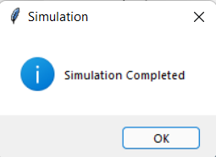
lav = tk.Label(numres, textvariable=lvavl, font= "Verdana 10 bold", fg = "green")
lav.grid(column=1, row=0, sticky=tk.W)
lvavl.set(np.round(lvav, 2))
lcurrav = tk.Label(numres, textvariable=lcavl, font = "Verdana 10 bold", fg = "green")
lcurrav.grid(column=1, row=1, sticky=tk.W)
lcavl.set(np.round(lcav,2))
rmsvv= tk.Label(numres, textvariable=rmsvl, font = "Verdana 10 bold", fg = "green")
rmsvv.grid(column=1, row=2, sticky=tk.W)
rmsvl.set(np.round(rmsv,2))
rmscv = tk.Label(numres, textvariable=rmscl, font = "Verdana 10 bold", fg = "green")
rmscv.grid(column=1, row=3, sticky=tk.W)
rmscl.set(np.round(rmsc,2))
lpow1 = tk.Label(numres, textvariable=lpowl, font = "Verdana 10 bold", fg = "green")
lpow1.grid(column=1, row=4, sticky=tk.W)
lpowl.set(np.round(ipowv,0))
tk.messagebox.showinfo("Simulation", "Simulation Completed")

Slide 29
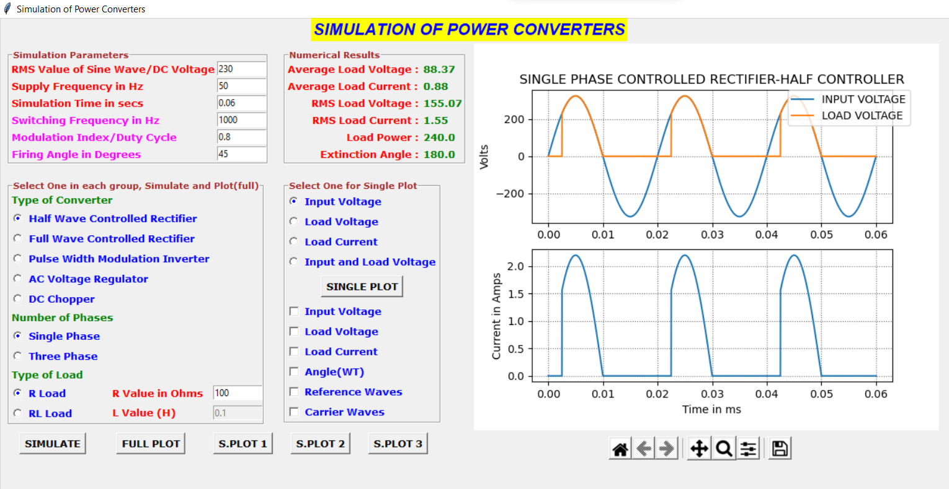
-:RESULT ANALYSIS:-

Slide 30
-:CONCLUSION:-
we have completely seen about requirements and importance of simulating power electronic circuits using python. In specifically, we have also seen the simulation procedure, python packages, libraries, and package installation procedure and simulation of power converters and their wave forms.

Slide 31
-:REFERENCES:-
Simulation of Power Electronic Circuit Using Python Programming (academiccollegeprojects.com)
https://www.youtube.com/watch?v=7uw--jgs3P4&t=7s

Slide 32

Thank You

