Slide 1
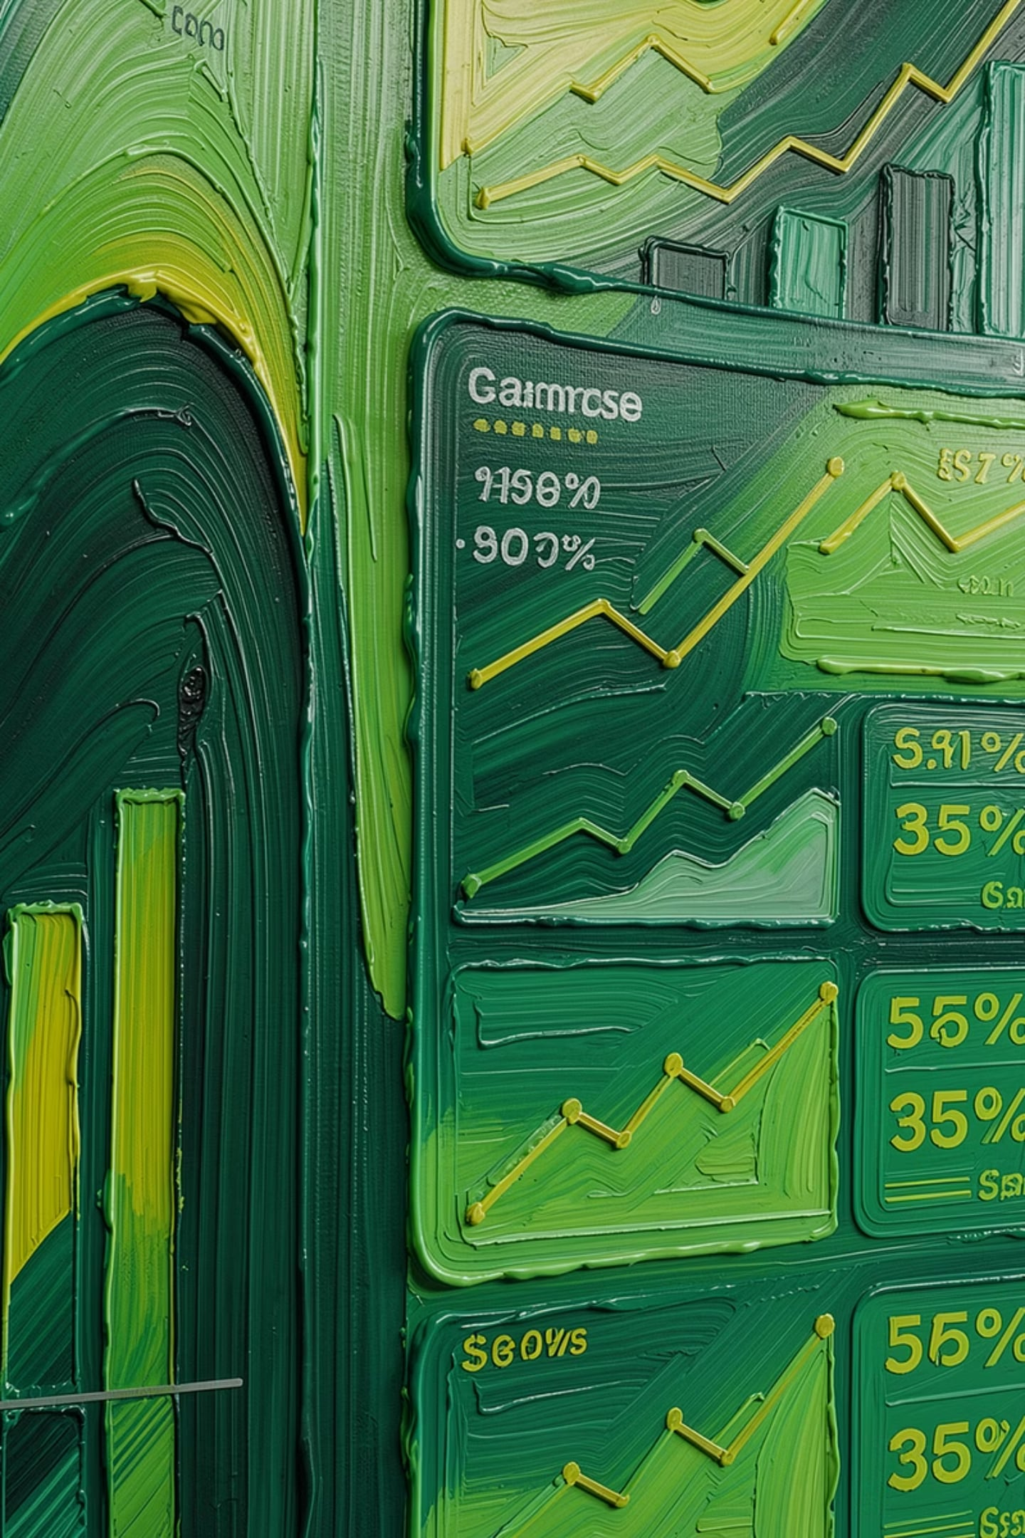
DATA ANALYTICS PROJECT
Customer Shopping Behavior Analysis
Analyzing Customer Purchasing Patterns Using Python, SQL, and Power BI
Prepared By: Abhijit Roy

Slide 2





Project Overview
Customer shopping behavior analysis is the process of studying customer purchasing habits to understand how people make buying decisions. Businesses use this information to improve customer satisfaction, increase sales, and create targeted marketing strategies.
Purchasing Trends
Payment Methods
Shopping Frequency
Business Insights
Identify patterns in buying behavior based on customer demographics and product categories.
Study how customers pay and identify the most preferred payment channels across segments.
Analyze how often customers shop and what drives repeat purchases over time.
Transform raw transaction data into actionable strategies for marketing and sales optimization.

Slide 3





PROJECT GOALS
Project Objectives
This project aims to deliver data-driven insights that enable businesses to make smarter decisions about marketing, inventory, and customer engagement strategies.
Spending
Behavior
Analyze spending patterns across different customer groups to identify high-value segments worth targeting.
Understand customer purchasing behavior and the key drivers behind buying decisions across different channels.
2
1
Categories
3
Identify the most popular product categories to inform inventory planning and promotional focus.
Payments
5
Examine preferred payment methods and generate visualization-driven business insights for decision-makers.
Demographics
4
Study the impact of age and gender on shopping habits to power personalized marketing campaigns.

Slide 4



DATA SOURCE
Dataset Description
What the Dataset Contains
Purchase Details
The dataset holds comprehensive customer shopping records spanning multiple dimensions of the purchasing journey — from who the customer is, to where they shop, what they buy, how they pay, and when they transact.
Purchase Amount, Quantity Purchased, Payment Method, and Purchase Date capture every transaction.
1
→ 10 Fields
Customer Profile
2
Customer ID, Age, and Gender form the demographic backbone for segmentation and pattern analysis.
Key data attributes per customer record
Why It Matters
Location & Context
This richness of information across demographic, product, and transactional dimensions enables identification of meaningful buying patterns, customer preferences, and actionable segmentation opportunities for targeted business strategy.
3
Shopping Mall/Store and Customer Location provide geographic and contextual dimension to each record.

Slide 5




Tools & Technologies
Data Processing — Python, Pandas & NumPy
Python powers the entire analytics pipeline. Pandas and NumPy handle data ingestion, cleaning, transformation, and statistical computation across all customer records.
Visualization — Matplotlib & Power BI
Matplotlib enables exploratory charting in Python, while Power BI delivers interactive dashboards with slicers, filters, and KPI visuals for business stakeholders.
Database & Reporting — SQL (MySQL) & Excel
MySQL handles structured querying for aggregations, segmentation, and revenue analysis. Excel supports auxiliary reporting, and Gamma AI powers the presentation layer.

Slide 6

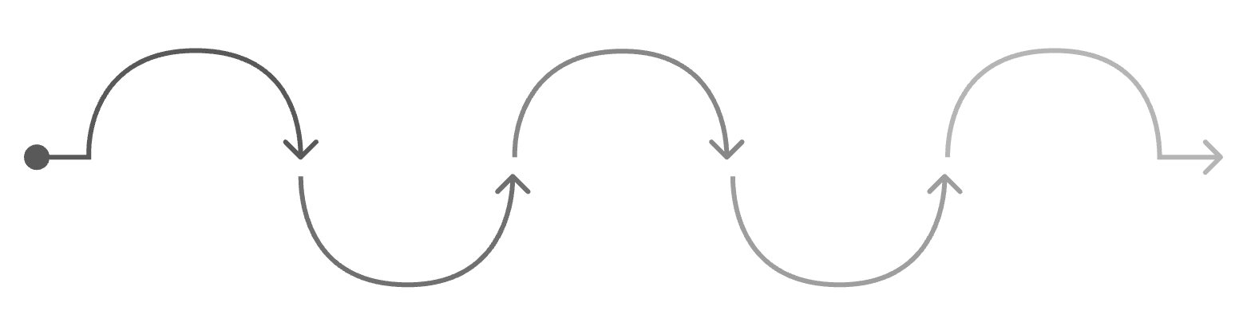


Data Analysis Process
A structured seven-stage workflow transforms raw shopping data into clear, actionable business intelligence.
Each stage of the pipeline builds on the last, ensuring data quality and analytical rigor before insights are surfaced.
Collection & Cleaning
Raw shopping records are ingested and cleansed to remove duplicates, nulls, and inconsistencies.
Data Collection
Data Cleaning
Exploratory Analysis
SQL Queries
Visualization
Remove errors and standardize records
Transform and aggregate datasets
Create charts to reveal trends
Gather raw shopping data sources
Identify patterns and anomalies
EDA & SQL Queries
Statistical exploration and structured queries uncover distributions, trends, and segment-level patterns.
This end-to-end process ensures every business recommendation is grounded in clean, validated, and well-visualized data.
Visualization & Insights
Dashboards and charts communicate findings to stakeholders, driving targeted business decisions.

Slide 7




Exploratory Data Analysis & SQL
8
8
25–40
EDA dimensions explored across customer and purchase data
SQL queries powering aggregated business analysis
Peak age group driving the highest sales volume
2
2
7
Top product categories: Clothing and Electronics
Preferred payment methods: Credit Card and UPI
Shopping malls and store locations captured in dataset
Example SQL: SELECT Category, SUM(Purchase_Amount) FROM Shopping_Data GROUP BY Category; — surfaces revenue by product category instantly.
EDA covers Customer Age Distribution, Gender Distribution, Purchase Amount Analysis, Product Category Analysis, Monthly Sales Trend, Shopping Frequency, Payment Method Distribution, and Customer Segmentation. SQL queries add Total Sales, Average Purchase Amount, Top Selling Categories, Highest Spending Customers, Gender-wise Sales, Age Group Analysis, Monthly Revenue, and Payment Method Usage.

Slide 8




Power BI Dashboard
The Power BI dashboard transforms all analytical outputs into an interactive, executive-ready interface. Decision-makers can explore the data through real-time filters and slicers without any coding knowledge.
KPI Cards:
Category & Gender:
Total Revenue, Number of Customers, and Average Purchase Amount displayed as at-a-glance headline metrics.
Sales by Category and Sales by Gender charts reveal which products and demographics drive the most revenue.
Age & Trends:
Interactivity:
Age Group Analysis and Monthly Sales Trend visuals surface the temporal and demographic dynamics of purchasing.
Dynamic filters and slicers allow stakeholders to drill down by time period, region, demographic, or product category.

Slide 9

Key Insights & Business Recommendations
Data analysis surfaces clear patterns that directly inform where to focus marketing investment and product strategy.
Key Business Insights
Recommendations
25–40 Age Group
Personalized Promotions
Customers aged 25–40 contribute the highest sales — the single most valuable demographic segment.
Target customers between 25–40 years with personalized offers based on purchase history and category affinity.
Gender Spending Gap
Category Discounts
Female customers spend slightly more than male customers, informing channel and messaging decisions.
Offer strategic discounts on Clothing and Electronics to drive volume in the highest-demand segments.
Top Categories
Digital Payments & Loyalty
Clothing and Electronics are the most popular product categories by purchase volume and revenue.
Strengthen Credit Card and UPI infrastructure, and launch loyalty programs to reward repeat customers.
Weekend & Repeat Effect
Segmented Marketing
Weekend shopping generates higher revenue and repeat customers contribute significantly to overall sales.
Use customer segmentation models to deliver targeted campaigns that resonate with each distinct buyer group.

Slide 10
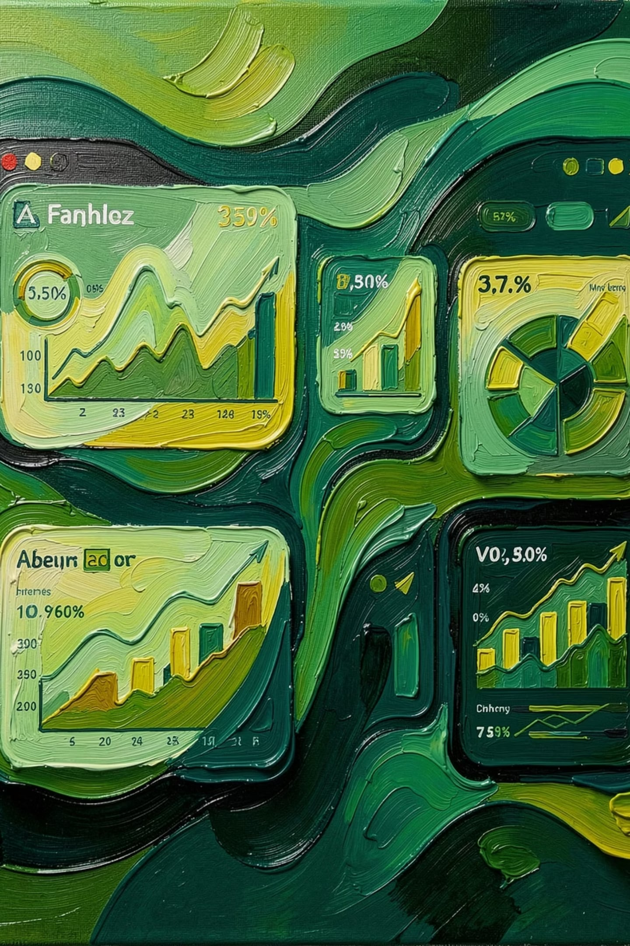
CONCLUSION
Thank You
Questions & Discussion
This project demonstrates how data analytics can transform raw customer transaction data into meaningful business insights. Using Python, SQL, and Power BI, businesses can better understand customer preferences, optimize inventory, improve marketing strategies, and enhance customer satisfaction.
Prepared By: Abhijit Roy

