Slide 1
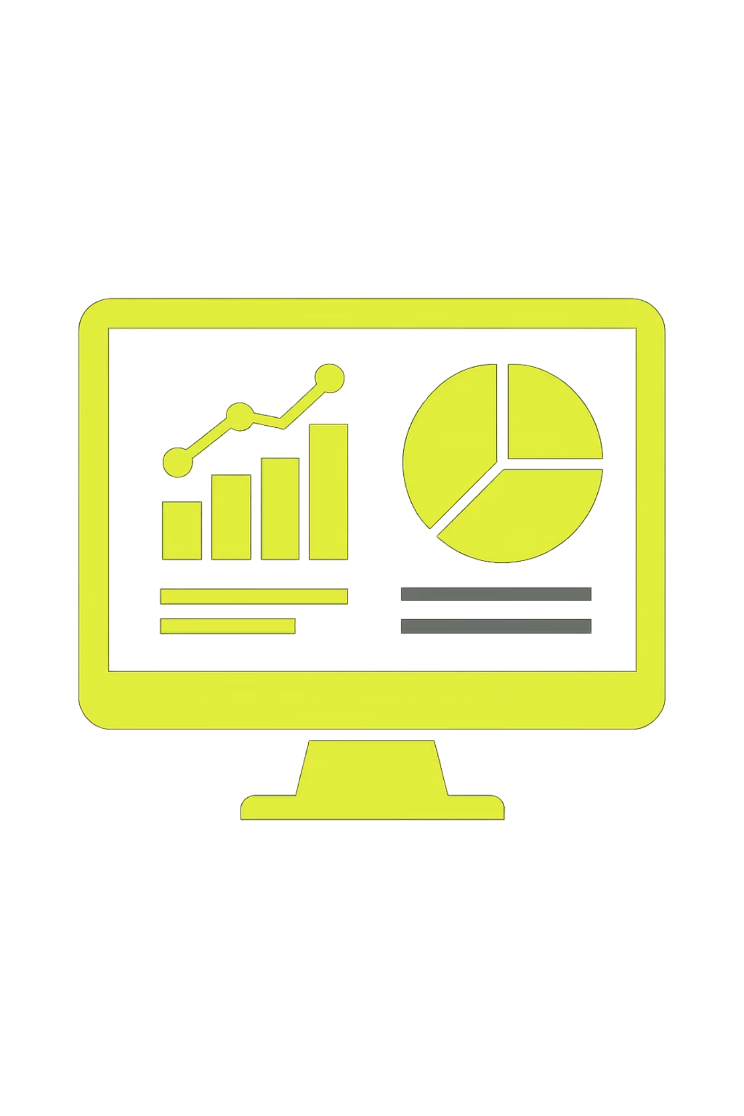
Customer Shopping Behavior Analysis
A comprehensive data-driven approach to understanding customer behavior and optimizing retail strategy across demographics, product categories, and channels.

Slide 2

Business Challenge
A leading retail company seeks to unlock deeper insights from customer shopping patterns across multiple dimensions. The organization needs to transform raw transaction data into strategic intelligence that drives growth.
Central Question
How can we leverage consumer shopping data to identify meaningful trends, improve customer engagement, and optimize marketing and product strategies?

Slide 3

Project Objectives & Deliverables
Data Preparation & Modeling
Data Analysis
Python-based data cleaning, imputation, and feature engineering to create a robust analytical dataset
SQL queries in PostgreSQL to extract targeted insights across customer segments and behaviors
Visualization & Insights
Strategic Report
Interactive Power BI dashboard with KPIs, trends, and segmentation analysis
Comprehensive findings and actionable recommendations for business stakeholders

Slide 4
Methodology: Python Data Cleaning
Data Foundation
Feature Engineering
Loaded 3,900-record dataset with comprehensive customer transaction history including demographics, product details, purchase patterns, and engagement metrics.
Created strategic new variables to enable deeper analysis:
Age_group categorization (Young, Middle, Senior)
Purchase_frequency_days calculation
Customer loyalty segmentation
Quality Enhancements
Imputed missing review ratings using category median values
Standardized column names to snake_case convention
Removed redundant columns and validated data integrity
Cleaned data loaded directly to PostgreSQL customer table for downstream analysis.

Slide 5
Methodology: SQL Analysis Framework
01
02
03
Revenue Analysis
Discount Impact
Product Performance
Gender, subscription status, and age group revenue contribution
Purchase behavior and spending patterns with promotional offers
Top products by review rating and discount percentage utilization
04
05
Loyalty Segmentation
Shipping Comparison
Customer classification based on purchase frequency and engagement
Express vs. standard shipping impact on purchase amounts

Slide 6
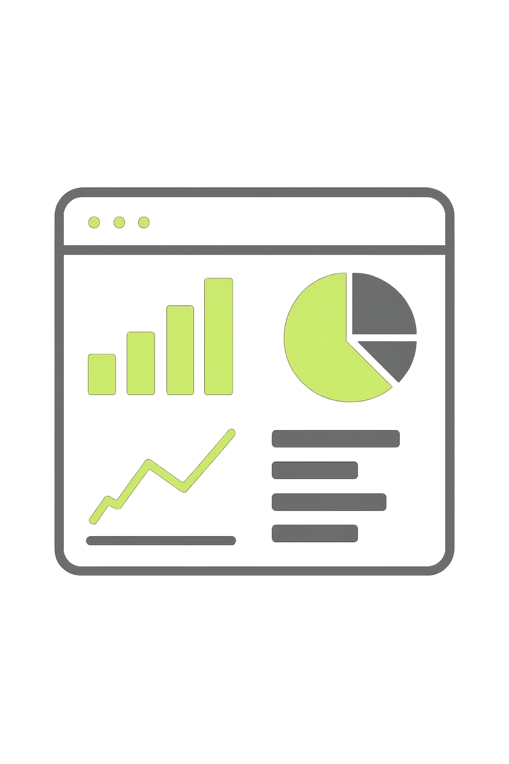
Methodology: Power BI Dashboard
Data Connection
Interactive Design
Direct live connection to PostgreSQL database ensuring real-time data synchronization and accuracy
Built dynamic dashboard with KPI cards, trend charts, bar graphs, and slicers for user-driven exploration
Key Visualizations
Revenue trends over time, demographic breakdowns, category performance, discount analysis, and loyalty segmentation

Slide 7
Key Insights: Revenue & Demographics
2.3x
45%
68%
Male Revenue Advantage
Subscription Premium
Prime Age Groups
Male customers generate significantly higher total revenue compared to female shoppers across all product categories
Subscribed customers demonstrate 45% higher average spend and contribute substantially more to total revenue
Middle-aged and Senior segments drive 68% of total revenue, indicating strong purchasing power in these demographics

Slide 8

Key Insights: Discounts & Products
Strategic Discount Patterns
High percentage of purchases involve discounted products, particularly in electronics and apparel categories. Analysis reveals that discounted customers often spend above average, suggesting promotions effectively drive basket size.
Top Performing Products
Identified top 5 products by average review rating above 4.5 stars, demonstrating strong customer satisfaction. These products represent opportunities for featured placement and cross-selling strategies.

Slide 9


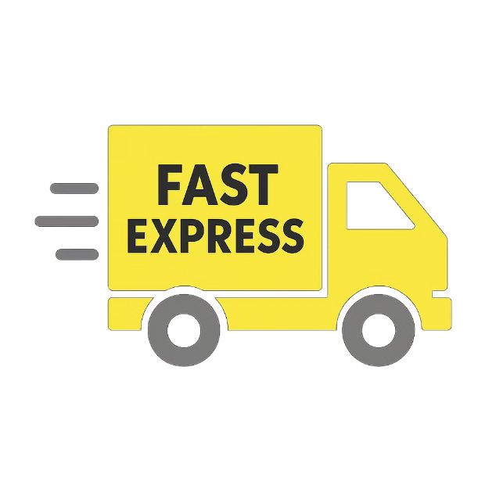
Key Insights: Loyalty & Shipping
Loyalty Dominance
Repeat Purchase Link
Shipping Value
Most customers classified as "Returning" or "Loyal" with repeat purchase behavior, indicating strong brand affinity and satisfaction
Customers with more than 5 previous purchases show 60% higher subscription conversion rate, suggesting loyalty program opportunities
Express shipping customers demonstrate 28% higher average purchase amounts, supporting premium shipping for high-value orders

Slide 10




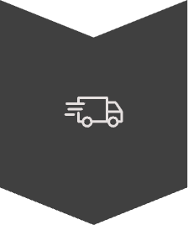

Strategic Recommendations & Next Steps
Premium Loyalty Programs
Target male and subscribed customers with exclusive benefits, early access, and personalized rewards to maximize lifetime value
Product-Based Promotions
Run targeted campaigns on high-review and high-discount products to capitalize on proven purchase drivers and satisfaction
Age-Segment Marketing
Focus advertising and messaging on Middle-aged and Senior segments through channels and offers that resonate with these demographics
Repeat Purchase Incentives
Encourage repeat purchases with personalized offers, email campaigns, and loyalty points specifically for customers with 3-5 purchases
Express Shipping Optimization
Promote express shipping for higher-value orders and consider tiered pricing to maximize profitability while meeting customer expectations
Conclusion: This end-to-end analysis—from Python data preparation through SQL analysis to Power BI visualization—delivers actionable insights to boost sales, enhance customer engagement, and build long-term loyalty. The framework is scalable and can be extended to incorporate additional data sources and predictive modeling.

