Slide 1
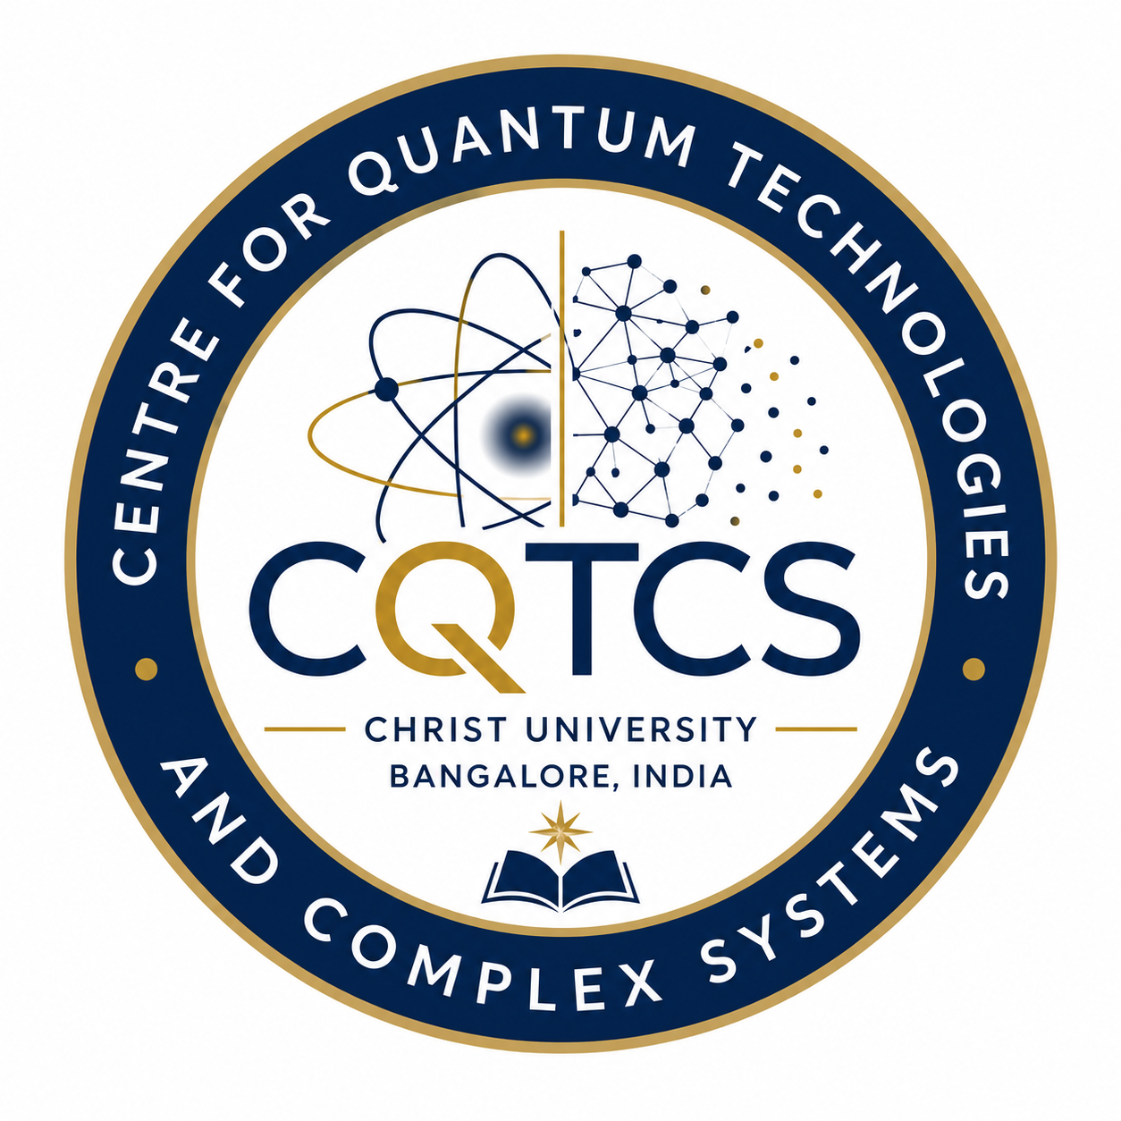
Centre for Quantum Technologies and Complex Systems
Established on 2nd July, 2025
CHRIST(Deemed to be University)

Slide 2
CENTER FOR QUANTUM TECHNOLOGIES AND COMPLEX SYSTEMS (CQTCS)
CQTCS aims to establish an international level world-leading research centre dedicated to advancing foundational and applied research in quantum science, engineering, and complex systems dynamics.
Centre will train the next generation of physicists and interdisciplinary researchers, and provide support for innovation in quantum technologies and complex systems
Centre will foster international collaborations and partnerships.
This centre follows the pattern of the world class institution Max Planck, Germany
Goal of the centre

Slide 3
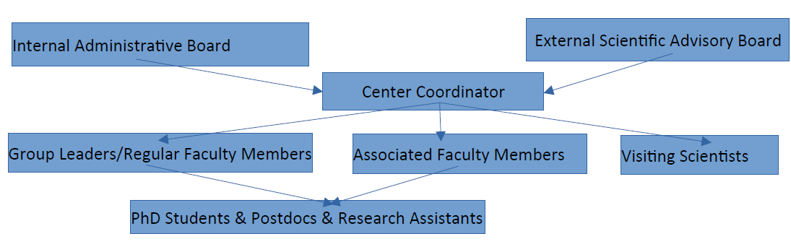
CENTER FOR QUANTUM TECHNOLOGIES AND COMPLEX SYSTEMS (CQTCS)

Slide 4
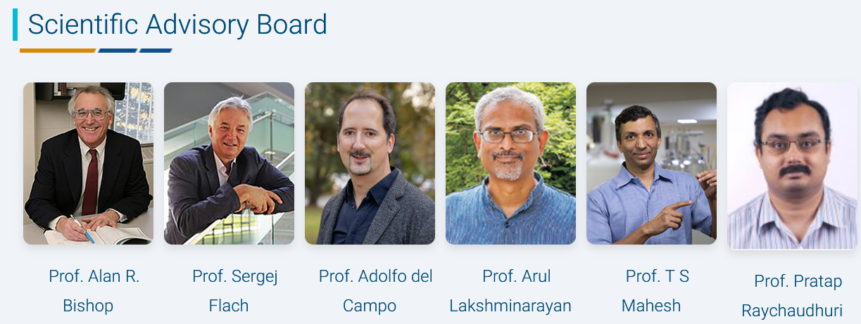
CENTER FOR QUANTUM TECHNOLOGIES AND COMPLEX SYSTEMS (CQTCS)
Los Alamos National LAB, USA
PCS-IBS, South Korea
Uni. Luxembourg, Luxembourg
IIT Madras, India
IISER Pune, India
TIFR Mumbai, India

Slide 6
Research Domains of CQTCS
Theory
Dr. Mithun Thudiyangal
Dr. Sreeja CS
Dr. Arindam Mallick
Experiment
Dr. Basudeb Sain
Dr. Ranjith Kumar K M
Quantum algorithms and Simulations
Quantum computing and Quantum communications
Complex Systems
Photonics quantum systems
Low Temperature Physics
Quantum Magnetism & Materials

Slide 7
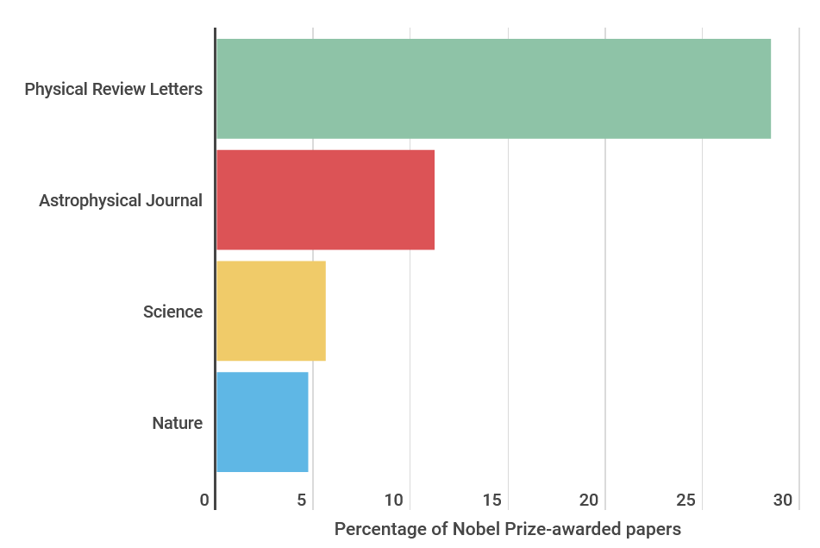

Features of Group Leaders
In interdisciplinary Journals
In subject Journals
4 - Physical Review Letters - American Physical Society (APS)
4 - Light: Science & Applications - Nature
3 - Science advances - Science
> 50 APS papers
Publications in ACS journals,
Nano Letters, RSC Advances,
Nanoscale, Nature Photonics, Nanophotonics etc.

Slide 8
Collaborations
Academic
Industry
University of Maryland, USA
University of Luxembourg, Luxembourg
National Institute of Standards and Technology (NIST), USA
Los Alamos National Laboratory, USA
Institute for Basic Science, South Korea
Kindai University, Japan
University of Massachusetts, Amherst, USA
Lancaster University, England
IIT Delhi, IIT Kharagpur
Qutools, Germany
Kipu Quantum, Germany
Ansys, India
Pernishq Delhi
MoU
Qutools, Germany
Ansys, India

Slide 9
Lab Facilities

Slide 10

CHRIST
Deemed to be University

