Slide 1

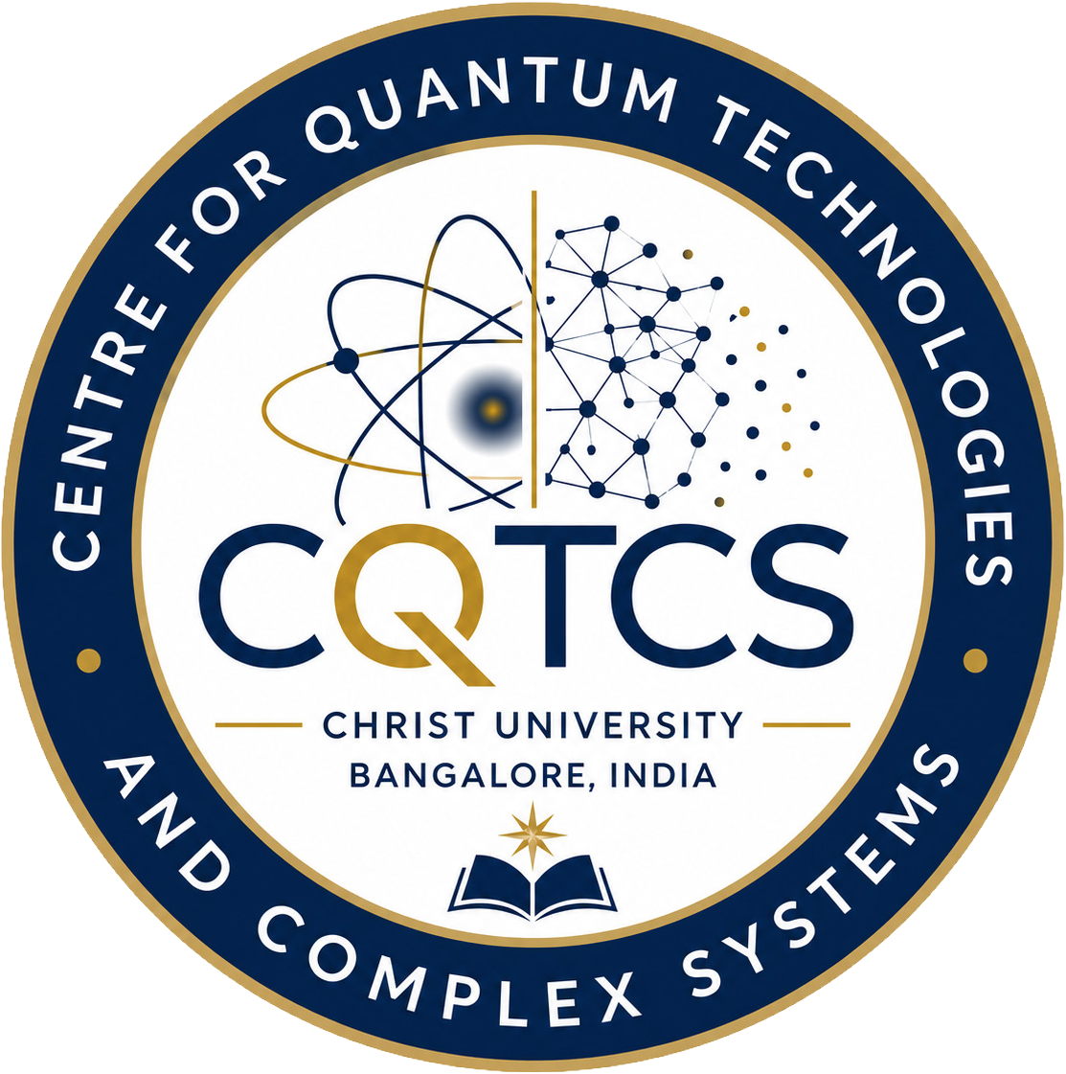

Centre for Quantum Technologies and Complex Systems
Established on 2 July, 2025
CHRIST(Deemed to be University)
Mission
Christ University is a nurturing ground for an individual’s holistic
development to make effective contribution to the society in a dynamic environment
Vision
Excellence and Service
Core Values
Faith in God | Moral Uprightness
Love of Fellow Beings | Social Responsibility
Pursuit of Excellence

Slide 2


CENTER FOR QUANTUM TECHNOLOGIESAND COMPLEX SYSTEMS (CQTCS)
Goal of the centre
CQTCS aims to establish an international level world-leading research centre dedicated to advancing foundational and applied research in quantum science, engineering, and complex systems dynamics.
Centre will train the next generation of physicists and interdisciplinary researchers, and provide support for innovation in quantum technologies and complex systems
Centre will foster international collaborations and partnerships.
This centre follows the pattern of the world class institution Max Planck, Germany

Slide 3












CENTER FOR QUANTUM TECHNOLOGIES AND COMPLEX SYSTEMS (CQTCS)
Internal Administrative Board External Scientiﬁc Advisory Board
Center Coordinator
Group Leaders / Regular Faculty Members
Associated Faculty Members
Visiting Scientists
PhD Students & Postdocs & Research Assistants

Slide 4
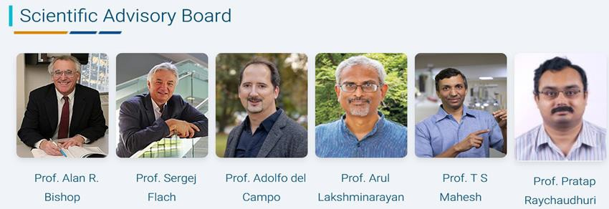

CENTER FOR QUANTUM TECHNOLOGIES AND COMPLEX SYSTEMS (CQTCS)
Los Alamos National LAB,
PCS-IBS, South Korea
Uni. Luxembourg, Luxembourg
IIT Madras, India
IISER Pune, India
TIFR Mumbai, India
USA

Slide 5


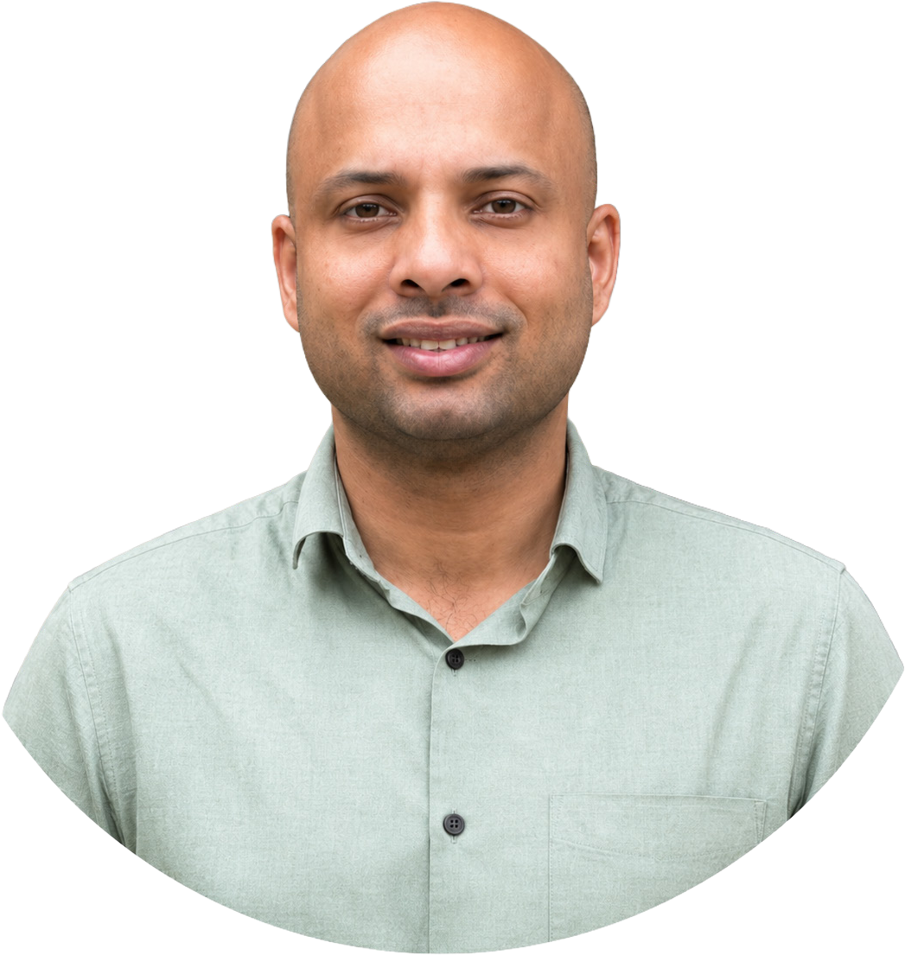
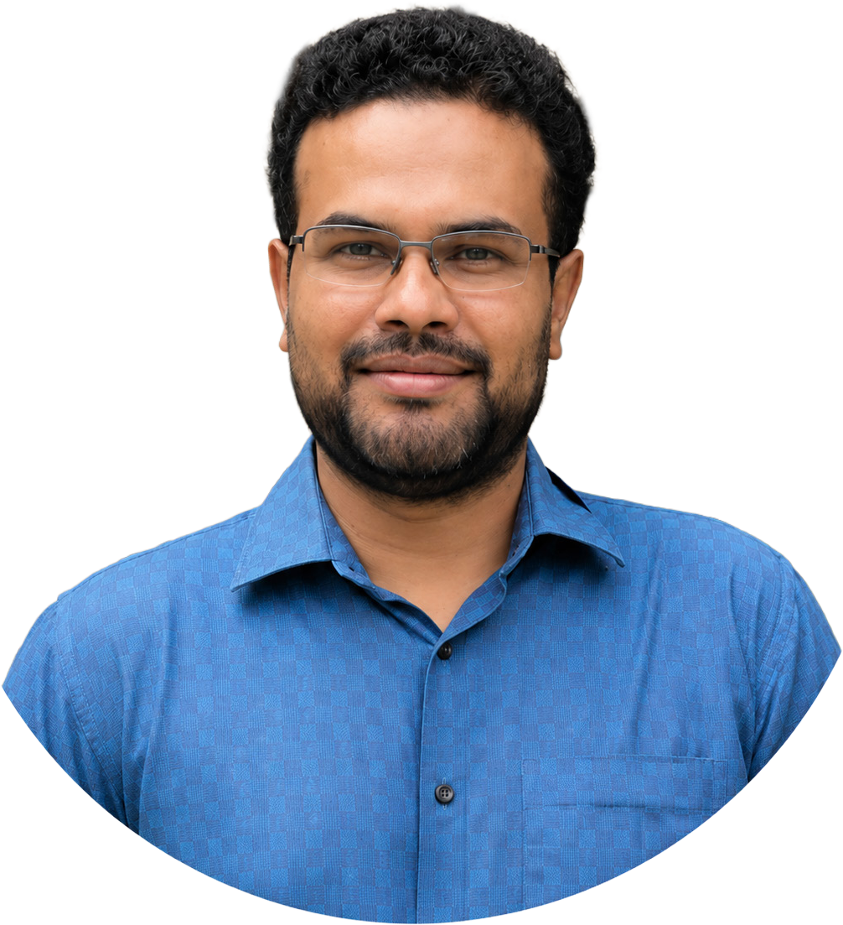
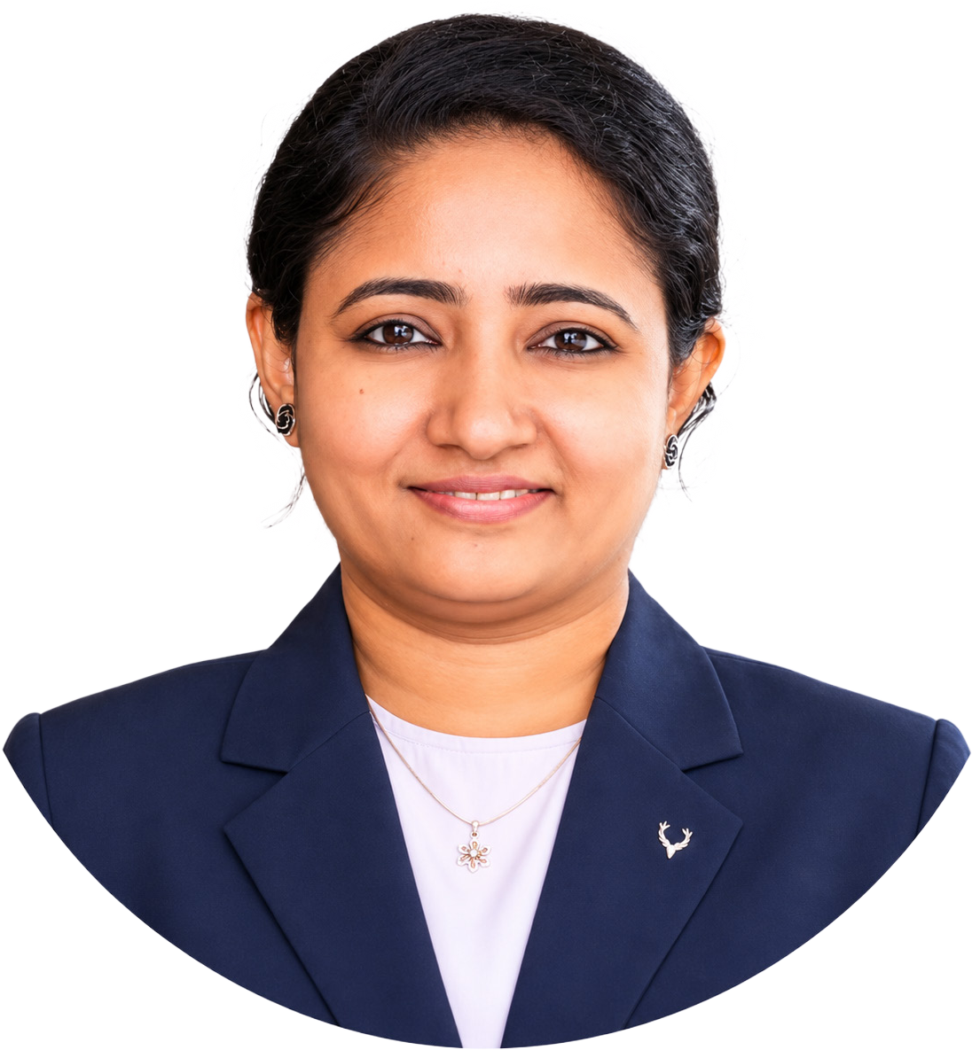
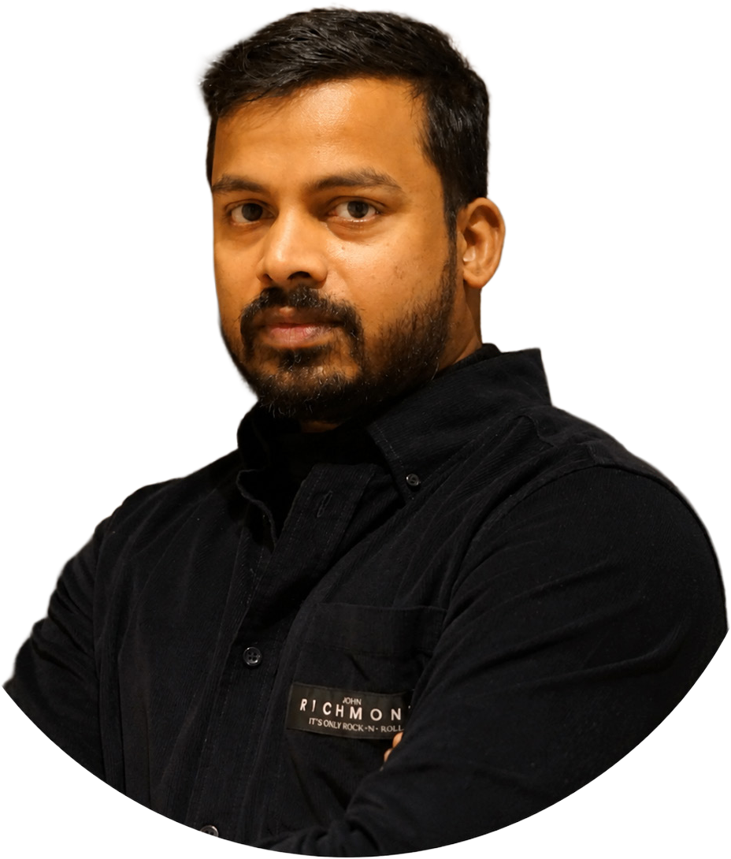
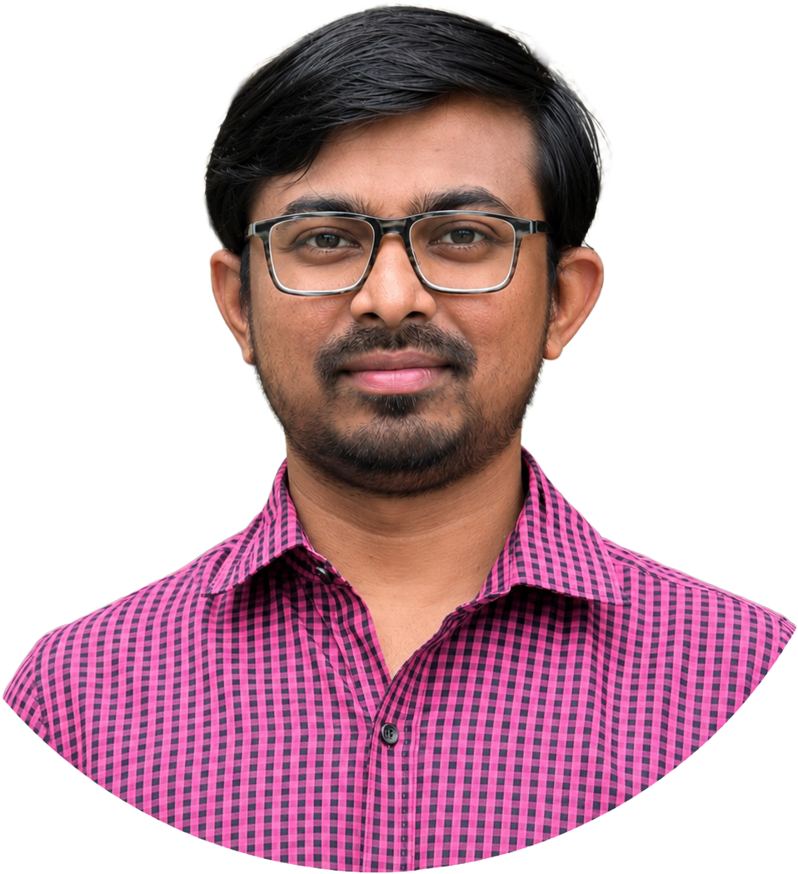







Dr. Mithun Thudiyangal
Group Leader
Dr. Basudeb Sain
Dr. Arindam Mallick
Dr. Sreeja C S
Dr. Ranjith Kumar K M
Group Leader
Group Leader
Group Leader
Group Leader
Research Focus
Research Focus
Research Focus
Research Focus
Research Focus
Ultracold Quantum Matter and Quantum Algorithms
Photonics / Quantum Photonics & Optical Metasurfaces
Quantum Information, Quantum Simulation & Mathematical Physics
Quantum-Safe Cryptography
& Cyber Security
Quantum Materials & Quantum Magnetism Low Temperature Physics

Slide 6
Research Domains of CQTCS
Theory
Dr. Mithun Thudiyangal
Dr. Sreeja CS
Dr. Arindam Mallick
Experiment
Dr. Basudeb Sain
Dr. Ranjith Kumar K M
Quantum algorithms and Simulations
Quantum computing and Quantum communications
Complex Systems
Photonics quantum systems
Low Temperature Physics
Quantum Magnetism & Materials

Slide 7
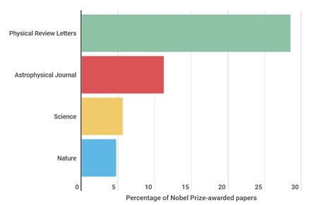

Features of Group Leaders
In subjectJournals
> 50 APS papers
Publications in ACS journals,
Nano Letters, RSC Advances,
Nanoscale, Nature Photonics, Nanophotonics etc.
In interdisciplinaryJournals
4 -Physical Review Letters -American Physical Society (APS)
4 -Light: Science & Applications -Nature
3 -Science advances -Science

Slide 8
Collaborations
Academic
✔ University of Maryland, USA
University of Luxembourg, Luxembourg
National Institute of Standards and Technology (NIST), USA
Industry
Qutools, Germany
Kipu Quantum, Germany
Ansys, India
Pernishq Delhi
Institute for Basic Science, South Korea
Lancaster University, England
IIT Delhi, IIT Kharagpur
✔ Los Alamos National Laboratory, USA
✔ Kindai University, Japan
✔ University of Massachusetts, Amherst, USA
MaxPlanck Institute, Germany
National High magnetic ﬁeld Laboratory, Grenoble, France
Leibniz Institute (IFW) Dresden, Germany
High Magnetic ﬁeld Laboratory, Germany
MoU
Qutools, Germany
Ansys, India
Space Applications Centre (SAC), ISRO

Slide 9
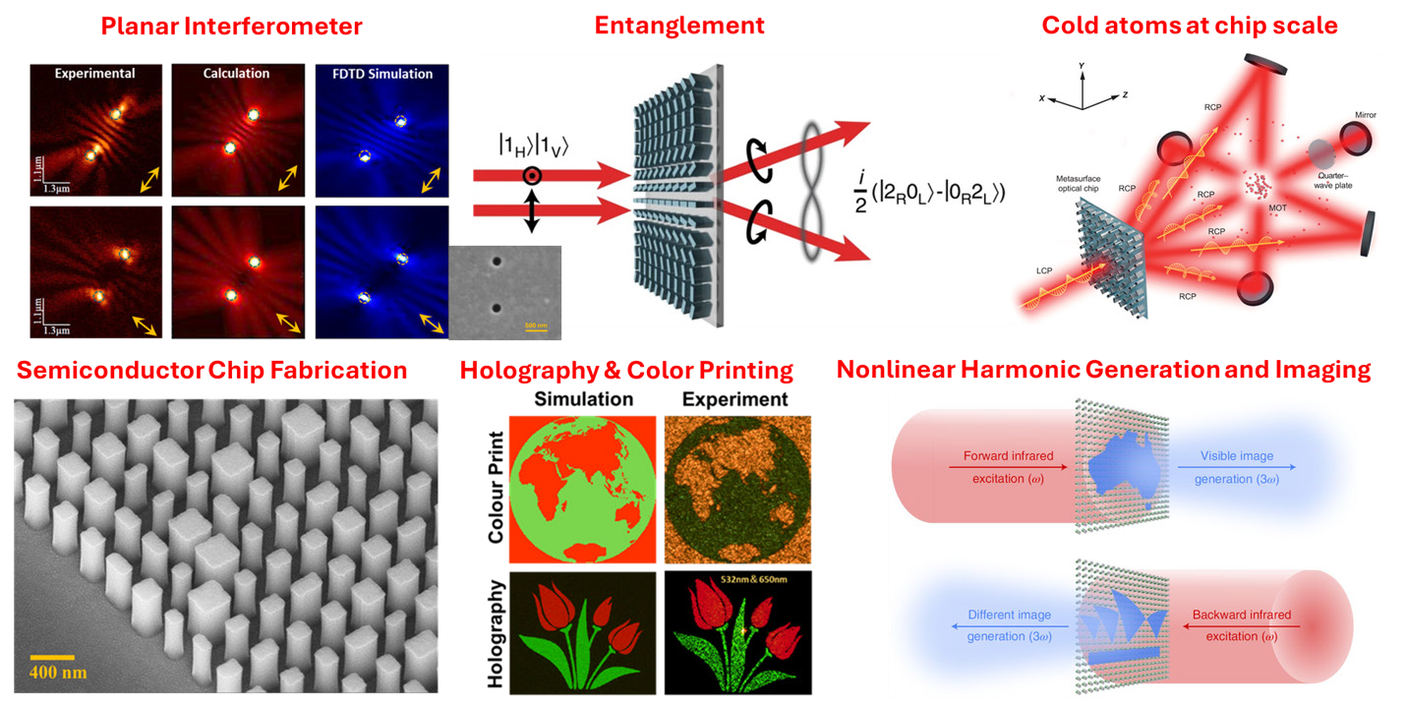
Photonics Lab Facilities
Supercontinuum Laser System
Chemical Nanofabrication Lab
Photonic characterization facilities (Microscopic and Spectroscopic)

Slide 10
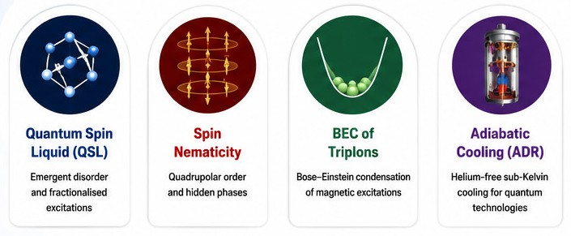
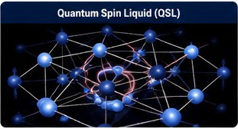
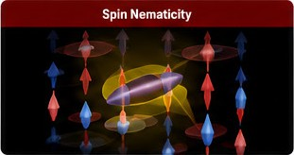
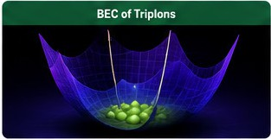
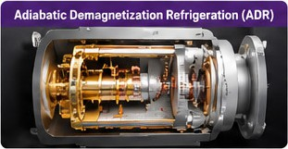
Quantum Magnetism & Materials Research

Slide 11
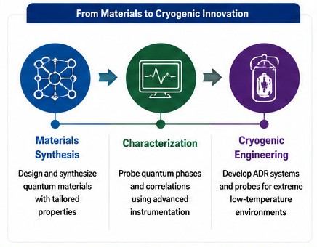
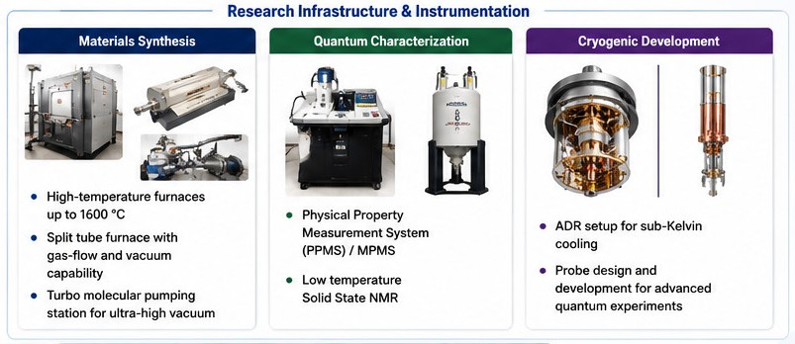
Cryogenic Technologies & Research Infrastructure

Slide 12
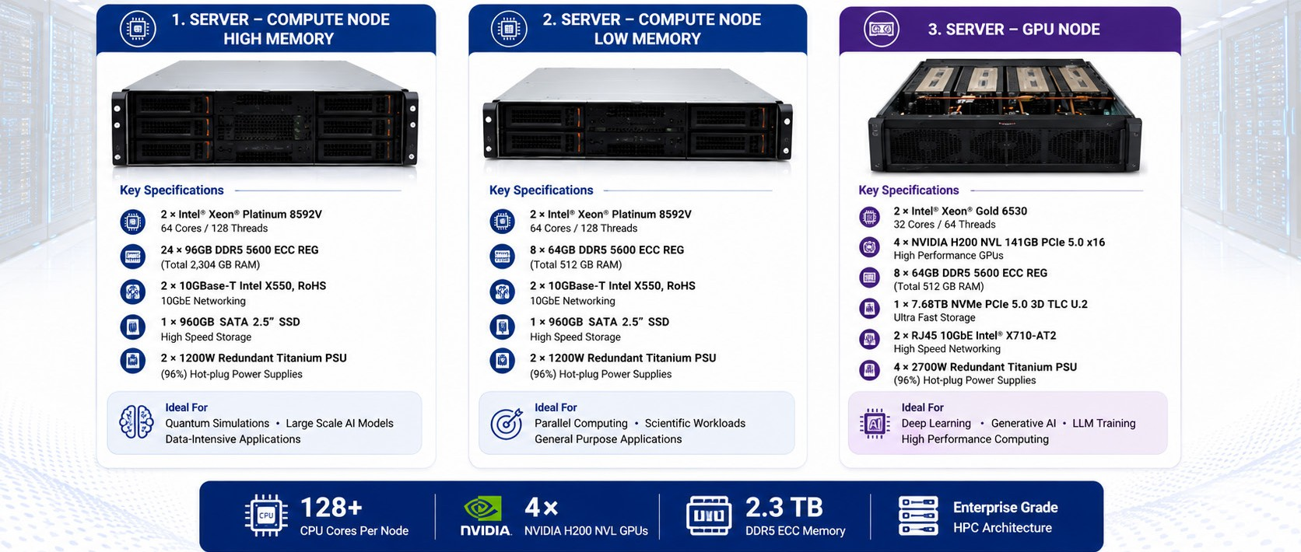
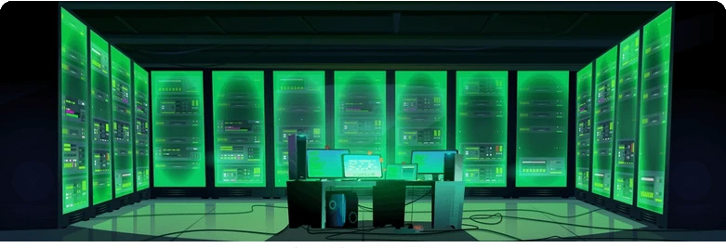

HPC Infrastructure - System Speciﬁcations

