Slide 1
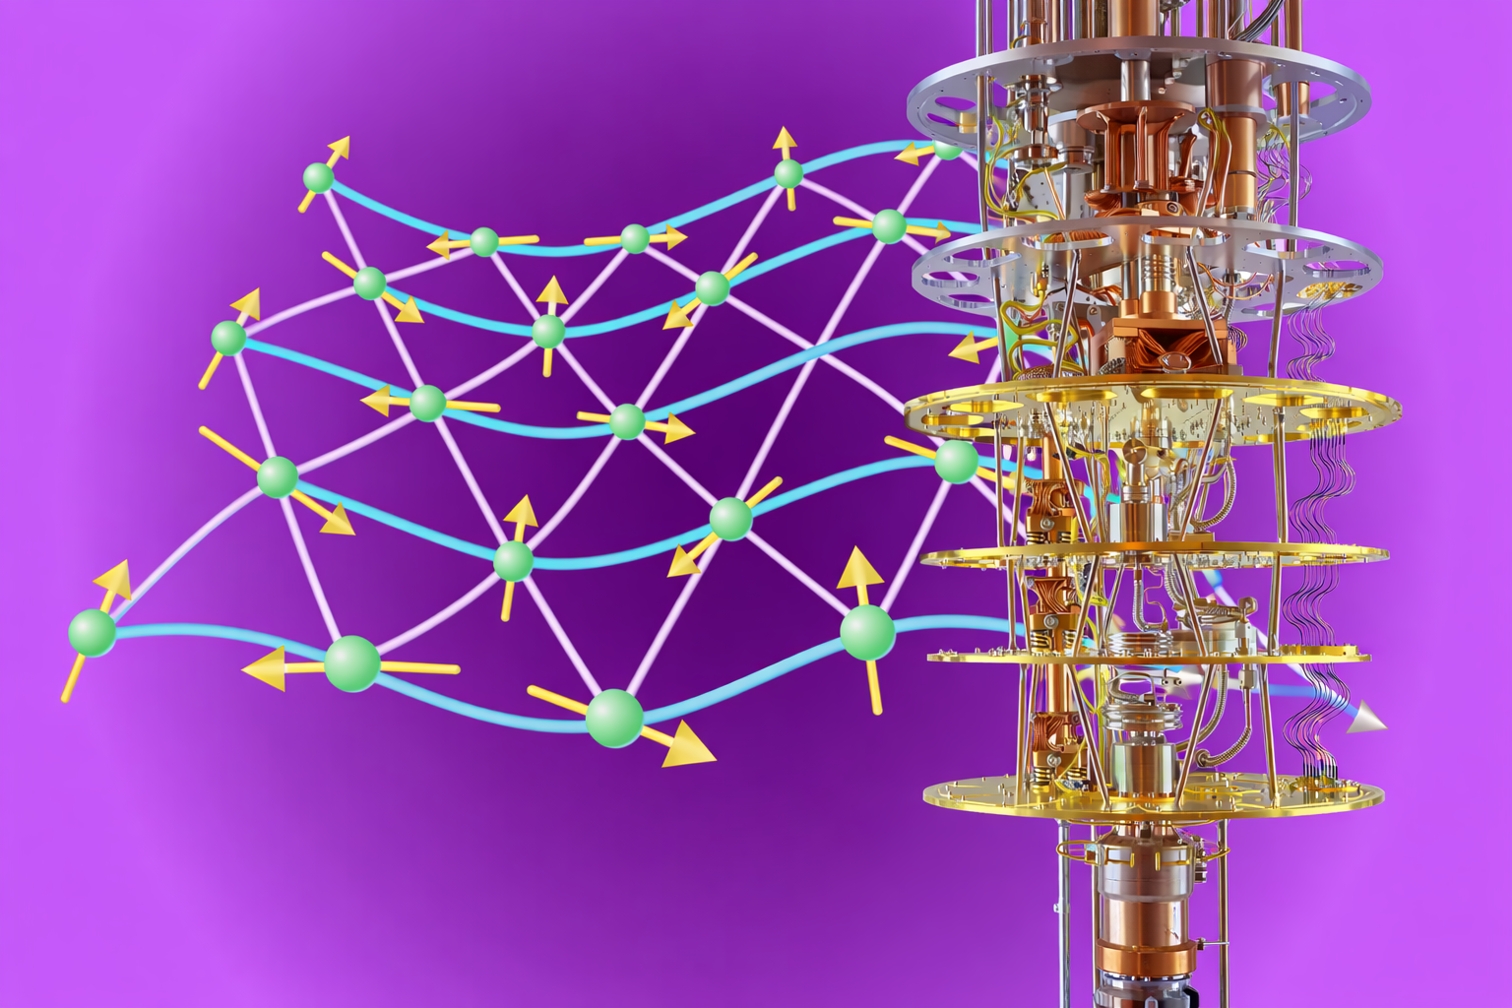
Quantum Magnetism & Materials:
From
Exotic Phases
to
Cryogenic Technologies
Dr. K. M. Ranjith Kumar

Slide 2

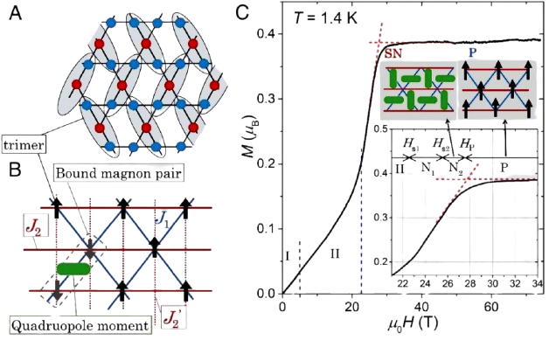
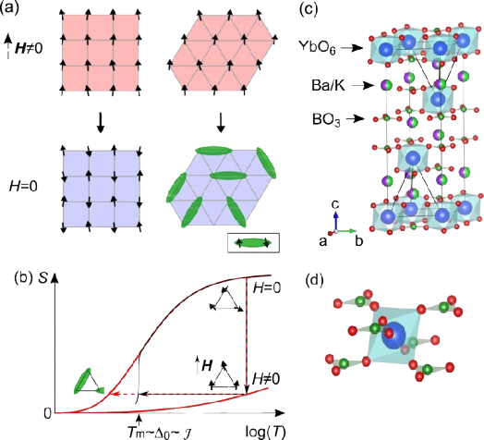
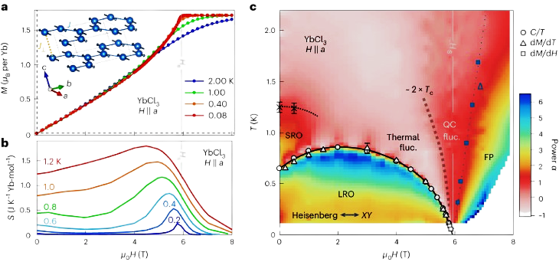
Research outline
Spin Nematicity
Quantum Spin Liquid (QSL)
Spin-Nematicity
Quantum magnetism
&
materials
BEC
QSL
BEC of triplons
Adiabatic Cooling (ADR)
ADR
a central playground for studying strong correlations, entanglement, and emergent collective behavior

Slide 3
Adiabatic Cooling (ADR)
The Future of Absolute Zero
exploring how frustrated magnetic materials unlock helium‑free refrigeration and compact low‑temperature probes for quantum research and space technology.
Engineering the Sub‑Kelvin Window
Cryogenic Probe Design for Modern Research
With engineered materials, continuous ADR architectures and compact probe designs, milli‑Kelvin capability will be accessible, scalable and flight‑ready — enabling the next generation of quantum experiments and space missions.

Slide 4
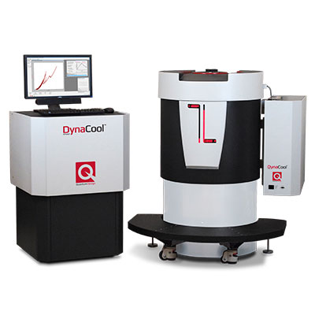
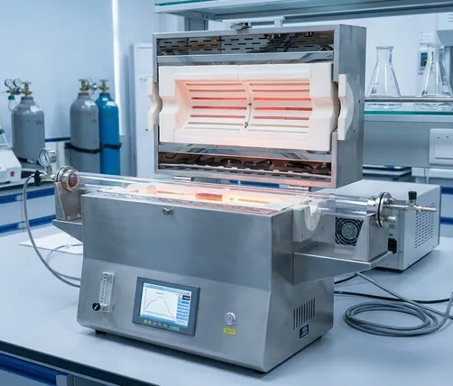
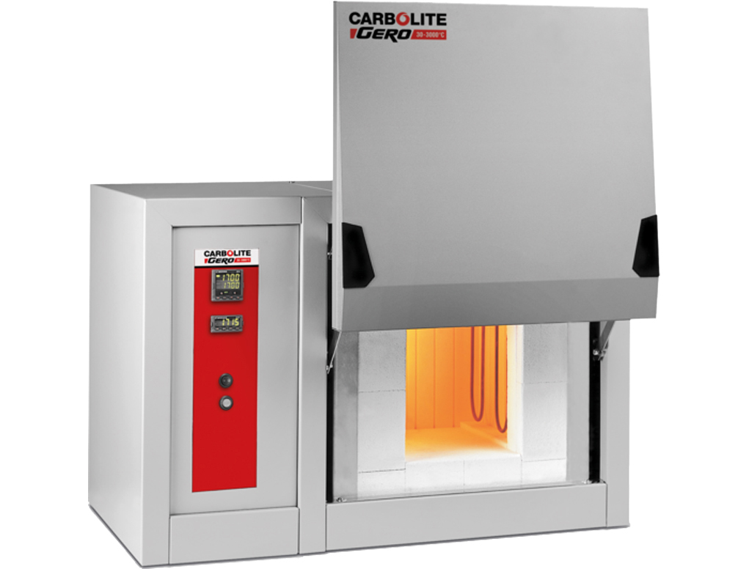
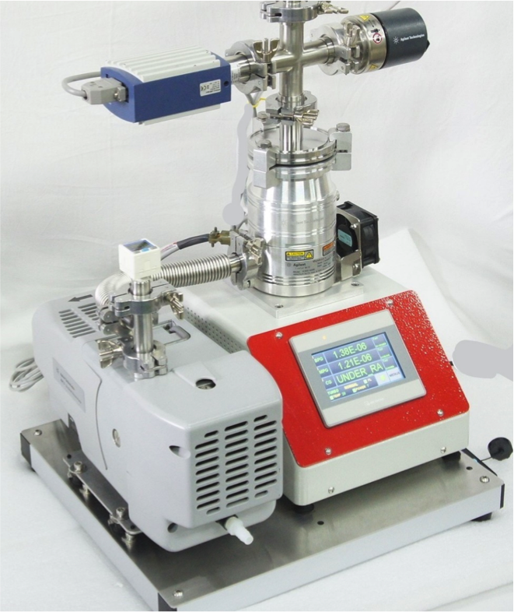
Instruments and facilities
First stage: Discover & Explore the materials
High temperature Furnaces which can go up to 1600 C
Split tube furnace capable of gas flow and under high vacuum
Turbo molecular pumping station to achieve ultra high vacuum
Next: Exploring the quantum phases & Instrumentation
Physical Property Measurement System (PPMS)/MPMS
Low temperature Solid state NMR
ADR setup and probe design

