Slide 1

QUANTUM OPTIMIZATION PRACTICAL SESSION
Travelling Salesman Problem
& the 0/1 Knapsack Problem
Classical Algorithms → QUBO / Ising Formulation → QAOA on Qiskit
Full source code
Executed outputs
Diagrams & charts
Build-ready material
Python 3.12 · Qiskit 1.4 · qiskit-optimization 0.7 · qiskit-algorithms 0.4

Slide 2








SESSION OVERVIEW
The Complete Optimization Journey
Both problems — TSP and Knapsack — are walked through the same nine-stage journey, connecting directly to later syllabus topics such as QAOA and Quantum Annealing.
1
2
3
Real World
Problem
Problem
Statement
Mathematical
Model
4
5
6
Brute Force
Solution
Better Classical
Algorithm
Why Classical
Struggles
7
8
9
Quantum
Formulation
QAOA
Implementation
Compare
Results
Quantum Optimization Practical Session
2

Slide 3
SESSION OVERVIEW
Recommended Practical Structure
STEP | ACTIVITY
1 | Understand the real-world story
2 | Write inputs and outputs
3 | Draw the graph / table
4 | Solve manually
5 | Implement brute force in Python
6 | Measure execution time
7 | Implement a better classical algorithm
8 | Compare the two classical methods
9 | Introduce the quantum formulation (QUBO / Hamiltonian)
10 | Run a simple Qiskit QAOA example (simulator) and compare results
Quantum Optimization Practical Session
3

Slide 4

PART A
Travelling Salesman Problem
Finding the shortest route across 5 Karnataka cities
Quantum Optimization Practical Session
4

Slide 5
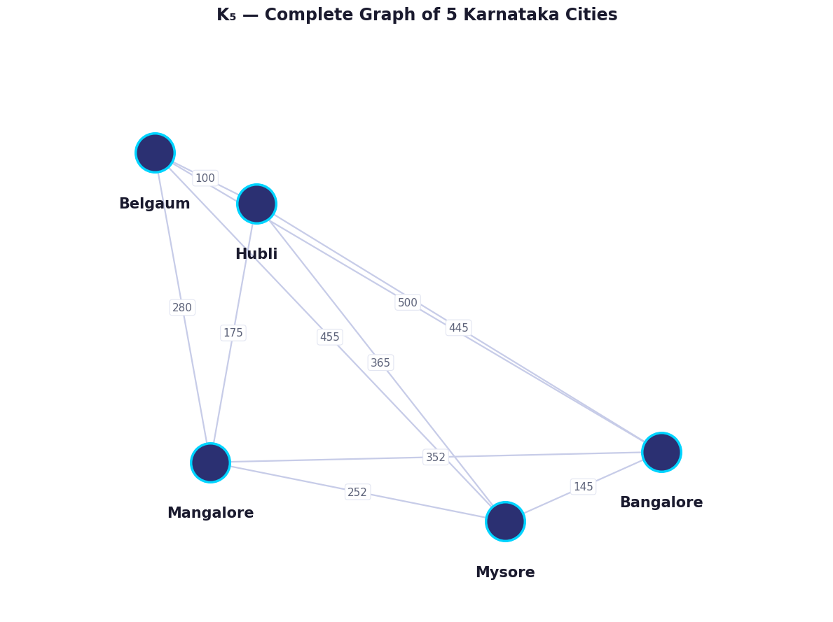
A.1 — REAL-WORLD STORY
An Amazon Delivery Truck's Dilemma
It must visit Bangalore, Mysore, Mangalore, Hubli, and Belgaum
Every city must be visited exactly once
The truck must return to its starting city
Which route is the shortest?
5
K5
120
Cities to visit
Complete graph
Total orderings
Distances shown are approximate road distances (km)
Quantum Optimization Practical Session
5

Slide 6
A.2 — WHY COMBINATORIAL OPTIMIZATION IS HARD
Routes Explode Combinatorially
For n cities, there are (n−1)!/2 distinct routes to check. Brute force guarantees the optimal answer — but only while n stays small.
24
Routes for 4 cities
3,628,800
Routes for 10 cities
6.08 × 10¹⁷
Routes for 20 cities
This is exactly why optimization becomes difficult — and why we need smarter algorithms.
Quantum Optimization Practical Session
6

Slide 7

A.3 — STEP 1: BRUTE FORCE SOLUTION
Check Every Route, Keep the Best
Generate every possible route → calculate total distance → choose the minimum. Guarantees the optimal answer, but scales as O(n!).
for route in itertools.permutations(cities):
total = 0
for i in range(len(route) - 1):
total += get_distance(route[i], route[i+1])
total += get_distance(route[-1], route[0])
if total < best_cost:
best_cost = total
best_route = route
24
1222
0.06
Routes
checked
Best cost
(km)
Time
(ms)
Guaranteed Optimal
Brute force always finds the true shortest route because it evaluates every possibility. The trade-off is speed: it becomes impossible beyond roughly 12–15 cities.
EXECUTED RESULT
Bangalore → Mysore → Mangalore → Belgaum → Hubli → Bangalore
Optimal distance: 1,222 km · 24 routes checked · 0.06 ms
Quantum Optimization Practical Session
7

Slide 8
A.4 — STEP 2: BETTER CLASSICAL ALGORITHM
Nearest Neighbor Heuristic
Instead of checking every route, greedily move to the closest unvisited city at each step. Runs in O(n²) — dramatically faster, but not always optimal.
BRUTE FORCE (optimal)
NEAREST NEIGHBOR (heuristic)
+12 km
1.0%
1,222 km
1,234 km
Optimality gap
Worse than optimal
Bangalore → Mysore → Mangalore → Belgaum → Hubli
Bangalore → Mysore → Mangalore → Hubli → Belgaum
0.06 ms
0.02 ms
The trade-off, in one line
execution time
execution time — 7x faster
A near-instant heuristic sacrifices only 1% solution quality — a trade many real logistics systems happily accept at scale.
Quantum Optimization Practical Session
8

Slide 9






A.5 — STEP 3: QUANTUM FORMULATION
TSP → QUBO → Hamiltonian → QAOA
Instead of checking every route, we encode the optimization problem into a cost Hamiltonian and use a parameterized quantum circuit to search for good solutions. QAOA is a hybrid quantum-classical algorithm: the quantum computer prepares candidate solutions while a classical optimizer updates the circuit parameters.
→
→
→
→
→
TSP
Graph
QUBO
Ising
Hamiltonian
QAOA
Optimal
Route
A scaling reality worth teaching
The standard TSP QUBO encoding needs n² qubits for n cities. The full 5-city problem would need 25 qubits — too heavy for a live classroom simulation.
This material uses a 4-city subset (16 qubits) for the live QAOA demo, while brute force and nearest neighbor use the full 5-city problem — this trade-off is itself worth discussing with students.
Quantum Optimization Practical Session
9

Slide 10
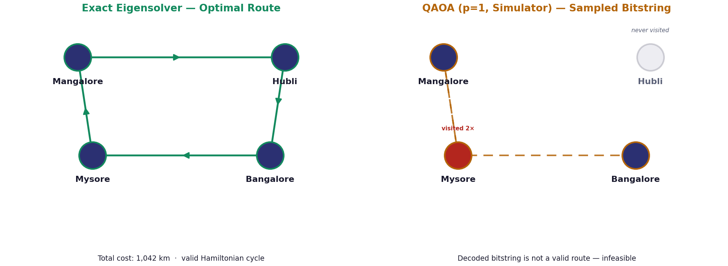

A.6 — QAOA EXECUTION (QISKIT, SIMULATOR)
Exact Solver vs QAOA on the 4-City Subset
QAOA Did Not Match the Exact Solution
On this run, QAOA's sampled bitstring did not decode into a valid Hamiltonian route — a common outcome with shallow circuit depth and limited optimizer iterations on a real (noisy) objective landscape.
This is expected, teachable behaviour: QAOA approximates, and quality depends heavily on circuit depth (p), shot count, and the classical optimizer's budget — not simply on “using a quantum computer.”
16
1042 km
112
Qubits used
Exact optimal cost
Ising terms
Quantum Optimization Practical Session
10

Slide 11
A.7 — STEP 4: COMPARE RESULTS
TSP — Four Methods, Side by Side
METHOD | SCOPE | COST (KM) | TIME (MS) | OPTIMAL?
Brute Force | 5 cities | 1,222 | 0.06 | Yes
Nearest Neighbor | 5 cities | 1,234 | 0.02 | No (heuristic)
Exact Eigensolver | 4 cities (subset) | 1,042 | 1,251.9 | Yes
QAOA (Quantum) | 4 cities (subset) | N/A (infeasible) | 64,028.6 | Approximate
Quantum algorithms are not “always faster”
They are promising for certain classes of optimization problems, but remain an active area of research — solution quality depends heavily on circuit depth, shots, and optimizer budget, not just “using a quantum computer.”
Quantum Optimization Practical Session
11

