Slide 1

Boosting Agriculture Yields with Effective Recommendations
Done by - Abhijith Nagarajan

Slide 2
Table of contents
SNO | Topic | Slide Number
1. | Farms of the future – Problem Statement and Solution | 3
2. | Solution 1a) Dashboard 1 - Precipitation and Temperature Analysis | 4-5
3. | Solution 1b) Dashboard 2 – Crop Commodity Costs and Returns | 6-7
4. | Solution 2) Weather Prediction – Dataset generation | 8
5. | Solution 3) Crop Recommendation – Predictive modelling and deployment | 9-10
6. | Conclusion | 11

Slide 3
Farms of the future
Problem Statement
The constant threat of environmental degradation, unpredictable weather patterns, and rising cultivation costs looms over the future of agriculture. This urgency is compounded by a growing population and inflation. Hence, there is a necessity to embrace eco-friendly, sustainable solutions empowered by technology to address these challenges head-on.
My solution is an interpretation of Bayer’s Farms of the future initiative, where agriculture has been transformed with digitization.
Solution
Environmental variations and crop commodity price changes – Tableau Dashboard:
To demonstrate the variations in precipitation & temperature in the US and analyze cultivation costs for five crops. This study corroborates the need for a smart solution.
Skills: Data Visualization and Communication
Weather Prediction:
Practicing precision farming can aid in utilizing water judiciously for irrigation. One means to achieve this is by being able to predict the weather in advance. For this part of the project, I have collated data to build a dataset to predict the weather condition in advance.
Skills – Data Collection, Database Management, API
Crop Recommendation:
Given several parameters, such as nitrogen, phosphorus, potassium, temperature, humidity, pH, rainfall and sowing season, suggest which crop can be grown.
Skills – Exploratory Data Analysis, Model building and evaluation, Model deployment.

Slide 4
Temperature and Precipitation Analysis
Salient features of the data and dashboard:
Cities considered (24): Avon Lake, Berkeley, Cambridge, Centralia, Champaign, Chesterfield, Hebron, Illiopolis, Kansas City, Kearney, Luling, Montvale, Muscatine, Myerstown, Phoenix, Pittsburg, Remington, Rogers, San Francisco, Shakopee, Tucson, Waterman, Whippany, Woodland
Source of data: PRISM Climate Group
Aim of the dashboard: To study the temperature and precipitation variations from 2017 to 2023.
Some key observations:
For winters – The Midwest region has seen a 25% decrease, roughly 8F drop, in average temperatures from 2017 to 2022. However, from 2022 to 2023, there has been an average uptick of 10F across all states.
For the Northeast states of Massachusetts, New Jersey and Pennsylvania, there is a palpable change in precipitation received in Fall.
For instance, since 2018, Pennsylvania has recorded a steady fall in rainfall from 3571 to 1895 mm.
On the other hand, for New Jersey, a decrease was initially observed from 2018-2020; 3584 to 2423 mm but was followed by a 32% increase of 3198 mm in 2023.

Slide 5
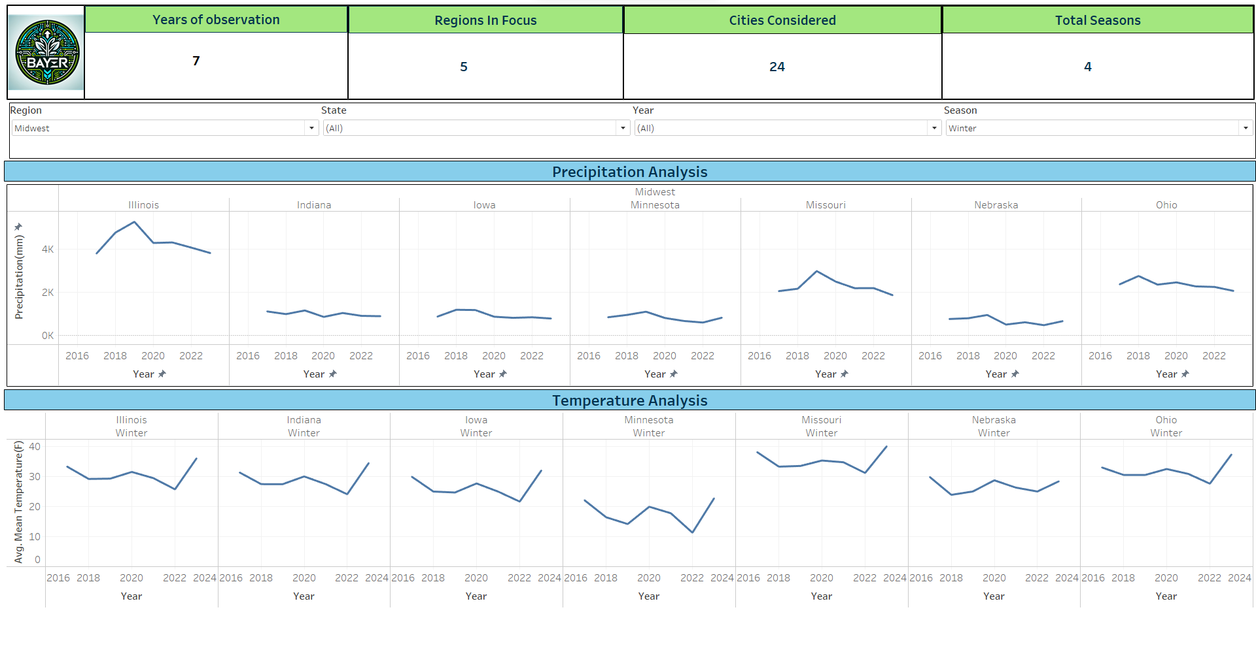
Temperature and Precipitation Analysis

Slide 6
Crop Commodity Prices Analysis
Salient features of the data and dashboard:
Crops used: Corn, Rice, Wheat, Soybean, Cotton
Source of data: US Department of Agriculture
Aim of the dashboard: To study the crop commodity variations from the late 90s to 2022.
Some key observations:
For all crops, the total operating costs roughly rose by 60% between 2016 and 2022, thanks to the steady increase of fertilizer and chemicals costs. [Nearly 100% increase]
While the yield and gross production is expected to increase year on year, the associated overhead costs are also projected to increase.
Cotton has the lowest opportunity cost of land, averaging 80.24 from 2016 to 2022, which is nearly half the price than the other crops. However, the ginning cost, exclusive to cotton, has witnessed an increase from 69.54 to 88.01.

Slide 7
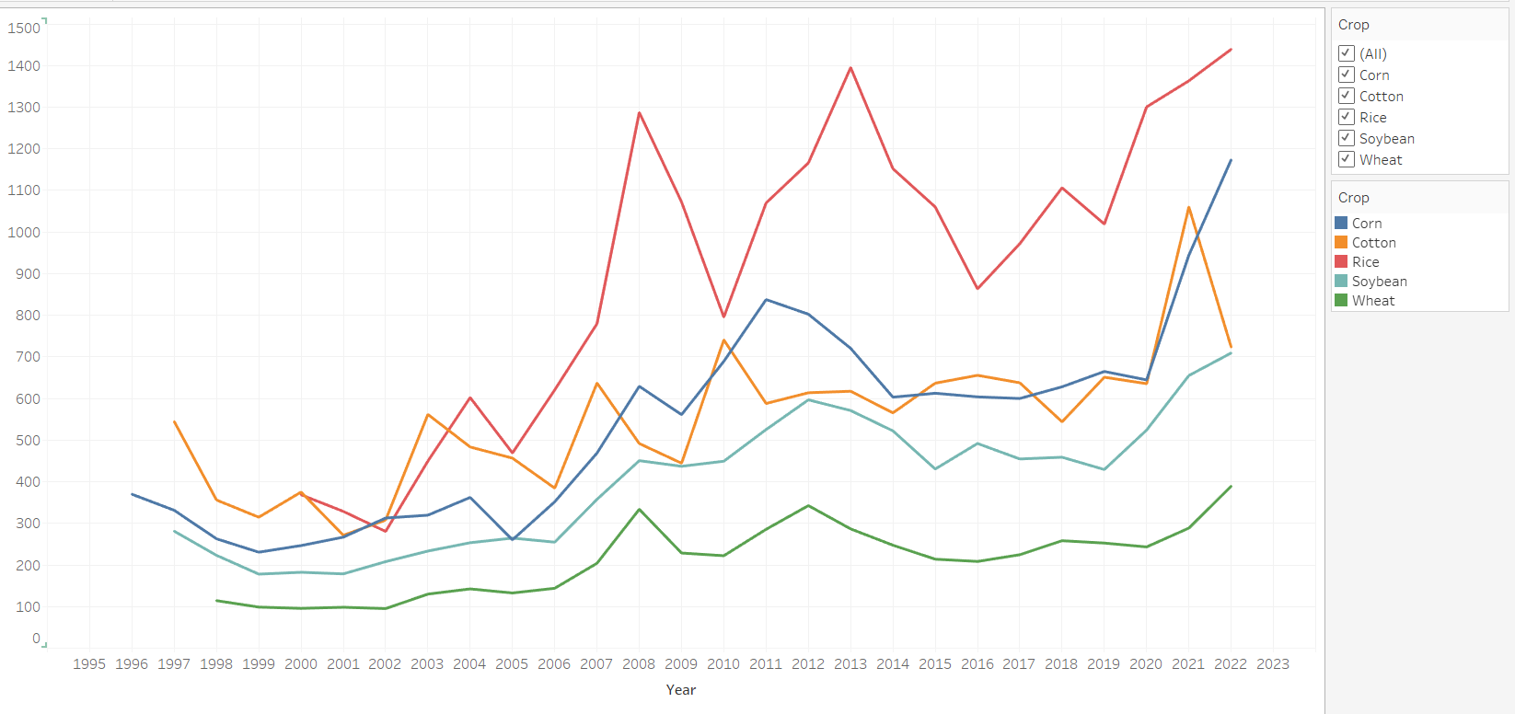
Crop Commodity Prices Analysis

Slide 8
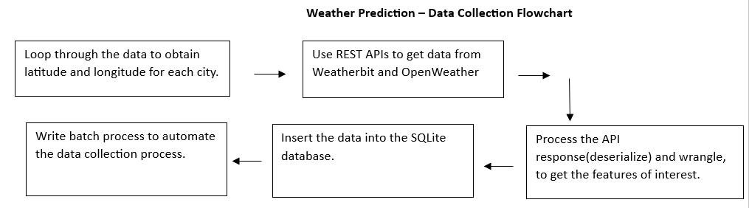
Weather Prediction – Data Collection
Weather profoundly influences agricultural productivity. Hence, it's vital to anticipate and adapt to unforeseen weather fluctuations to minimize their adverse effects.
Here are some details about how the data was collected and stored:
Cities considered – The same 24 as dashboard 1
Source of the data – Open Weather API and Weatherbit API
Flowchart for the process:

Slide 9
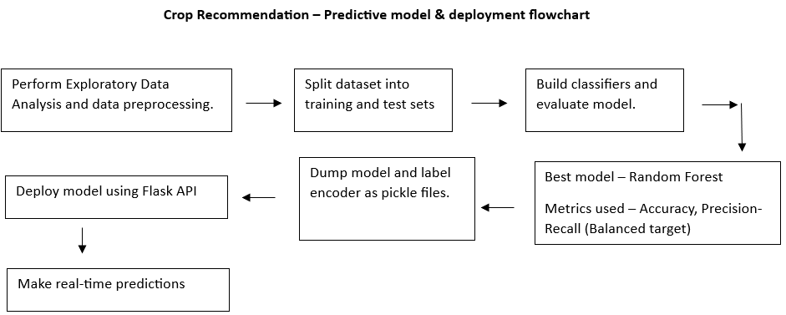
Crop Recommendation – Predictive model & deployment
Salient features of the data and dashboard:
Crops predicted: rice, maize, chickpea, kidney beans, pigeon peas, moth beans, mung bean, black gram, lentil, pomegranate, banana, mango, grapes, watermelon, muskmelon, apple, orange, papaya, coconut, cotton, jute, coffee
Source of data: Kaggle
Aim of the solution: Given inputs about the soil constituents, relative humidity, rainfall, temperature, and sowing season, suggest the most ideal crop to be cultivated.
Solution flowchart:

Slide 10
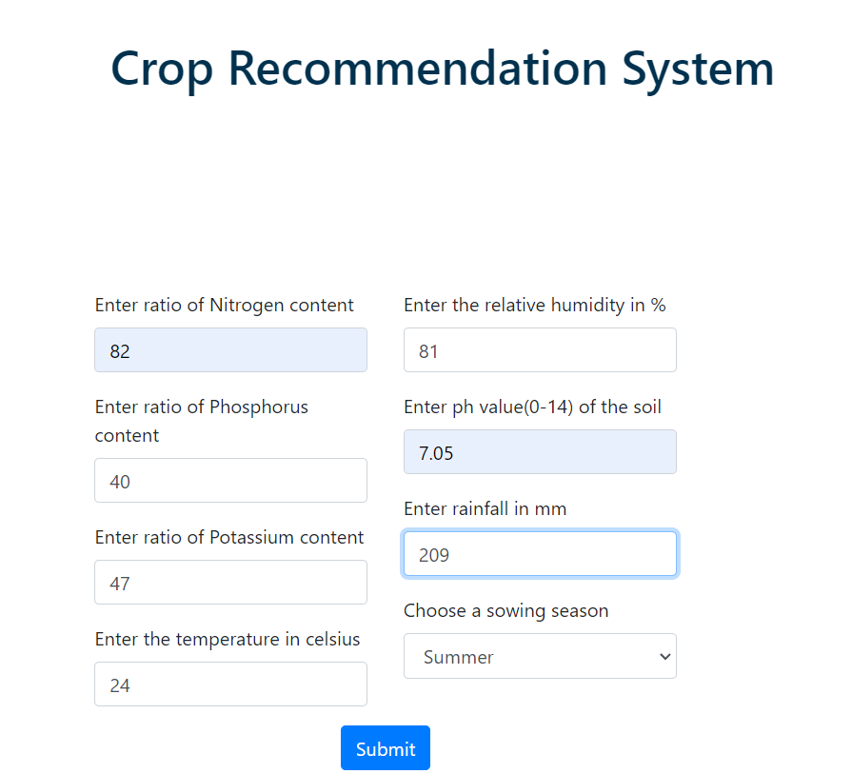
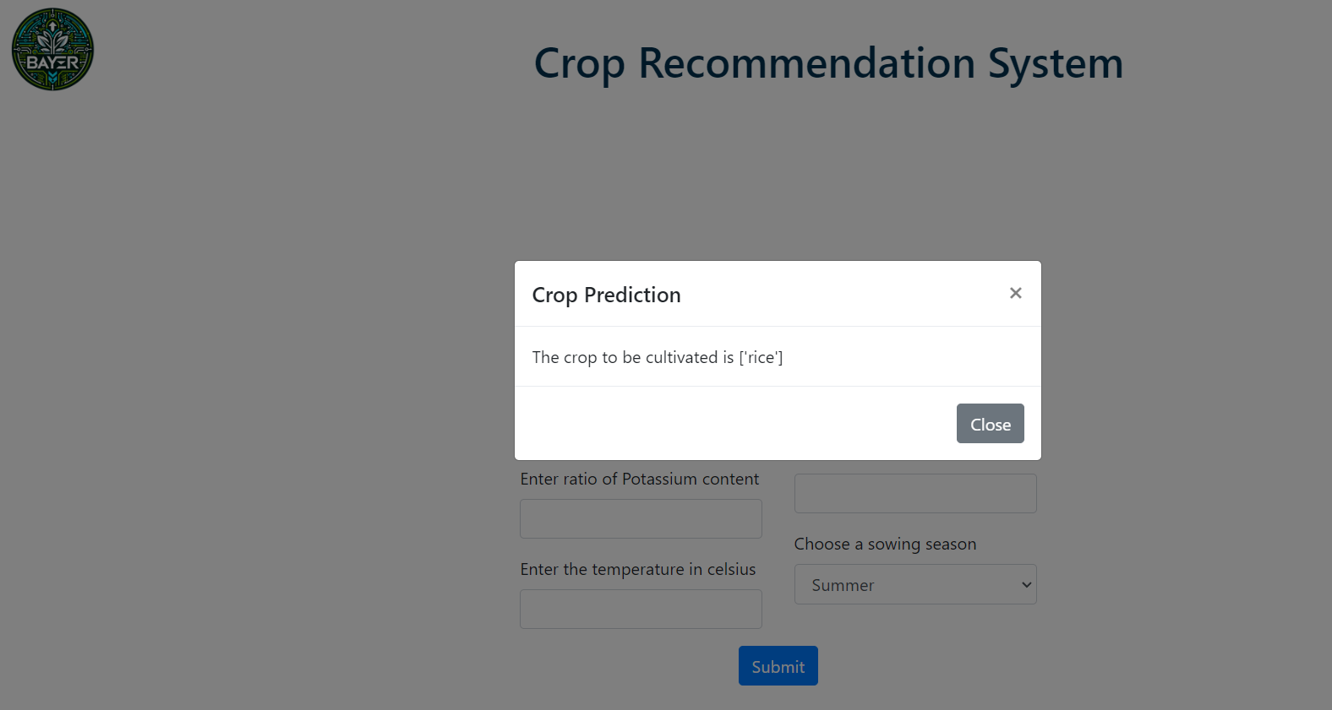
Crop Recommendation – Predictive model & deployment

Slide 11
Conclusion
The three components of Farms of the future shed light on the present ecological conditions and propose means to harness the power of technology and innovation for practicing sustainable agriculture.
By incorporating progressive methods like precision farming and data-driven insights, we can cultivate healthier crops, protect our environment, and ensure a brighter future for generations to come.

