Slide 1

Boosting Agriculture Yields with Effective Recommendations
Done by - Abhijith Nagarajan

Slide 2
Table of contents
SNO | Topic | Slide Number
1. | Farms of the future – Problem Statement and Solution | 3
2. | Solution 1a) Dashboard 1 - Precipitation and Temperature Analysis | 4-5
3. | Solution 1b) Dashboard 2 – Crop Commodity Costs and Returns | 6-7
4. | Solution 2) Weather Prediction – Dataset generation | 8
5. | Solution 3) Crop Recommendation | 9
6. | Conclusion | 10

Slide 3
Farms of the future
Problem Statement
The constant threat of environmental degradation, unpredictable weather patterns, and rising cultivation costs looms over the future of agriculture. This urgency is compounded by a growing population and inflation. Hence, there is a necessity to embrace eco-friendly, sustainable solutions empowered by technology to address these challenges head-on.
My solution is an interpretation of Bayer’s Farms of the future initiative, where agriculture has been transformed with digitization.
Solution
Environmental changes and commodity price – Tableau Dashboard:
To demonstrate the variations in precipitation & temperature in the US and analyze cultivation costs for five crops. This study corroborates the need for a smart solution.
Skills: Data Visualization and Communication
Weather Prediction:
Practicing precision farming can aid in utilizing water judiciously for irrigation. One means to achieve this is by being able to predict the weather in advance. For this part of the project, I have collated data to build a dataset to predict the weather condition in advance.
Skills – Data Collection, Database Management, API
Crop Recommendation:
Given several parameters, such as nitrogen, phosphorus, potassium, temperature, humidity, pH and rainfall, suggest which crop can be grown.
Skills – Exploratory Data Analysis, Model building and evaluation, Model deployment.

Slide 4
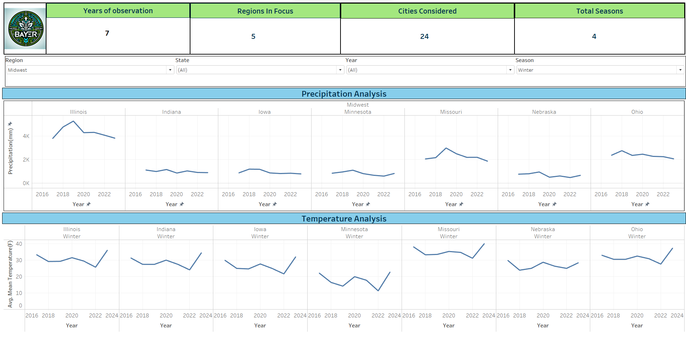
Temperature and Precipitation Analysis

Slide 5
Temperature and Precipitation Analysis

