Slide 1

ECE 143 FINAL PROJECT PREGNANCY-RELATED COMPLICATIONS AND MORTALITY IN THE U.S.
TEAM 3 Pulkit Agrawal • Mandy Cheung • Abhijith Dasharathi • Atishna Samantaray • Naman Sehgal
Notes:
Slides Created by m3cheung@ucsd.edu

Slide 2
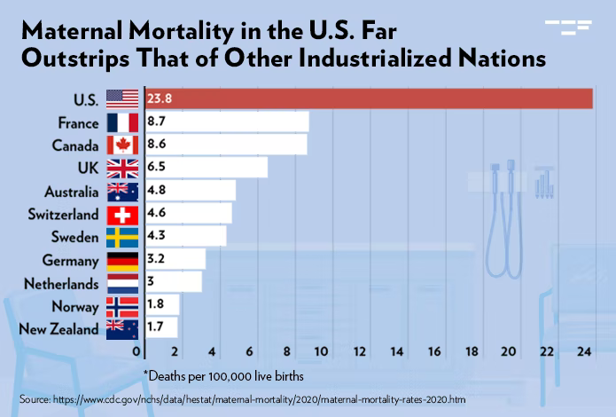
MOTIVATION
The U.S. has experienced a higher MMR than other industrialized countries for over 20 years
“What factors contribute to pregnancy-related complications?”
Plot source: https://tcf.org/content/commentary/worsening-u-s-maternal-health-crisis-three-graphs/

Slide 3

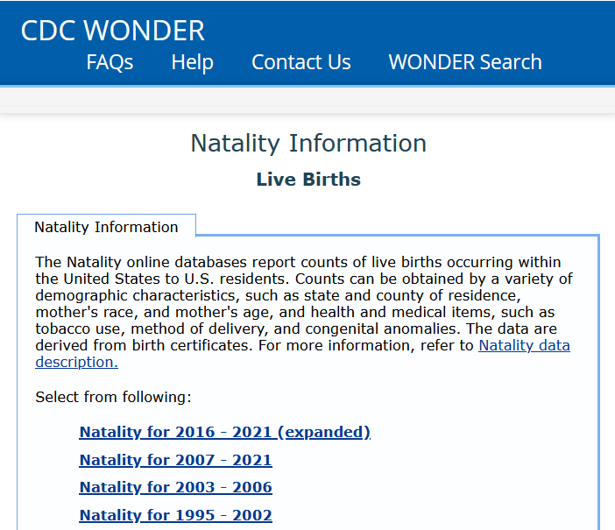
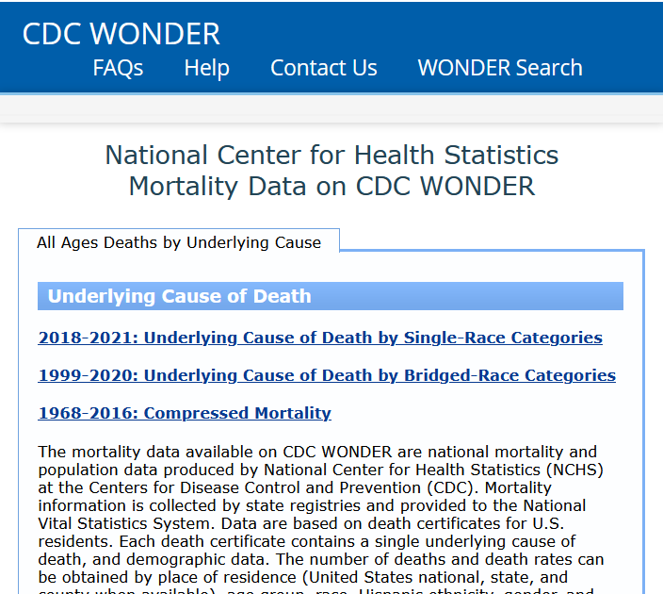
DATA OVERVIEW
Accessible at https://wonder.cdc.gov/
Natality for 2016-2021 reports live births using over 130 parameters
Underlying Cause of Death for 2018-2021 reports mortality by cause of death

Slide 4
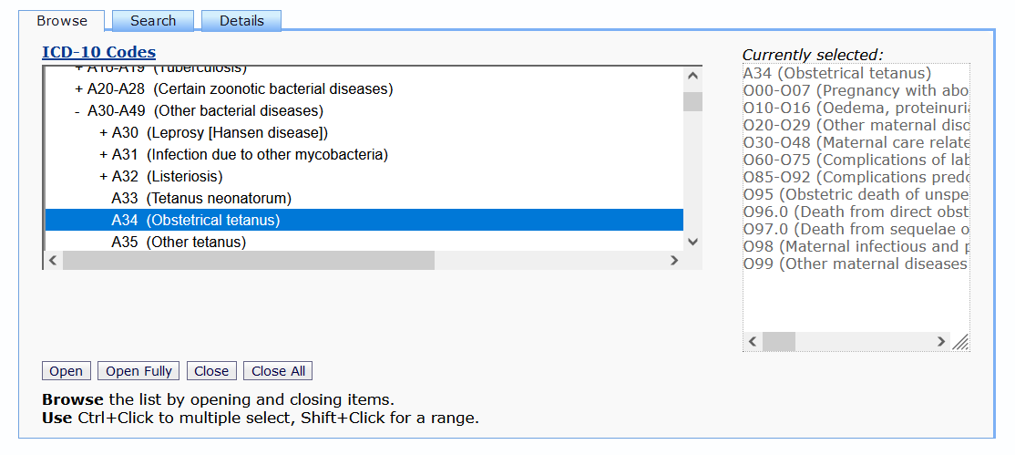
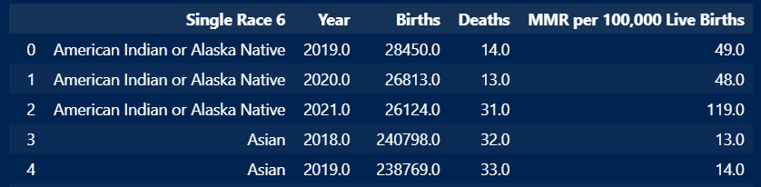
METHODOLOGY
CDC Dataset
CDC datasets are large & encoded
API
To navigate this, we wrote code to access the CDC Wonder API
Pre-processing
We merged datasets and removed “Not Reported”, “Suppressed”, and “Unreliable” data

Slide 5

ANALYSIS OVERVIEW
Physical Maternal Characteristics
Social Maternal Characteristics
Healthcare Characteristics

Slide 6
Physical Maternal Characteristics

Slide 7
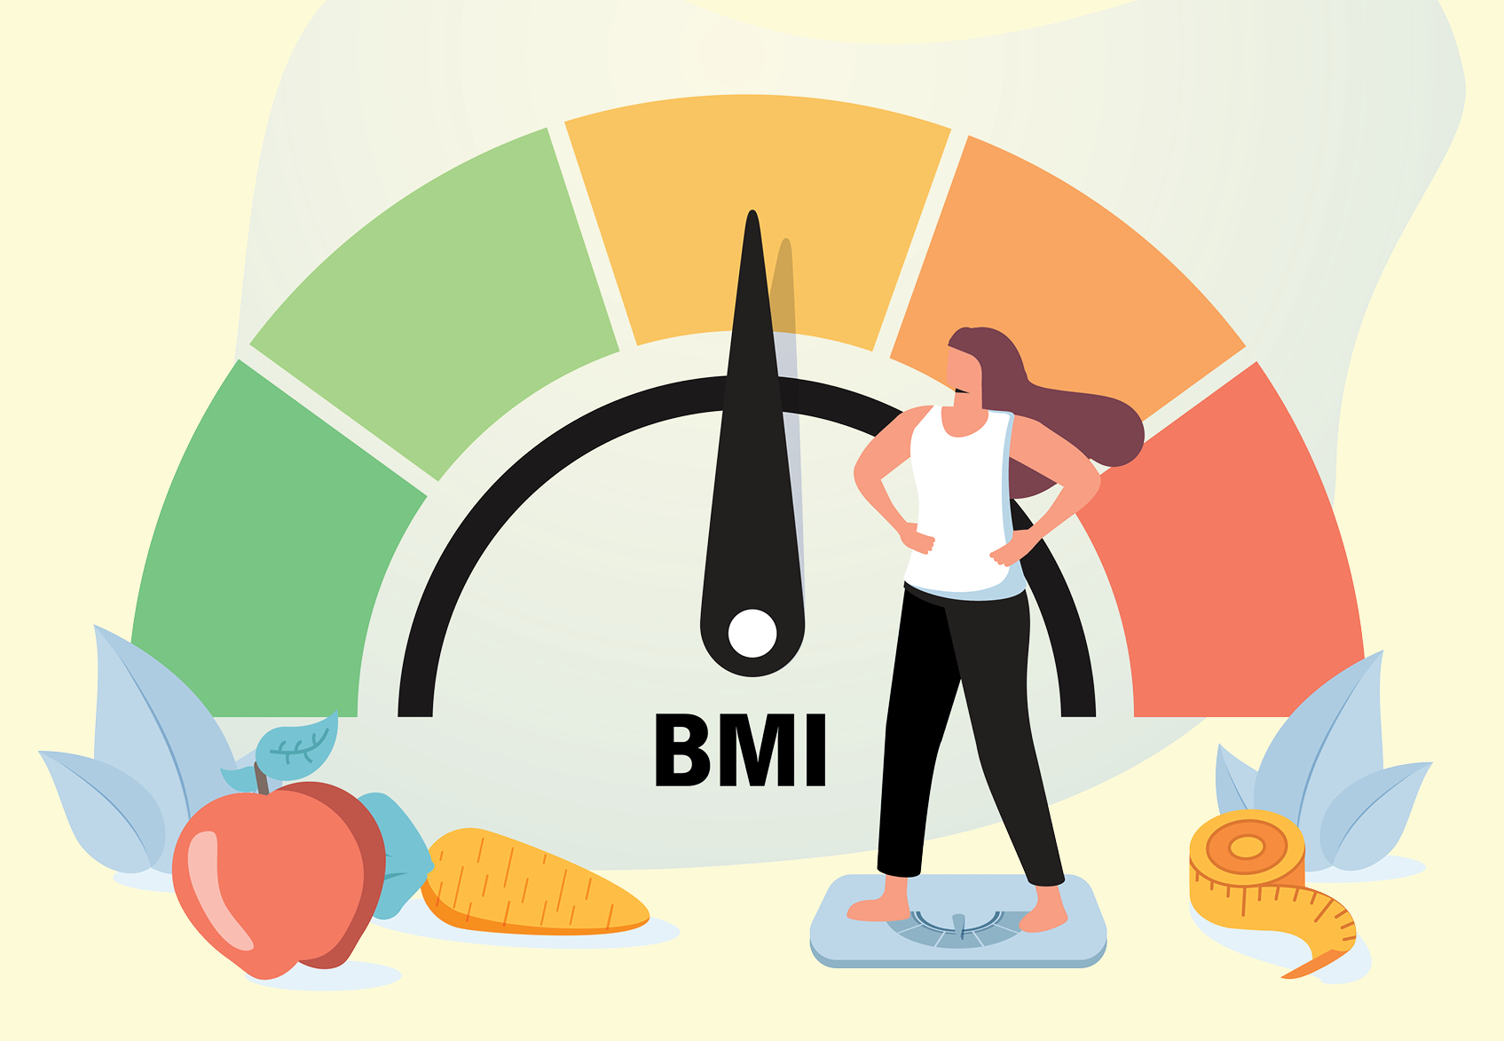
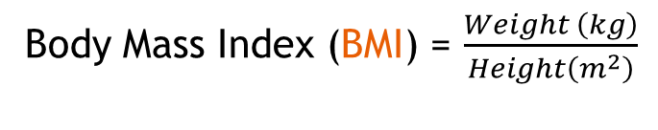
Parameters analyzed in this section
Tobacco and Cigarette Use
Height
Weight
Body Mass Index (BMI) = $\frac{Weight \left(kg\right)}{Height\left(m^{2}\right)}$
Photo source: https://health.clevelandclinic.org/is-bmi-accurate/

Slide 8
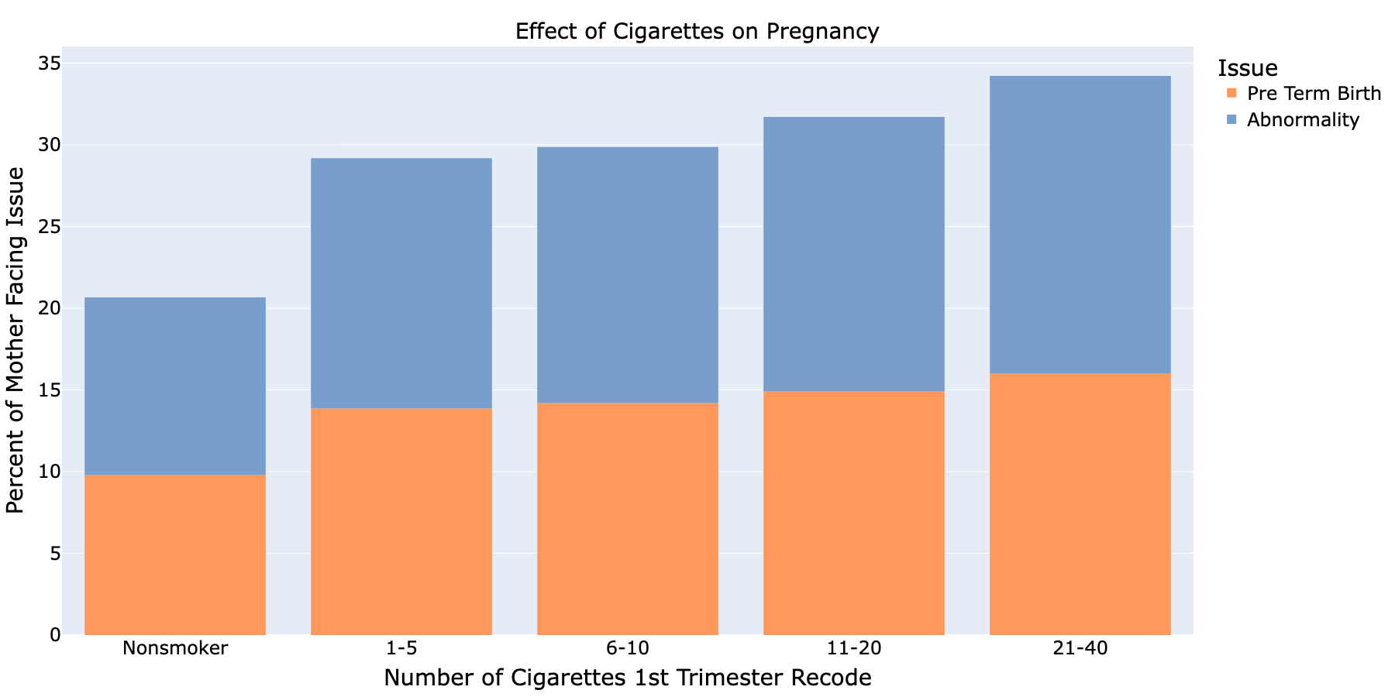
IMPACT OF Cigarettes
Abnormalities refer to live births where the newborn experiences
Assisted Ventilation
NICU Admission
Surfactant Replacement Therapy
Antibiotics for Suspected Neonatal Sepsis
OR Seizures
Physical Characteristics

Slide 9
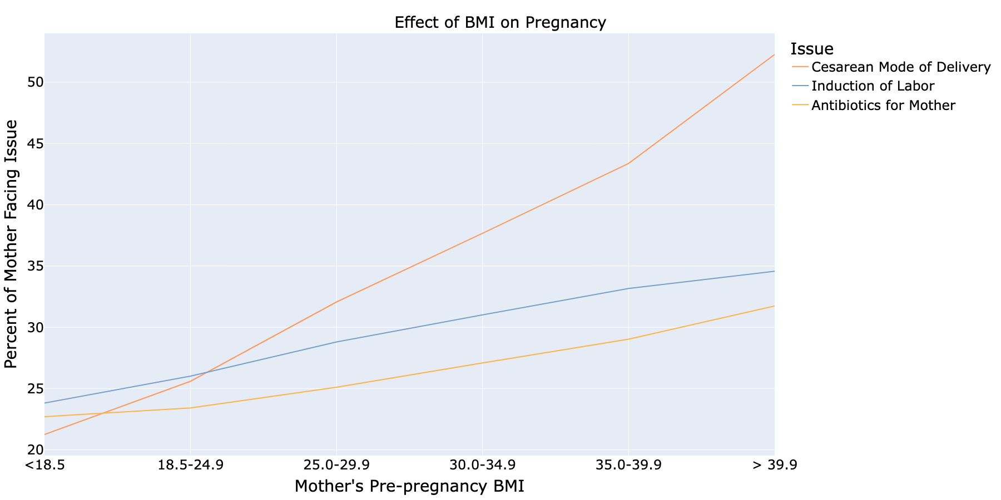
IMPACT OF BMI
Cesarean Mode refers to the surgical delivery procedure
Induction of Labor refers to methods of stimulating the uterus for the purposes of inducing labor
Physical Characteristics

Slide 10
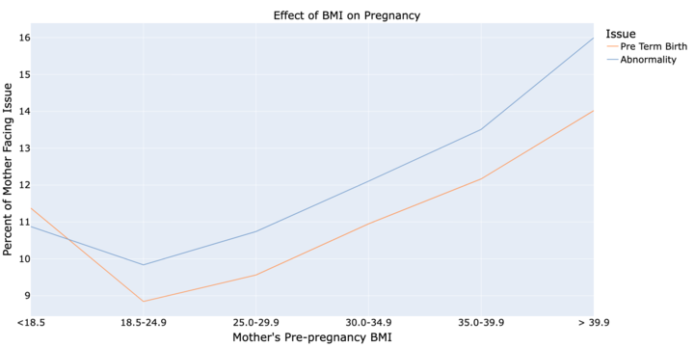
IMPACT OF BMI
Preterm births refer to live births that occur before 37 weeks of pregnancy is completed
This is generally considered dangerous, as the baby may develop long-term health issues
Normal BMI
Physical Characteristics

Slide 11
Social Maternal Characteristics

Slide 12
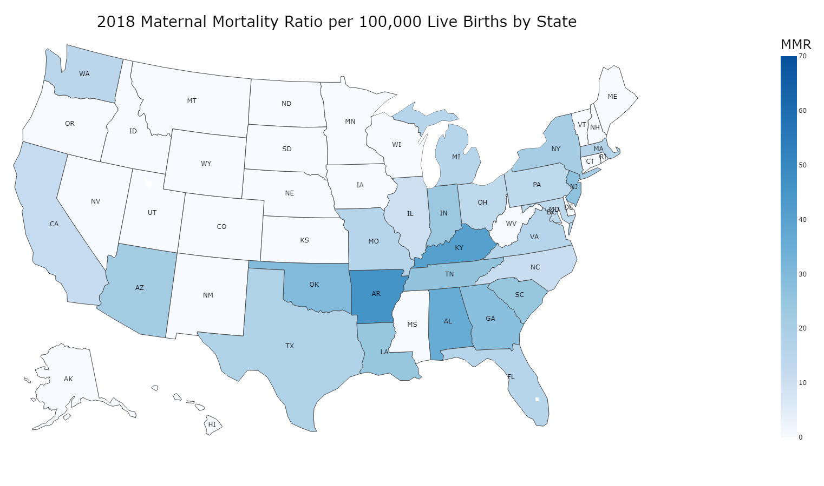
IMPACT OF LOCATION
MMR is defined as deaths/100,000 live births of that population
There is uneven MMR distribution in the U.S.
NOTE: states with zero value do not necessarily have zero MMR, the values may be too low and are “suppressed” by the CDC dataset
Social Characteristics

Slide 13
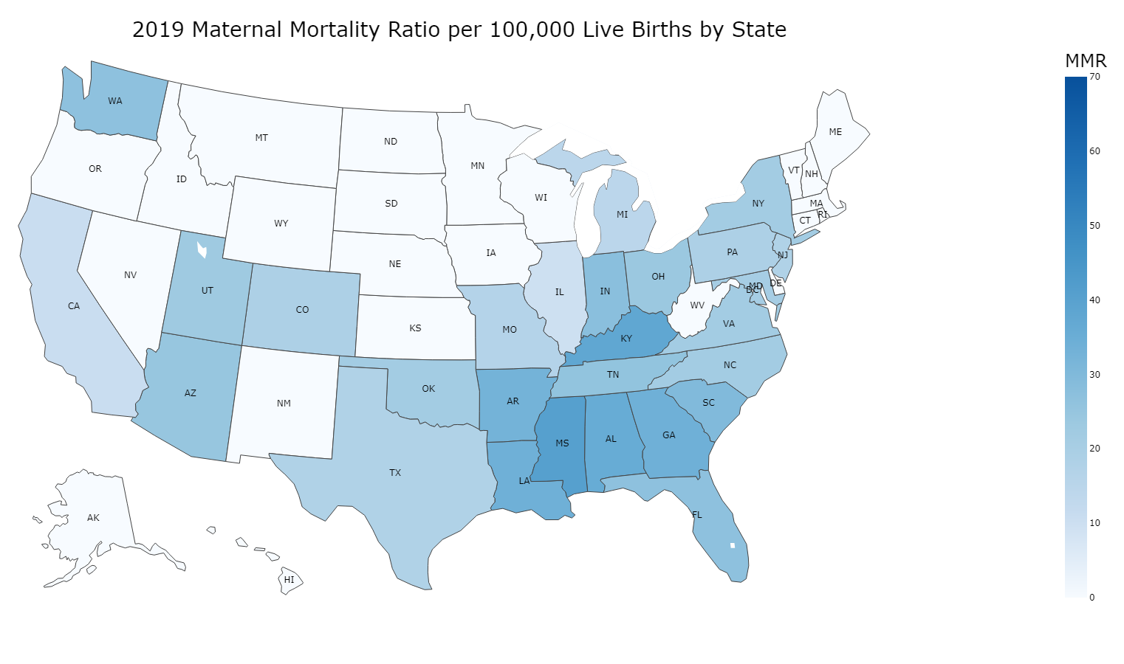
2018
2019
Social Characteristics

Slide 14
2018
2019
Social Characteristics

Slide 15
2018
2019
Social Characteristics

Slide 16
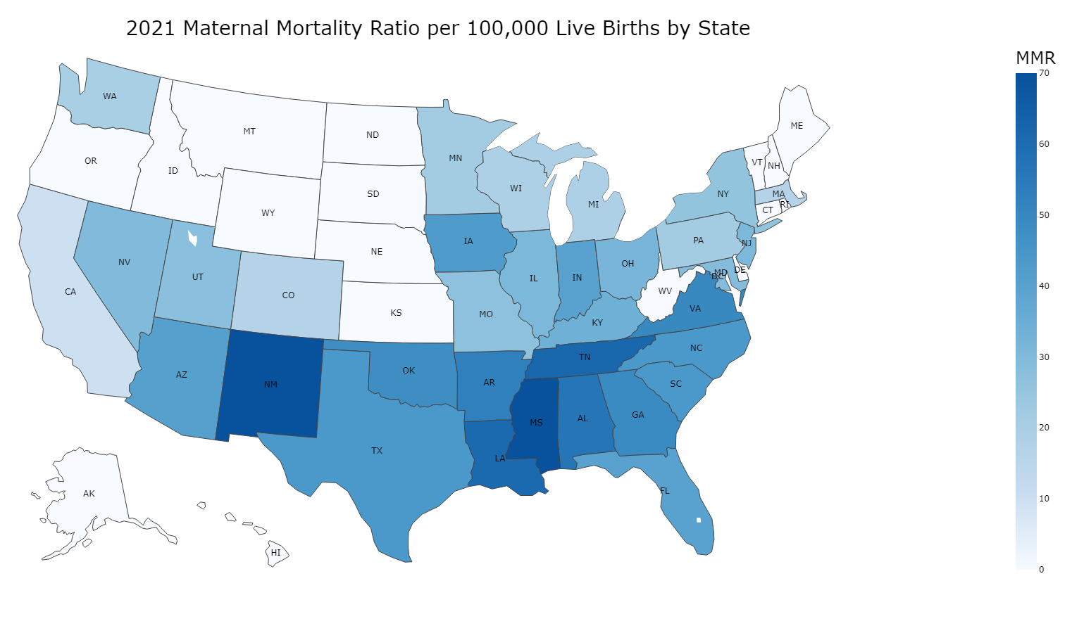
2019
2021
Social Characteristics

Slide 17
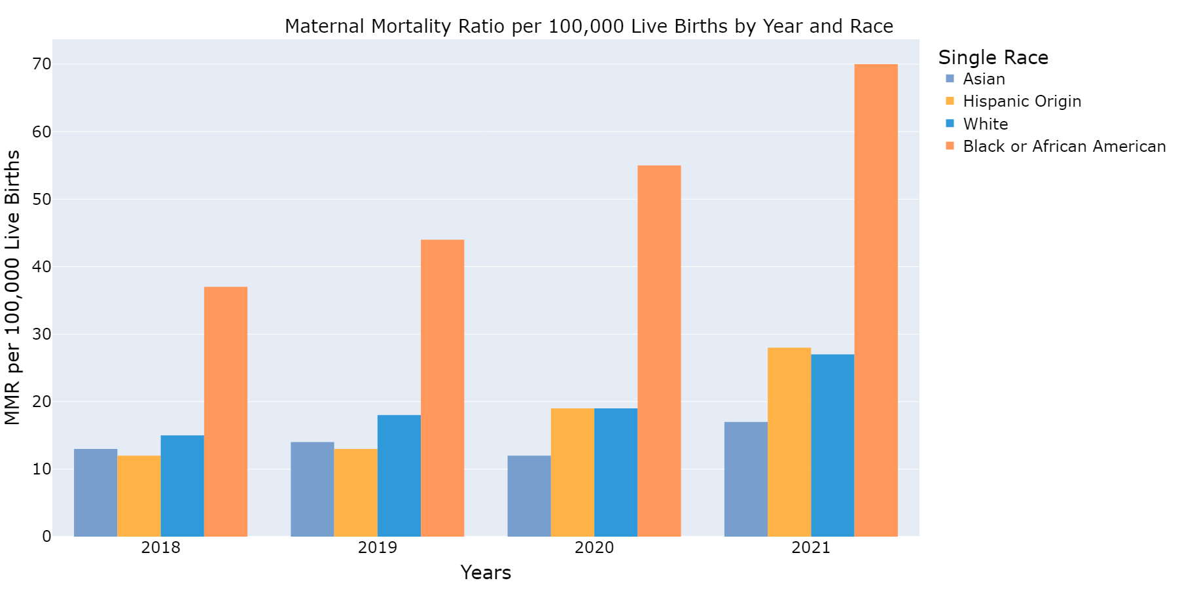
Impact of race
43 deaths
Racial disparity in MMR exists year after year
This concern is worsened by the COVID-19 pandemic
26
deaths
Note: “American Indian and Pacific Islander” and “More than one race” are omitted here due to “suppressed” data
Social Characteristics

Slide 18
Healthcare Characteristics

Slide 19
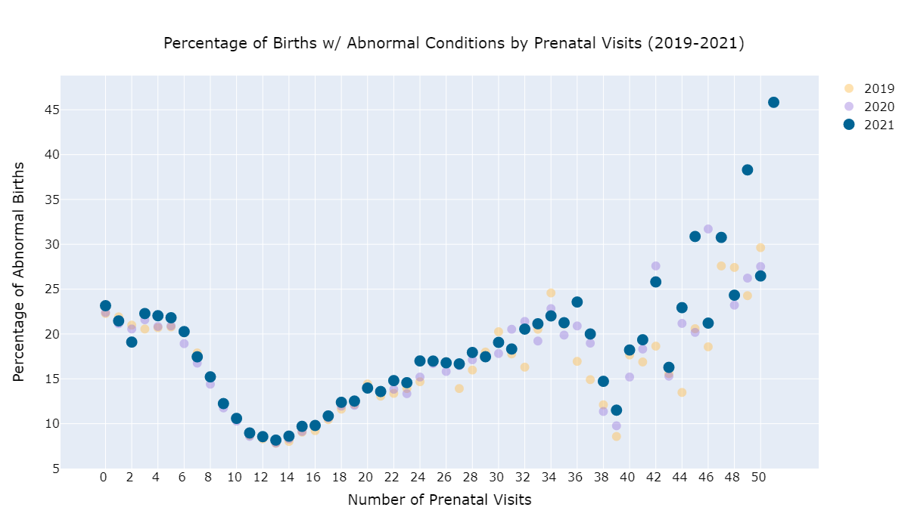
impact of prenatal care
This trend shows up year-after-year
Around 0-12 visits, the trend is intuitive
But what is going on after 12 visits?
Healthcare Characteristics

Slide 20
impact of prenatal care
This trend shows up year-after-year
Around 0-12 visits, the trend is intuitive
But what is going on after 12 visits?
Healthcare Characteristics

Slide 21
impact of prenatal care
This trend shows up year-after-year
Around 0-12 visits, the trend is intuitive
But what is going on after 12 visits?
Healthcare Characteristics

Slide 22
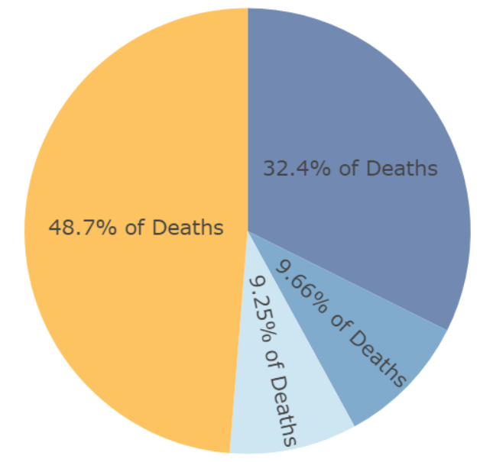
impact of postnatal care
About 41% of pregnancy-related deaths occur after childbirth
Pregnancy
280 days
Labor, Delivery 2 days
After Childbirth 42 days
Late Maternal
43 to 365 days
Healthcare Characteristics

Slide 23

CONCLUSION
Pregnancy-related complications can be a difficult topic that requires us to consider multiple dimensions. We’ve only scratched the surface in this presentation!
Physical Maternal Characteristics
Social Maternal Characteristics
Healthcare Characteristics

Slide 24
Thank you for listening!

Slide 25
APPENDIX A: RESOURCES
About Physical Health Maternal Characteristics: https://www.cdc.gov/reproductivehealth/maternalinfanthealth/pretermbirth.htm
https://pubmed.ncbi.nlm.nih.gov/35469531/
https://www.uptodate.com/contents/fetal-macrosomia
https://my.clevelandclinic.org/health/diseases/22311-shoulder-dystocia
About Social Maternal Characteristics:
https://www.nytimes.com/interactive/2019/us/abortion-laws-states.html
https://www.gao.gov/assets/gao-23-105871.pdf

Slide 26
APPENDIX A: RESOURCES
About Maternal Mortality Reporting:
https://www.cdc.gov/nchs/maternal-mortality/evaluation.htm
https://www.who.int/data/gho/indicator-metadata-registry/imr-details/4622
https://apps.who.int/iris/bitstream/handle/10665/70929/9789241548458_eng.pdf;jsess
https://www.ncbi.nlm.nih.gov/pmc/articles/PMC7592741/

Slide 27
APPENDIX B: DEFINITIONS
Maternal Mortality is defined as deaths due to pregnancy-related complications during pregnancy or up to a year after childbirth. Subclassify (between 42 days - 1year after childbirth as late maternal death).
CDC uses A34, O00-O95, O98-O99
Ratio is defined as number of events per 100,000 live births
https://www.who.int/data/gho/indicator-metadata-registry/imr-details/26
We’re basically using WHO’s standard definition for “Maternal Mortality Ratio”
The CDC uses the word “rate”, but apparently this is just for ease of language

Slide 28
APPENDIX B: DEFINITIONS
We used Single Race 6 Category and whether mother was of Hispanic origin or not to classify race.
Non-Hispanic American Indian or Alaska Native
Non-Hispanic Asian
Non-Hispanic Black or African American
Non-Hispanic Native Hawaiian or Other Pacific Islander
Non-Hispanic White
Non-Hispanic More than one race
Hispanic

Slide 29
APPENDIX B: DEFINITIONS
Maternal Morbidity includes any one or more of the following conditions:
Maternal Transfusion - Yes; No; Unknown or Not Stated.
Third or Fourth Degree Perineal Laceration - Yes; No; Unknown or Not Stated.
Ruptured Uterus - Yes; No; Unknown or Not Stated.
Unplanned Hysterectomy - Yes; No; Unknown or Not Stated.
Admission to Intensive Care Unit - Yes; No; Unknown or Not Stated.

