Slide 1

ECE 143 FINAL PROJECT PREGNANCY-RELATED COMPLICATIONS AND MORTALITY IN THE U.S.
TEAM 3 Pulkit Agrawal • Mandy Cheung • Abhijith Dasharathi • Atishna Samantaray • Naman Sehgal
Notes:
Slides Created by m3cheung@ucsd.edu

Slide 2
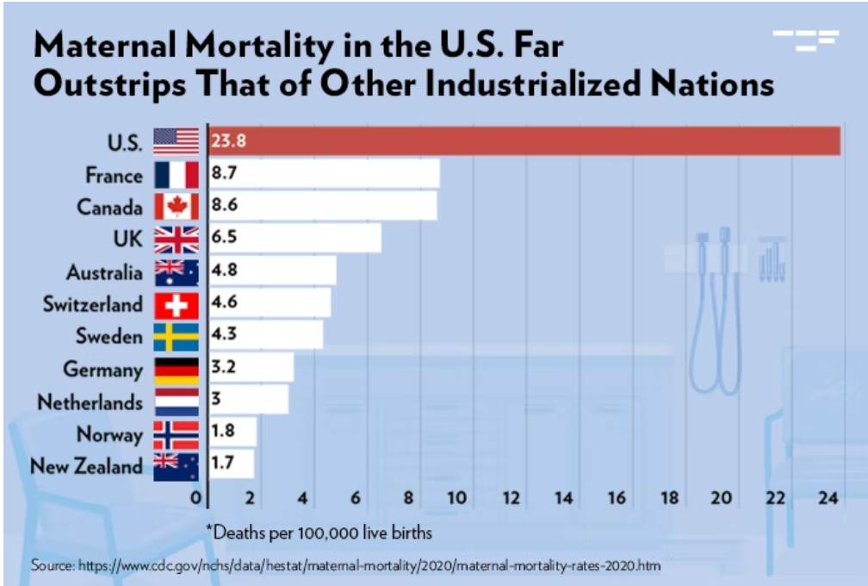
MOTIVATION
The U.S. has experienced a higher MMR than other industrialized countries for over 20 years
“What factors contribute to pregnancy-related complications?”

Slide 3

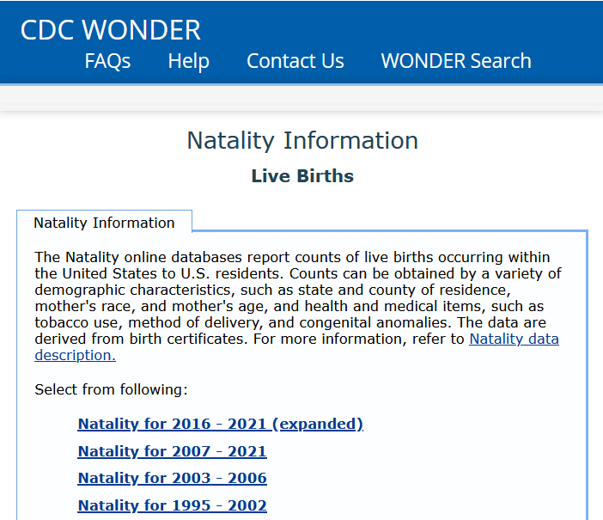
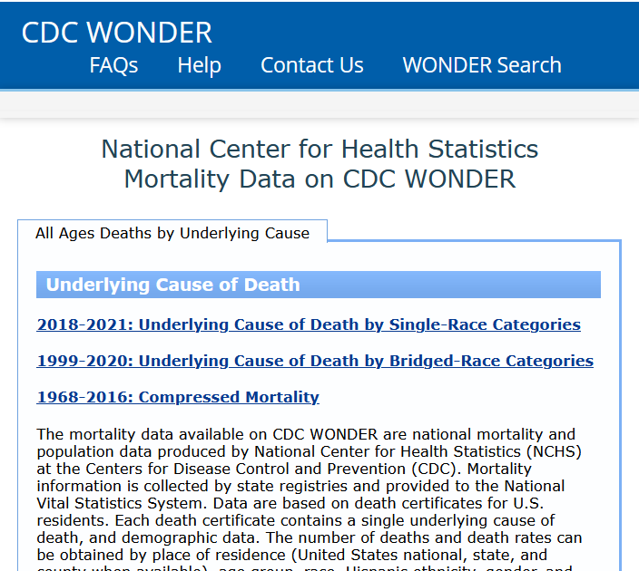
DATA OVERVIEW
Accessible at https://wonder.cdc.gov/
Natality for 2016-2021 reports live births using over 130 parameters
Underlying Cause of Death for 2018-2021 reports mortality by cause of death

Slide 4
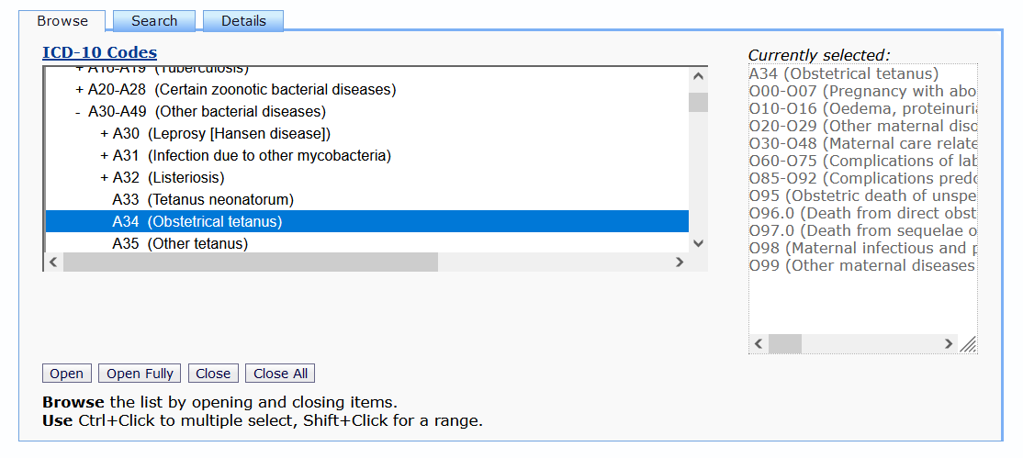
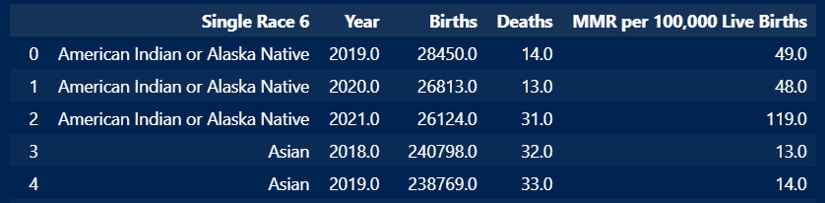
METHODOLOGY
CDC Dataset
CDC datasets are large & encoded
API
To navigate this, we wrote code to access the CDC Wonder API
Pre-processing
We merged datasets and removed “Not Reported”, “Suppressed”, and “Unreliable” data

Slide 5

ANALYSIS OVERVIEW
Physical Maternal Characteristics
Social Maternal Characteristics
Healthcare Characteristics

Slide 6
Physical Maternal Characteristics

Slide 7
Physical Maternal Characteristics
Height
Weight
Tobacco Use, cigarettes

Slide 8
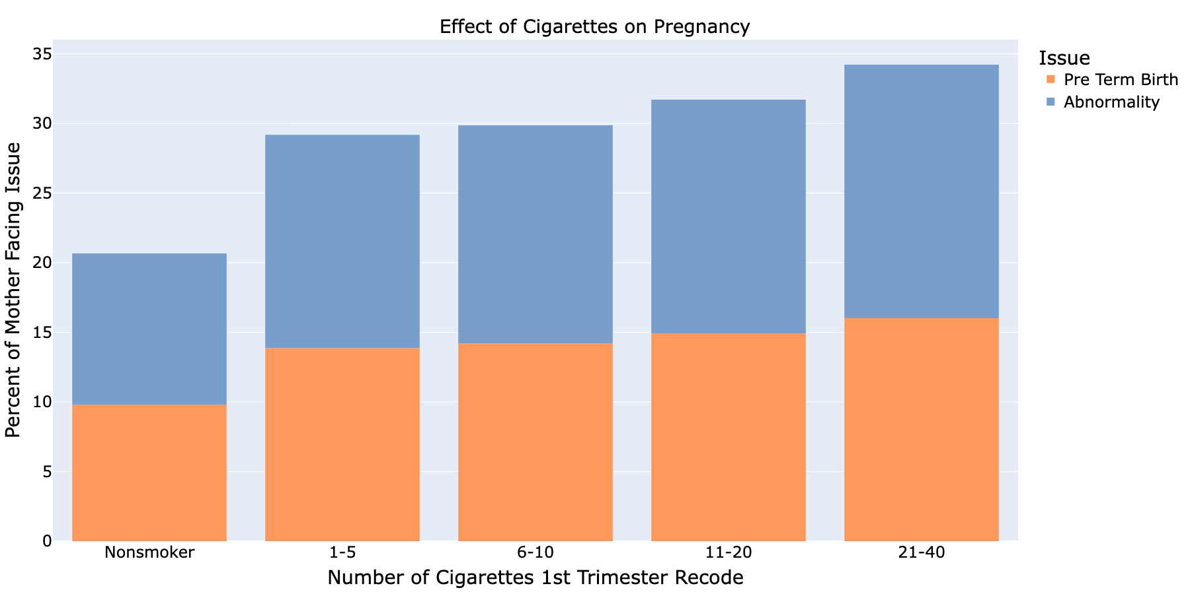
Abnormalities refer to live births where newborn experiences at least one of the following:
Assisted Ventilation
NICU Admission
Surfactant Replacement Therapy
Antibiotics for Suspected Neonatal Sepsis
Seizures
Physical Characteristics

Slide 9
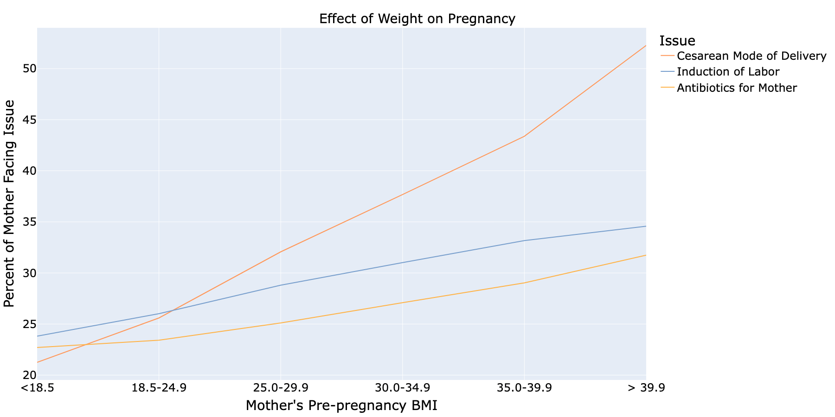
Body Mass Index is the ratio of a person’s height and weight
Physical Characteristics

Slide 10
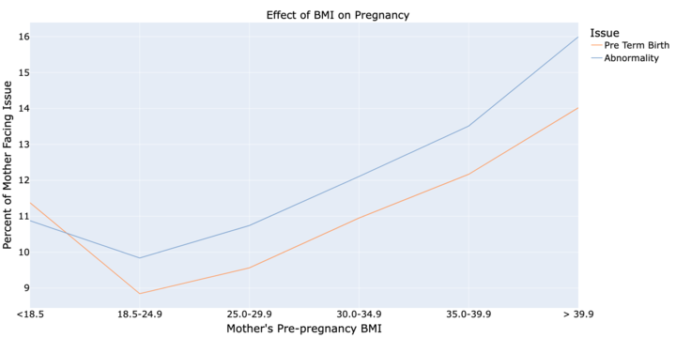
Preterm births refer
Gestation age less than 36 weeks
Pre term births increase long term health conditions
Physical Characteristics

Slide 11
Social Maternal Characteristics

Slide 12
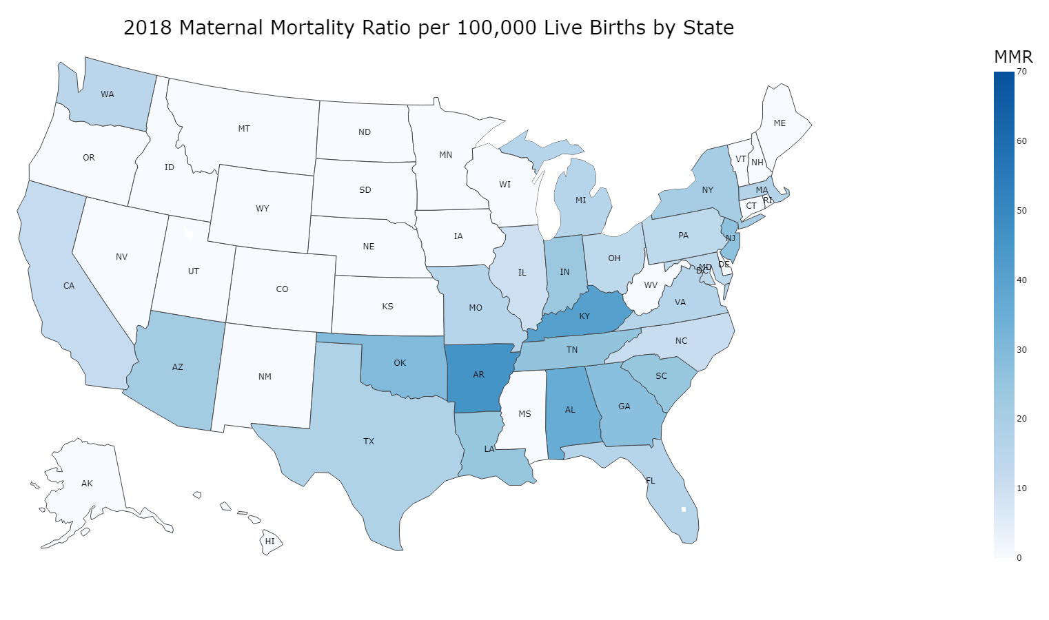
IMPACT OF LOCATION
MMR is defined as deaths/100,000 live births of that population
There is uneven MMR distribution in the U.S.
NOTE: states with zero value do not necessarily have zero MMR, the values may be too low and are “suppressed” by the CDC dataset
Social Characteristics

Slide 13
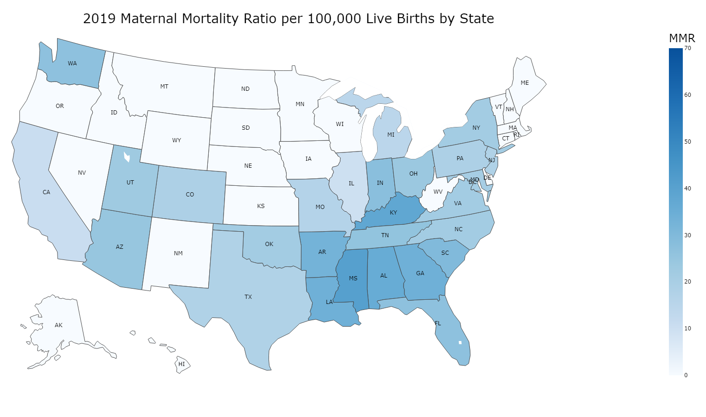
2018
2019
Social Characteristics

Slide 14
2018
2019
Social Characteristics

Slide 15
2018
2019
Social Characteristics

Slide 16
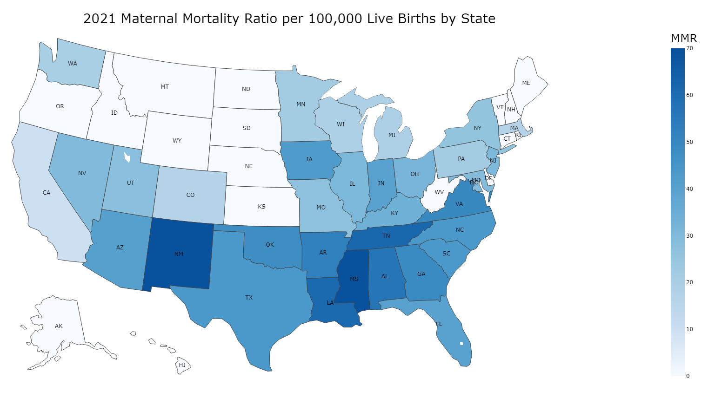
2019
2021
Social Characteristics

Slide 17
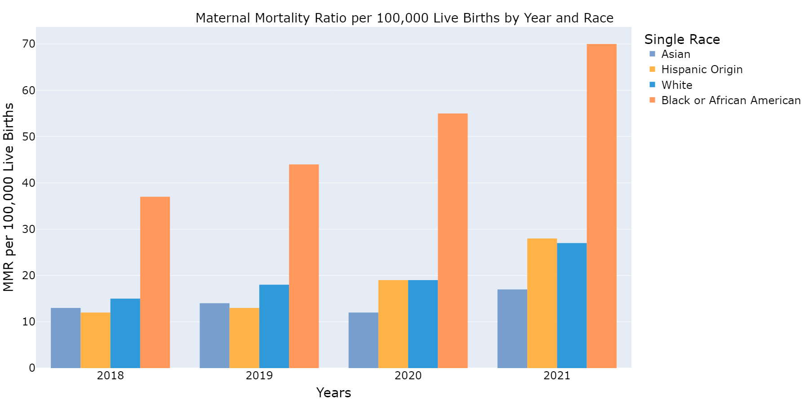
Impact of race
43 deaths
Racial disparity in MMR exists year after year
This concern is worsened by the COVID-19 pandemic
26
deaths
Note: “American Indian and Pacific Islander” and “More than one race” are omitted here due to “suppressed” data
Social Characteristics

Slide 18
Healthcare Characteristics

Slide 19
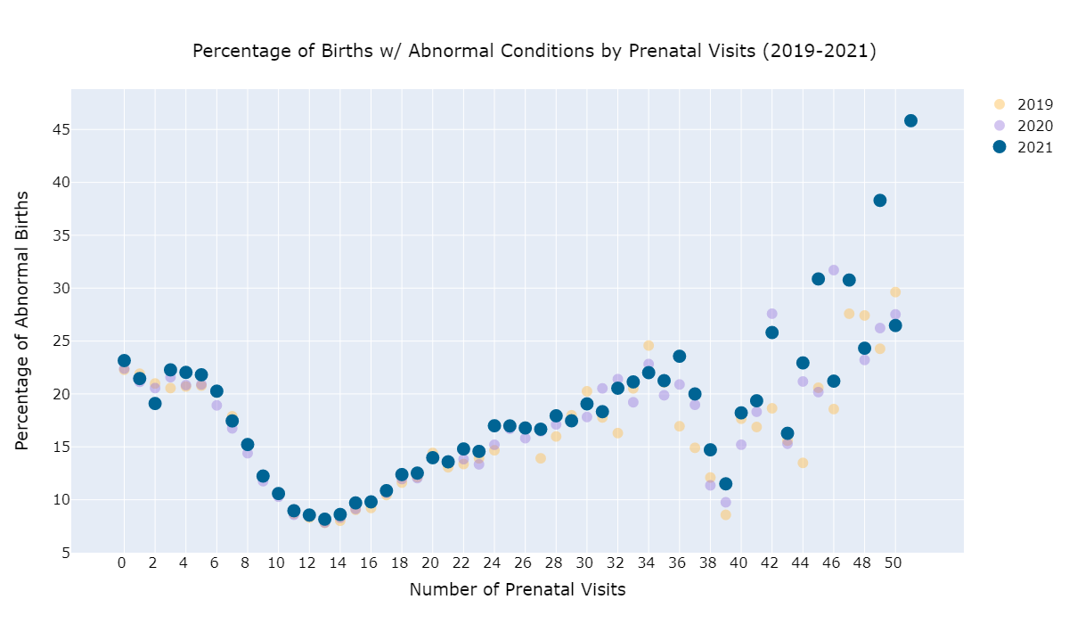
impact of prenatal care
This trend shows up year-after-year
Around 0-12 visits, the trend is intuitive
But what is going on after 12 visits?
Healthcare Characteristics

Slide 20
impact of prenatal care
This trend shows up year-after-year
Around 0-12 visits, the trend is intuitive
But what is going on after 12 visits?
Healthcare Characteristics

Slide 21
impact of prenatal care
This trend shows up year-after-year
Around 0-12 visits, the trend is intuitive
But what is going on after 12 visits?
Healthcare Characteristics

Slide 22
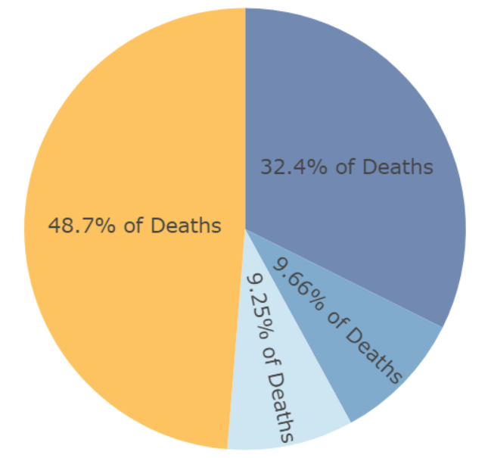
impact of postnatal care
About 41% of pregnancy-related deaths occur after childbirth
Pregnancy
280 days
Labor, Delivery 2 days
After Childbirth 42 days
Late Maternal
43 to 365 days
Healthcare Characteristics

Slide 23

CONCLUSION
Pregnancy-related complications can be a difficult topic that requires us to consider multiple dimensions. We’ve only scratched the surface in this presentation!
Physical Maternal Characteristics
Social Maternal Characteristics
Healthcare Characteristics

Slide 24
Thank you for listening!

Slide 25
APPENDIX A: RESOURCES
Slide 6: We also looked at age as well…

Slide 26
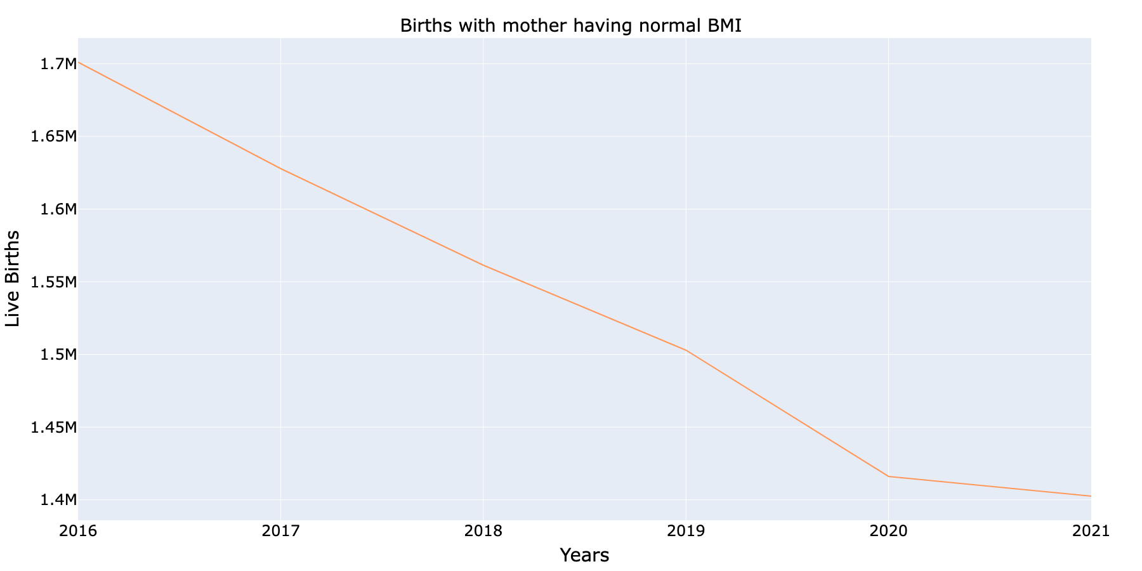
Physical Characteristics

Slide 27
APPENDIX B: DEFINITIONS

Slide 28
APPENDIX C: NEXT STEPS
Some other things to consider: Maternal History

