Slide 1
CERTIFICATIONS PORTFOLIO
Abhijith Sivakumar Rekha
A collection of completed training and online courses

Slide 2
CERTIFICATES INCLUDED
01
AWS Cloud Practitioner Essentials
AWS Training & Certification • Completed March 28, 2026
02
Learn Java Course
Codecademy • May 1, 2025
03
Technical Support Fundamentals
Google via Coursera • May 10, 2023
04
The Bits and Bytes of Computer Networking
Google via Coursera • June 1, 2023
05
Generative AI: Prompt Engineering Basics
IBM via Coursera • March 28, 2025
06
Python for Data Science, AI & Development
IBM via Coursera • Completed April 26, 2025

Slide 3
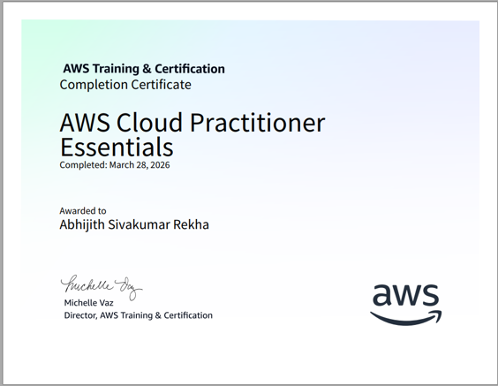
01 | AWS Cloud Practitioner Essentials

Slide 4
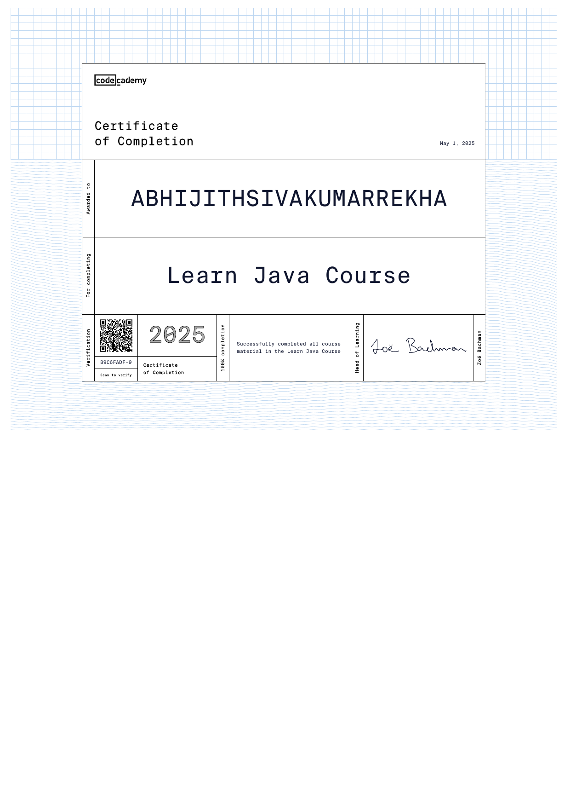
02 | Learn Java Course

Slide 5
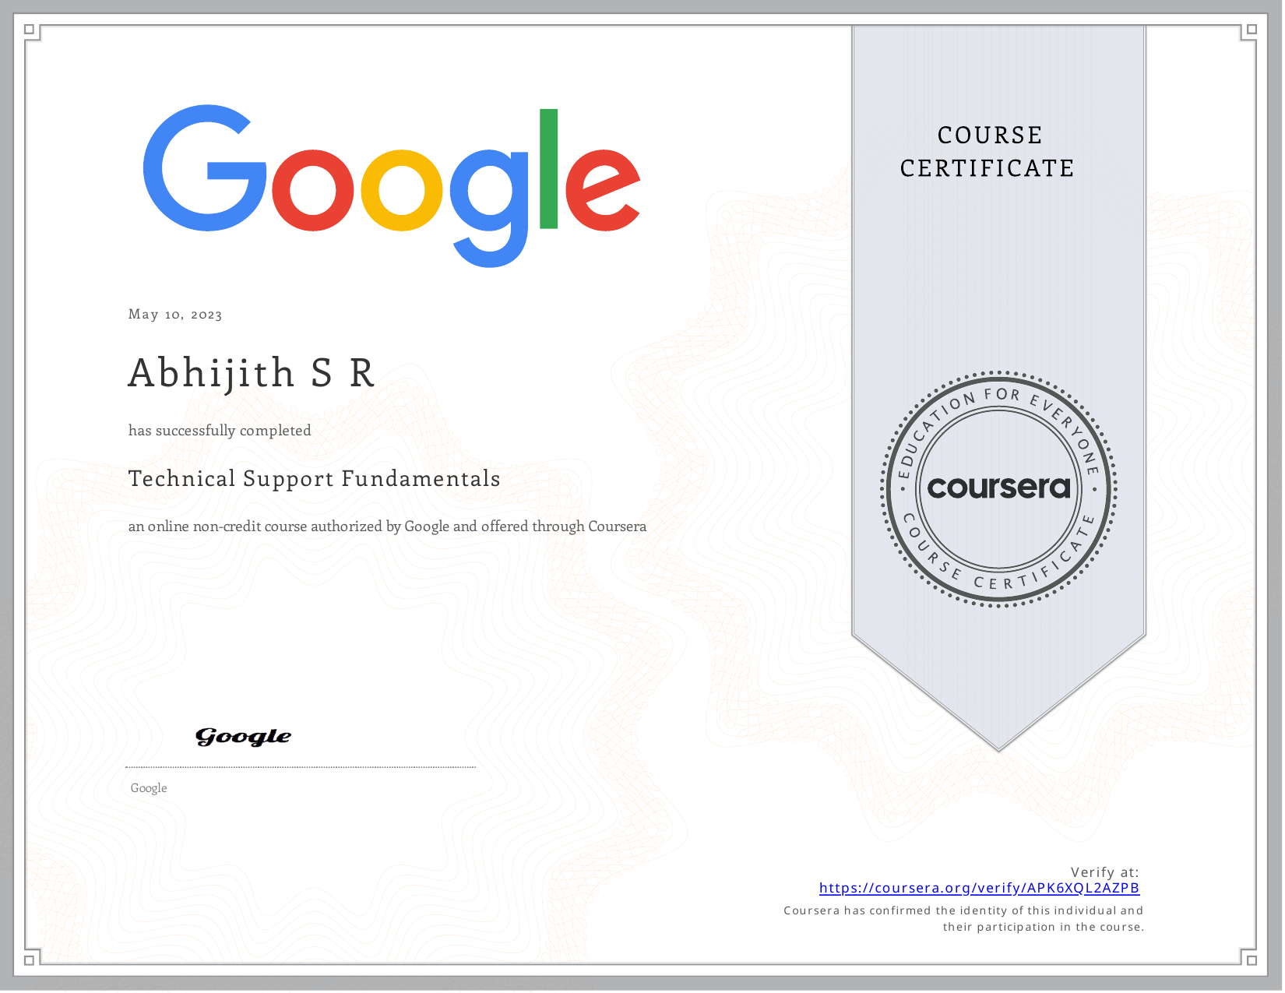
03 | Technical Support Fundamentals

Slide 6

04 | The Bits and Bytes of Computer Networking

Slide 7
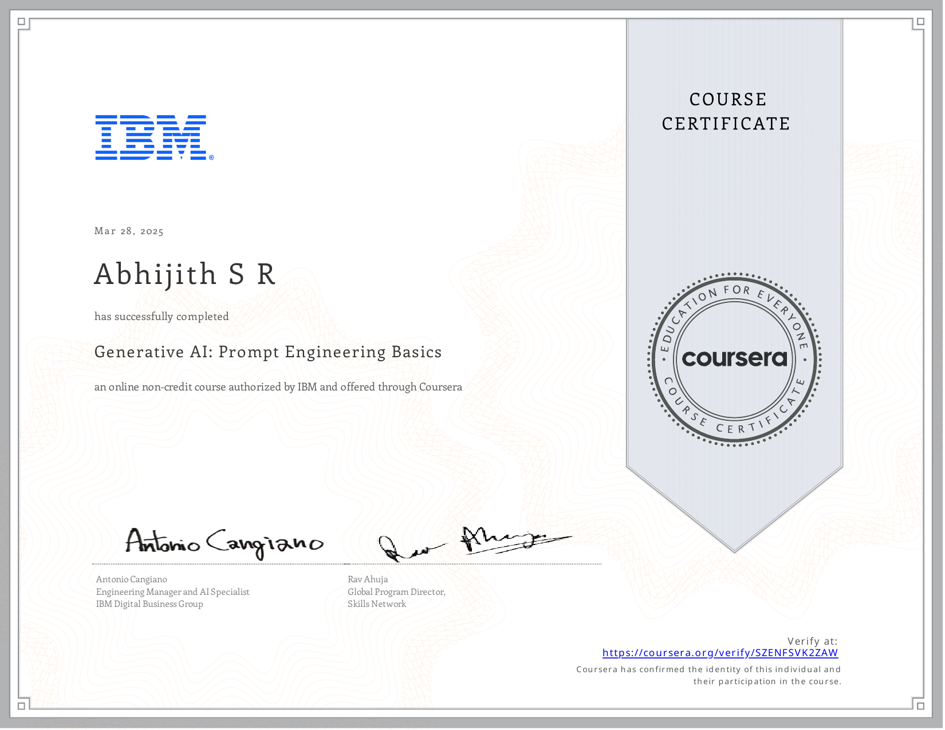
05 | Generative AI: Prompt Engineering Basics

Slide 8
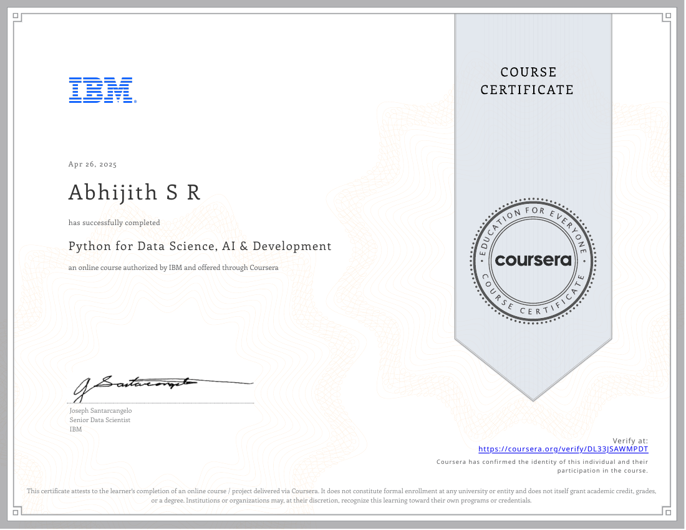
06 | Python for Data Science, AI & Development

