Slide 1

Lightweight, Compression-Robust Audio Deepfake Detection for Edge Deployment
BY
2023BCS0060 Nikkath Zabeen Shaik
2023BCS0198 Bhuvan S M
2023BCS0109 Abhijith Jayan
2023BCS0087 Joshi Kshitij Santosh
B.Tech Project — Phase I (Final Report Presentation)
October 2026
Guided By,
Dr. Sivaiah Bellamkonda

Slide 2
Introduction: Audio Deepfakes
• Artificially generated or manipulated audio imitating real voices or acoustic scenes
• TTS (text-to-speech), voice conversion, vocoders, diffusion, and audio LLMs
• Threats: fraud, misinformation, forged evidence, voice-biometric bypass
f_θ(x) → {bona-fide, synthetic/manipulated} (binary detection)
→ Type-agnostic Track 2 — category unknown at test time

Slide 3
Introduction: Accuracy, Robustness, and Efficiency
• Reliable deployment needs all three jointly — not benchmark accuracy alone
• Clean-lab scores overstate performance on messaging, telephony, and social media
• Edge hardware limits model size (~1.5M params) and latency
→ Train-time robustness without enlarging the inference graph (FT-RCL)

Slide 4
Motivation: Why Compression Robustness?
• Operational audio is resampled, codec-compressed, band-limited, and noise-corrupted
• High-frequency synthesis cues may vanish after MP3/AAC or telephony band-limiting
• Compression can add artifacts on real speech → false alarms if the model is clean-only
ΔM = M_clean − M_degraded (Macro-F1, AUROC, or EER)
→ Same semantic clip should yield a stable real/fake decision after channel change

Slide 5
Motivation: Consistent Decisions Under Degradation
• Original waveform → channel (codec / resample / telephony) → received waveform
• Edge detector must classify received audio consistently with the source intent
• Robustness is measured by how little M drops under conditioned evaluation
→ Phase 1 compares clean-only baseline (M0) vs FT-RCL training (M3)

Slide 6
Motivation: Edge Deployment
• Cloud detection: latency, privacy, connectivity, and recurring cost
• On-device path: local inference after standard platform compression
max_θ detection quality s.t. params, memory, latency budgets
→ MobileNetV3-Small (~1.52M) + 80-bin log-mel @ 24 kHz at inference

Slide 7
Literature Review (1/4): Benchmarks & Datasets
• ASVspoof (LA/PA/DF): speech-centric spoofing; EER is standard metric
• AT-ADD Track 2: all-type real vs fake; Macro-F1 over speech/singing/music/sound
• Generator-disjoint eval splits reduce memorization of synthesis fingerprints
• Challenge winners report 96%+ Macro-F1 with large SSL and fusion
→ We adopt AT-ADD Track 2 as primary benchmark for general audio

Slide 8
Literature Review (2/4): Architectures & Scale
• CNN/CRNN on log-mel or LFCC: compact but struggle on music and ambient sound
• SSL encoders (Wav2Vec2, XLS-R): strong accuracy, heavy inference cost
• Audio LLMs + frequency-time RL: SOTA interpretability, not edge-deployable
• Multimodal (audio-visual) methods improve robustness with extra modalities
→ Gap for ~1.5M-parameter models competitive across all audio types

Slide 9
Literature Review (3/4): Robustness & Compression
• Data augmentation (codec/noise) improves robustness but lacks view pairing
• Condition-aware and coherence training (e.g., Vicomtech Wav2Vec2) motivate FT-RCL
• Audio compression (input) ≠ model compression (INT8) — both matter for edge
• Surveys emphasize generalization and adversarial robustness as open problems
→ Explicit clean/degraded coherence + curriculum under-studied at edge scale

Slide 10
Literature Review (4/4): Synthesis & Research Gap
• Detection ✓ | Robustness △ | Lightweight △ — rarely optimized together
• Music/environmental sound remain hardest domains in compact mel-CNN systems
• Few student-scale pipelines report clean metrics and ΔM under one protocol
• Research question: Can a single lightweight detector generalize across types while tolerating compression-like degradations?
→ FT-RCL keeps inference identical to baseline; robustness is training-time only

Slide 11
Objectives (Phase 1)
• Reproduce E1 v4 baseline: MobileNetV3-Small, 80-bin log-mel @ 24 kHz, repeat-pad
• Implement FT-RCL M1–M3: paired degradations, PC, FTSC, gating, severity curriculum
• Evaluate clean Macro-F1, AUROC, EER; per-type breakdown on 30% stratified subset
• Frontend & backbone ablation (E1 CNN vs E2 CRNN) on full AT-ADD where reported
• Planned next: systematic ΔM, STAR-Edge eval, INT8/latency on target edge device

Slide 12
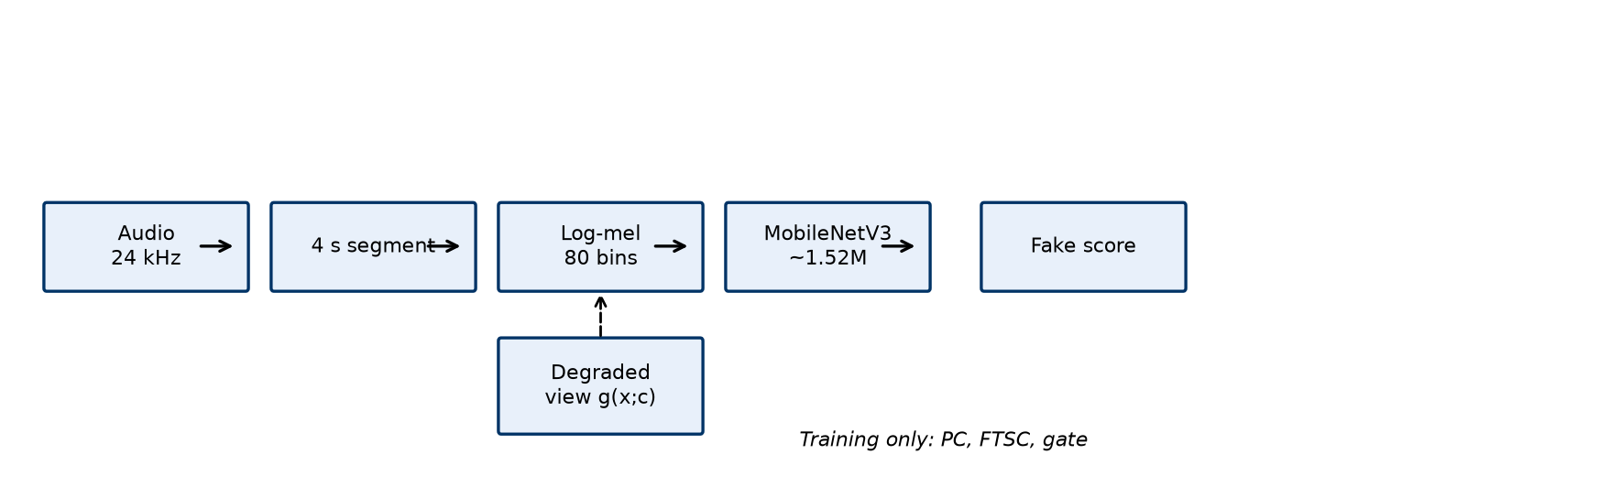
Methodology: End-to-End Pipeline
• Manifest CSV → load 24 kHz → 4 s crop (repeat-pad) → log-mel → classifier
• Training (M3): identical crop index for clean x and degraded x̃
• Eval: clean clips only for primary tables; conditioned eval for ΔM
→ Single mel → MobileNet path at inference for both systems
Pipeline overview (report Figure)

Slide 13
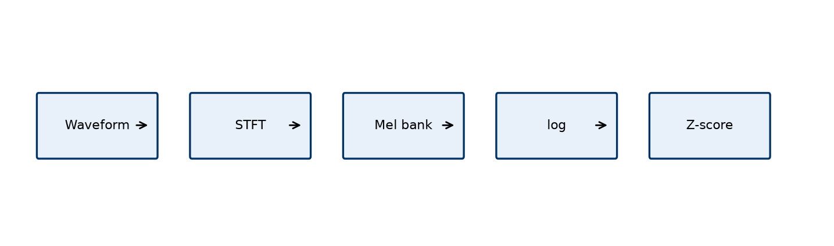
Acoustic Frontend (E1 v4 Standard)
• 24 kHz sampling (captures 8–12 kHz vocoder artifacts vs 16 kHz telephony)
• Circular repeat-pad avoids duration shortcuts from trailing silence (ASVspoof study)
• 80 mel bins; global mean/std normalization from training statistics
x_padded[n] = x[n mod L] for short clips
→ Same frontend for baseline and FT-RCL ensures fair comparison

Slide 14
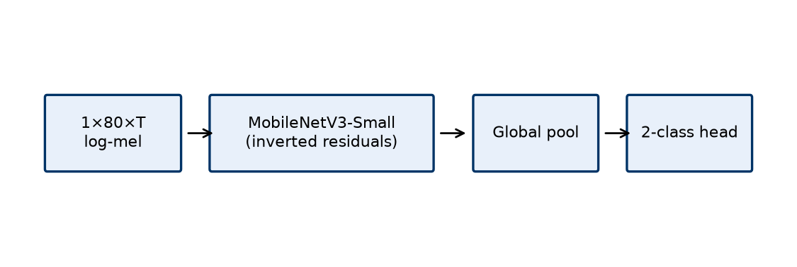
Baseline Detector (Mode M0)
• MobileNetV3-Small adapted to 1-channel mel input (~1,519,618 parameters)
• Class-weighted cross-entropy on clean batches only
• Checkpoint: best development Macro-F1
• Full-split reference: 75.70% acc, 0.875 AUROC, 19.92% EER (E1 v4)
→ Pure 2D CNN beats CRNN (GRU/LSTM) on full AT-ADD heterogeneous audio

Slide 15
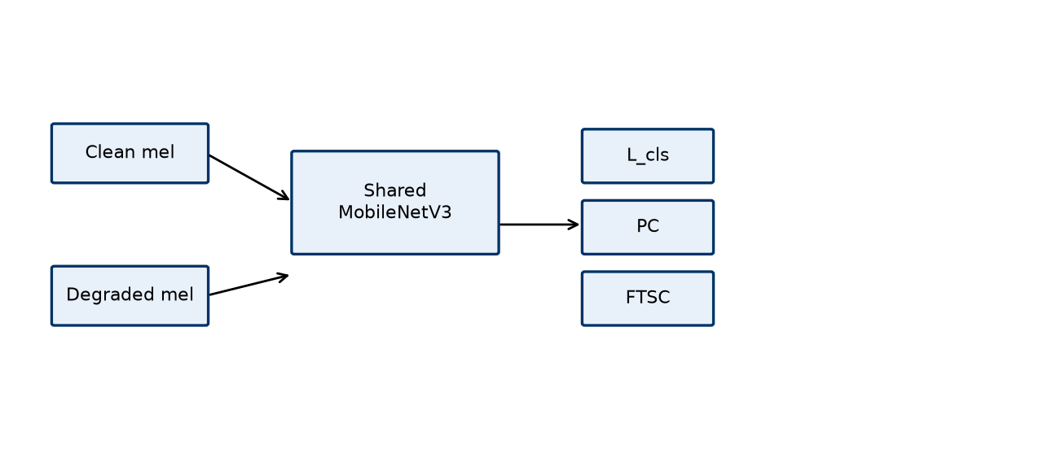
FT-RCL: Paired Clean / Degraded Views
• Shared backbone weights; dual forward on clean and degraded mels
• Subband pooling → L2-normalized 8-D frequency signatures (training only)
• Degradations applied in waveform domain before identical mel extraction
→ Inference graph unchanged — only one forward pass on received audio

Slide 16
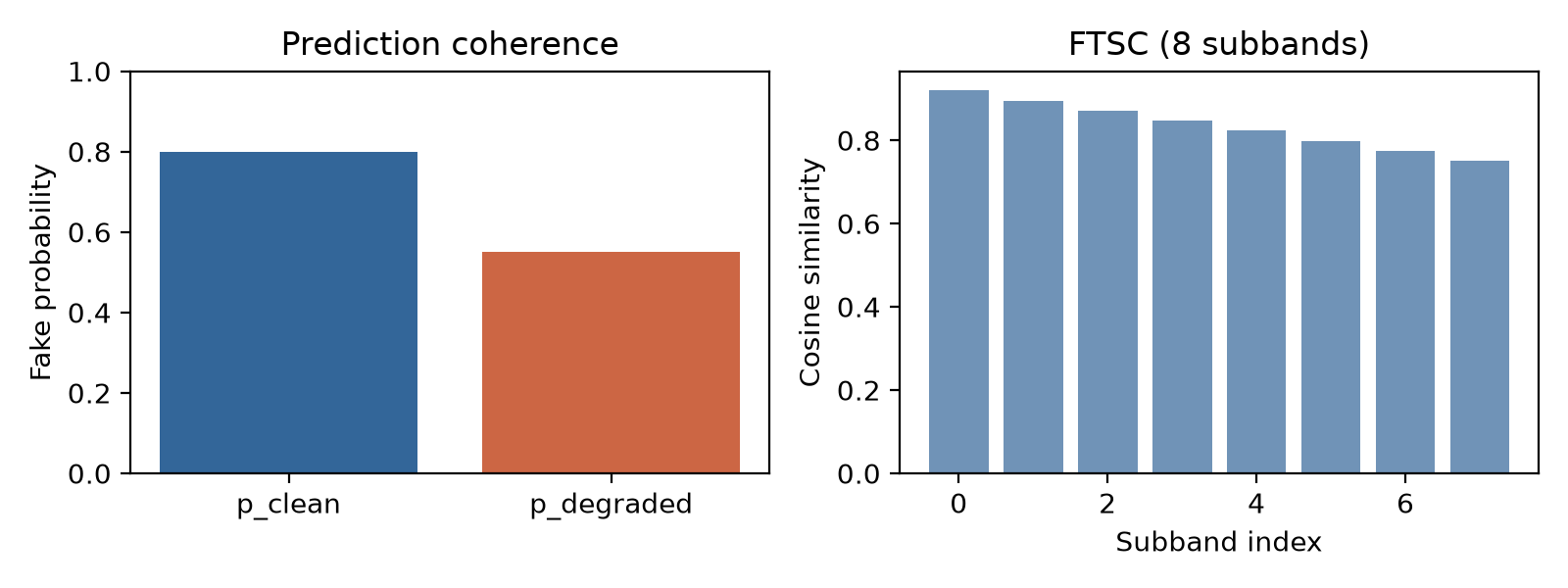
Loss Functions (Mode M3)
L_cls = CE(z_c,y) + 0.5·CE(z_d,y)
L_PC = (1/B) Σ (q_c − q_d)² (fake-class probability match)
L_FTSC = (1/BK) Σ (1 − cos(s_c, s_d)) per mel subband
L_M3 = L_cls + w̄(γ_pc·L_PC + γ_ftsc·L_FTSC); w_i = α_t·κ_i·η(ρ_i)
→ PC aligns decisions; FTSC aligns internal signatures under degradation

Slide 17
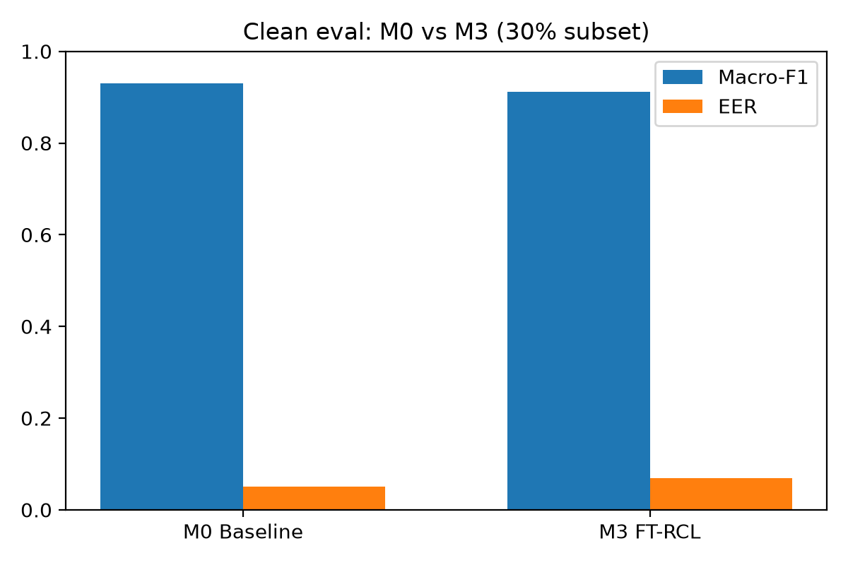
Training Modes M0–M3 (Ablation Ladder)
• M0: CE on clean mel only (baseline)
• M1: CE on degraded view only
• M2: L_cls + gated prediction coherence (η ≡ 1)
• M3: M2 + FTSC + type/confidence/severity gate + J-score checkpointing
→ M3 is the proposed system compared against M0 on identical data

Slide 18
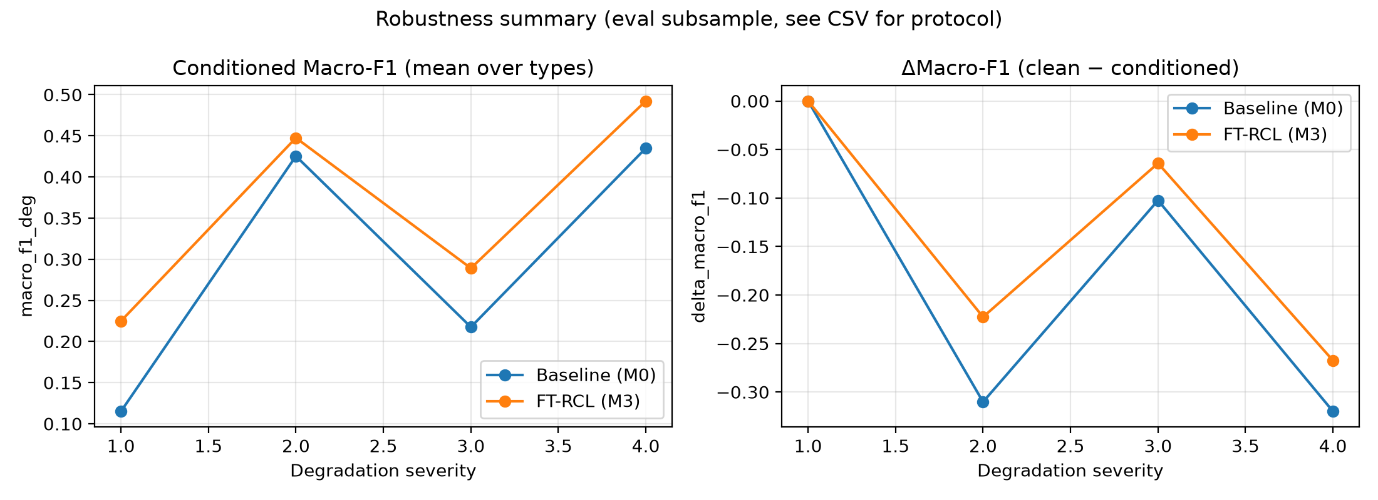
Degradations & Severity Curriculum
• Families: resample 16 kHz, MP3 bitrates, additive noise (SNR), telephony 300–3400 Hz
• Same random crop index ties clean and degraded waveforms
• Curriculum: severity cap 1 (epochs 1–5) → 3 (6–12) → 4 (13+)
→ Gradual exposure reduces early training collapse on harsh degradations

Slide 19
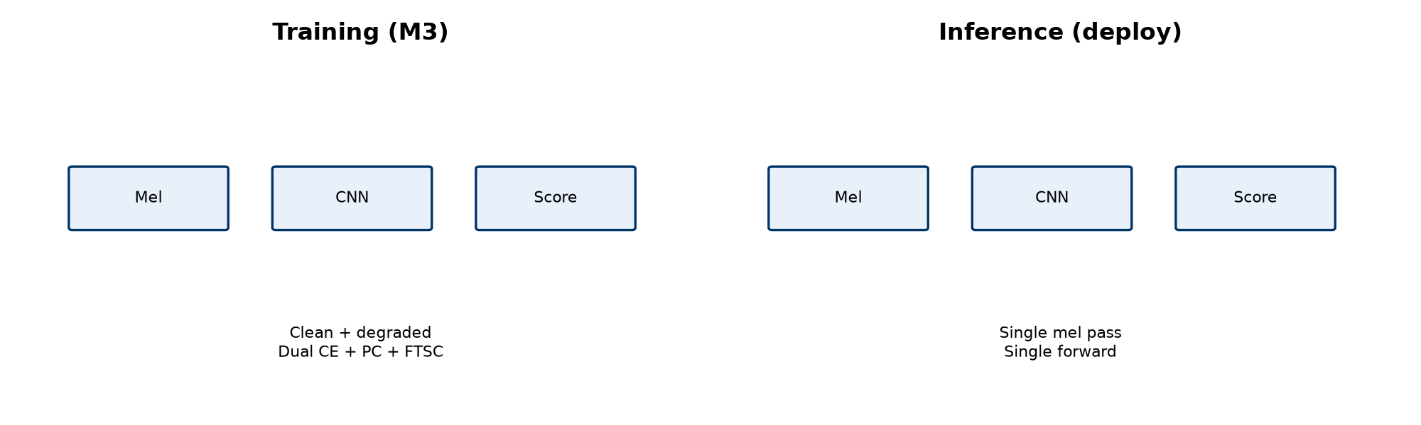
Training vs Inference (Edge Path)
• Training: paired views + PC/FTSC + optional STAR-Edge (ABR, STC, CAD)
• Inference: waveform → log-mel → MobileNet → softmax fake score
• No teacher network, no second forward, no signature head at deploy time
→ Robustness bought during training; deploy-time cost equals baseline

Slide 20
Evaluation Protocol & Metrics
• Dataset: AT-ADD Track 2; phase runs on 30% stratified subset (seed 42)
• Eval subset: n = 13,287 clean clips; types balanced in Macro-F1
• Macro-F1 (primary), AUROC (ranking), EER (threshold-free error rate)
J = Macro-F1_dev − 0.5·Δ̂Macro-F1_dev (FT-RCL checkpoint)
→ Baseline uses dev Macro-F1; FT-RCL uses J to favor robustness

Slide 21
Results: Clean Evaluation (30% subset)
Clean eval only. Full-split E1 from complete AT-ADD training (report Table).
Model | Macro-F1 | Accuracy | AUROC | EER
Baseline (E1 / M0) | 0.672 | 0.759 | 0.852 | 0.216
FT-RCL (M3) | 0.659 | 0.748 | 0.843 | 0.234
Ref. full-split E1 v4 | — | 75.7% | 0.875 | 19.92%

Slide 22
Results: Macro-F1 & EER by Audio Type
Type-averaged Macro-F1 ≈ 0.587 (baseline) vs 0.589 (FT-RCL) — tied; music remains hardest.
Type | Baseline F1 | FT-RCL F1 | Baseline EER | FT-RCL EER
Speech | 0.695 | 0.665 | 0.162 | 0.179
Singing | 0.794 | 0.764 | 0.157 | 0.208
Sound | 0.467 | 0.522 | 0.426 | 0.394
Music | 0.393 | 0.403 | 0.399 | 0.467

Slide 23
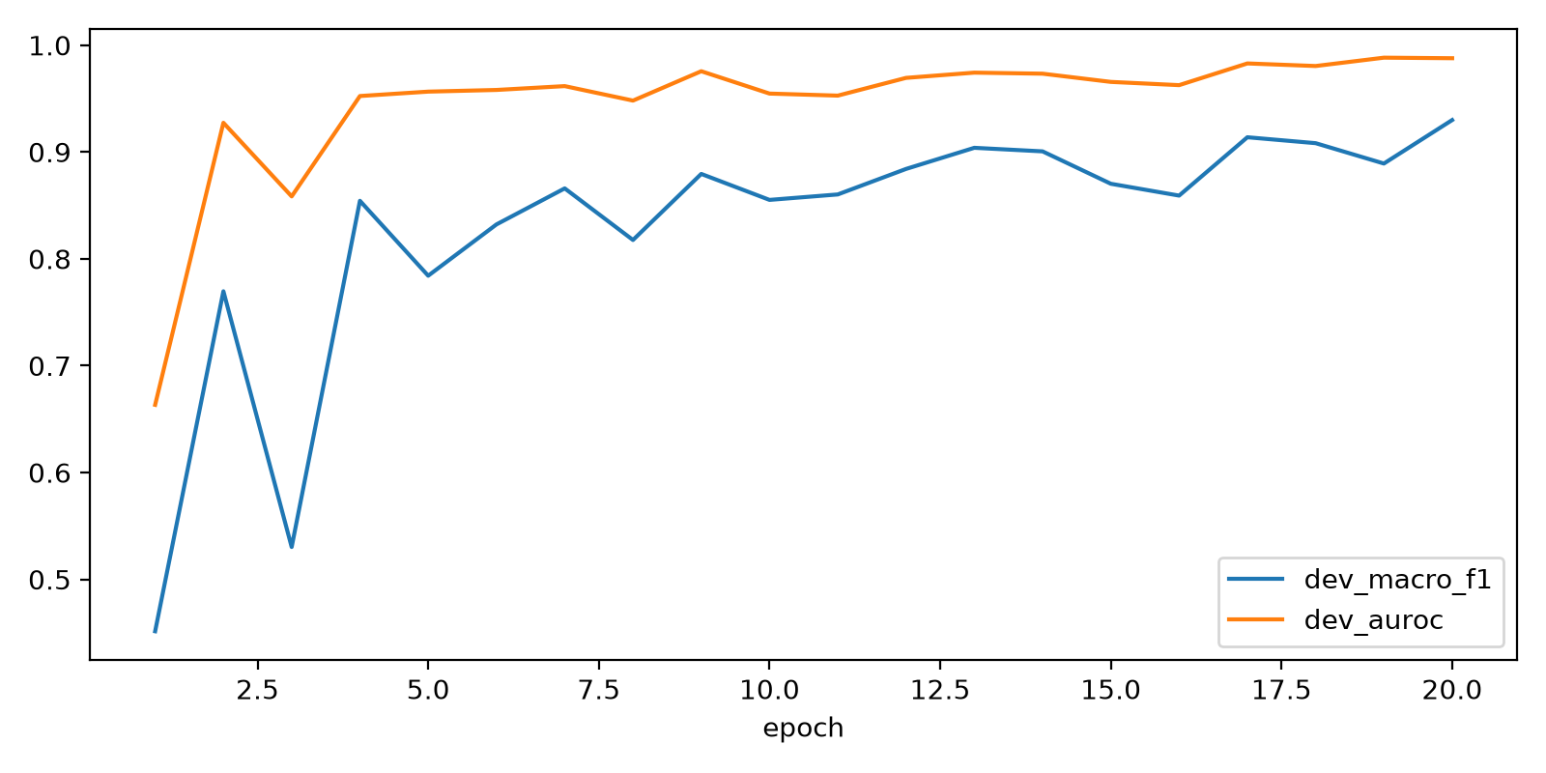
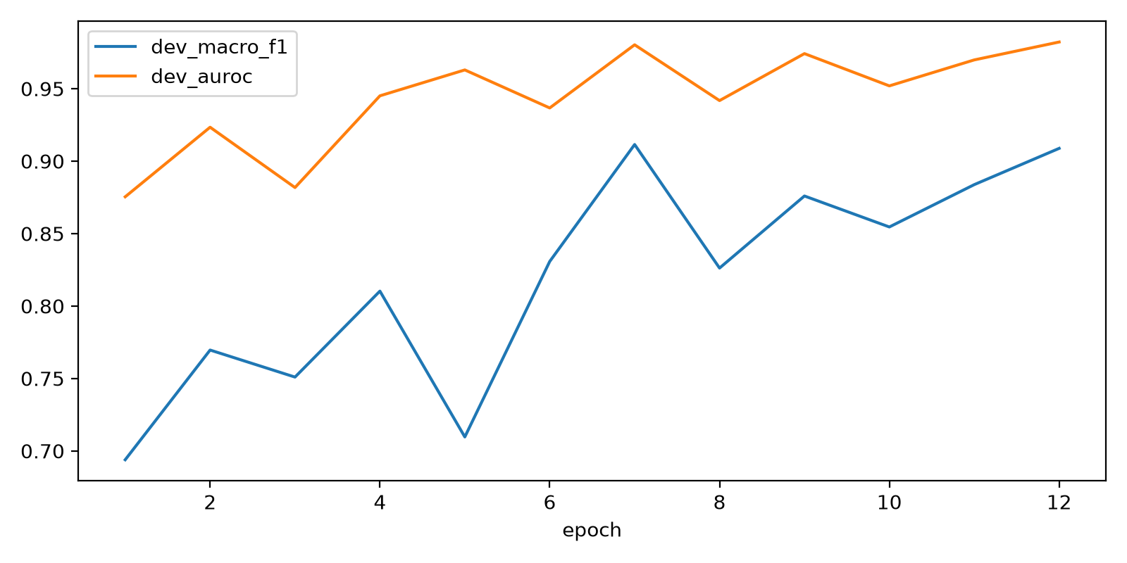
Training Dynamics (Development Set)
• Baseline peak dev Macro-F1 ≈ 0.930 @ epoch 20
• FT-RCL peak dev Macro-F1 ≈ 0.909, best J ≈ 0.902 @ epoch 12
• M3 train loss unreliable under FP16 — select checkpoints via dev Macro-F1 / J
Baseline (M0)
FT-RCL (M3)

Slide 24
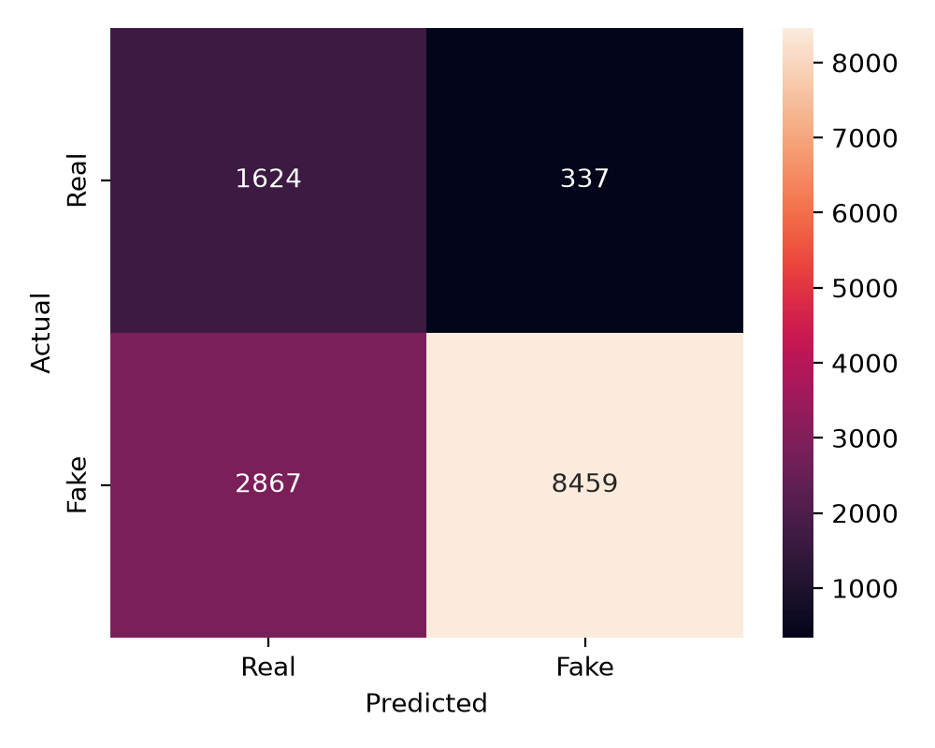
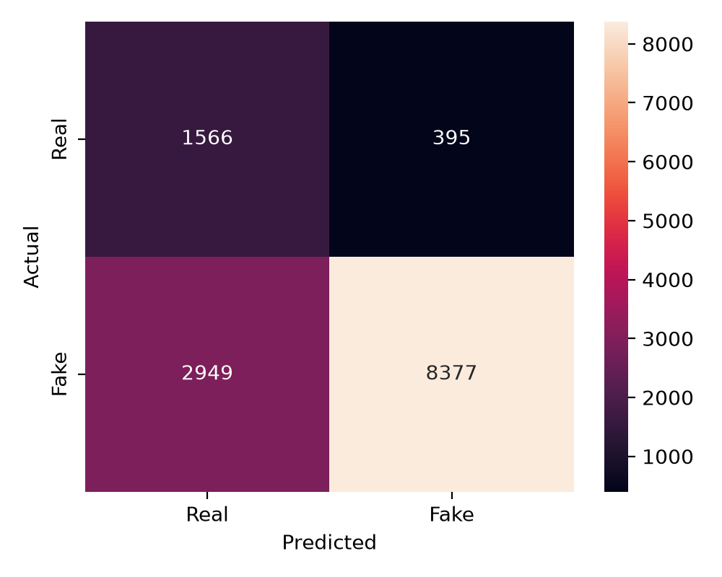
Evaluation Curves & Confusion (Clean)
• ROC and confusion matrices at threshold 0.5 on held-out eval
• Both models struggle most on music (high EER ~0.40)
→ Per-type errors drive low type-averaged Macro-F1 vs pooled accuracy
Baseline confusion
FT-RCL confusion

Slide 25
Conclusion, Limitations & Future Work
• Established E1 v4 mel-CNN baseline and FT-RCL M3 on shared AT-ADD protocol
• Frontend repeat-pad @ 24 kHz and CNN-over-CRNN choice supported by ablations
• Limitation: 30% subset; primary tables are clean-only — ΔM sweep in progress
• Limitation: music domain still ~40% EER for both systems
• Future: full-split training, STAR-Edge held-out eval, INT8/latency edge benchmark
→ Lightweight inference preserved; next phase quantifies compression robustness (ΔM)

Slide 26
References (IEEE Style)
• [1] Y. Xie et al., “AT-ADD: A benchmark and challenge for robust all-type audio deepfake detection,” arXiv:2608.23437, 2026.
• [2] A. Howard et al., “Searching for MobileNetV3,” arXiv:1905.02244, 2019.
• [3] T. Wang et al., ASVspoof 2019 challenge evaluation plan, Computer Speech & Language, 2020.
• [4] X. Li, P.-Y. Chen, W. Wei, “Where are we in audio deepfake detection?,” ACM TOIT, 2025.
• [5] J. M. Martín-Doñas and A. Álvarez, Vicomtech Wav2Vec2 ADD system, ICASSP 2022.
• [6] Y. Kim et al., “X-AVDT: Audio-visual cross-attention for robust deepfake detection,” arXiv:2603.08483, 2026.
• [7] H.-H. Nguyen-Le et al., “Deepfake Detection Across Image, Video, and Audio,” AI Review, 2026.
• [8] Y. Xie et al., “Interpretable All-Type Audio Deepfake Detection with Audio LLMs,” arXiv:2601.02983, 2026.
• [9] H. Pham et al., deepfake detection with ImageNet-pretrained CNNs, 2024 (reproduced in report).
• [10] B. Zhang et al., “Audio Deepfake Detection: What Has Been Achieved,” Sensors, 2025.

Slide 27
Thank You
• Questions and discussion
• Dr. Sivaiah Bellamkonda — Project Guide
• Team 29 — IIIT Kottayam, Department of CSE

