Slide 1
LINKING IN WINDOWS

Slide 2
what is dll
A DLL (Dynamic Link Library) is a file format used in Windows that contains code, data, and resources that can be shared by multiple programs. DLLs help improve modularity, reduce memory usage, and enable software updates without recompiling the entire application.
Key Features of DLLs
Code Reusability – Multiple programs can use the same functions from a single DLL instead of including the same code in each executable.
Memory Efficiency – DLLs are loaded into memory only once and shared by multiple processes, reducing resource usage.
Modularity – Applications can be updated or extended by replacing or adding DLLs without modifying the main program.
Faster Execution – Since DLLs are loaded dynamically, they reduce executable file size and improve performance.

Slide 3
what is LINKING
Linking is the process of combining multiple pieces of code and libraries into a single executable or program. It resolves references to functions, variables, and libraries, making sure the program has everything it needs to run.
WHY LINKING?
Linking is essential in software development because it allows programs to be modular, efficient, and scalable. Without linking, every program would have to include all the code it needs in a single file, making software development inefficient and inflexible.

Slide 4
Key Benefits of Linking
1. Code Reusability 🛠️
2. Smaller Executable Size 📦
3. Easier Updates & Maintenance 🔄
4. Faster Compilation ⏩
5. Modularity & Scalability 🏗️
6.Memory Efficiency 💾

Slide 5
How Linking Happens in a Program
Linking is the process of combining multiple object files (.obj/.o) and libraries (.lib/.a or .dll/.so/.dylib) into a single executable or a shared library.
This happens in two main steps:
compilation- converts source code(.c/.cpp) into object files(.obj/.o)
Linking – Combines object files and external libraries into an executable
(.exe/.out) or a shared library (.dll/.so)

Slide 6
1. Stages of Linking
Step 1: Compilation
The compiler (e.g., gcc, clang, msvc) converts each source file into a separate object file (.o or .obj).
Each object file contains machine code but has unresolved function calls (symbol references).
Step 2: Linking
The linker resolves unresolved function calls by finding definitions in:
Other object files (.o/.obj).
Static libraries (.lib/.a).
Dynamic libraries (.dll/.so).
It then creates a final executable (.exe/.out).

Slide 7
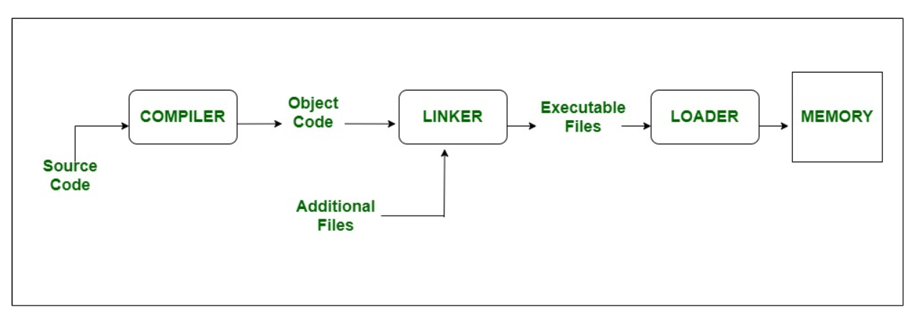
Linker and loader
What is Linker?
A linker is a special program that combines the object files, generated by the compiler/assembler and other pieces of code to originate an executable file that has a .exe extension.

Slide 8
loader
What is Loader?
It is special program that takes input of executable files from linker, loads it to main memory, and prepares this code for execution by computer.
Loader allocates memory space to program.
Function of Loader
. Loading: The loader loads the executable file into memory and allocates memory for the program.
Relocation: The loader adjusts the program’s memory addresses to reflect its location in memory.
Symbol Resolution: The loader resolves any unresolved external symbols that are required by the program.
Dynamic Linking: The loader can dynamically link libraries into the program at runtime to provide additional functionality.

Slide 9
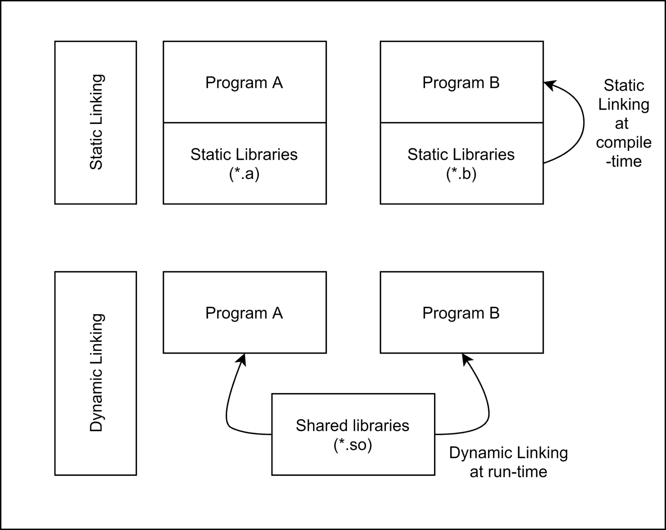
How Static and Dynamic Linking Work
Static Linking (At Compile Time)
The linker copies all required functions from a static library (.lib or .a) into the final executable.
The resulting executable is self-contained and does not need external libraries at runtime.
eg: g++ main.cpp mylib.a -o program.exe # Statically linking a library

Slide 10
Dynamic Linking (At Runtime)
The program does not include library code directly.
Instead, it loads the library at runtime (.dll/.so), reducing the executable size.
eg : g++ main.cpp -o program.exe -L. -lmylib.dll

Slide 11
3. How Dynamic Linking Works at Runtime
When a program using dynamic linking runs:
The Operating System searches for the required DLL (.dll) or shared object (.so).
The OS loads the DLL into memory only once (even if multiple programs use it).
The program resolves function addresses dynamically and calls them.
🔹 Windows Search Order for DLLs:
When a program loads a Dynamic Link Library (DLL), the operating system searches for it in a specific order
The application directory.
C:\Windows\System32 (for system DLLs).
Directories listed in the PATH environment variable.
🔹 Linux Search Order for Shared Libraries (.so):
/lib and /usr/lib.
Paths in LD_LIBRARY_PATH.

Slide 12
Manually Loading a DLL in Windows (Explicit Linking)
LoadLibrary() loads the DLL.
GetProcAddress() finds the function inside the DLL.
FreeLibrary() unloads the DLL when done.
#include <windows.h>
#include <iostream>
typedef void (*HelloFunc)();
int main() {
HINSTANCE hDLL = LoadLibrary("mylib.dll");
if (!hDLL) {
std::cerr << "DLL Not Found!\n";
return 1;
}
HelloFunc hello = (HelloFunc)GetProcAddress(hDLL, "hello");
if (hello) hello(); // Call function from DLL
FreeLibrary(hDLL); // Unload DLL
return 0;
}

Slide 13
Linking Errors & Troubleshooting
🚨 Undefined Reference Error
Happens when the linker cannot find a function definition.
🔹 Fix: Make sure all object files or libraries are linked.
🚨 DLL Not Found (Windows) / Shared Object Not Found (Linux)
The program cannot find the required DLL.
🔹 Fix: Ensure the DLL is in the correct directory or update PATH.
🚨 Version Conflicts (DLL Hell)
Different programs require different versions of the same DLL.
🔹 Fix: Use Side-by-Side (SxS) Assemblies or statically link critical dependencies.

Slide 14
summary
Linking Type | When It Happens | Pros | Cons
Static Linking | At Compile Time | Fast execution, No external dependencies | Large file size, Requires recompilation for updates
Dynamic Linking | At Runtime | Smaller executables, Easier updates | DLL must be available, Slightly slower startup

Slide 15
Linking in Memory Management
Linking plays a crucial role in memory management, particularly in how programs access code and data stored in memory. Depending on how a program is linked, memory usage and efficiency can change significantly.

Slide 16
How Dynamic Linking Optimizes Memory Management
A. Shared Libraries in Virtual Memory:
The OS maps shared libraries into each process’s virtual memory space but only loads them once into physical memory (RAM).
B. Position-Independent Code (PIC):
Shared libraries use Position-Independent Code (PIC), which allows them to be loaded at any memory address.
This avoids address conflicts when multiple programs use the same library.

Slide 17
Linking and Paging (Demand Paging)
When a dynamically linked program runs, only necessary pages of the shared library are loaded into memory (demand paging).
This reduces initial memory usage and improves performance.
1️⃣ The OS loads only essential parts of the executable. 2️⃣ Additional library functions are loaded only when needed.

Slide 18
Linking and Memory Layout
A. Static Linking Memory Layout
Segment | Description
Text Segment | Contains program instructions (machine code).
Data Segment | Stores global/static variables.
Heap | Dynamic memory (allocated via malloc, new).
Stack | Function call frames, local variables.
✅ Static Linking → Faster execution but higher memory usage.

Slide 19
B. Dynamic Linking Memory Layout
Instead of embedding library code in each executable:
The OS loads the library only once in memory.
Multiple programs reference the same memory location for library functions.
✅ Dynamic Linking → Reduces memory usage via shared libraries.

Slide 20
Thank you Abhijith j

