Slide 1
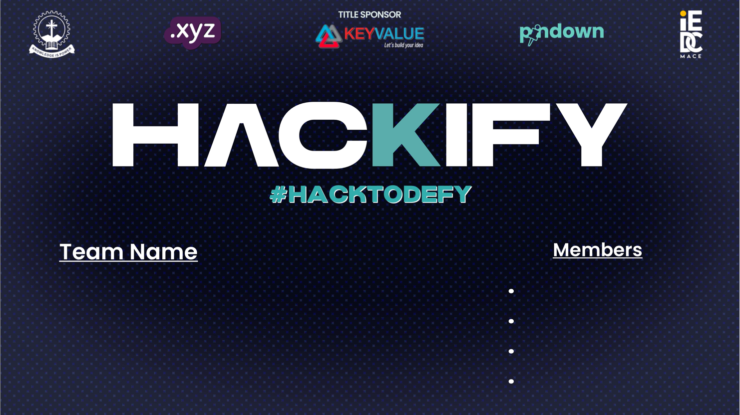
ABIJITH K
ABHINAND K
DEVARTH RAJ
IRFAN SADIQUE
405

Slide 2
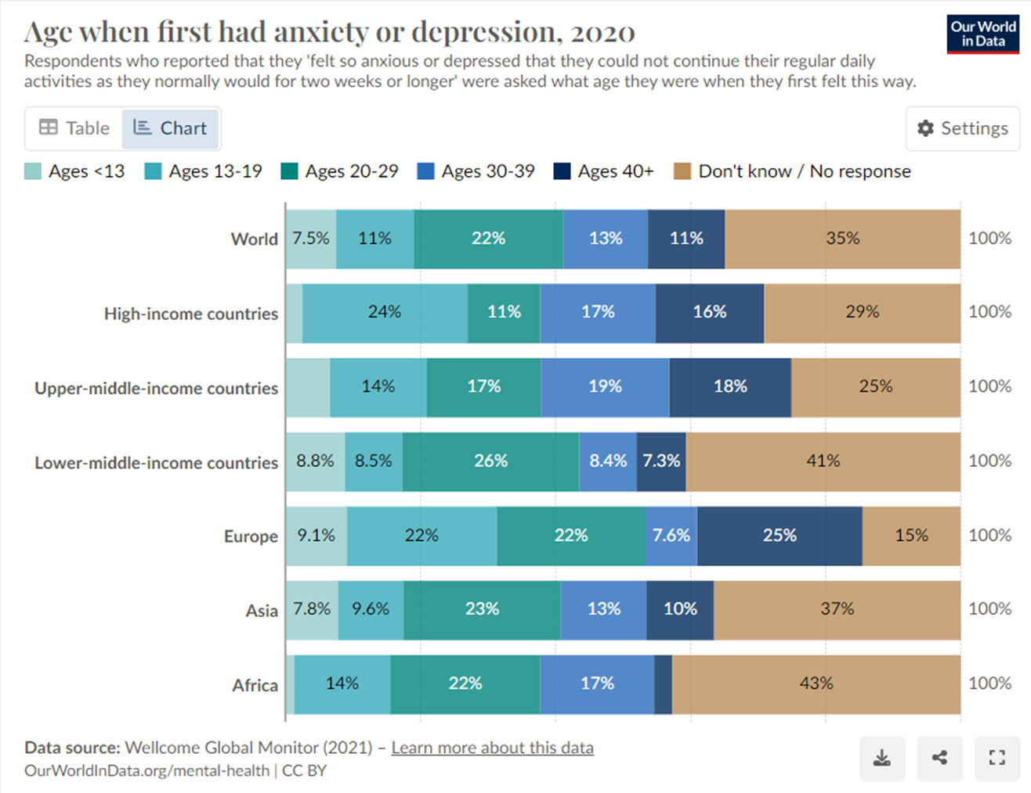
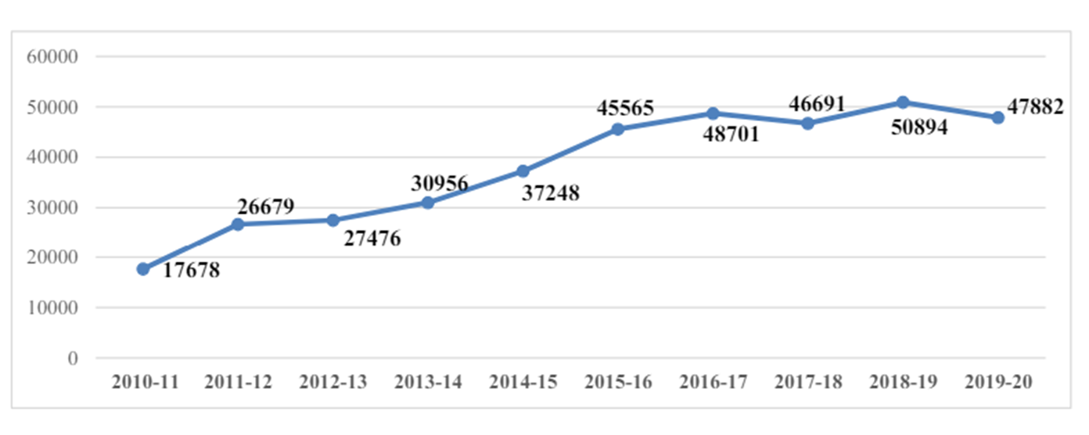
PROBLEM STATEMENT
From daily stressors to long-term illnesses, individuals face a spectrum of mental health hurdles.
Existing support is often inaccessible, leaving many feeling isolated and overwhelmed.
Without proper support, individuals may face tragic outcomes like suicide or violence.
Suicides due to depression from www.prc.mohfw.gov.in

Slide 3
Solution: Mindspace
Mindspace connects individuals to diverse resources for holistic support.
Through community and sharing, Mindspace empowers individuals to navigate mental health challenges with resilience.
Community Support: Mindspace provides a supportive online venue for those with mental health difficulties.
Expressive Environment: Users can freely express their ideas and experiences in a private setting.
Interactive Exchange: Consult with mental health specialists and others to gain varied perspectives and guidance.
Resource Library: Get access to handpicked articles, videos, and expert guidance for extra help.
Inclusivity: Create an accessible space for connection and understanding.
Holistic Approach: Combine professional skills with peer assistance to provide holistic care.
Addressing Obstacles: Address a wide spectrum of mental health difficulties, from daily stressors to chronic conditions.
Urgent Need: Implement a comprehensive platform to address the lack of inclusive support systems.
Preventing Tragic Outcomes: Combat emotions of isolation to lower risks.

Slide 4



TECH USED
Thanks to the utilisation of the sophisticated software solutions ,we are able to make our prototype
Front-end Development: HTML
Version Control: Git
Prototyping and testing : Chatgpt

Slide 5
MARKET OPPORTUNITIES
The target market for our platform includes individuals dealing with mental health challenges, specifically depression and other mental illnesses.
From the researches we are able to find that people India uses several types of mental health improvement applications.
The websites similar to ours have a well funished front end and back but at the same tap they lack features like helpline, curated libraries and several other features that can help a person overcome these types of illness .
So we focus on integrating those important aspects into our platform.
Regarding market strategy and capturing market share, consider the following:
Differentiation: Highlight what sets your platform apart from others. This could be your focus on community support, access to mental health experts, or user-friendly interface.
Localized Content: India is a diverse country with many languages and cultures. Providing content in local languages and addressing cultural nuances can help reach a wider audience.

Slide 6
BUSINESS model
Hospital Ads: Partnering with hospitals and mental health institutions to display targeted advertisements.
Subscription Fee: Charging a small payment for contacting and consulting
Paid Workshops: Hosting workshops and events with paid access for users seeking specialized guidance and support.
Data Brokerage: Personal data of users are sold to third parties which can be used for research purposes
As a potential growth opportunity, there is scope for tying up with companies producing health products and delivery services to form a full-fledged e-commerce system within the website.

Slide 7
Marketing and sales
Some of the promoting ways include :
Paid Advertising :Platforms such as Google Ads, social network ads, and display ads can help you reach a wider audience. Target your advertisements with appropriate keywords, demographics, and interests.
Search Engine Optimization (SEO): Make your website more visible on search engine results pages. To increase organic traffic, target relevant keywords connected to mental health and your services.
Collaboration: Collaborate with popular personalities and mental health activists. They can help market your website to their target demographic, expanding your reach and trustworthiness.
Offline Marketing: Do not forget traditional marketing strategies such as networking events, workshops, and lectures. These can help you connect with potential customers and partners in person.

Slide 8
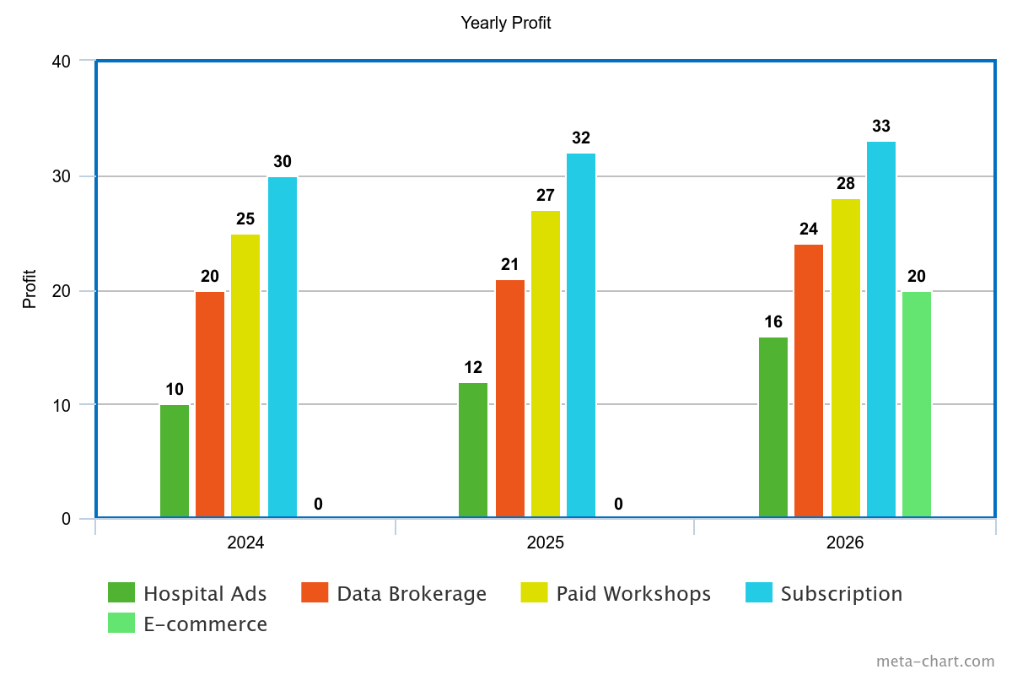
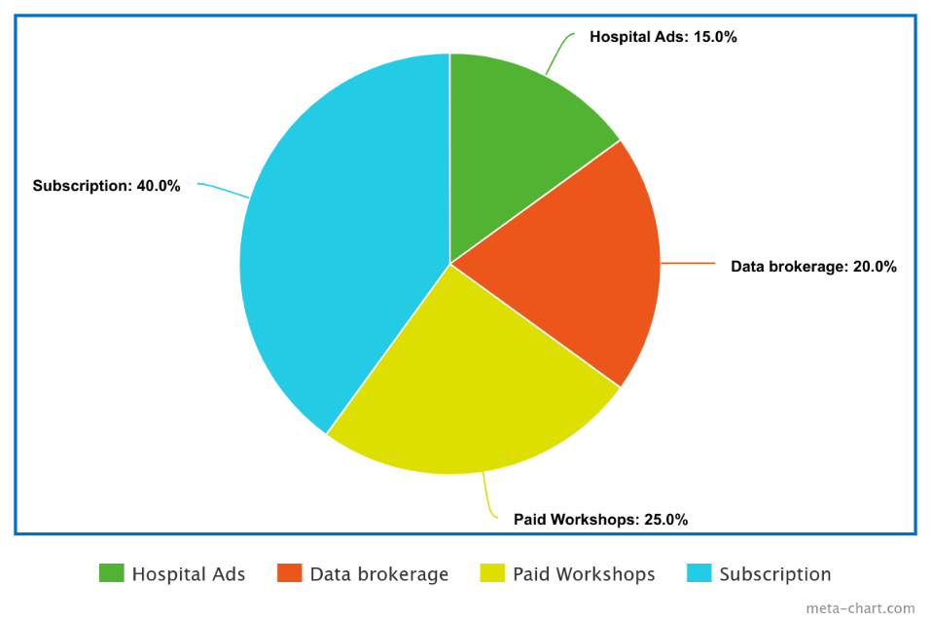
Financials
The total investment in this platform is formed as the sum of the formation of website, paid advertisements, arranging offline lectures with specialists and offline promoting.
Creating a full-fledged e-commerce system is also be huge investment .
Average monthly profit
Expected Growth in the revenue

Slide 9
Contact information
Abijith K
Phone No: 96047797217
Email:abhijithkalkkattil@gmail.com
Abhinand K
Phone No: 7902401465
Email:abhinand1118@gmail.com
Devarth Raj
Phone No: 9746268456
Email:devarthraj@gmail.com
Irfan Sadique
Phone No: 9496040814
Email:irfansadique@gmail.com

