Slide 1
CROSS CLUSTER ANALYSIS
GROUP 24
Abhijith Madhav
Saumya Tayal
Nikita Shah

Slide 2
Procedure
Clustered entire data set using kmeans on the basis of the course marks
Number of initial clusters chosen using an elbow plot of the SSE for various number of clusters

Slide 3
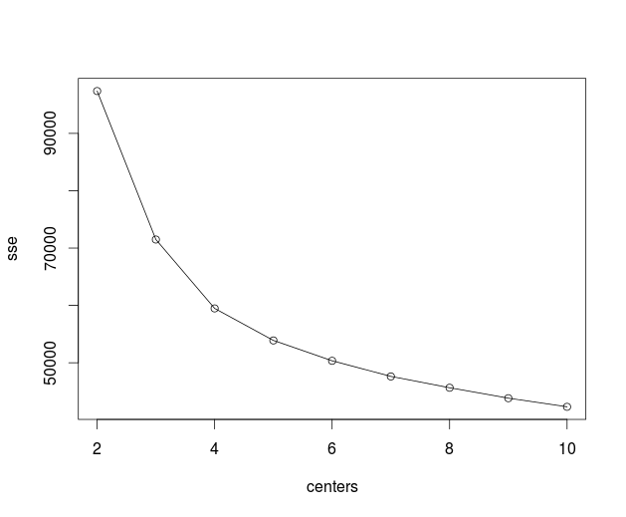
Elbow plot to determine the initial number of clusters

Slide 4
Procedure(Continued)
Characterize the created clusters using association rules as in experiment 3.
Cluster 1 | Cluster 2 | Cluster 3 | Cluster 4
{L1_CLASS=FAIL} {NRC_CLASS=FAIL} {S1_CLASS=FAIL} {S2_CLASS=FAIL} {NRC_MEDIUM=K} | {NRC_CLASS=PASS} {NRC_MEDIUM=K} {CANDIDATE_TYPE=RF} | {CANDIDATE_TYPE=RF} {NRC_CASTE_CODE=4} {NRC_MEDIUM=K} | {NRC_CLASS=1} {NRC_CASTE_CODE=4} {CANDIDATE_TYPE=RF}

Slide 5
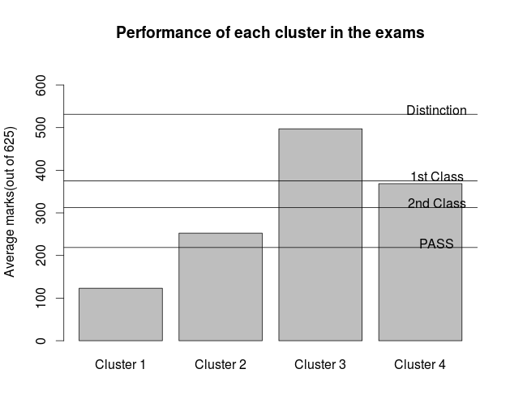
Cluster Characteristic in terms of average marks

Slide 6
Procedure(Continued)
Now partition the dataset and cluster the partitions separately.
Categorize each clustering using associations rules.
We have partitioned dataset using the GENDER_CODE and URBAN_RURAL attributes.
The elbow plot for each partitioning turned out to be similar to that of the total population.

Slide 7
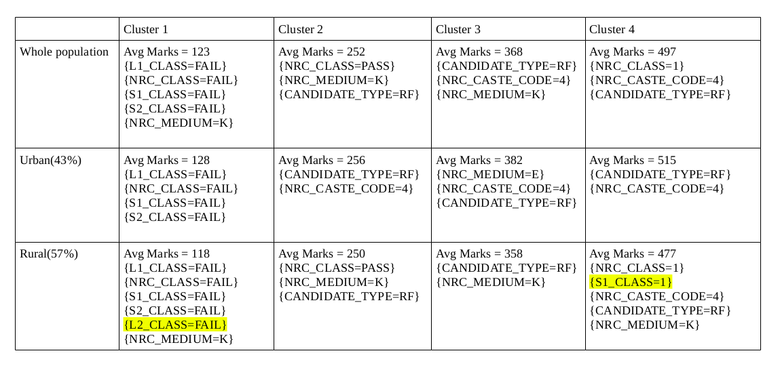
Cross Cluster Analysis
Urban vs Rural

Slide 8
URBAN vs RURAL
Candidates who fail
  Urban - Their medium is not necessarily Kannada
  Rural - They also fail in L2 which is typically English
Candidates who just pass
  Rural – Repeaters do not just pass
Missing First Class
  Urban distinction - English
  Rural distinction – kannada
  Both - Students are freshers
Missing Distinction
  Urban - General caste and freshers
  Rural - Typically Kannada medium

Slide 9
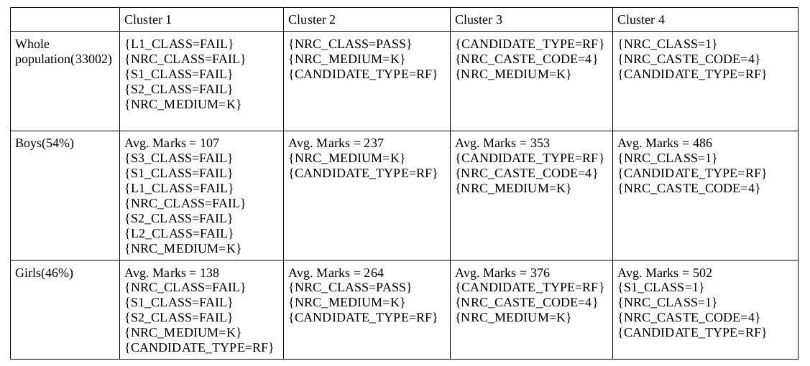
Cross cluster analysis
Boys vs Girls

Slide 10
BOYS vs GIRLS
Candidates who fail
  Boys - Fail in everything except L3
  Girls - do not fail in languages and
  Girls - who fail are freshers
Students who just pass,
  Characteristic of the girls cluster resembles very much to that of the whole population
High performing students (just missing first class and above)
  Partitioning of the data has no effect on cluster characteristics

Slide 11
Questions?

